Slide 1
Artificial Neural Networks
Assignment 2

Slide 2
Team Members
Nehal Bhagat, 110050008
Tanmay Randhavane, 110050010
Alok Yadav, 110050043
Rajlaxmi, 110050087

Slide 3
Error Rate vs Number of Iterations

Slide 4
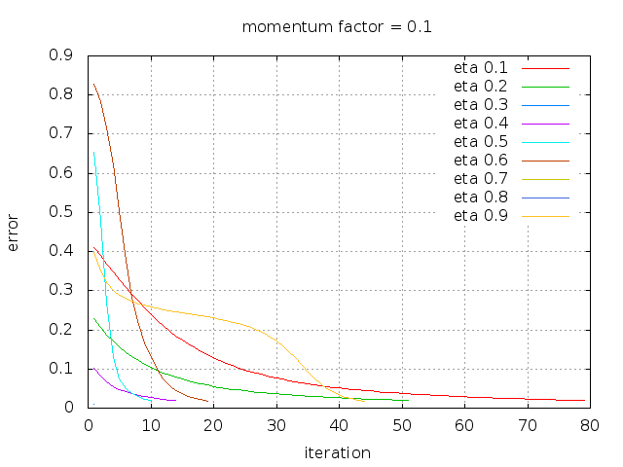
XOR
The plot of error rate vs number of iterations for varying learning rate while keeping the momentum factor constant (0.1).

Slide 5
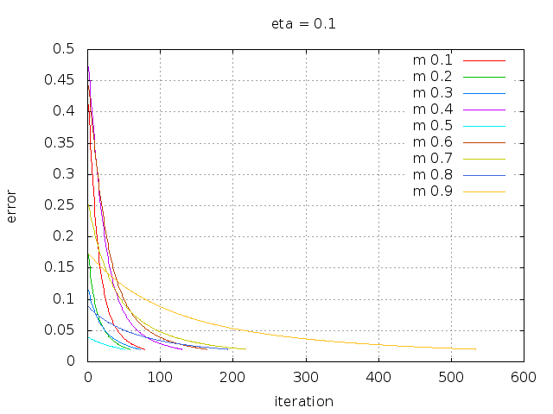
XOR
The plot of error rate vs number of iterations for varying momentum factor while keeping the learning rate constant (0.1).

Slide 6
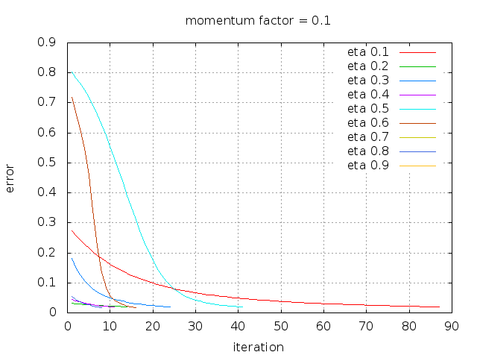
Palindrome
The plot of error rate vs number of iterations for varying learning rate while keeping the momentum factor constant (0.1).

Slide 7
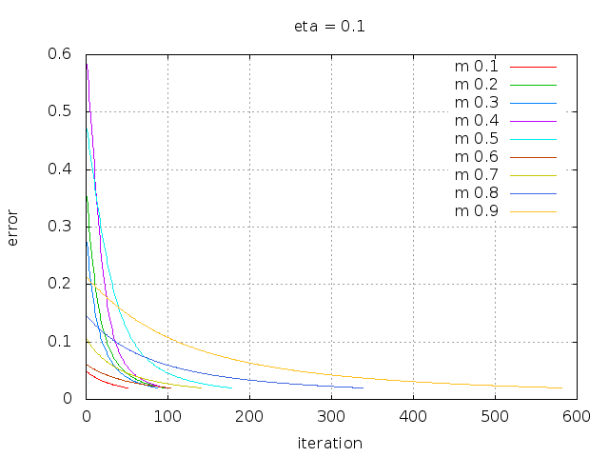
Palindrome
The plot of error rate vs number of iterations for varying momentum factor while keeping the learning rate constant (0.1).

Slide 8
The Effect of Learning Rate

Slide 9
As the learning rate increases the number of epochs (iterations) needed for the convergence decrease as can be seen in the following plots.
For these experiments, we varied learning rate and kept momentum factor constant at 0.8.

Slide 10
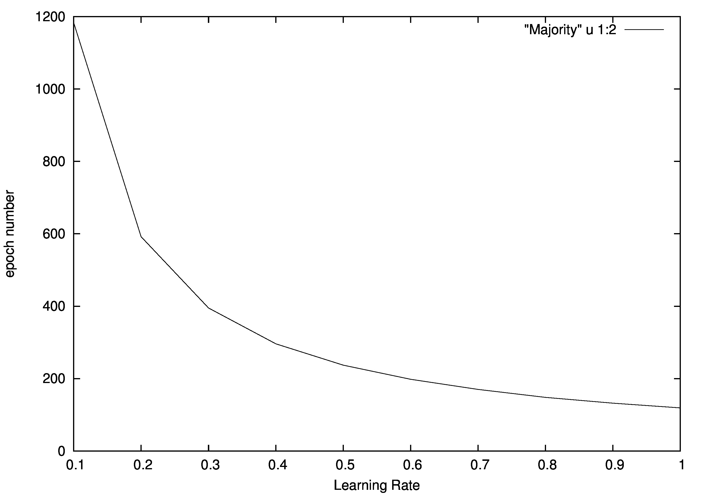
Majority

Slide 11
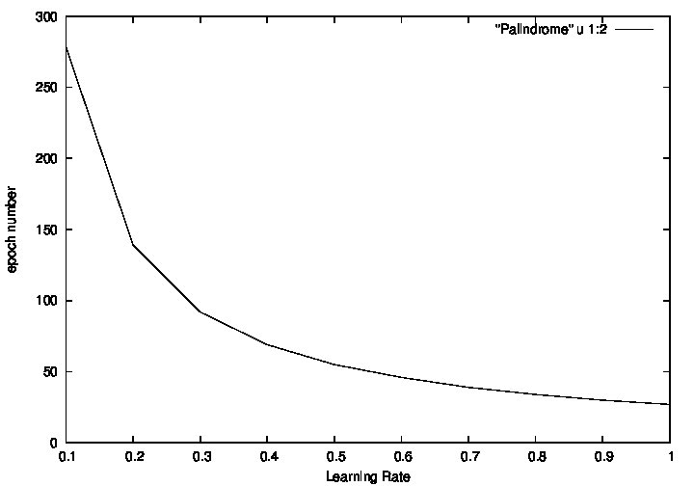
Palindrome

Slide 12
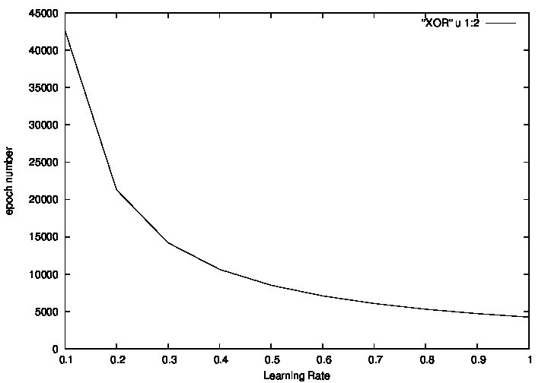
XOR

Slide 13
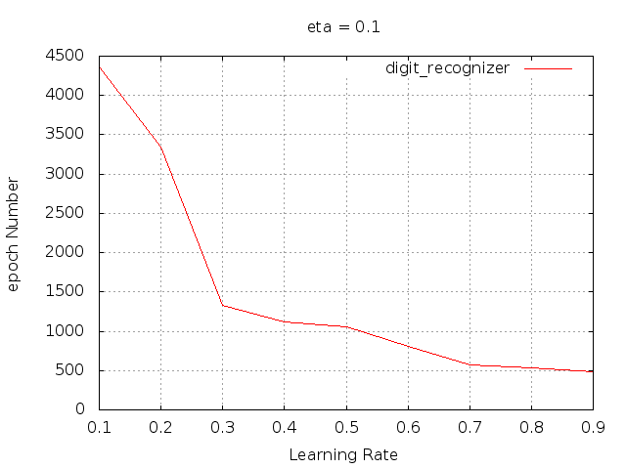
Digit Recognizer

Slide 14
The Effect of Momentum Factor

Slide 15
The number of epochs are generally less for momentum factor closer to 0.5. For momentum factors close to either 1 or 0 the number of epochs increase.
For these experiments, we varied momentum factor and kept learning rate constant at 0.9.

Slide 16
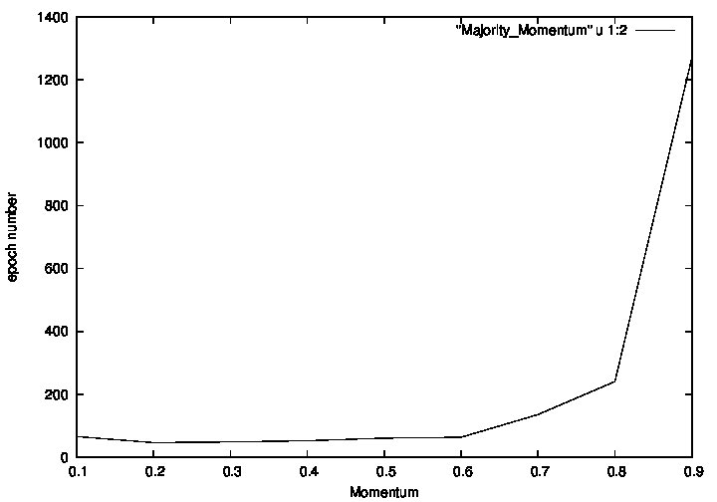
Majority

Slide 17
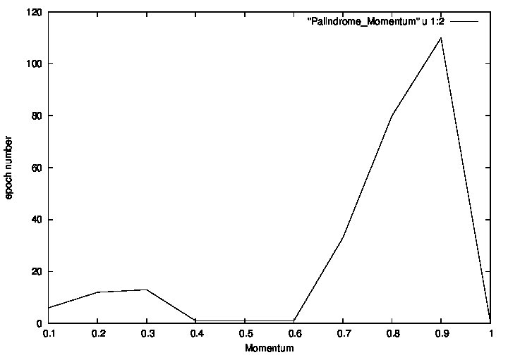
Palindrome

Slide 18
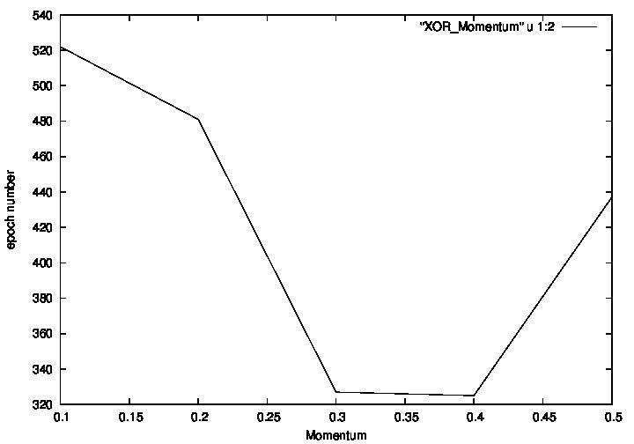
XOR

Slide 19
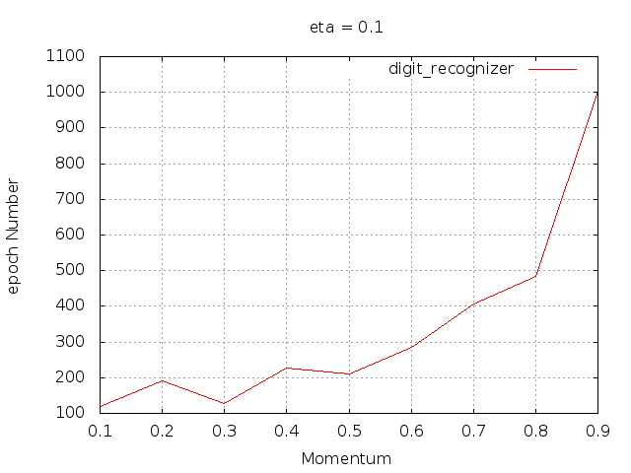
Digit Recognizer

Slide 20
Effect of Symmetric Initialization

Slide 21
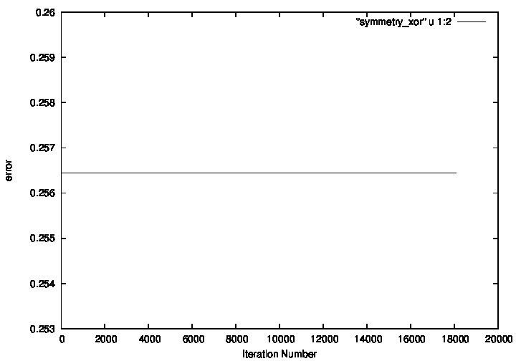
XOR

Slide 22
If all weights are initialized with same values, the error remains constant. This happens because, the backpropagation algorithm keeps on adding equal amount gradient (∆w) into each weight and thus the weights remain equal throughout the iterations, giving the same value of error.

Slide 23
Function of Hidden Layers

Slide 24
XOR
For learning rate = 0.6.
The hidden layer contains two neurons.
For the first neuron, the weights are (-1.73, 3.88, -3.65)
And its truth table is as follows, which corresponds to the rule,
(a+b')
Input 1 | Input 2 | Output
0 | 0 | 1
0 | 1 | 0
1 | 0 | 1
1 | 1 | 1

Slide 25
For the second neuron, the weights are (2.81, 4.69, -4.81).
And its truth table is as follows, which corresponds to the rule,
ab'
Input 1 | Input 2 | Output
0 | 0 | 0
0 | 1 | 0
1 | 0 | 1
1 | 1 | 0

Slide 26
The output layer contains one neurons.
For this neuron, the weights are (-2.2, -5.07, 5.61)
And its truth table is as follows, which corresponds to the rule,
(a'+b)
Input 1 | Input 2 | Output
0 | 0 | 1
0 | 1 | 1
1 | 0 | 0
1 | 1 | 1

Slide 27
Conclusion:
The output of XOR is calculated as follows:
Output = (a + b' )' + (ab')' = XOR(a, b)
Whose truth table is as follows:
Input 1 | Input 2 | Output
0 | 0 | 0
0 | 1 | 1
1 | 0 | 1
1 | 1 | 0

Slide 28
For learning rate = 0.1.
The hidden layer contains two neurons.
For the first neuron, the weights are (4.26, 2.84, 2.84)
And its truth table is as follows, which corresponds to the rule,
ab
Input 1 | Input 2 | Output
0 | 0 | 0
0 | 1 | 0
1 | 0 | 0
1 | 1 | 1

Slide 29
For the second neuron, the weights are ( 1.83, 5.21, 5.23).
And its truth table is as follows, which corresponds to the rule,
a+b
Input 1 | Input 2 | Output
0 | 0 | 0
0 | 1 | 1
1 | 0 | 1
1 | 1 | 1

Slide 30
The output layer contains one neurons.
For this neuron, the weights are (2.67, -6.00, 5.86)
And its truth table is as follows, which corresponds to the rule,
a'b
Input 1 | Input 2 | Output
0 | 0 | 0
0 | 1 | 1
1 | 0 | 0
1 | 1 | 0

Slide 31
Conclusion:
The output of XOR is calculated as follows:
Output = (ab )' (a + b) = XOR(a, b)
Whose truth table is as follows:
Input 1 | Input 2 | Output
0 | 0 | 0
0 | 1 | 1
1 | 0 | 1
1 | 1 | 0

Slide 32
For learning rate = 0.7.
The hidden layer contains two neurons.
For the first neuron, the weights are (-1.36 , -7.65, -7.65)
And its truth table is as follows, which corresponds to the rule,
a'b'
Input 1 | Input 2 | Output
0 | 0 | 1
0 | 1 | 0
1 | 0 | 0
1 | 1 | 0

Slide 33
For the second neuron, the weights are ( 3.99, 2.71, 2.71).
And its truth table is as follows, which corresponds to the rule,
ab
Input 1 | Input 2 | Output
0 | 0 | 0
0 | 1 | 0
1 | 0 | 0
1 | 1 | 1

Slide 34
The output layer contains one neurons.
For this neuron, the weights are (-2.99, -6.92, -5.58)
And its truth table is as follows, which corresponds to the rule,
a'b'
Input 1 | Input 2 | Output
0 | 0 | 1
0 | 1 | 0
1 | 0 | 0
1 | 1 | 0

Slide 35
Conclusion:
The output of XOR is calculated as follows:
Output = (a'b' )' (ab)' = XOR(a, b)
Whose truth table is as follows:
Input 1 | Input 2 | Output
0 | 0 | 0
0 | 1 | 1
1 | 0 | 1
1 | 1 | 0

Slide 36
3 Bit Palindrome
For learning rate = 0.6.
The hidden layer contains three neurons.
For the first neuron, the weights are (2.22, 3.93, -0.11, -4.13)
And its truth table is as follows, which corresponds to the rule,
(ac')

Slide 37
Input 1 | Input 2 | Input 3 | Output
0 | 0 | 0 | 0
0 | 0 | 1 | 0
0 | 1 | 0 | 0
0 | 1 | 1 | 0
1 | 0 | 0 | 1
1 | 0 | 1 | 0
1 | 1 | 0 | 1
1 | 1 | 1 | 0

Slide 38
For the second neuron, the weights are (0.41, 0.67, 0.62, -0.47).
And its truth table is as follows, which corresponds to the rule,
a'bc'+ab'c'+ab
Input 1 | Input 2 | Input 3 | Output
0 | 0 | 0 | 0
0 | 0 | 1 | 0
0 | 1 | 0 | 1
0 | 1 | 1 | 0
1 | 0 | 0 | 1
1 | 0 | 1 | 0
1 | 1 | 0 | 1
1 | 1 | 1 | 1

Slide 39
For the third neuron, the weights are (2.41, -4.42, -0.11, 4.18).
And its truth table is as follows, which corresponds to the rule,
a'c
Input 1 | Input 2 | Input 3 | Output
0 | 0 | 0 | 0
0 | 0 | 1 | 1
0 | 1 | 0 | 0
0 | 1 | 1 | 1
1 | 0 | 0 | 0
1 | 0 | 1 | 0
1 | 1 | 0 | 0
1 | 1 | 1 | 0

Slide 40
The output layer contains one neurons.
For this neuron, the weights are (-2.45, -5.29, 0.29, -5.24)
And its truth table is as follows, which corresponds to the rule,
a'c'
Input 1 | Input 2 | Input 3 | Output
0 | 0 | 0 | 1
0 | 0 | 1 | 0
0 | 1 | 0 | 1
0 | 1 | 1 | 0
1 | 0 | 0 | 0
1 | 0 | 1 | 0
1 | 1 | 0 | 0
1 | 1 | 1 | 0

Slide 41
Conclusion:
The output of Palindrome is calculated as follows:
Output = (ac' )' (a'c)' = Palindrome(a, b, c)
Whose truth table is as follows:
Input 1 | Input 2 | Input 3 | Output
0 | 0 | 0 | 1
0 | 0 | 1 | 0
0 | 1 | 0 | 1
0 | 1 | 1 | 0
1 | 0 | 0 | 0
1 | 0 | 1 | 1
1 | 1 | 0 | 0
1 | 1 | 1 | 1

