Slide 1
GROUP 6
Nehal Bhagat 110050008
Tanmay Randhavane 110050010
Alok Yadav 110050043
Rajlaxmi 110050087

Slide 2
ASSIGN 1
Perceptron Training Algorithm

Slide 3
Perceptron Training Algorithm
Nehal Rajlaxmi Tanmay Alok

Slide 4
Problem Statement
Implement perceptron training algorithm (PTA).
Run PTA on:
2-input NAND, NOR, XOR
5-input palindrome, majority
6-input parity
Observe the convergence of the above functions and detect cycle if exits.
Observe the effect of initialization of the weights.
Run the PTA to find the output of a 7 segment display.

Slide 5
Algorithm Implementation
The weight vector for PTA is initialized as a vector of 0s.
For cycle detection, a hash map is maintained. This hash map stores weight vector at all iterations. If weight obtained in an iteration is already present in the hash map, cycle is detected.

Slide 6
Convergence:
PTA converges for linearly separable functions OR, NOR, NAND, Palindrome and Majority
PTA does not converge for XOR and Parity because they are non-linear functions.

Slide 7
Effect of weight initialization on number of iterations
If we initialize w is initialized as vector of constant t i.e (t,t,t, …. )
Palindrome: No of iterations increases with increase in t
Majority, NAND: No of iterations first decreases with increase in t and then increases
OR, NOR: Higher no of iterations for lower value of t and then constant
XOR, Parity: Cycle detected. No of iterations required to detect cycle increases with increase in t

Slide 8
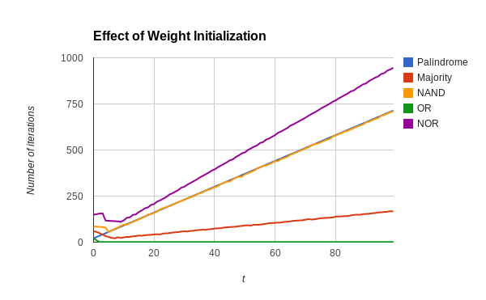
Effect of Weight Initialization for Linear Functions

Slide 9
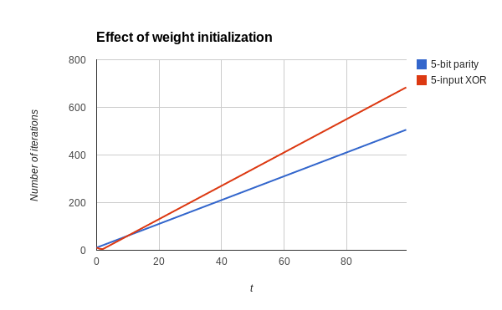
Effect of Weight Initialization for Non-Linear Functions

Slide 10
Explanation of Graphs
Vector Interpretation Of Perceptron training Algorithm
In perceptron training algorithm we try to find a vector which has dot product greater than zero i.e. angle between the two vectors should be (-90, 90) degrees
When dot product is negative, we add the vector which bring the result vector closer to input vector, making dot product positive

Slide 11
Explanation of Graphs
When w[i] is larger, the result vector after addition is still closer to the original vector as compared to when w[i] is smaller. So greater number of iterations are required.
Decrease in angle is less

Slide 12
7 Segment Display
Implementation:
PTA is trained and weight vector for each digit is obtained
Dot product of given input vector with weight vector is taken and if product is positive the digit is shown as output

Slide 13
Number of Iterations Required For each digit
0 | 197
1 | 44
2 | 124
3 | 135
4 | 94
5 | 131
6 | 197
7 | 68
8 | 292
9 | 208

