Slide 1
Artificial Neural Networks
Assignment 2

Slide 2
Team Members
Nehal Bhagat, 110050008
Tanmay Randhavane, 110050010
Alok Yadav, 110050043
Rajlaxmi Sahu, 110050087

Slide 3
The Effect of Learning Rate

Slide 4
As the learning rate increases the number of epochs (iterations) needed for the convergence decrease as can be seen in the following plots.
For these experiments, we varied learning rate and kept momentum factor constant at 0.8.

Slide 5
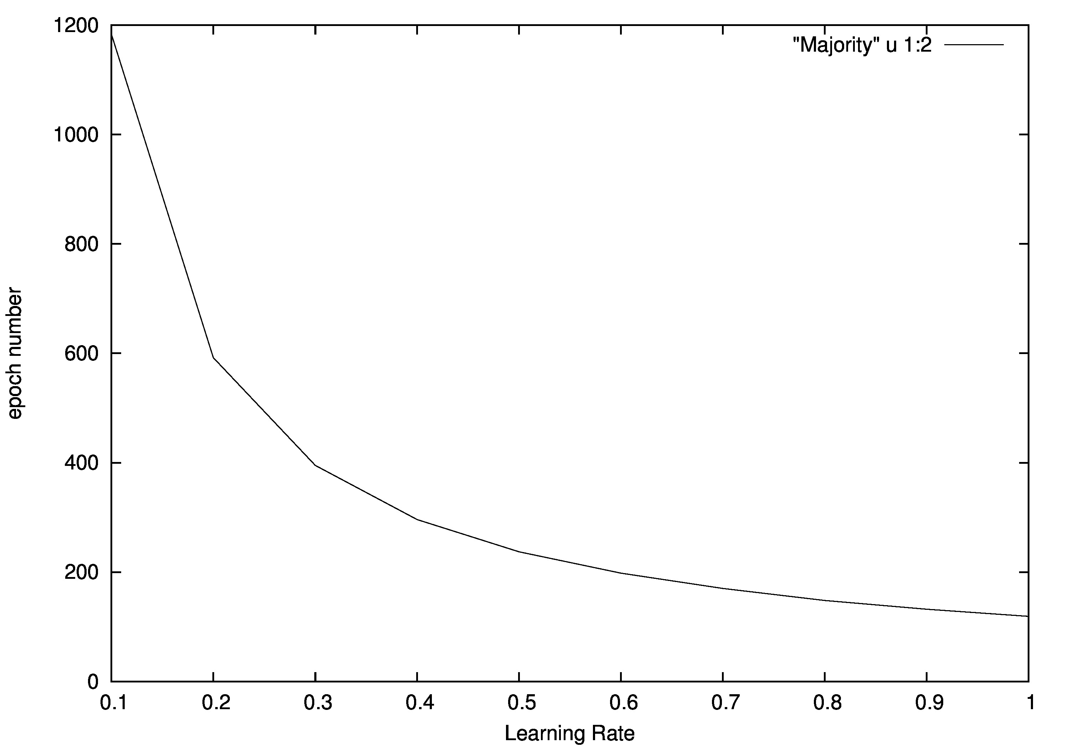
Majority

Slide 6
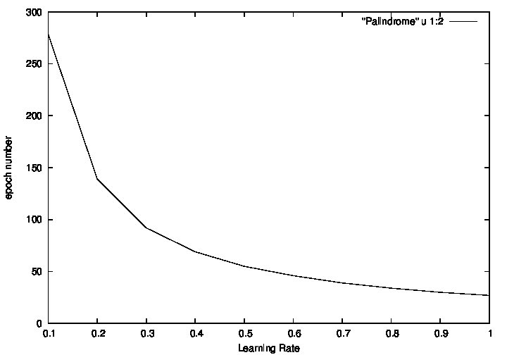
Palindrome

Slide 7
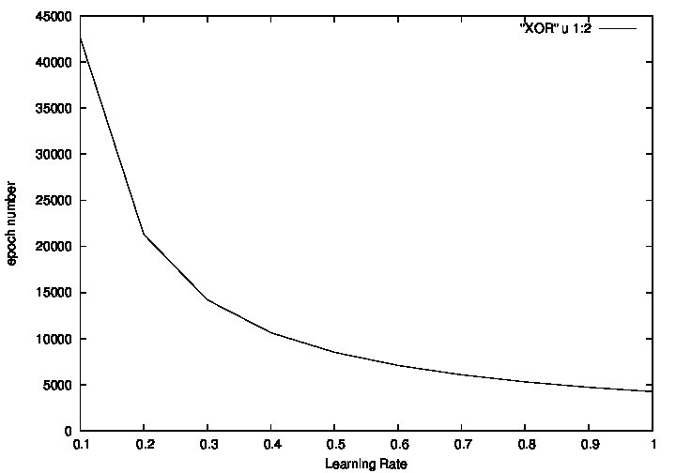
XOR

Slide 8
The Effect of Momentum Factor

Slide 9
The number of epochs are generally less for momentum factor closer to 0.5. For momentum factors close to either 1 or 0 the number of epochs increase.
For these experiments, we varied momentum factor and kept learning rate constant at 0.9.

Slide 10
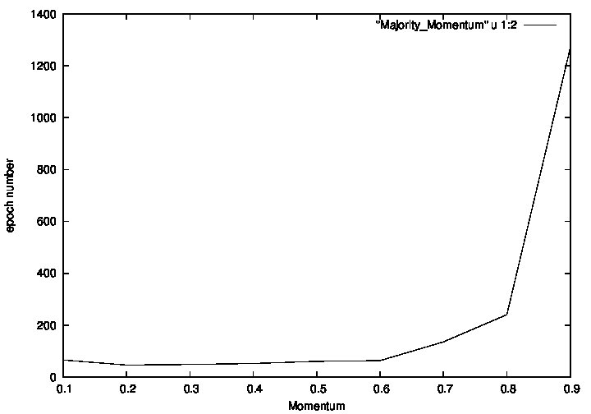
Majority

Slide 11
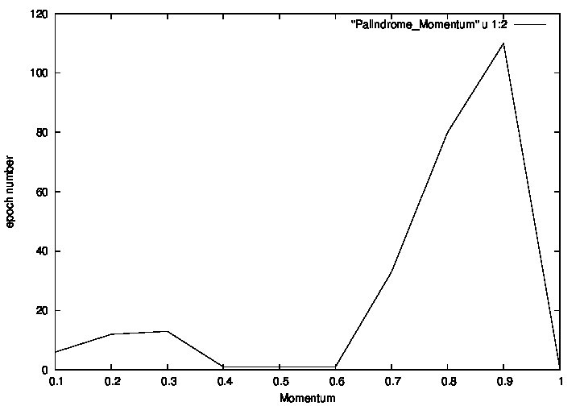
Palindrome

Slide 12
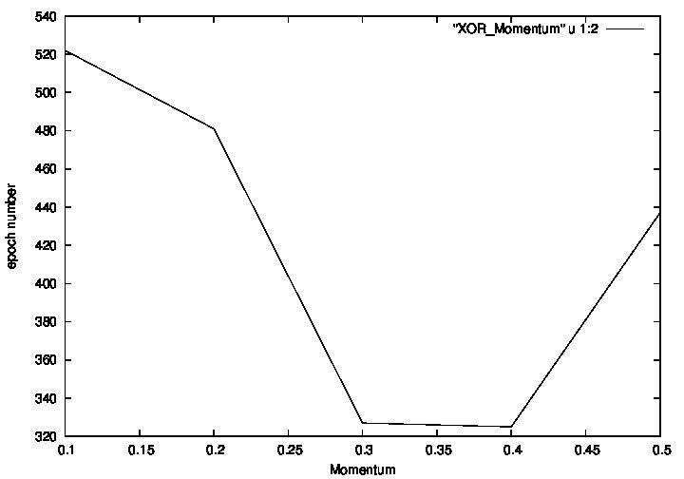
XOR

Slide 13
Effect of Symmetric Initialization

Slide 14
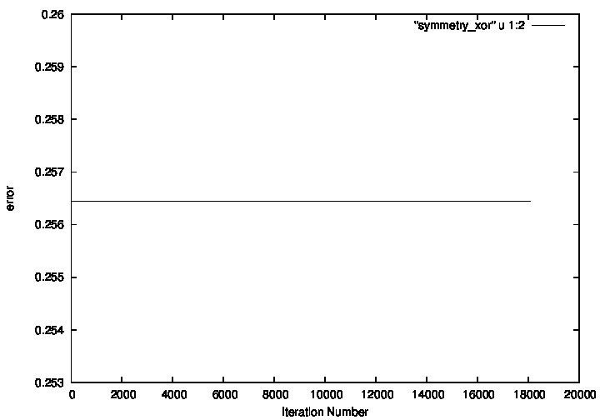
XOR

Slide 15
If all weights are initialized with same values, the error remains constant. This happens because, the backpropagation algorithm keeps on adding equal amount gradient (∆w) into each weight and thus the weights remain equal throughout the iterations, giving the same value of error.

Slide 16
Function of Hidden Layers

Slide 17
XOR
For learning rate = 0.6.
The hidden layer contains two neurons.
For the first neuron, the weights are (-1.73, 3.88, -3.65)
And its truth table is as follows, which corresponds to the rule,
(a+b')
Input 1 | Input 2 | Output
0 | 0 | 1
0 | 1 | 0
1 | 0 | 1
1 | 1 | 1

Slide 18
For the second neuron, the weights are (2.81, 4.69, -4.81).
And its truth table is as follows, which corresponds to the rule,
ab'
Input 1 | Input 2 | Output
0 | 0 | 0
0 | 1 | 0
1 | 0 | 1
1 | 1 | 0

Slide 19
The output layer contains one neurons.
For this neuron, the weights are (-2.2, -5.07, 5.61)
And its truth table is as follows, which corresponds to the rule,
(a'+b)
Input 1 | Input 2 | Output
0 | 0 | 1
0 | 1 | 1
1 | 0 | 0
1 | 1 | 1

Slide 20
Conclusion:
The output of XOR is calculated as follows:
Output = (a + b' )' + (ab')' = XOR(a, b)
Whose truth table is as follows:
Input 1 | Input 2 | Output
0 | 0 | 0
0 | 1 | 1
1 | 0 | 1
1 | 1 | 0

Slide 21
For learning rate = 0.1.
The hidden layer contains two neurons.
For the first neuron, the weights are (4.26, 2.84, 2.84)
And its truth table is as follows, which corresponds to the rule,
ab
Input 1 | Input 2 | Output
0 | 0 | 0
0 | 1 | 0
1 | 0 | 0
1 | 1 | 1

Slide 22
For the second neuron, the weights are ( 1.83, 5.21, 5.23).
And its truth table is as follows, which corresponds to the rule,
a+b
Input 1 | Input 2 | Output
0 | 0 | 0
0 | 1 | 1
1 | 0 | 1
1 | 1 | 1

Slide 23
The output layer contains one neurons.
For this neuron, the weights are (2.67, -6.00, 5.86)
And its truth table is as follows, which corresponds to the rule,
a'b
Input 1 | Input 2 | Output
0 | 0 | 0
0 | 1 | 1
1 | 0 | 0
1 | 1 | 0

Slide 24
Conclusion:
The output of XOR is calculated as follows:
Output = (ab )' (a + b) = XOR(a, b)
Whose truth table is as follows:
Input 1 | Input 2 | Output
0 | 0 | 0
0 | 1 | 1
1 | 0 | 1
1 | 1 | 0

Slide 25
For learning rate = 0.7.
The hidden layer contains two neurons.
For the first neuron, the weights are (-1.36 , -7.65, -7.65)
And its truth table is as follows, which corresponds to the rule,
a'b'
Input 1 | Input 2 | Output
0 | 0 | 1
0 | 1 | 0
1 | 0 | 0
1 | 1 | 0

Slide 26
For the second neuron, the weights are ( 3.99, 2.71, 2.71).
And its truth table is as follows, which corresponds to the rule,
ab
Input 1 | Input 2 | Output
0 | 0 | 0
0 | 1 | 0
1 | 0 | 0
1 | 1 | 1

Slide 27
The output layer contains one neurons.
For this neuron, the weights are (-2.99, -6.92, -5.58)
And its truth table is as follows, which corresponds to the rule,
a'b'
Input 1 | Input 2 | Output
0 | 0 | 1
0 | 1 | 0
1 | 0 | 0
1 | 1 | 0

Slide 28
Conclusion:
The output of XOR is calculated as follows:
Output = (a'b' )' (ab)' = XOR(a, b)
Whose truth table is as follows:
Input 1 | Input 2 | Output
0 | 0 | 0
0 | 1 | 1
1 | 0 | 1
1 | 1 | 0

Slide 29
3 Bit Palindrome
For learning rate = 0.6.
The hidden layer contains three neurons.
For the first neuron, the weights are (2.22, 3.93, -0.11, -4.13)
And its truth table is as follows, which corresponds to the rule,
(ac')

Slide 30
Input 1 | Input 2 | Input 3 | Output
0 | 0 | 0 | 0
0 | 0 | 1 | 0
0 | 1 | 0 | 0
0 | 1 | 1 | 0
1 | 0 | 0 | 1
1 | 0 | 1 | 0
1 | 1 | 0 | 1
1 | 1 | 1 | 0

Slide 31
For the second neuron, the weights are (0.41, 0.67, 0.62, -0.47).
And its truth table is as follows, which corresponds to the rule,
a'bc'+ab'c'+ab
Input 1 | Input 2 | Input 3 | Output
0 | 0 | 0 | 0
0 | 0 | 1 | 0
0 | 1 | 0 | 1
0 | 1 | 1 | 0
1 | 0 | 0 | 1
1 | 0 | 1 | 0
1 | 1 | 0 | 1
1 | 1 | 1 | 1

Slide 32
For the third neuron, the weights are (2.41, -4.42, -0.11, 4.18).
And its truth table is as follows, which corresponds to the rule,
a'c
Input 1 | Input 2 | Input 3 | Output
0 | 0 | 0 | 0
0 | 0 | 1 | 1
0 | 1 | 0 | 0
0 | 1 | 1 | 1
1 | 0 | 0 | 0
1 | 0 | 1 | 0
1 | 1 | 0 | 0
1 | 1 | 1 | 0

Slide 33
The output layer contains one neurons.
For this neuron, the weights are (-2.45, -5.29, 0.29, -5.24)
And its truth table is as follows, which corresponds to the rule,
a'c'
Input 1 | Input 2 | Input 3 | Output
0 | 0 | 0 | 1
0 | 0 | 1 | 0
0 | 1 | 0 | 1
0 | 1 | 1 | 0
1 | 0 | 0 | 0
1 | 0 | 1 | 0
1 | 1 | 0 | 0
1 | 1 | 1 | 0

Slide 34
Conclusion:
The output of Palindrome is calculated as follows:
Output = (ac' )' (a'c)' = Palindrome(a, b, c)
Whose truth table is as follows:
Input 1 | Input 2 | Input 3 | Output
0 | 0 | 0 | 1
0 | 0 | 1 | 0
0 | 1 | 0 | 1
0 | 1 | 1 | 0
1 | 0 | 0 | 0
1 | 0 | 1 | 1
1 | 1 | 0 | 0
1 | 1 | 1 | 1

