Slide 1



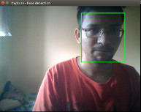
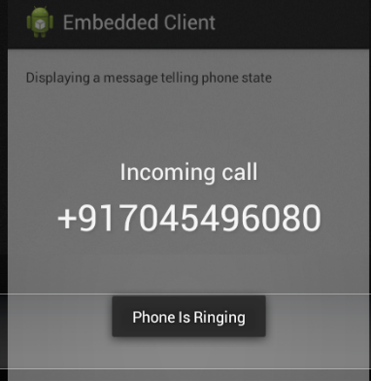
Motion Sensing TV
Embedded Systems Lab
Motivation:
Enhance user's watching experience accommodating movements
Automated audio/video control is necessary
Need for such a system in TVs, Computers, Audio Systems, Home Theatre, etc.
Work Done :
Implementation of android application to detect whether a phone call is on or not and muting/unmuting of the device accordingly.
Finding location and distance of the user with respect to the device using humanoid detection and face detection algorithms.
Adjusting the volume according to the distance using ALSA Master Control library.
Output a target rotation angle according to the user’s position with respect to the device.
When multiple users are in the view, selection of primary user to adjust volume and screen rotation accordingly.
Rotating firebird by the given angle
Call Control: The device should automatically muted when a call is received.
Results: Video Interface
Phone Interface
Movement Control: Volume of the device should be increased or decreased as dictated by the distance d
Approach:
Develop an android application and a corresponding linux program to mute or unmute the device whenever a call is received on the phone. TCP sockets to facilitate communication
Use humanoid detection and face detection to find the distance between the device and the user
According to the detected location of the user rotate the device so that it always faces the user
The phone application is able to instantaneously send a message to the device and mute/unmute the device. A delay of a few seconds can be seen in the video control component because of complex processing algorithms for face and humanoid detection.
Notes:
04/11/13
04/11/13
Major Result to go in lower left side: Figures should not be too complex or busy – this example is probably the limit of acceptable complexity.

