Slide 1
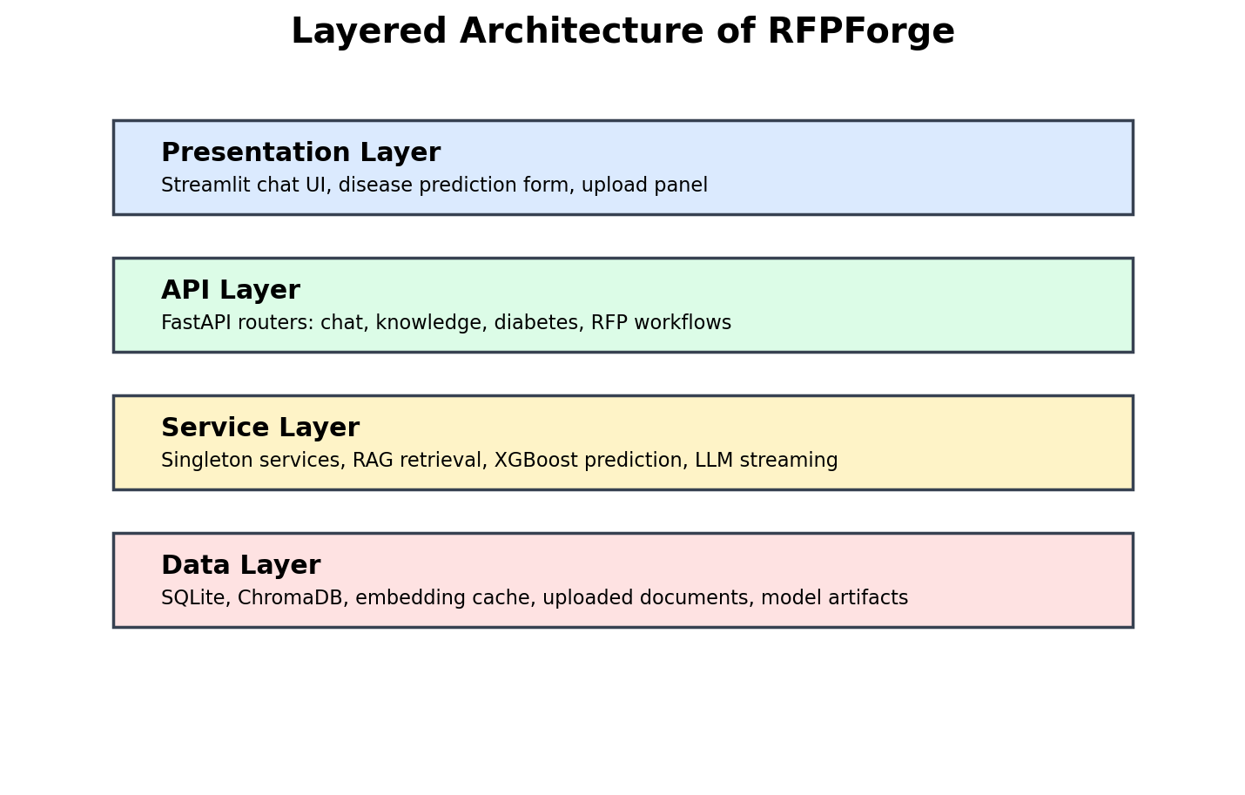
RFPForge
AI-powered RFP automation with multi-disease prediction, RAG explanations, SHAP, and calibrated probabilities
Professional Project Presentation
FastAPI backend, Streamlit frontend, ChromaDB vector store, local LLM workflow
Disease prediction models for diabetes, heart disease, breast cancer, and Parkinson's disease
Disease-specific retrieval validation prevents irrelevant medical context generation

Slide 2
Project Problem
Manual proposal drafting and raw ML outputs both need grounded, explainable assistance
RFP Problem Teams spend time searching scattered documents, copying clauses, and drafting answers manually.
Healthcare AI Problem Prediction numbers alone are hard to interpret and can become unsafe if generic medical text is retrieved.
Solution A single app combines document RAG, structured ML prediction, disease-aware templates, and retrieval validation.
Goal: make responses faster, more traceable, and easier to understand.
Scope: local educational research system, not a clinical diagnostic device.
Output: usable Streamlit workflows plus reproducible backend services.

Slide 3
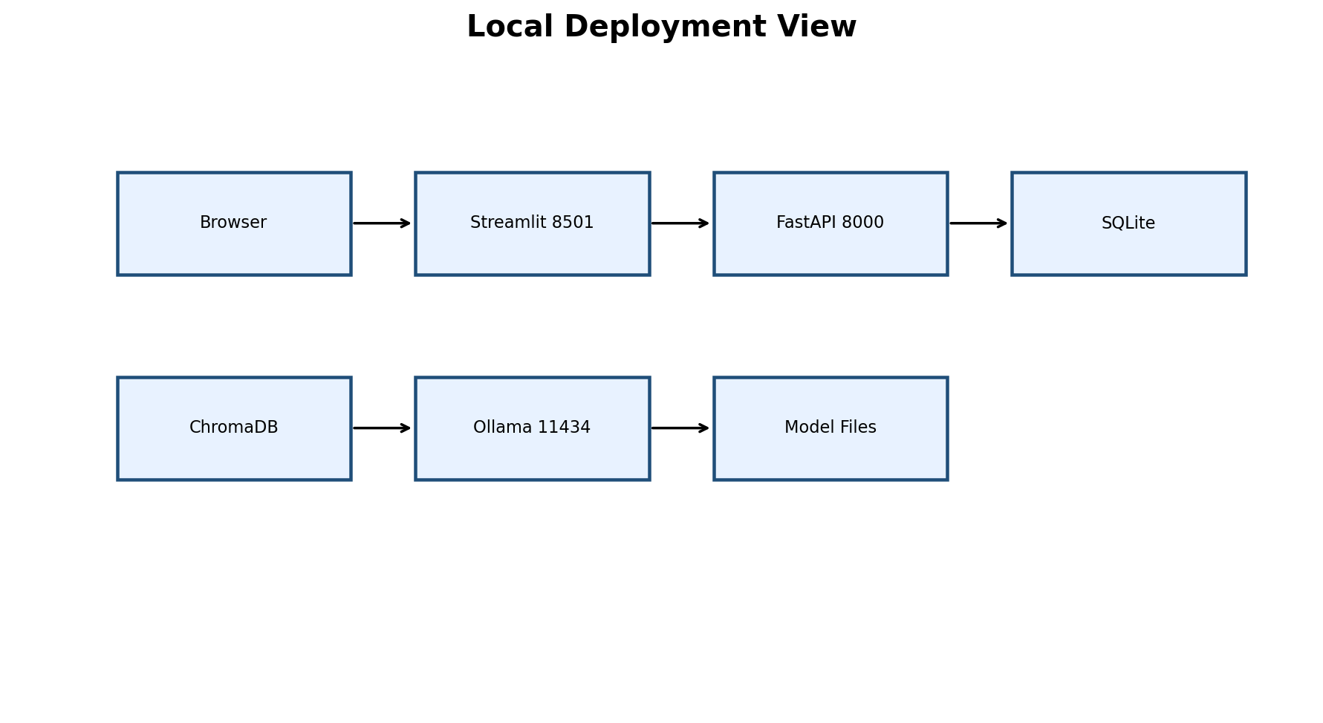
System Architecture
Layered architecture keeps UI, API, RAG, ML, and storage responsibilities clear

Slide 4
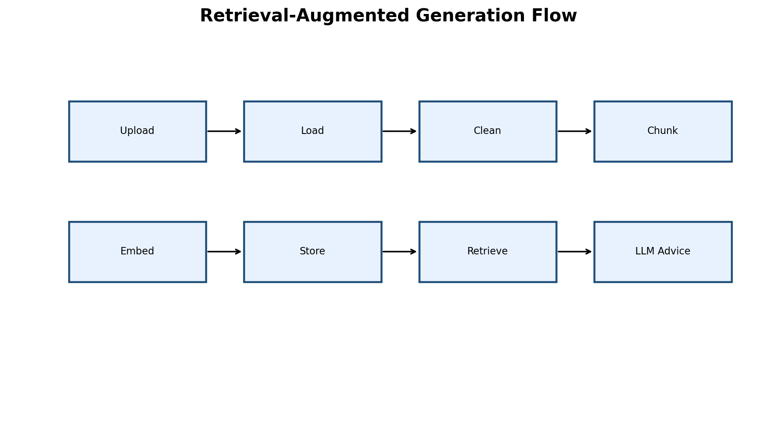
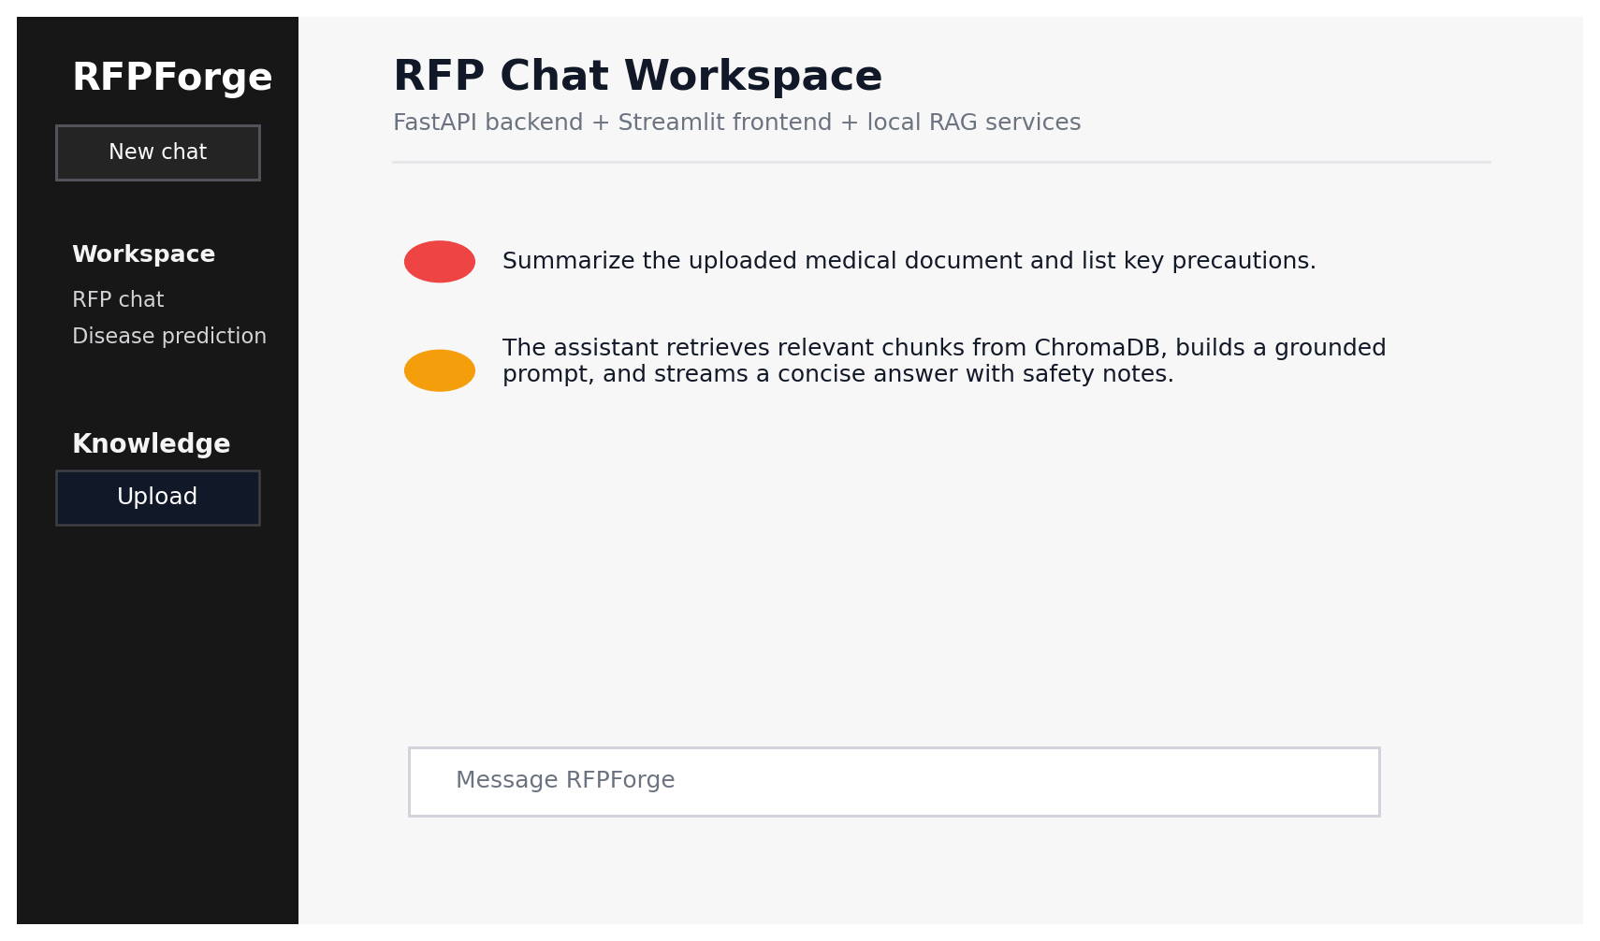
RAG Workflow
Documents are loaded, chunked, embedded, retrieved, and converted into grounded responses

Slide 5
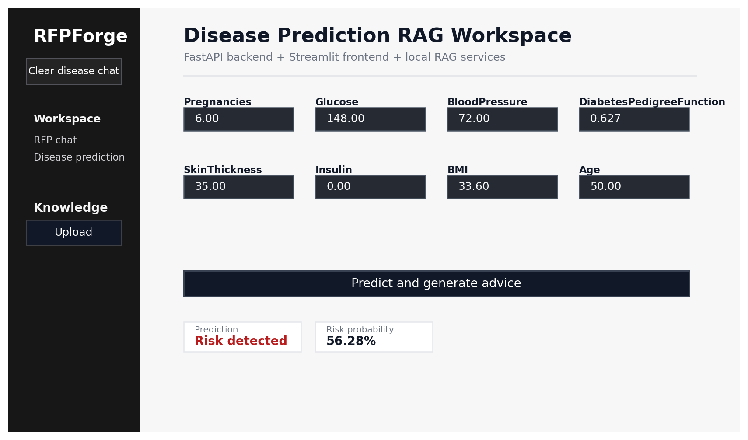
Disease Prediction Workflow
Users can use manual feature fields or ordered-list input for exact research samples
Registry-driven disease selector and feature form
Ordered list parser supports Python-style inputs with comments
Prediction response includes probability, confidence, SHAP impacts, and validated guidance
Known diseases use disease-aware templates to avoid hallucinated clinical procedures

Slide 6
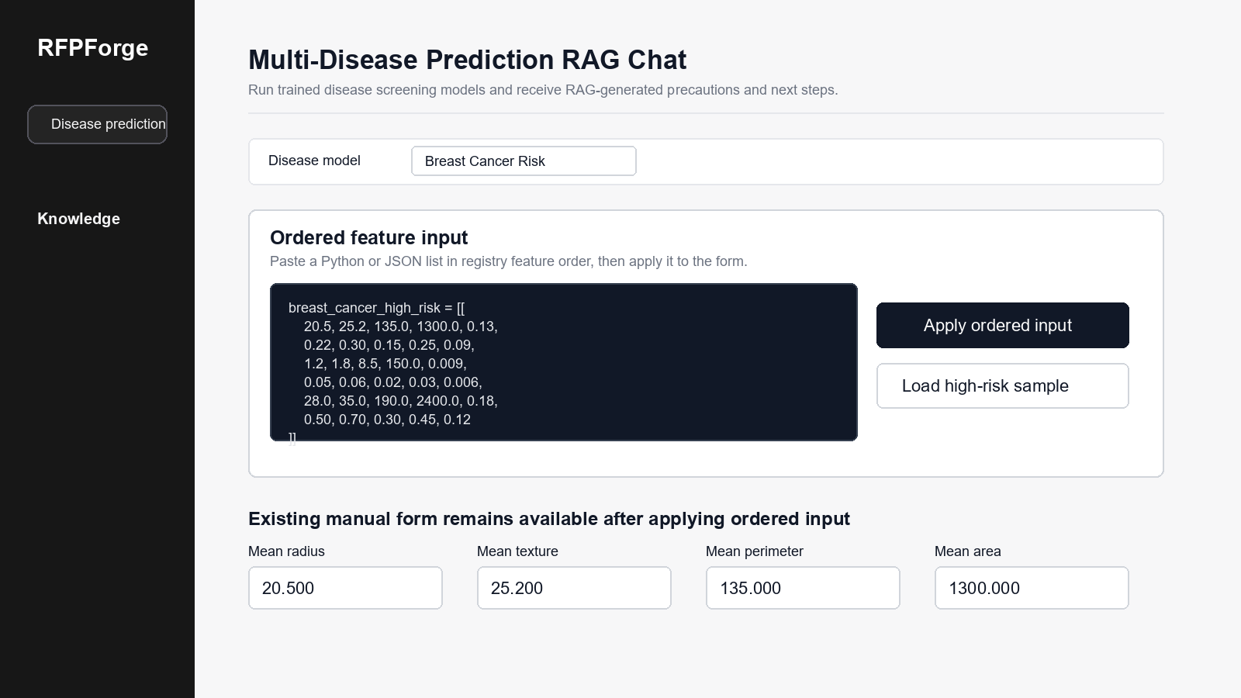
Ordered Input Example
Breast cancer high-risk sample pasted in the exact feature order

Slide 7
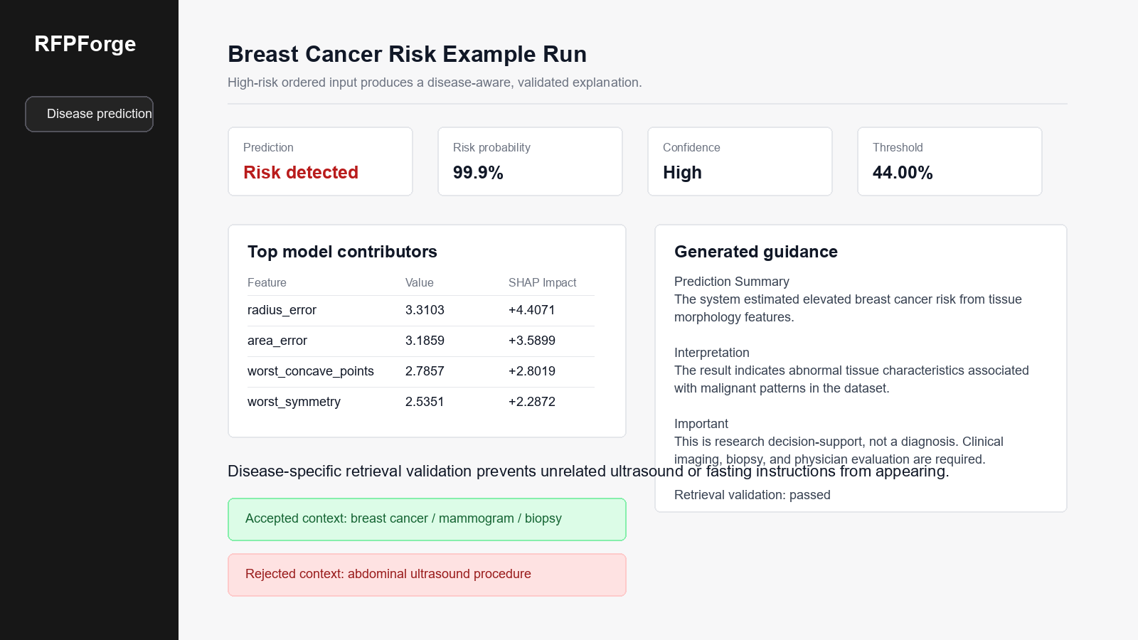
Example Prediction Output
The output is what a user would see after applying the sample and running prediction

Slide 8
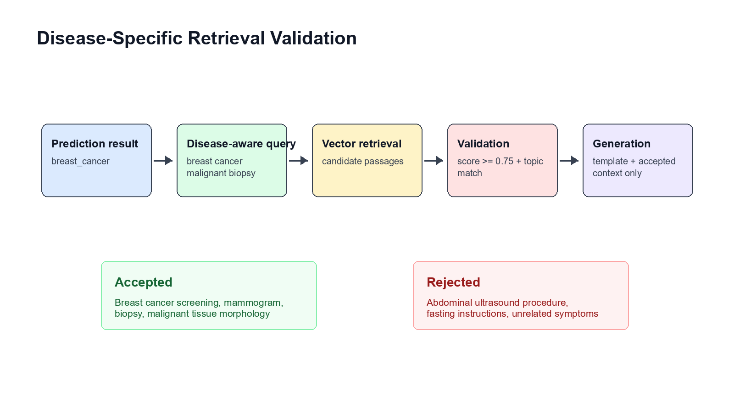
Retrieval Guardrails
Unrelated ultrasound, fasting, and symptom blocks are rejected before generation

Slide 9
Model Coverage
Current disease models and artifact-backed metrics
Diabetes Selected: xgboost Accuracy: 0.7403 F1: 0.6429 ROC-AUC: 0.8176
Heart Disease Selected: random_forest Accuracy: 0.8333 F1: 0.8148 ROC-AUC: 0.9420
Breast Cancer Selected: logistic_regression Accuracy: 0.9737 F1: 0.9639 ROC-AUC: 0.9967
Parkinson's Selected: xgboost Accuracy: 0.9231 F1: 0.9492 ROC-AUC: 0.9828

Slide 10
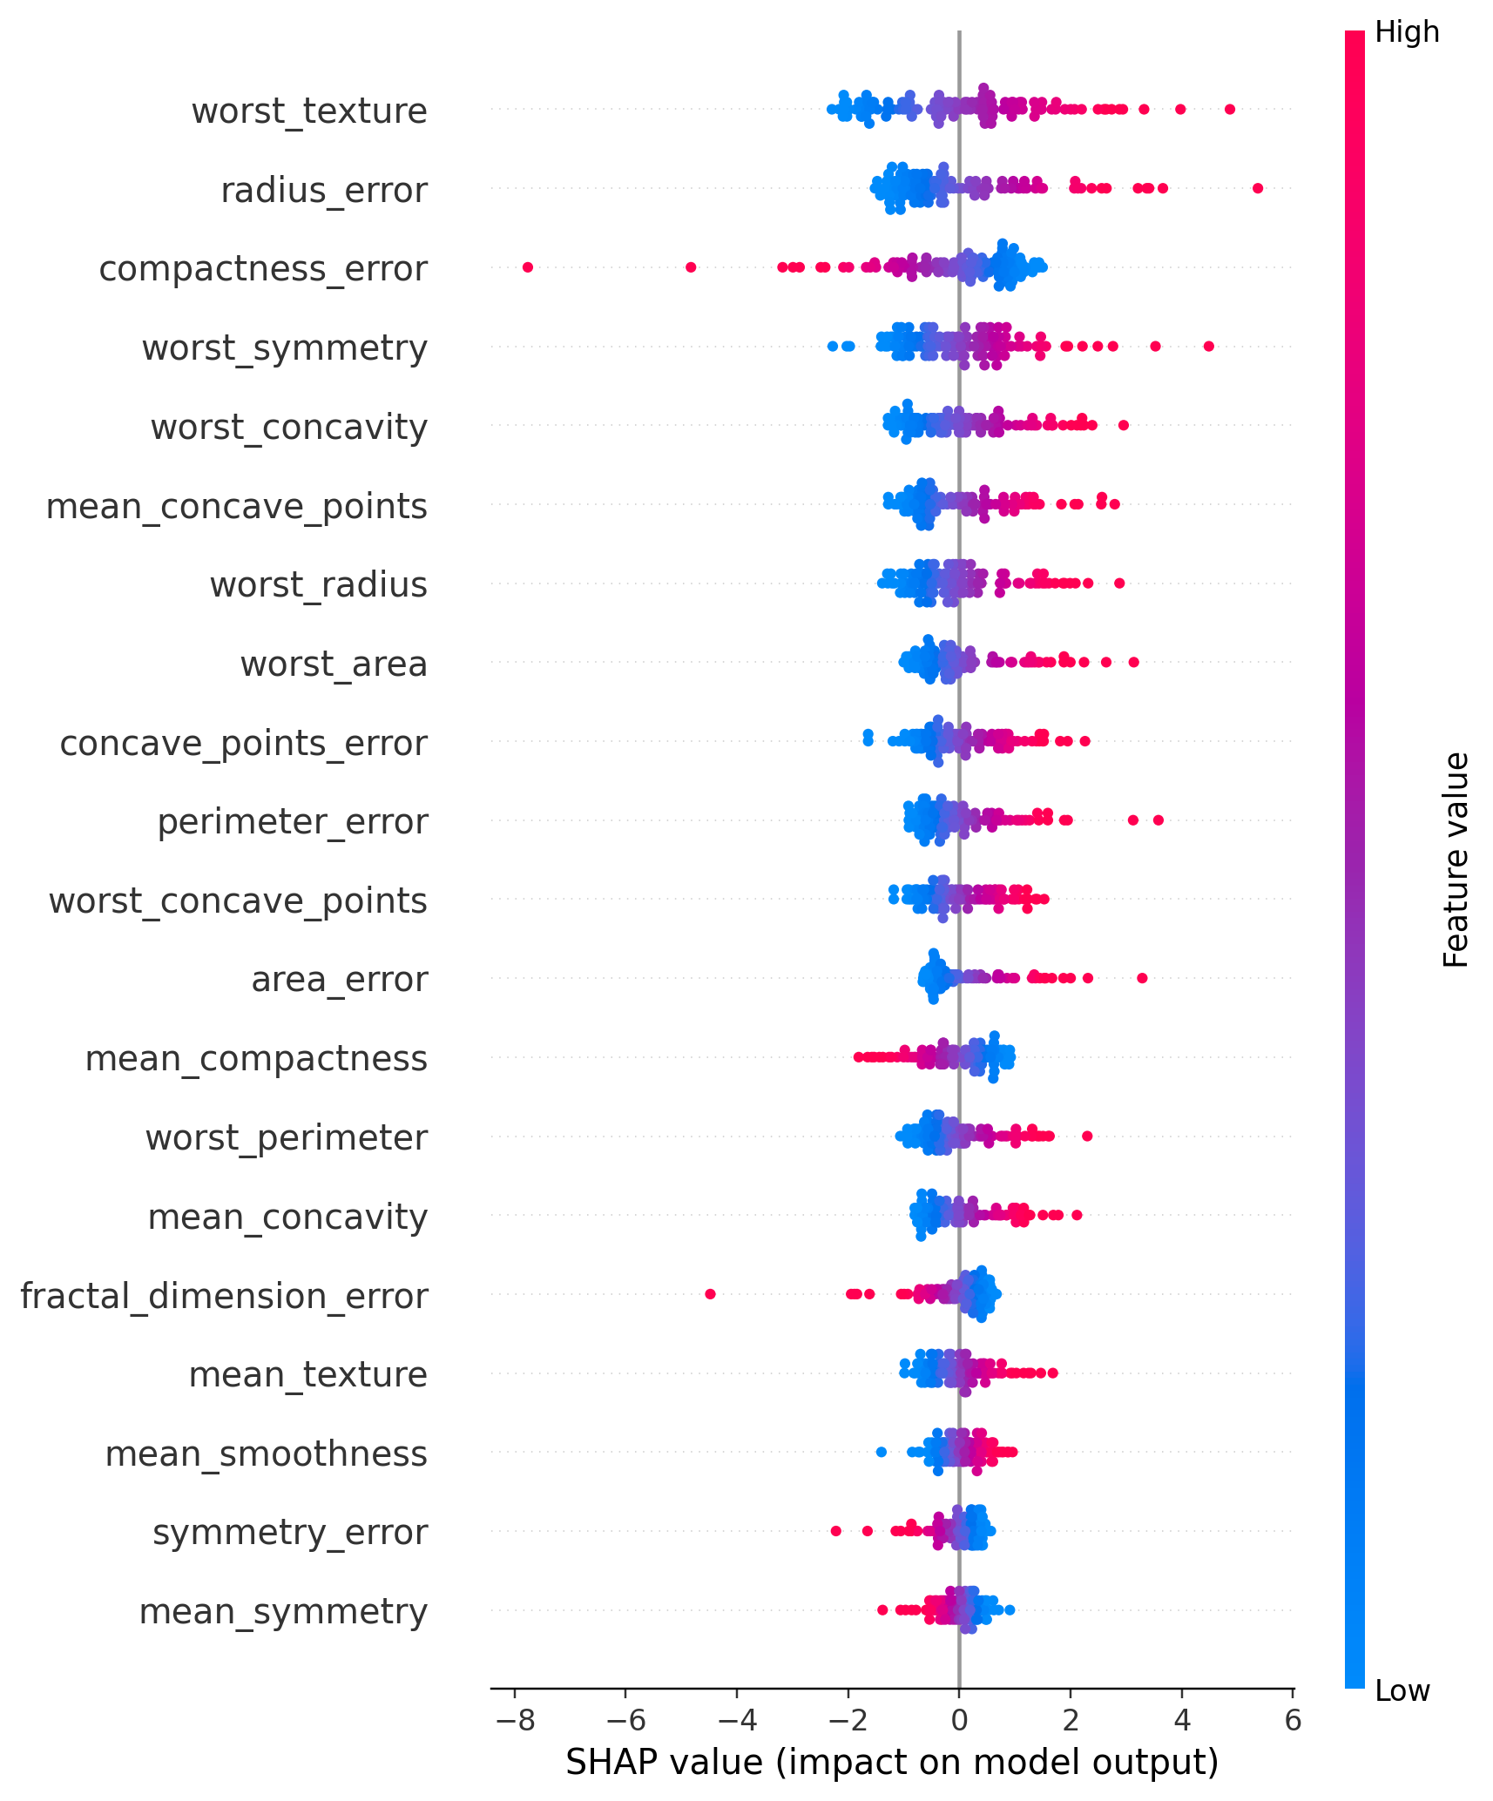
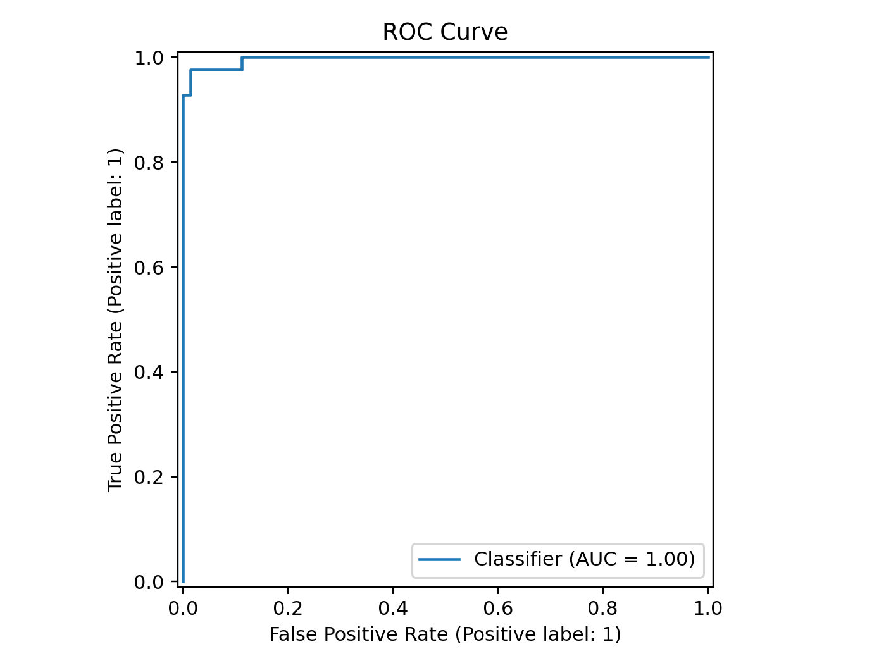
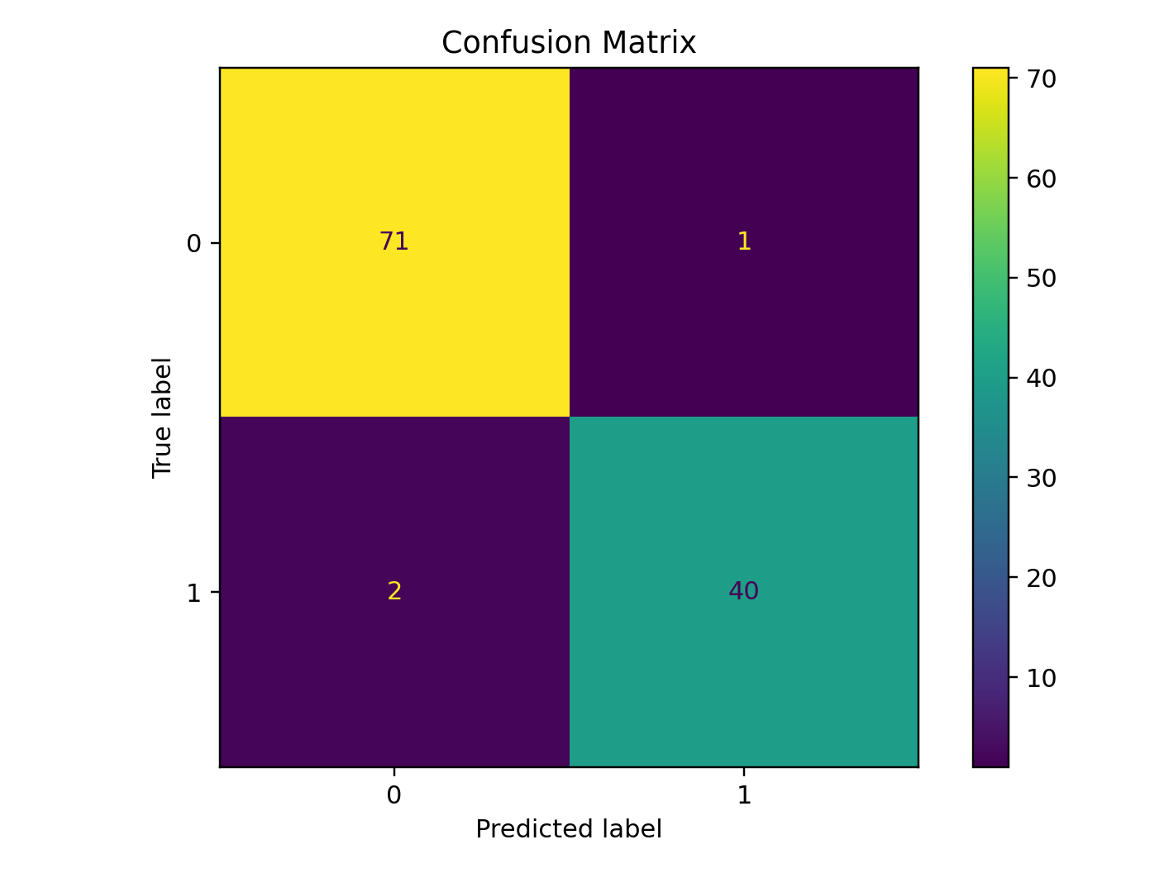
Breast Cancer Explainability
SHAP, ROC curve, and confusion matrix support academic explainability

Slide 11
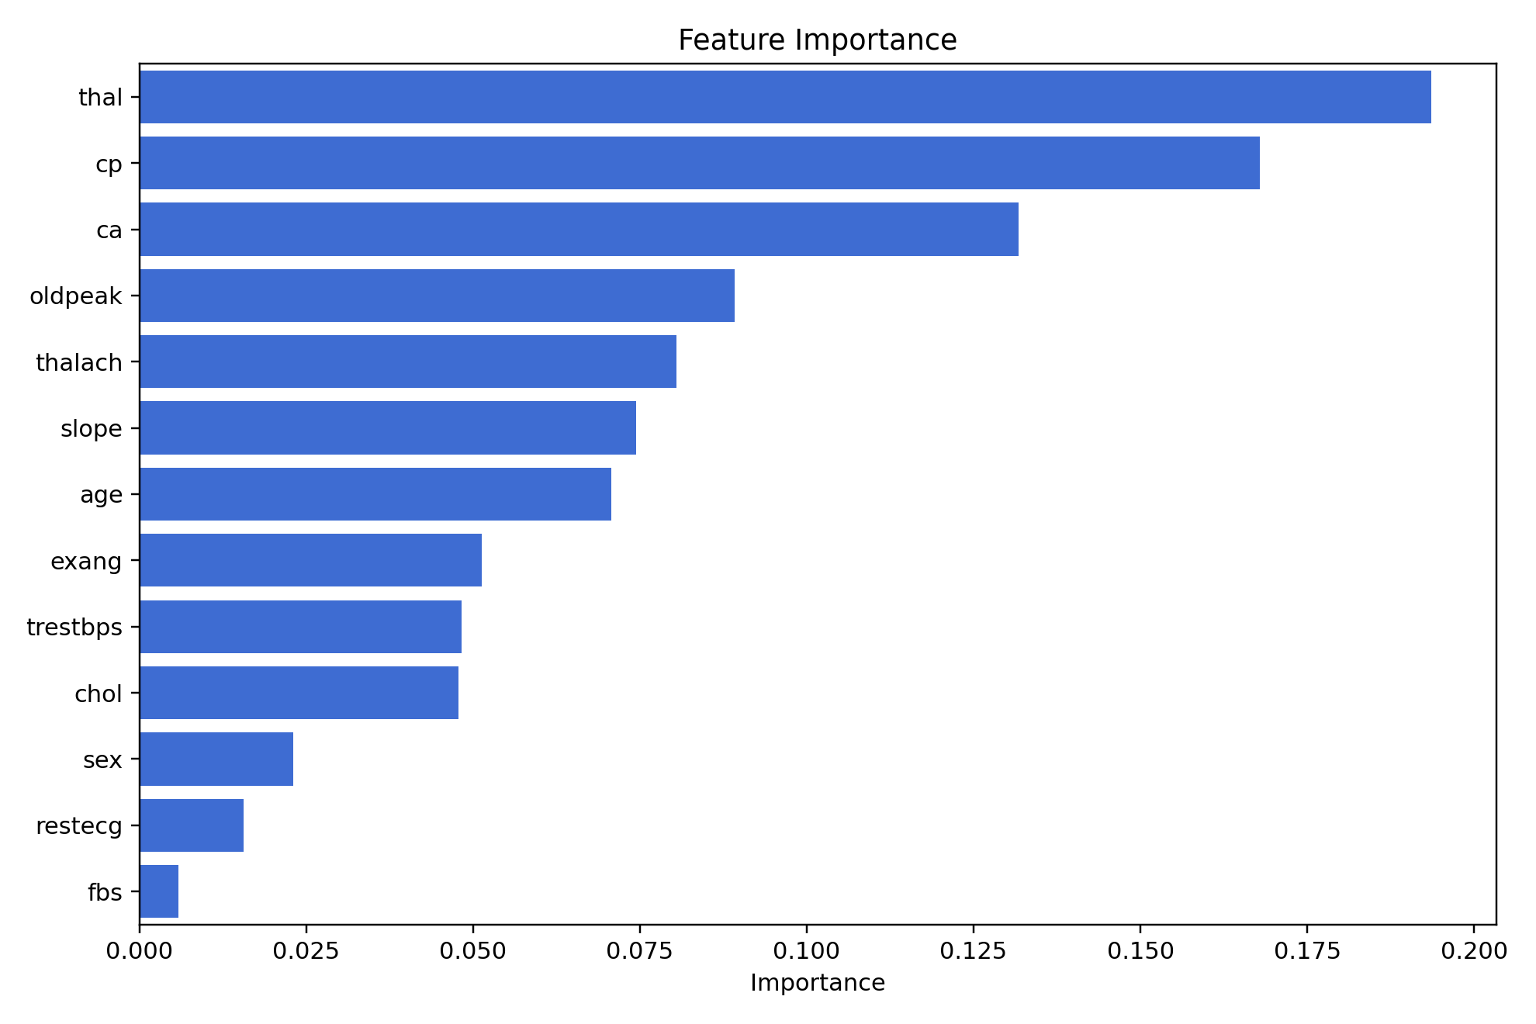
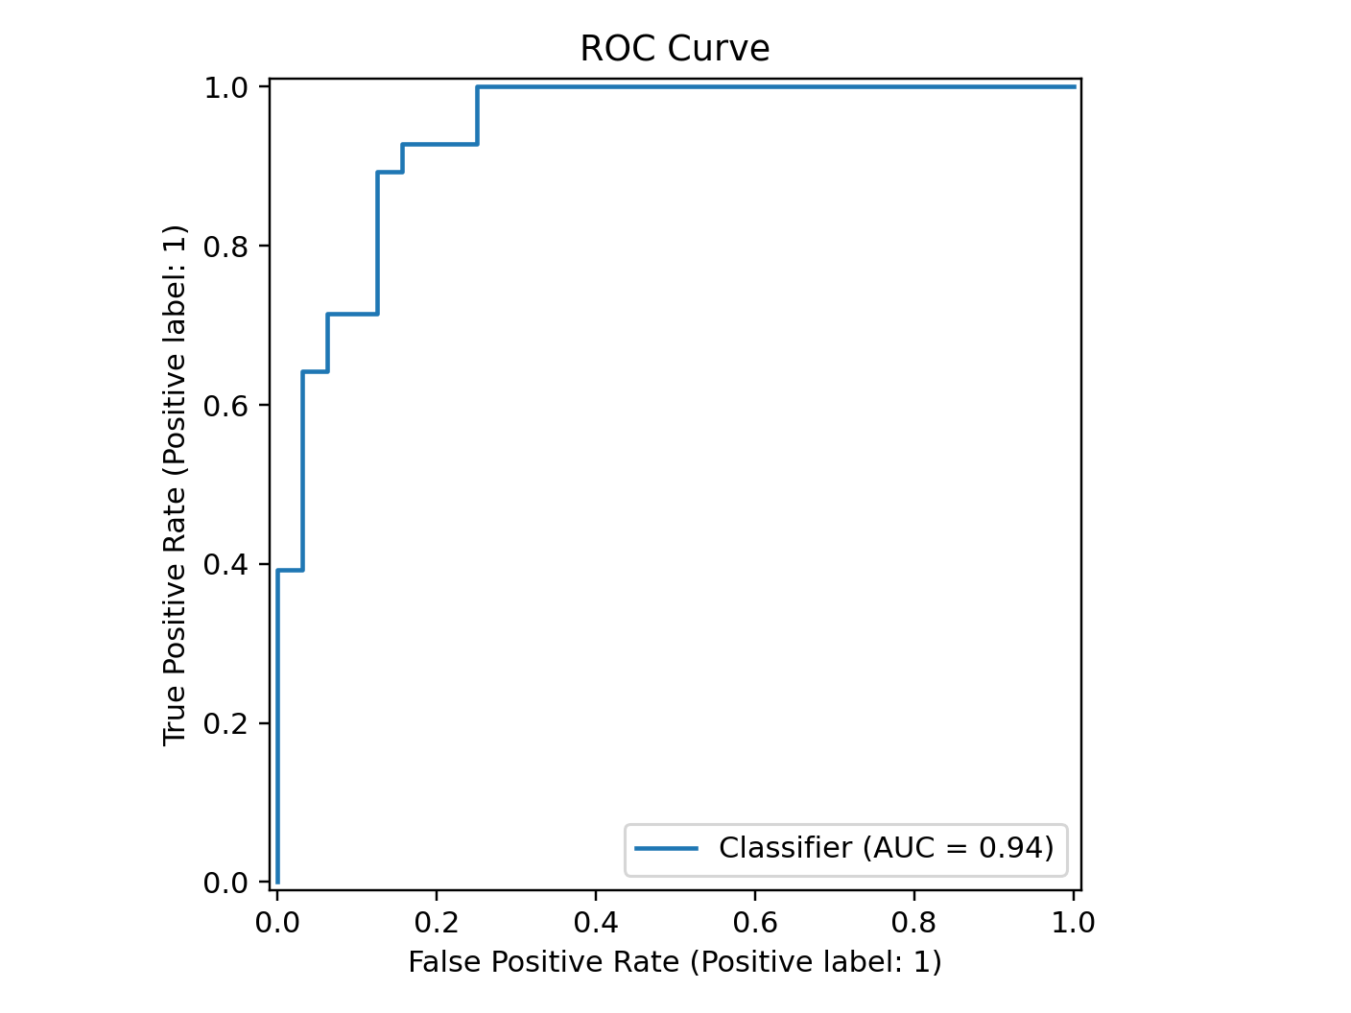
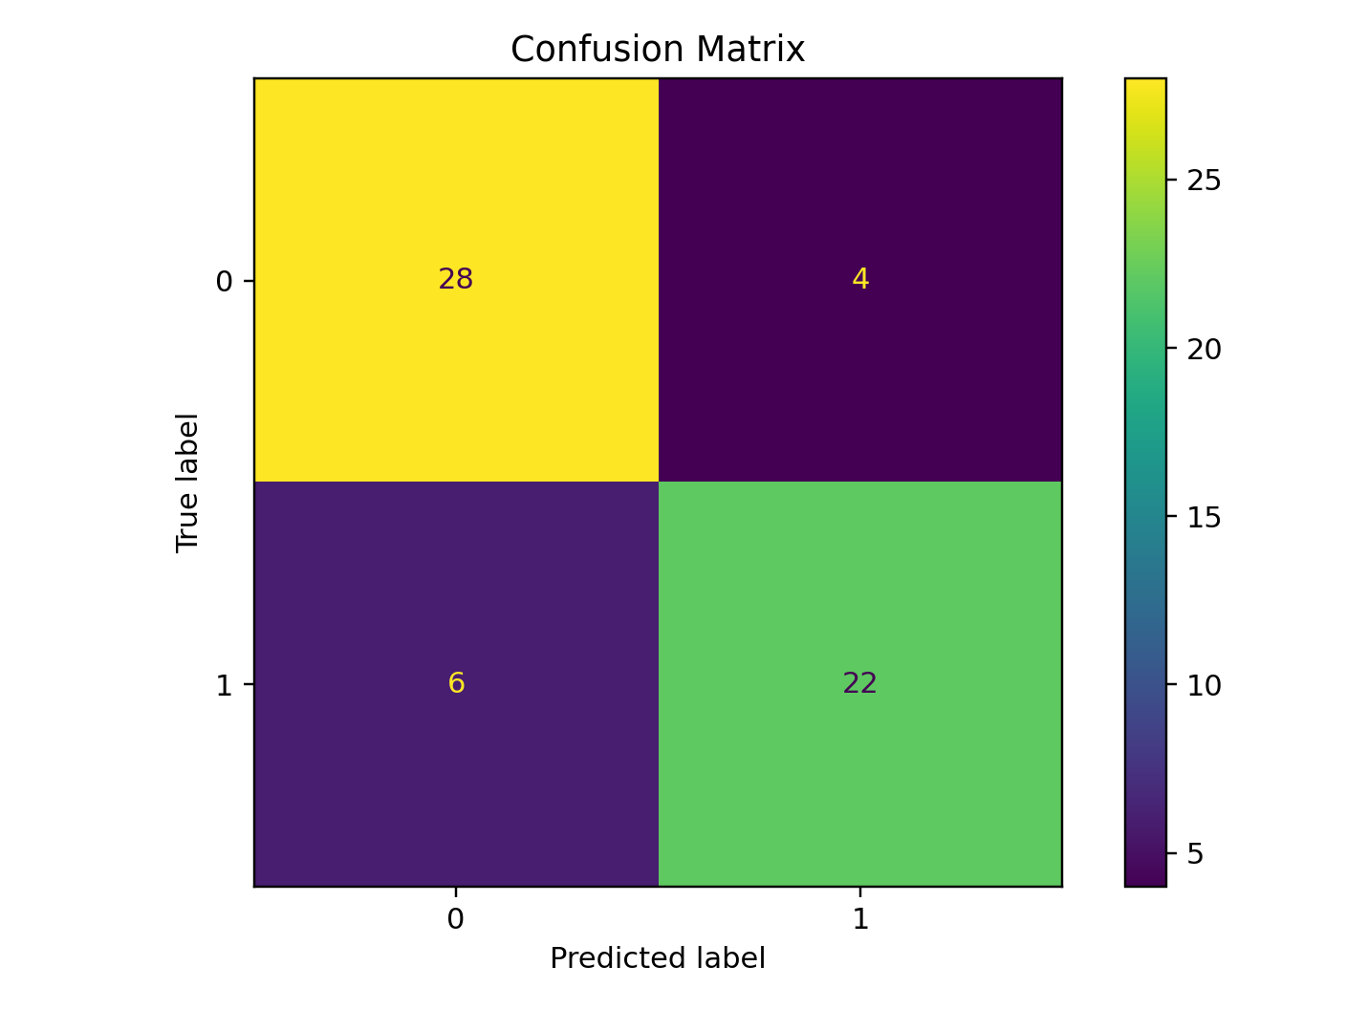
Heart Disease Explainability
Model behavior is reviewed with ROC, confusion matrix, and feature importance

Slide 12
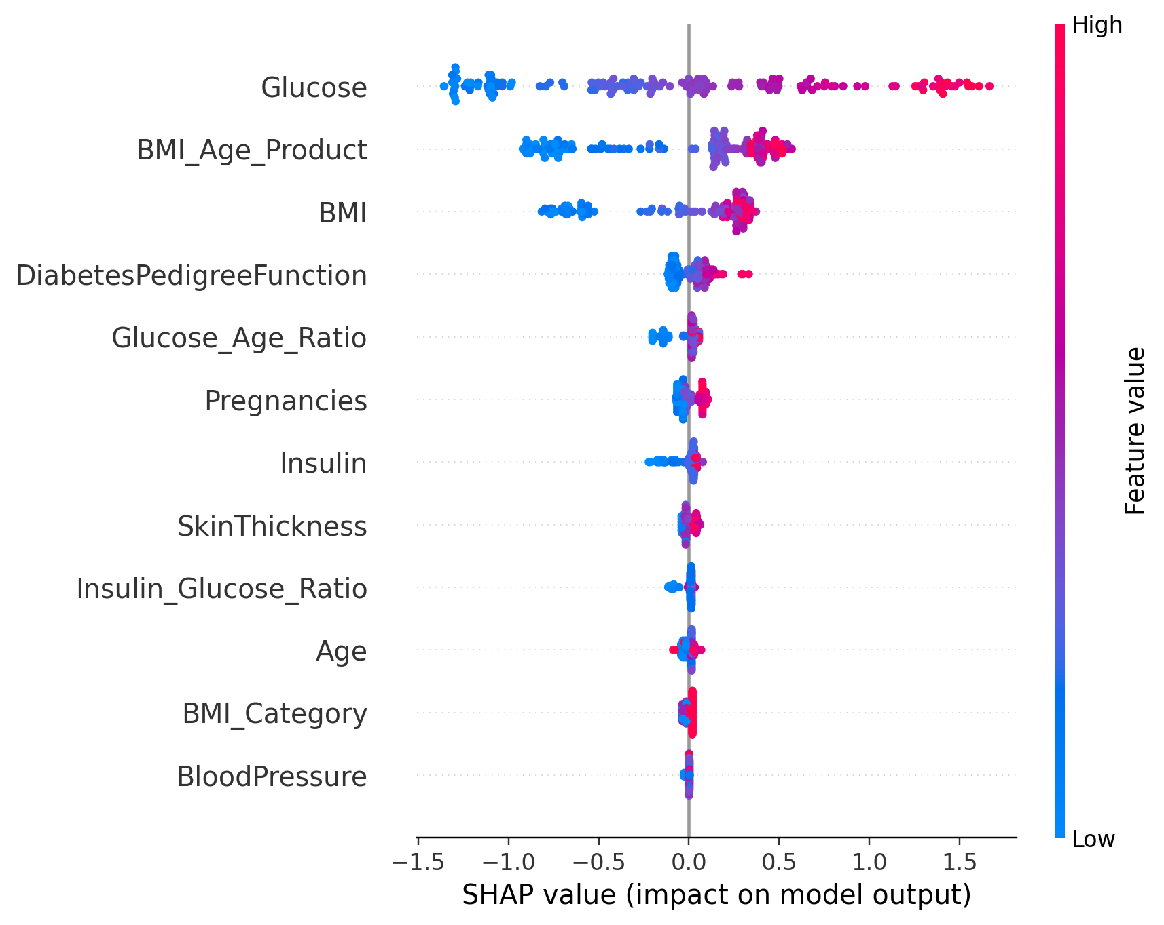
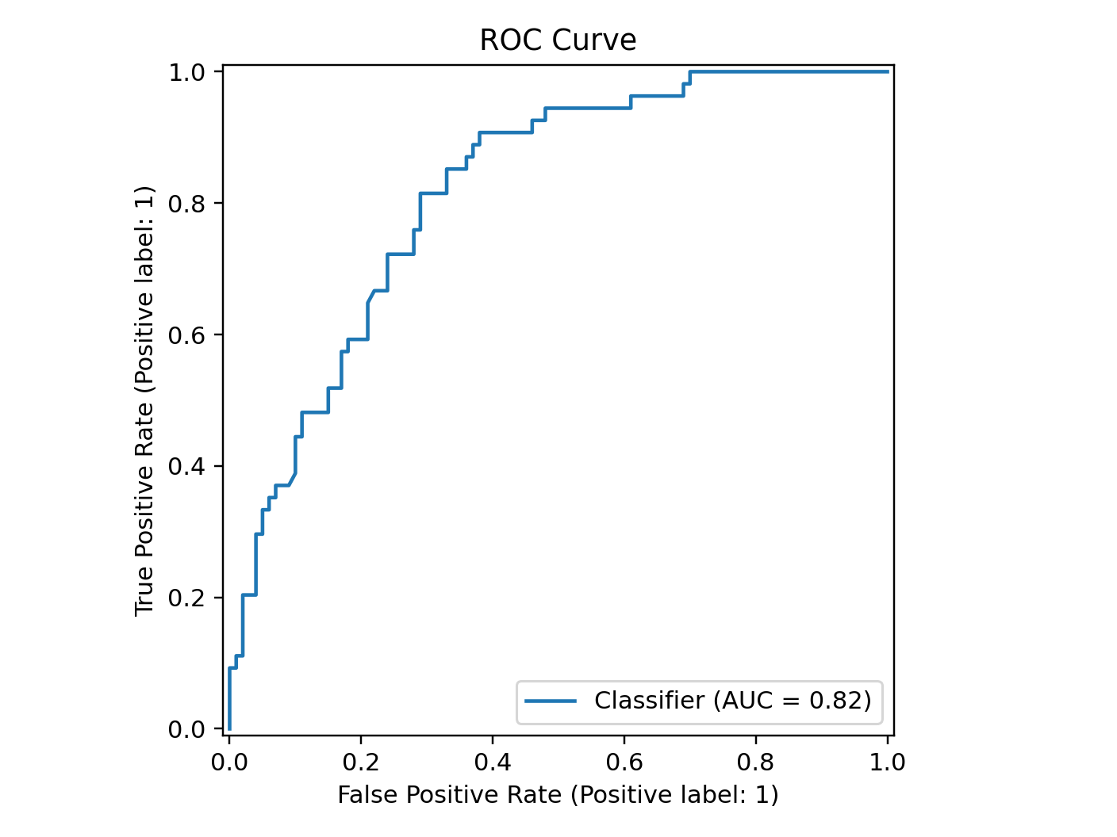
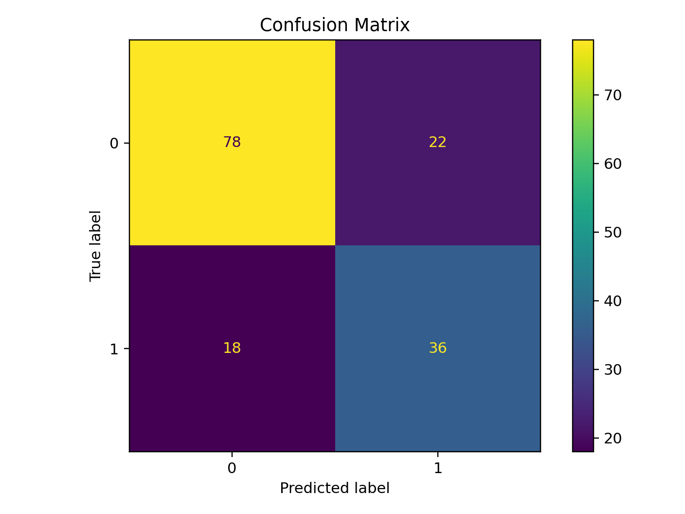
Diabetes Explainability
Legacy and publication-grade diabetes artifacts support comparison and reporting

Slide 13
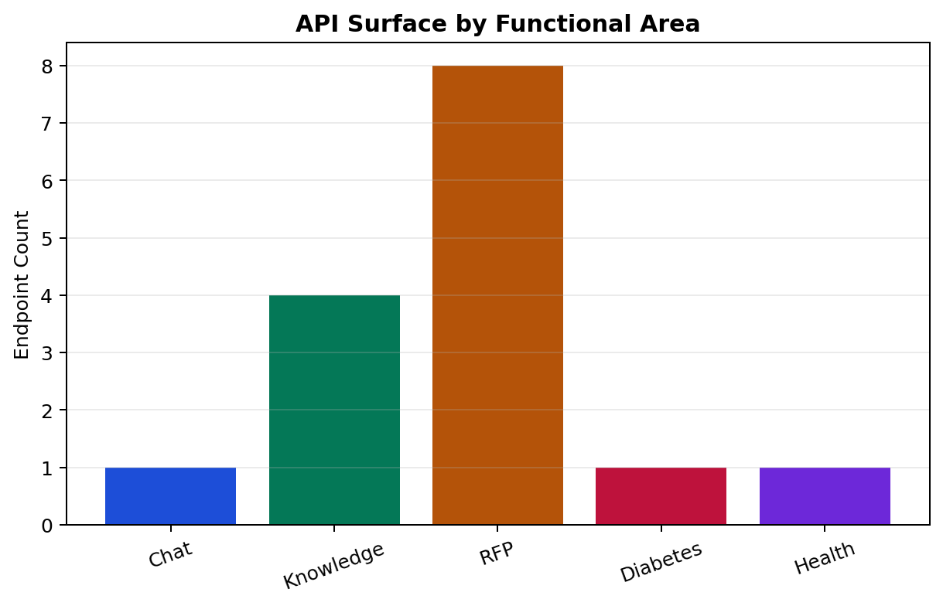
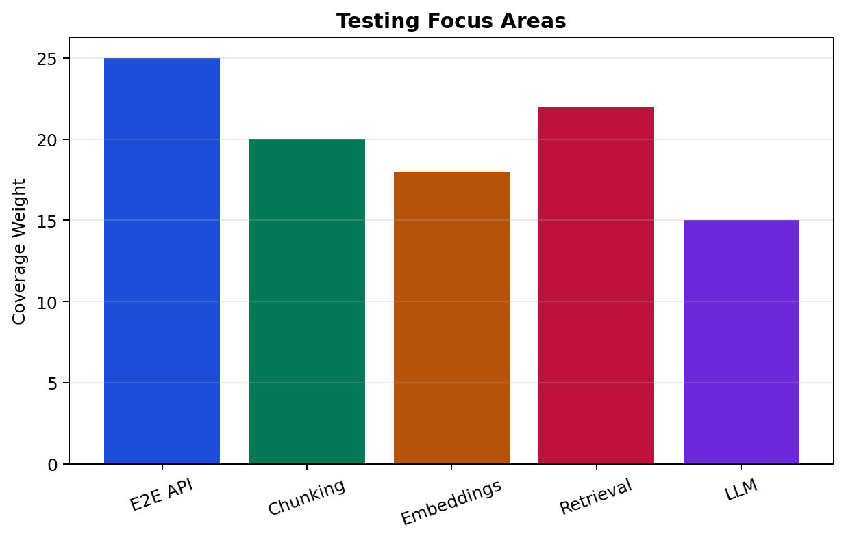
Testing and API Surface
Focused automated tests protect retrieval, ML contracts, and core API behavior

Slide 14
Key Improvements Implemented
The publication-strength changes focus on safety, explainability, and credibility
Semantic retrieval validation with disease-specific constraints
Disease-aware response templates for breast cancer and other disease models
SHAP impact table shown in the UI instead of generic medical paragraphs
CalibratedClassifierCV added to the training pipeline for future artifacts
Probability display capped at 99.9% and confidence labels added
Ordered input button supports exact paper/test samples and manual field editing

Slide 15
Conclusion
RFPForge is a complete applied AI system, not only a model or a notebook
What works RAG chat, document ingestion, vector search, disease prediction, SHAP display, ordered input, validated guidance.
Future work External clinical validation, citation previews, authentication, Docker deployment, richer calibration plots, clinician-reviewed content.
Final message: explainability, retrieval filtering, calibrated probabilities, and disease-aware generation improve the paper more than chasing another 1-2% accuracy.

