Slide 1
NDWI Water-Body Segmentation
Extracting water bodies from satellite imagery using NDWI + Mean-Shift segmentation
GNR Semester 8 — Problem Statement #6
Tanmay Mandaliya · Rohan · Pravesh Khaparde

Slide 2
The problem
What the assignment asks for
"Generate an NDWI image and make a 3-band image of Green, NIR, and NDWI components. Extract all water bodies from this 3-band image using the Mean-Shift segmentation algorithm."
• Input: a Green-band and a NIR-band satellite GeoTIFF of the same place.
• Output: a binary water mask (white = water, black = everything else) plus area in km² for each water body.
• No training data. No labels. Unsupervised clustering only.
• Must be defended as our own implementation — no sklearn / cv2 Mean-Shift.
NDWI Water-Body Segmentation · GNR Semester 8

Slide 3
NDWI — why water pops out
NDWI = (Green − NIR) / (Green + NIR)
• Water reflects Green light but absorbs NIR → NDWI is large and positive.
• Vegetation does the opposite (absorbs Green, reflects NIR) → NDWI is negative.
• Built-up and bare soil → NDWI is near zero.
• Pure arithmetic, applied pixel-by-pixel. No training, no model.
NDWI range: −1 ⇐ land / vegetation built-up ≈ 0 water ⇒ +1
NDWI Water-Body Segmentation · GNR Semester 8

Slide 4
Stacking into a 3-D feature space
Every pixel becomes one point in a 3-D feature space
• Step: stack Green, NIR, NDWI into a single array of shape (H, W, 3).
• Every pixel is now a 3-D point with coordinates (Green, NIR, NDWI).
• Water pixels cluster together in one region of this 3-D space.
• Vegetation pixels cluster in a different region; built-up in yet another.
• Clustering this point cloud is the job of Mean-Shift.
NDWI Water-Body Segmentation · GNR Semester 8

Slide 5
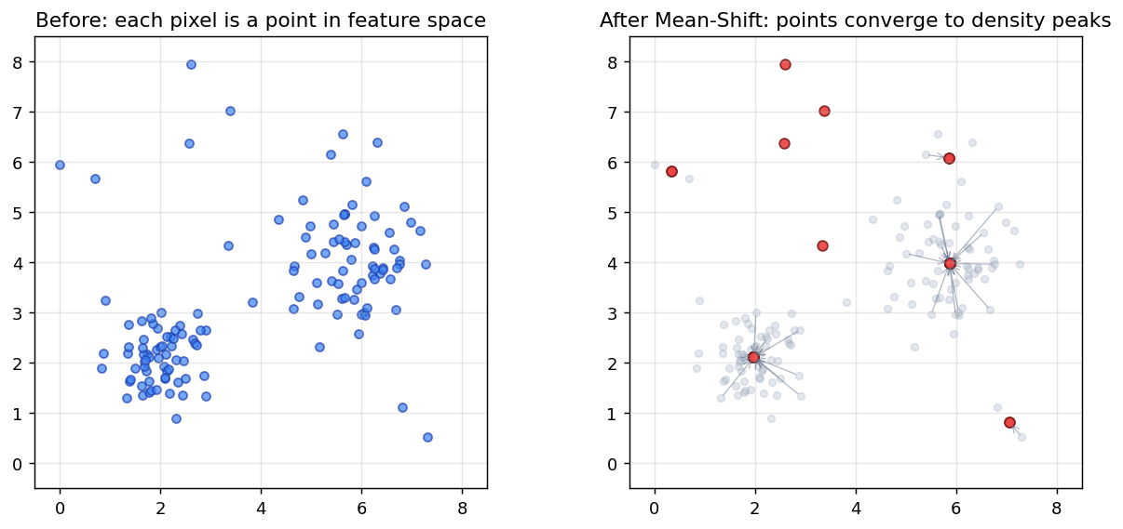
Mean-Shift — the core idea
Each point shifts toward the weighted mean of its neighbours within a radius called the bandwidth. Repeating this shrinks the cloud into a handful of density peaks. Points that converge to the same peak are one cluster.
NDWI Water-Body Segmentation · GNR Semester 8

Slide 6
Our segment() algorithm — written from scratch
def segment(img3, bandwidth, max_iter=100, eps=1e-3): points = img3.reshape(H*W, 3) # normalise so bandwidth is isotropic pts = (points - points.mean(0)) / (points.std(0) + 1e-9) tree = cKDTree(pts) # fast neighbour lookup for i in range(N): # shift every pixel-point x = pts[i] while True: nbrs = pts[ tree.query_ball_point(x, bandwidth) ] w = exp(-||nbrs - x||² / (2·h²)) # Gaussian weights x_new = (w · nbrs).sum() / w.sum() # weighted mean if |x_new − x| < eps: break x = x_new shifted[i] = x # points landing within bandwidth/2 → same cluster return merge_modes(shifted).reshape(H, W)
NDWI Water-Body Segmentation · GNR Semester 8

Slide 7
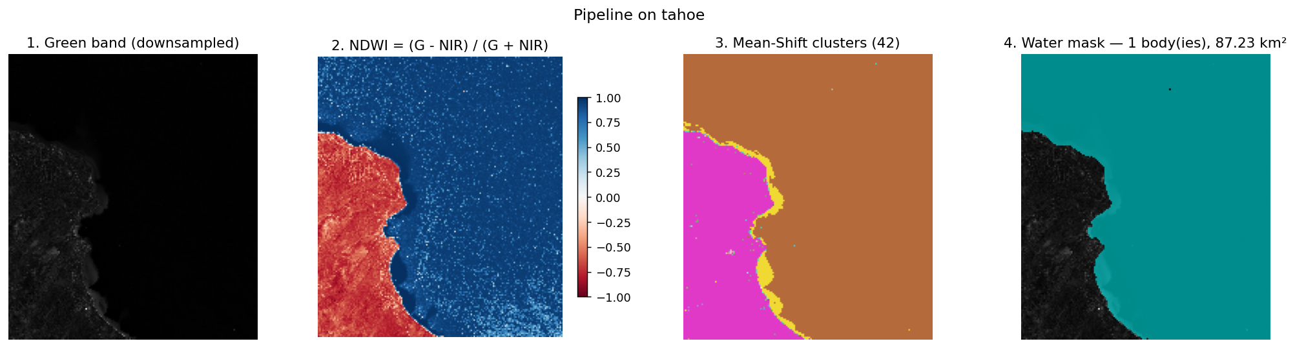
The full pipeline, in one picture
Lake Tahoe sample: (1) raw Green band → (2) NDWI coloured blue→red → (3) Mean-Shift clusters (random colours) → (4) final water mask overlaid on Green.
NDWI Water-Body Segmentation · GNR Semester 8

Slide 8
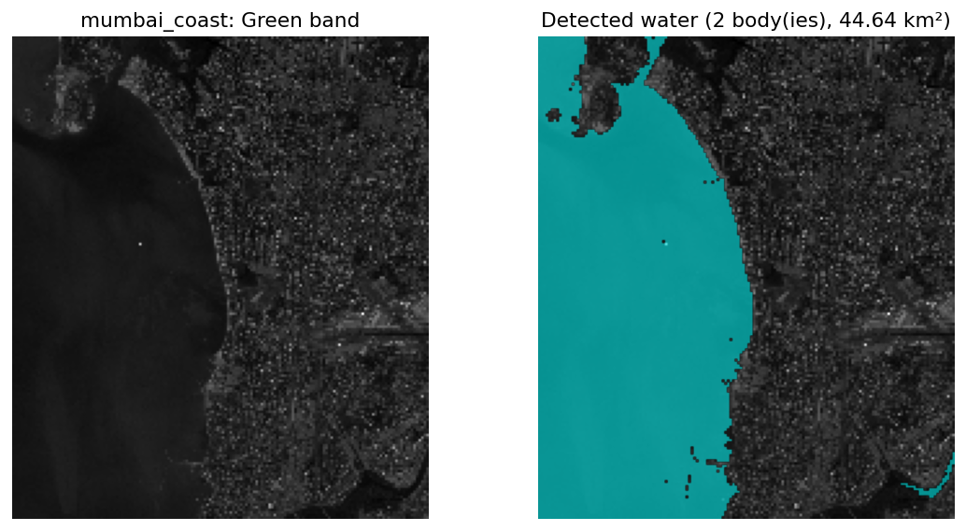
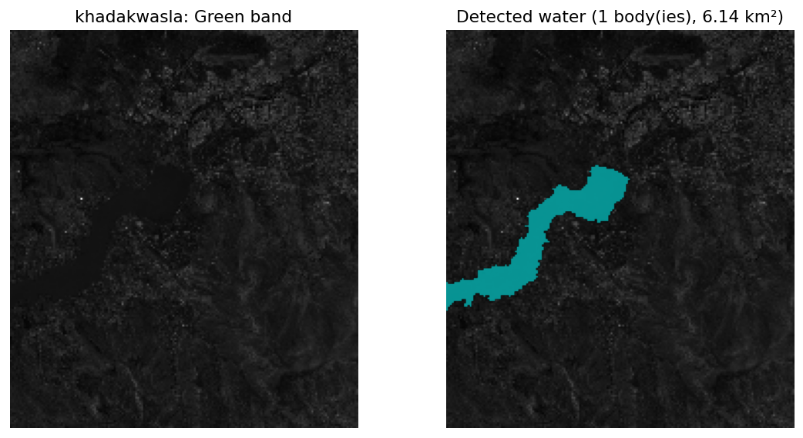
Results on other scenes
Left: Mumbai coast — captures sea and creek. Right: Khadakwasla reservoir.
• 10 Sentinel-2 scenes bundled: Tahoe, Mumbai, Dal Lake, Chilika, Amazon, Sundarbans, Great Salt Lake, Khadakwasla, Ganges, Iceland.
• All pulled from AWS public Sentinel-2 COGs — no authentication needed.
NDWI Water-Body Segmentation · GNR Semester 8

Slide 9
The Streamlit UI
• Sidebar: pick a scene from a dropdown, tweak four parameters (downsample k, bandwidth, min-NDWI, min-blob).
• Five tabs: Input · NDWI · Segmentation · Water mask · Stats.
• Click Run — Mean-Shift takes ~30-60 s with a progress bar.
• Stats tab reports: how many water bodies, total area in km², per-blob breakdown.
• No file upload, no download buttons — kept simple so the algorithm is the focus.
NDWI Water-Body Segmentation · GNR Semester 8

Slide 10
Summary — what is ours vs what is a library
Ours (we wrote the code) NDWI formula · band stacking · Mean-Shift shift loop · Gaussian kernel · convergence check · mode merging · water-cluster selection · blob cleanup
Plumbing (library call, labelled as such) rasterio — GeoTIFF I/O · scipy.cKDTree — fast neighbour search · scipy.ndimage.label — connected components · numpy — array math · streamlit/matplotlib — UI
Deliberately NOT used sklearn.cluster.MeanShift · cv2.pyrMeanShiftFiltering — would defeat the project
Thank you — questions welcome.
NDWI Water-Body Segmentation · GNR Semester 8

