Slide 1
The way through ‘complexity’ towards an optimal algorithm for matrix multiplication
KASHAN HASAN - 180123022
TANMAY JAIN -180123050

Slide 2
AIM
We shall look at Strassen, and it is parallel implementation to reduce the execution time significantly.
Also, we analyze Frievald's algorithms, a quadratic time verifier of the problem.
We take a glance at one of the latest algorithms ( Coppersmith and Winograd) and finally conclude by our understanding and intuition.

Slide 3
Why do we need a faster algorithm?
Matrix multiplication is one of the most fundamental operations in mathematics.
Applications in almost every area, such as network theory, perspective projections, linear equations.
calculations involving very large matrices having time complexity, O(n³) is practically of no use.
Need to resort to more advanced approaches with complexity< O(n³).

Slide 4
Naive Approach
The definition of matrix multiplication is that if C = AB for an n × m matrix A and an m × p matrix B, then C is an n × p matrix with entries C_{ij} =∑^{m}_{k=1} a_{ik}b_{kj}
Input: matrices A and B
Let C be a new matrix of the appropriate size
For i from 1 to n:
For j from 1 to p:
Let sum = 0
For k from 1 to m:
Set sum ← sum + A_{ik} × B_{kj}
Set C_{ij} ← sum
Return C with time complexity as O(n³)

Slide 5
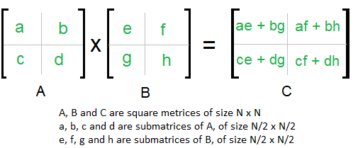
Divide And Conquer approach
The
In the above method, we do 8 multiplications for matrices of size N/2 x N/2 and 4 additions. Addition of two matrices takes O(N) time. So the time complexity can be written as
T(N) = 8T(N/2) + O(N^2) .From Masters Theorem complexity is O(n³)

Slide 6
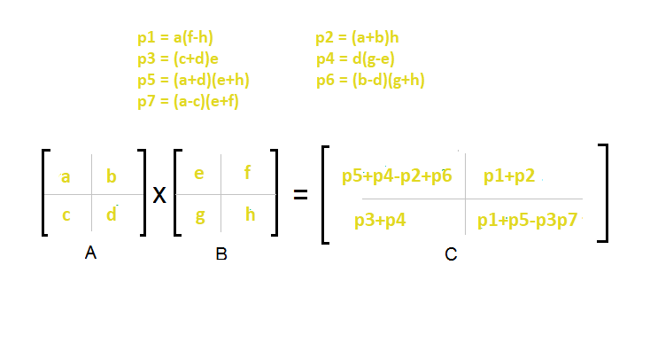
The Strassen Approach-
We can finish the call with 7 recursive calls and a little bit of addition and subtraction. The following takes T(n) = 7T(n/2) + O(n²) which leads to O(n^{log}(7)) runtime. This comes out to approximately O(n^{2.8074}) which is better than O(n³)

Slide 7
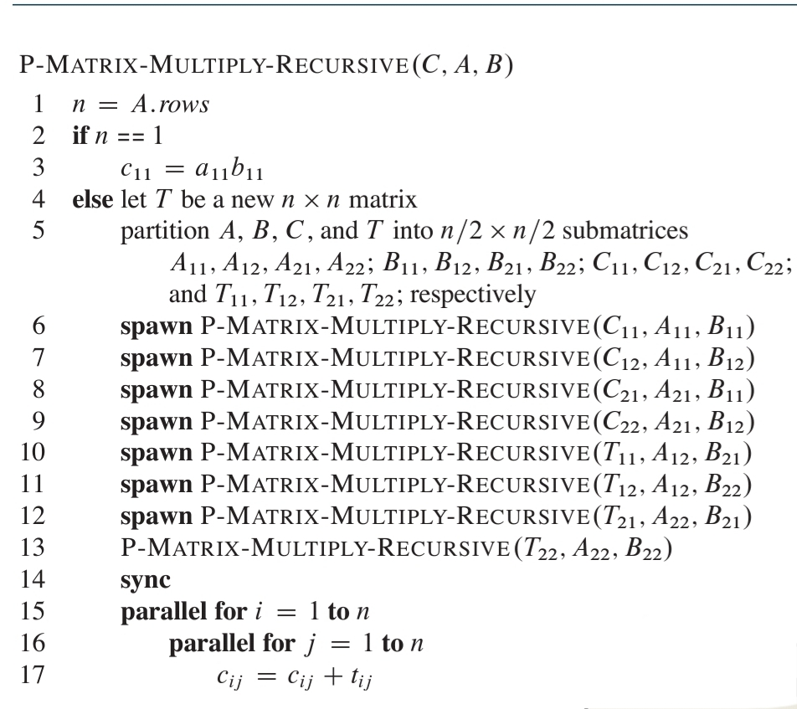
Pseudo Code for Divide and Conquer in Parallel
For line 2-3 we have T∞(n)=θ(n)
For line 4-5 we have θ(n).
For line 6-13 we have eight
Multiplications in parallel.
For line 15-17 we have θ(logn)
Now T₁(n) = (n³)
T∞(n) = T∞(n/2) + θ(logn)

Slide 8
Strassen's Algorithm (Parallelised)
1. Partition each of the matrices into four n/2 x n/2 submatrices.
(This step takes Ө(1) work and span by index calculations.)
2. Create 10 matrices S₁, S₂, …, S₁₀. Each is n/2 x n/2 and is the sum
or difference of two matrices created in the previous step.
(Can create all 10 matrices with Ө(n²)work and Ө(log n)
span using the doubly nested parallel for loops).
3. Recursively compute 7 matrix products P₁, P₂,..., P₇, each n/2 x n/2.
(Recursively spawn the computation of the seven products.)
4. Compute n/2 x n/2 submatrices of C by adding and subtracting
various combinations of the P_{i}.

Slide 9
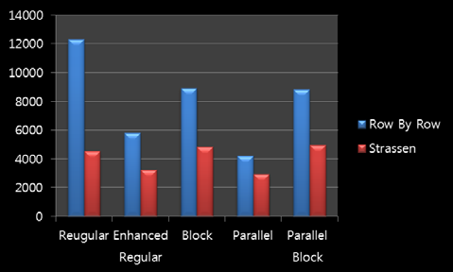
Strassen’s Method ( Parallel Implementation)
The required 7 products are computed recursively using concurrent operations, thus using lesser time than sequential execution.
T₁(n) = (n^{log7})
T∞(n) = (log₂n)

Slide 10
Where Are We?

Slide 11
Current State of Art
Asymptotic Complexities:
O(n³ ), naive approach
O(n^{2.808}), Strassen (1969)
O(n^{2.796}), Pan (1978)
O(n^{2.522}), Schönhage (1981)
O(n^{2.517}), Romani (1982)
O(n^{2.496}), Coppersmith and Winograd (1982)
O(n^{2.479}), Strassen (1986)
O(n^{2.376}), Coppersmith and Winograd (1989)
O(n^{2.374}), Stothers (2010)
O(n^{2.3728642}), V. Williams (2011)
O(n^{2.3728639}), Le Gall (2014)

Slide 12
Is O(n²) Achievable?

Slide 13
Frievalds’ Algorithm
Freivalds’ randomized algorithm achieves the time bound O(n²).
It is a randomized Monte Carlo algorithm and has a small probability of error.
By repeatedly running this algorithm, one can reduce the probability of error
Used as a verifier for matrix multiplication.

Slide 14
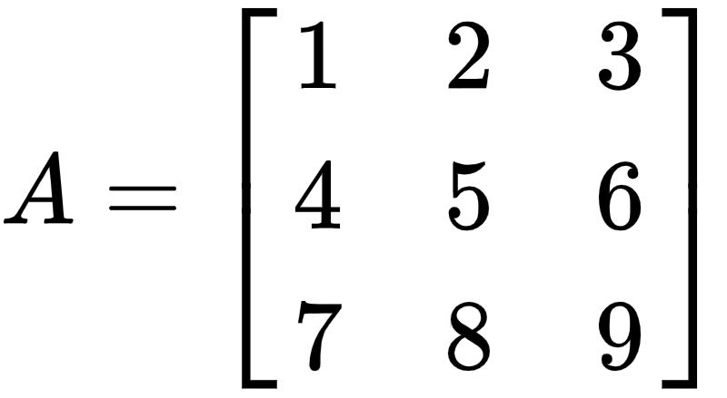
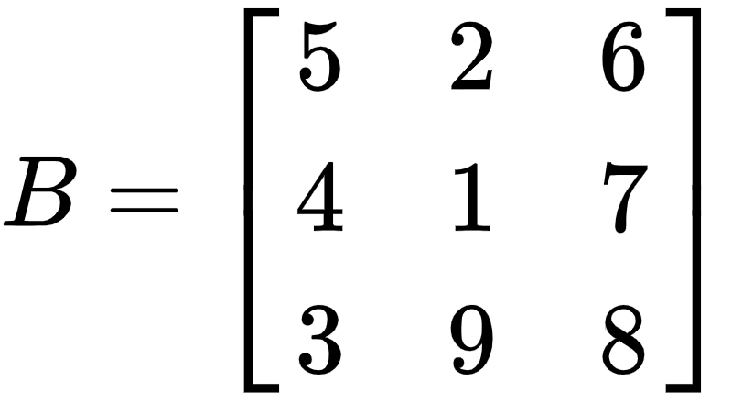
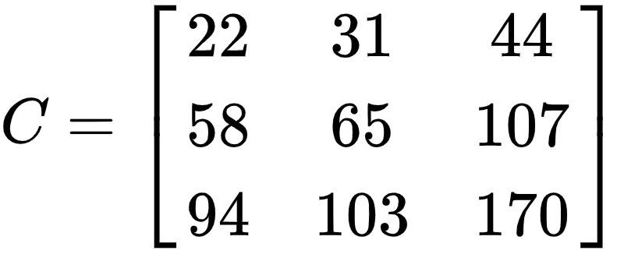
EXAMPLE
Let us be given with examples for better understanding. Let
We choose a random vector in {0,1}³ say v=[1,0,1] . We now compute vAB and vC and compare the results.

Slide 15
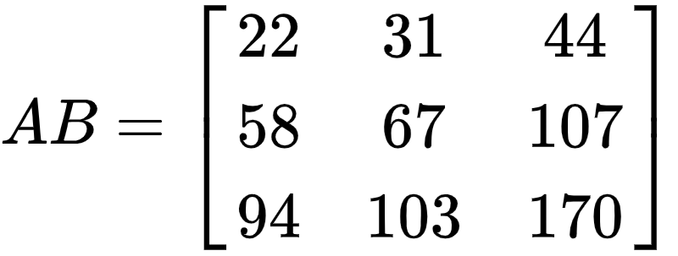
EXAMPLE CONTD.
We get vA = [8,10,12]. (vA)B = [116,134,214]. And vC= [116,134,214].
That is we have vAB = vC .
However if our random vector r = {0 ,1 , 1} then we would have
rA = (11, 13, 15) (rA)B = (152, 170, 277) and rC = (152, 168, 277)
This implies rAB ≠ rC
And . ≠

Slide 16
Error Analysis
We see that for AB=C the probability for correctness is 1.
While when AB ≠ C we see
Then (AB - C) ≠ 0, so there exists i, j with (AB - C)_{ij} ≠ 0.
Let (d₁, d₂ , …, d_{n} ) be i-th row of AB - C ; d_{j} ≠ 0 .
Now P((AB - C) x = 0 | AB ≠C) ≤ P( ∑ ^{n}_{i = 1} d_{i} x_{i} | AB ≠ C)
= P(x_{j} = {− 1 /d_{j} ∑_{𝑖≠𝑗} d_{i} x_{i}} | AB ≠ C) ≤ ½ .
This proves that the maximum possible error is ½
By iterating with k random, independent choices of x, we can decrease probability of error to 1/2^{k} , using time O(kn² ).

Slide 17
Is the fastest Algorithm the Best to use?

Slide 18
Coppersmith-Winograd Algorithm(1990)
Group Theoretic approach using daunting mathematics.
Achieves O(n^{2.375477})
large constant factors hidden in its running time.
Not of any practical usage.
All of latest algorithms(including this) are only of theoretical purposes.

Slide 19
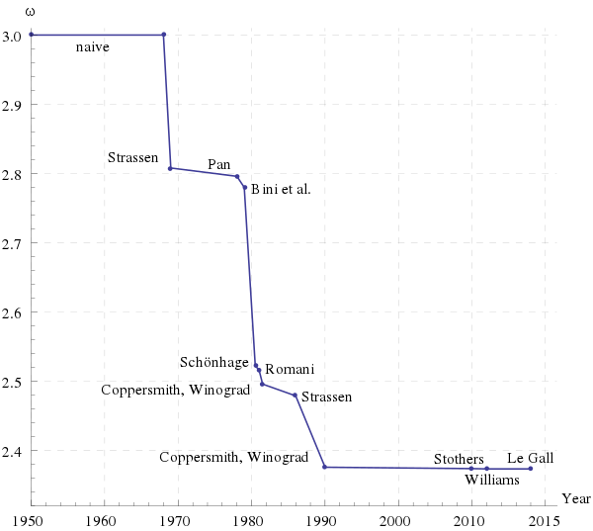
Development Over the Years

Slide 20
Future Developments
It is open whether or not there is a deterministic matrix multiplication algorithm which achieves the time bound O(n²), which is also the trivial lower bound.
In last 30 years , no major improvement has been made.
The fastest known algorithm is Le Gall with O(n^{2.3728639})( 2014.)
The whole presentation can be best visualised as a journey from O(n³) to the destination O(n²) which is yet to be completed.
We believe it is a matter of time when we see O(n²) time complexity algorithm.

Slide 21
Refrences
Grayson, Brian, and Robert Van De Geijn. "A high performance parallel Strassen implementation." Parallel Processing Letters 6.01 (1996): 3-12.
Cormen, Thomas H.; Leiserson, Charles E.; Rivest, Ronald L.; Stein, Clifford(2009) [1990]. Introduction to Algorithms (3rd ed.). MIT Press and McGraw-Hill.
Coppersmith, Don, and Shmuel Winograd. "Matrix multiplication via arithmetic progressions." Proceedings of the nineteenth annual ACM symposium on Theory of computing. 1987.
Korec, Ivan, and Jiří Wiedermann. "Deterministic verification of integer matrix multiplication in quadratic time." International Conference on Current Trends in Theory and Practice of Informatics. Springer, Cham, 2014.
Motwani, R., Raghavan, P.: Randomized Algorithms. Cambridge (1995)

Slide 22
THANK YOU!

