Slide 1
Introduction to Xamarin
[ Tanmay Srivastava ]
[Tanmay.Srivastava@studentpartner.com]

Slide 2
Types of Mobile App Development
SILO Approach
BLACKBOX Approach
XAMARIN Approach

Slide 3
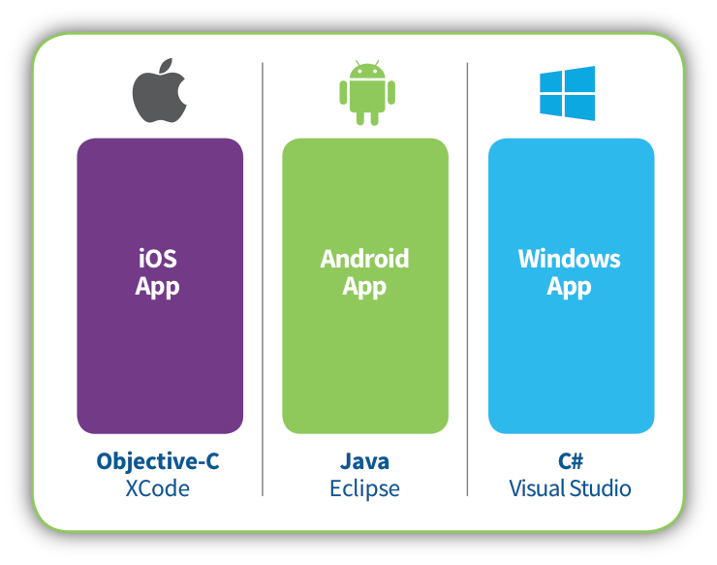
SILO Approaches
Multiple Teams Required.
Multiple Code Base.
Product cost increases

Slide 4
So Why Xamarin?

Slide 5
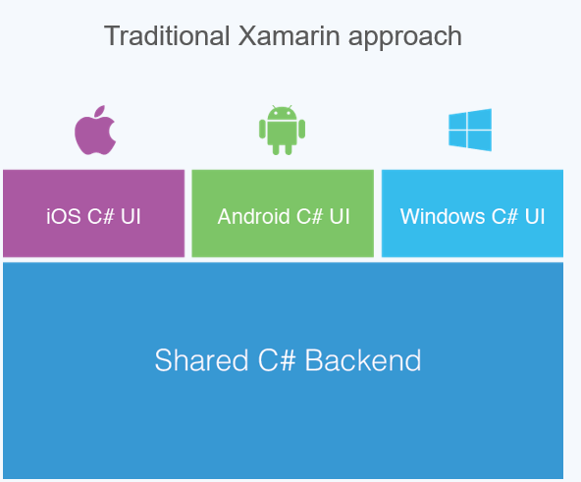
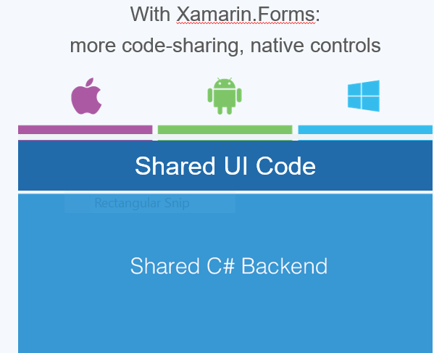
Types of Xamarin Approaches:

Slide 6
How XAMARIN is helpful ?
Business Logic & UI will be shared.
Single Team.
Single Code Base.
Development Time is faster.
Native App Will be developed.

Slide 7

Learn more about XAMARIN from:
xamarin.com/university

Slide 8
THANK YOU

