Slide 1

Santander Customer Satisfaction Want big impact?
Presented by: codeR

Slide 2









Problem of Santander Bank
Impact
Highlights
Our Process
Data Gathering
Data Preprocessing
Modeling
Feature Importance
Modeling Error
Model Comparison
Q & A
AGENDA
2

Slide 3

Problem Statement
Santander Bank is asking for help to identify dissatisfied customers early in their relationship.
The task is to predict the probability that each customer in the test set is an unsatisfied customer.
32

Slide 4

Impact
Doing so would allow Santander Bank to take proactive steps to improve a customer's happiness before it's too late
Better Customer Satisfaction means Increased growth revenue
4

Slide 5
Highlights
83%
Built Random Forest and Gradient Boosting models to find out the unhappy customers
Gradient Boosting gave us better results than Random Forest
The ROC value for GBM was
5

Slide 6
Our process is easy
Cleaning & Preprocessing
Modeling
Comparison
6

Slide 7
Data Gathering
We gathered data from kaggle.com
Data is clean and distributed in training and test data sets.
There are 370 variables in the data.
7

Slide 8
Data Preprocessing
Removed columns which has no variance
Removed correlated variables
Feature Engineering
8

Slide 9

Modeling
Machine learning techniques:
Random Forest
Gradient boosting modeling
9

Slide 10

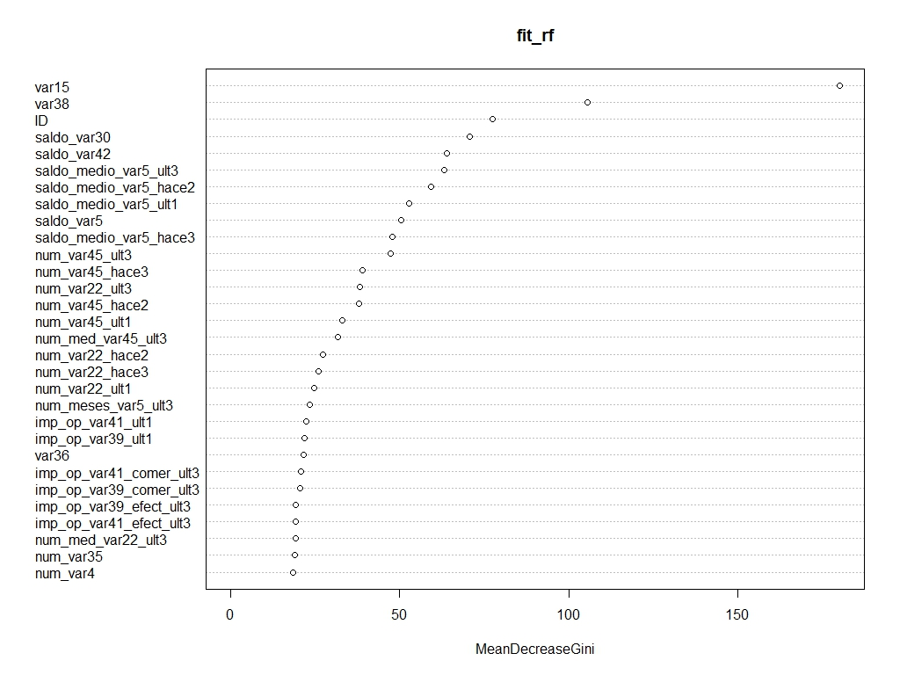
Feature Importance
10

Slide 11
Error = bias + variance
Bias
Error
Variance
11

Slide 12
Comparison
Random Forest
Fully grown decision trees
Less Parameters to tune
Less efficient
Does not overfit
Gradient Boosting
Based on weak learners
More parameters to tune
More efficient
Can overfit
Provides better accuracy
12

Slide 13

Lets check the Code!!
13

Slide 14
Thanks!
Any questions?
You can find us at:
shubham.pachori@uconn.edu
tanmay.khare@uconn.edu
swati.chelawat@uconn.edu
deependra.bundele@uconn.edu
14

