Slide 1



RSOC-2026
GROUP-13
Domain :– AI ML
Problem Statement Title:- AI Code Review
Team Leader Name: - Tanmay Patil
Group No:- 13
Team Name:- Bytecoders
Members:- Bhawana Nirwan , Sheikh Wasimuddin , Vedant Akare
Nagpur | Pune | Jalgaon | Amravati | Pandhura | Bhandara

Slide 2






IDEA TITLE
Studied transformer-based AI models used for understanding programming languages.
Researched CodeBERT, a pre-trained model designed for code analysis and natural language understanding.
Reviewed research papers on AI-powered code review and automated debugging techniques.
Analyzed machine learning approaches for improving code quality and detecting errors.
Explored existing studies on intelligent software development tools and code analysis systems.
GROUP-13
Nagpur | Pune | Jalgaon | Amravati | Pandhura | Bhandara

Slide 3
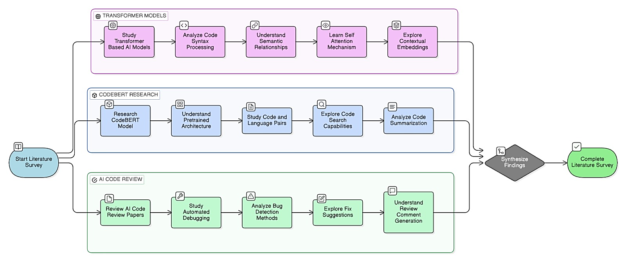
Methodology
GROUP-13
Nagpur | Pune | Jalgaon | Amravati | Pandhura | Bhandara

Slide 4
FEASIBILITY AND VIABILITY
1. Analysis of the Feasibility of the Idea The proposed AI-based Code Review System is feasible because it uses CodeBERT, a pre-trained transformer model designed for understanding programming languages and natural language. CodeBERT can analyze source code, detect errors, and provide suggestions for improvement. The system is implemented through a web interface where users can submit their code, and the model processes it to identify issues and recommend corrections. Since CodeBERT is already trained on large code datasets, it reduces development time and improves the accuracy of code analysis.
2. Potential Challenges and Risks
Ensuring accurate error detection and correction suggestions for different programming languages.
Handling large or complex code snippets that may require more processing time.
Integrating the AI model smoothly with the web application and maintaining system performance.
3. Strategies for Overcoming These Challenges
Utilize the pre-trained capabilities of CodeBERT and fine-tune it for better code understanding.
Optimize the system to process code efficiently and handle larger inputs.
Implement proper backend architecture and testing to ensure reliable integration between the AI model and the application.
.
GROUP-13
Nagpur | Pune | Jalgaon | Amravati | Pandhura | Bhandara

Slide 5
IMPACT AND BENEFITS
1. Anticipated Benefits and Improvements The proposed AI-based Code Review System using CodeBERT is expected to significantly improve the software development process. The system will help developers quickly detect syntax and logical errors in their code and receive suggestions for improvement. This will reduce the time spent on debugging and manual code review. The tool will also help beginners understand coding mistakes and improve their programming skills. Overall, the system aims to enhance code quality, development efficiency, and learning support for programmers.
2. Potential Impact on the Target Audience or Industry The system can benefit software developers, students, and development teams by providing an intelligent assistant for code analysis. It can be used in educational environments to help students learn coding more effectively and in the software industry to support faster development and better code quality. By automating the code review process, the solution can contribute to more efficient software development practices and improved productivity in the tech industry.
GROUP-13
Nagpur | Pune | Jalgaon | Amravati | Pandhura | Bhandara

Slide 6
RESEARCH AND REFERENCES
[1] F. Feng, D. Guo, D. Tang, N. Duan, X. Feng, M. Gong, L. Shou, B. Qin, T. Liu, D. Jiang, and M. Zhou, “CodeBERT: A Pre-Trained Model for Programming and Natural Languages,” in Proceedings of the 2020 Conference on Empirical Methods in Natural Language Processing (EMNLP), 2020. Available: https://arxiv.org/abs/2002.08155
[2] D. Guo, S. Ren, S. Lu, Z. Feng, C. Tang, S. Liu, L. Zhou, and N. Duan, “GraphCodeBERT: Pre-training Code Representations with Data Flow,” in International Conference on Learning Representations (ICLR), 2021. Available: https://arxiv.org/abs/2009.08366
[3] M. Allamanis, E. T. Barr, P. Devanbu, and C. Sutton, “A Survey of Machine Learning for Big Code and Naturalness,” ACM Computing Surveys, vol. 51, no. 4, pp. 1–37, 2018. Available: https://doi.org/10.1145/3212695
[4] Z. Chen, S. Kommrusch, and M. Tufano, “Learning to Detect Code Smells with Deep Learning,” in Proceedings of the IEEE/ACM International Conference on Software Engineering (ICSE), 2019.
GROUP-13
Nagpur | Pune | Jalgaon | Amravati | Pandhura | Bhandara

