Slide 1




ONCO THERAPY MANAGEMENT SYSTEM
Team 12

Slide 2
TEAM MEMBERS
Sahil Kasliwal 002443163
Tanmay Pawar 002322606
Ankit Deopurkar 002060187

Slide 3

PROBLEM STATEMENT
Oncology treatment involves complex workflows, including patient management, drug
prescriptions, test administration, and staff coordination. However, current systems
often lack integration, leading to ineﬃciencies such as fragmented data storage,
manual processes, and risks like delayed treatments, incorrect drug prescriptions, and
miscommunication in staff scheduling. The absence of a centralized oncotherapy
management system further results in poor communication between healthcare
providers, delays in treatment, ineﬃcient resource utilization, and limited access to
patient records for informed decision-making. Additionally, ensuring adherence to
safety protocols and regulatory standards, such as patient data privacy and treatment
guidelines, remains a significant challenge. To address these issues, there is a need for
an integrated oncotherapy management system that consolidates patient data, drug
prescriptions, staff schedules, test management, and treatment records into a single,
cohesive platform.

Slide 4


OBJETIVES
01
02
03
Objetive 01
Objetive 02
Objetive 03
Integrated and Automated Healthcare Management:
Centralize patient, staff, drug, and diagnostic data while automating key workflows like prescriptions, test administration, and staff scheduling for enhanced operational efficiency.
Improved Clinical Decision-Making and Patient Care:
Equiphealthcare professionals with comprehensive data for accurate diagnoses and treatment planning, along with detailed monitoring of patient symptoms, progress, and outcomes.
Compliance, Analytics, and Future-Ready Design:
Ensure regulatory adherence, enable advanced reporting and analytics, and build a scalable, interoperable system for seamless integration with other healthcare IT platforms.

Slide 5
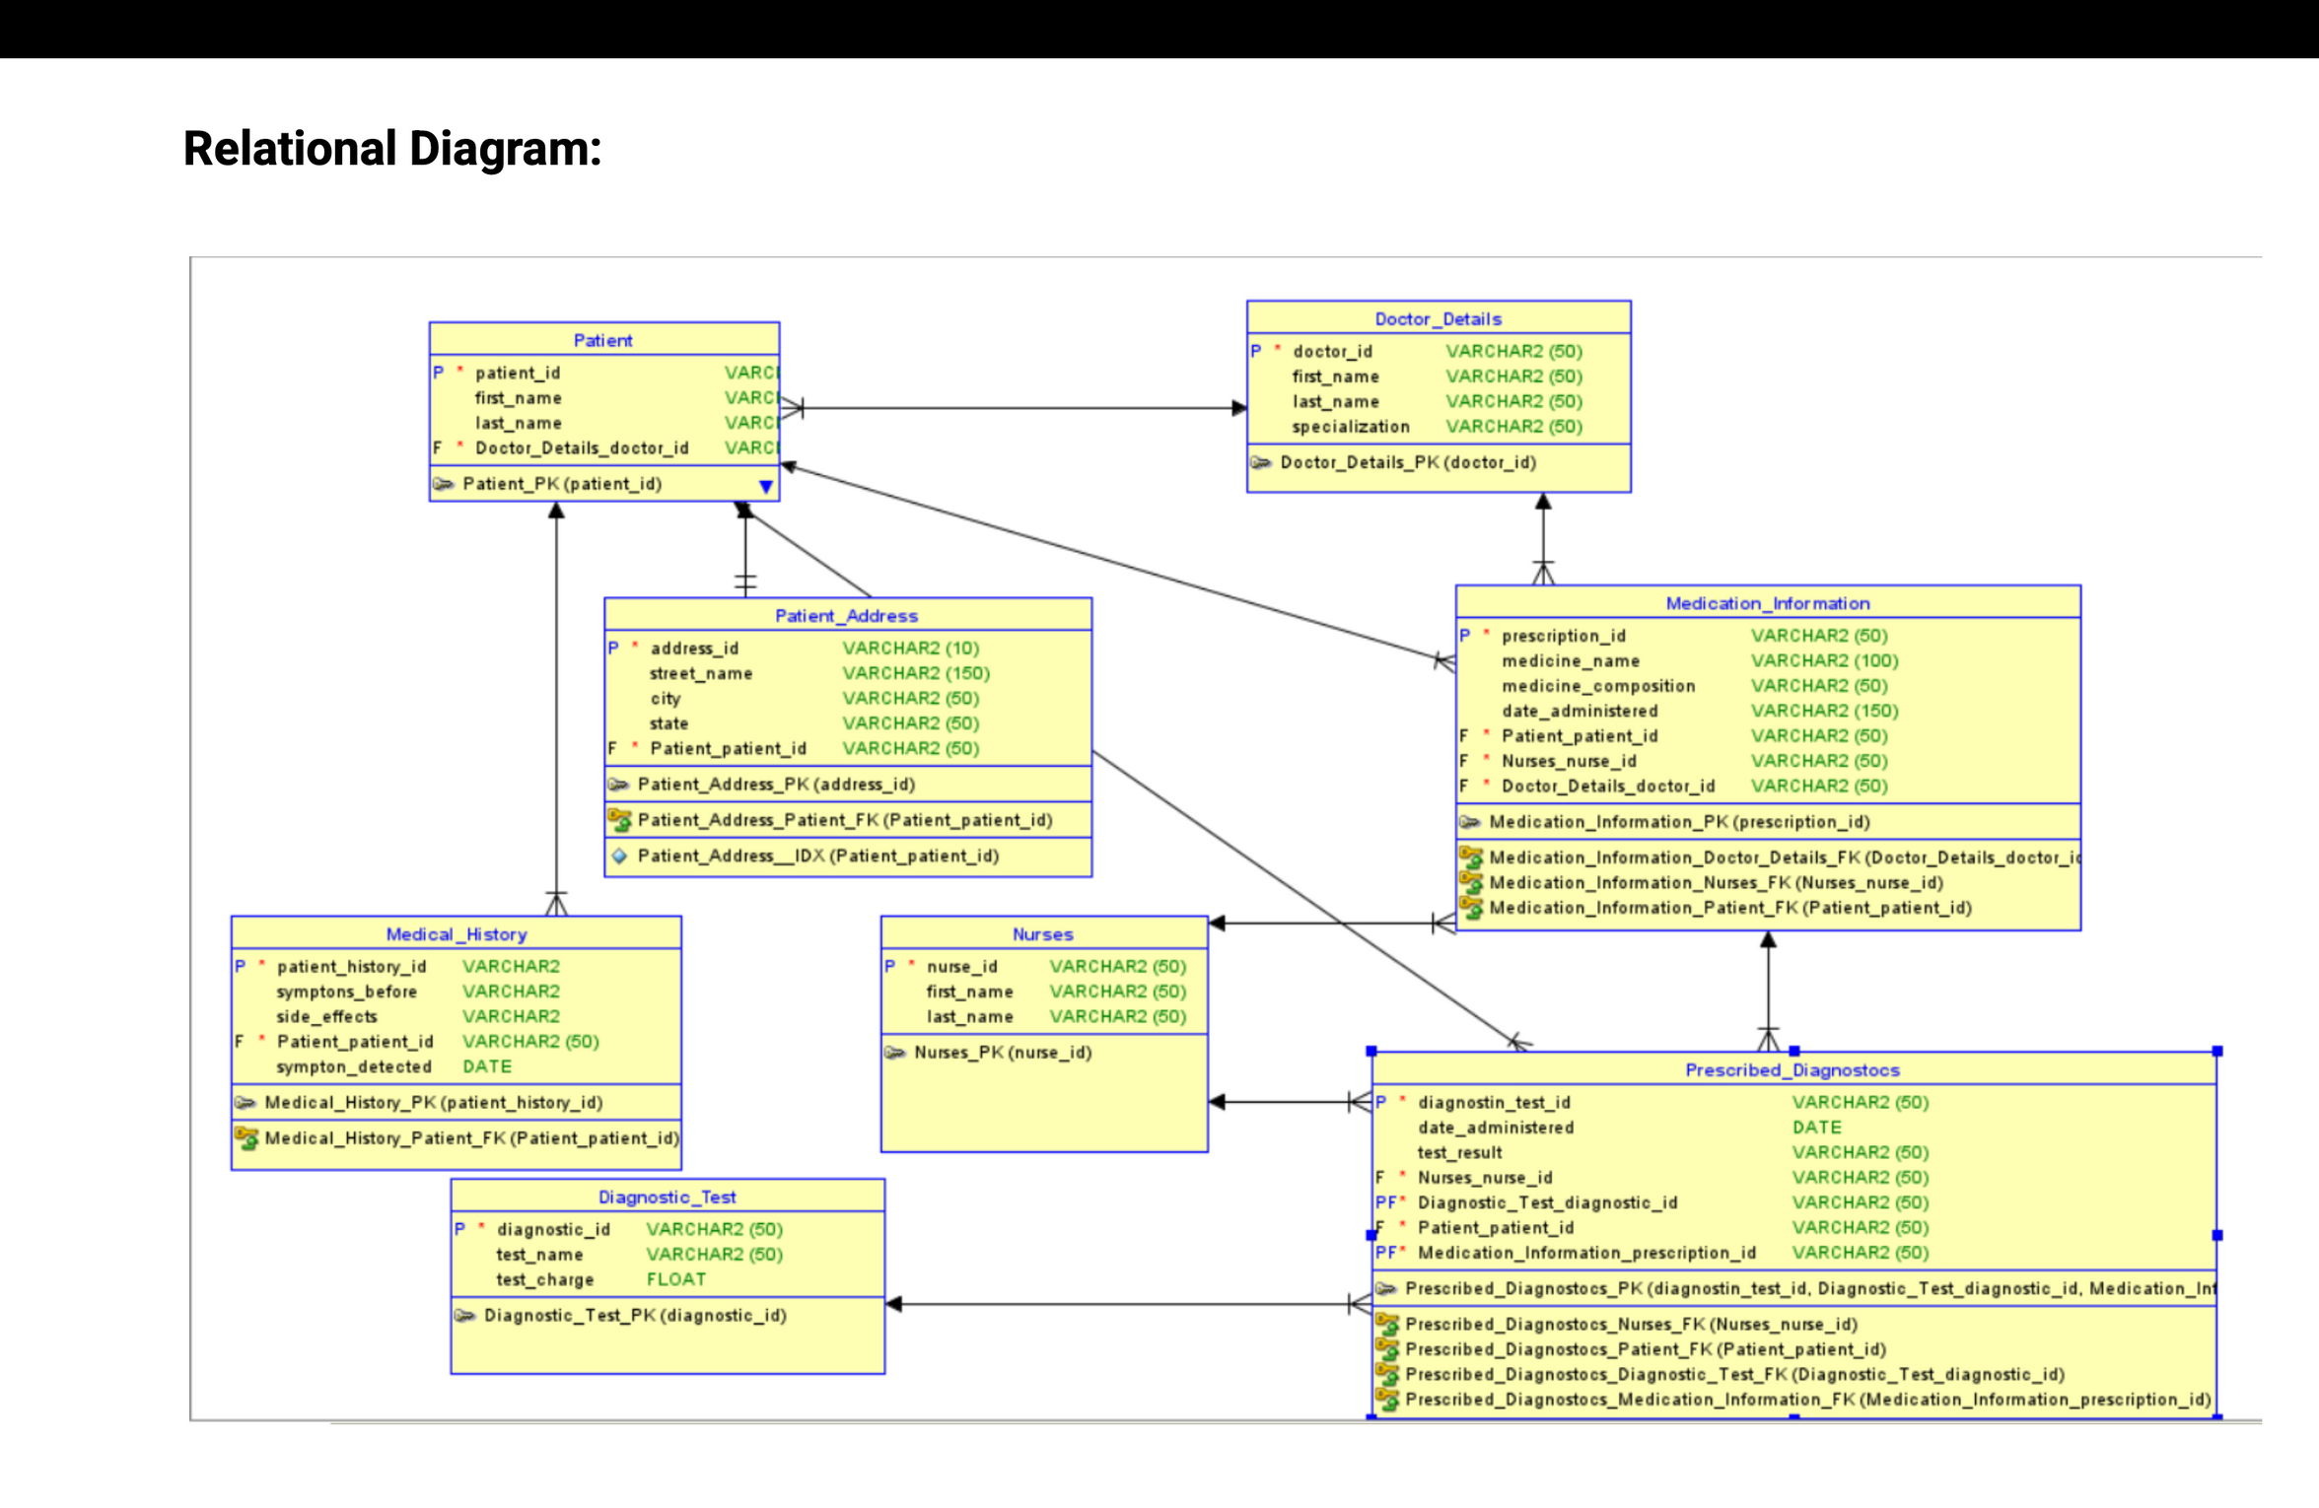

Slide 6
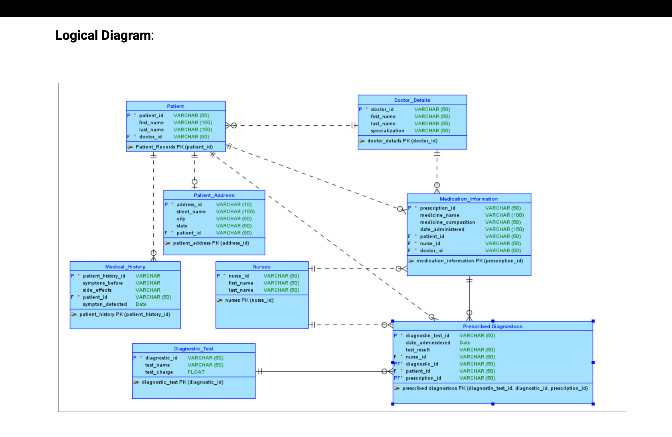

Slide 7

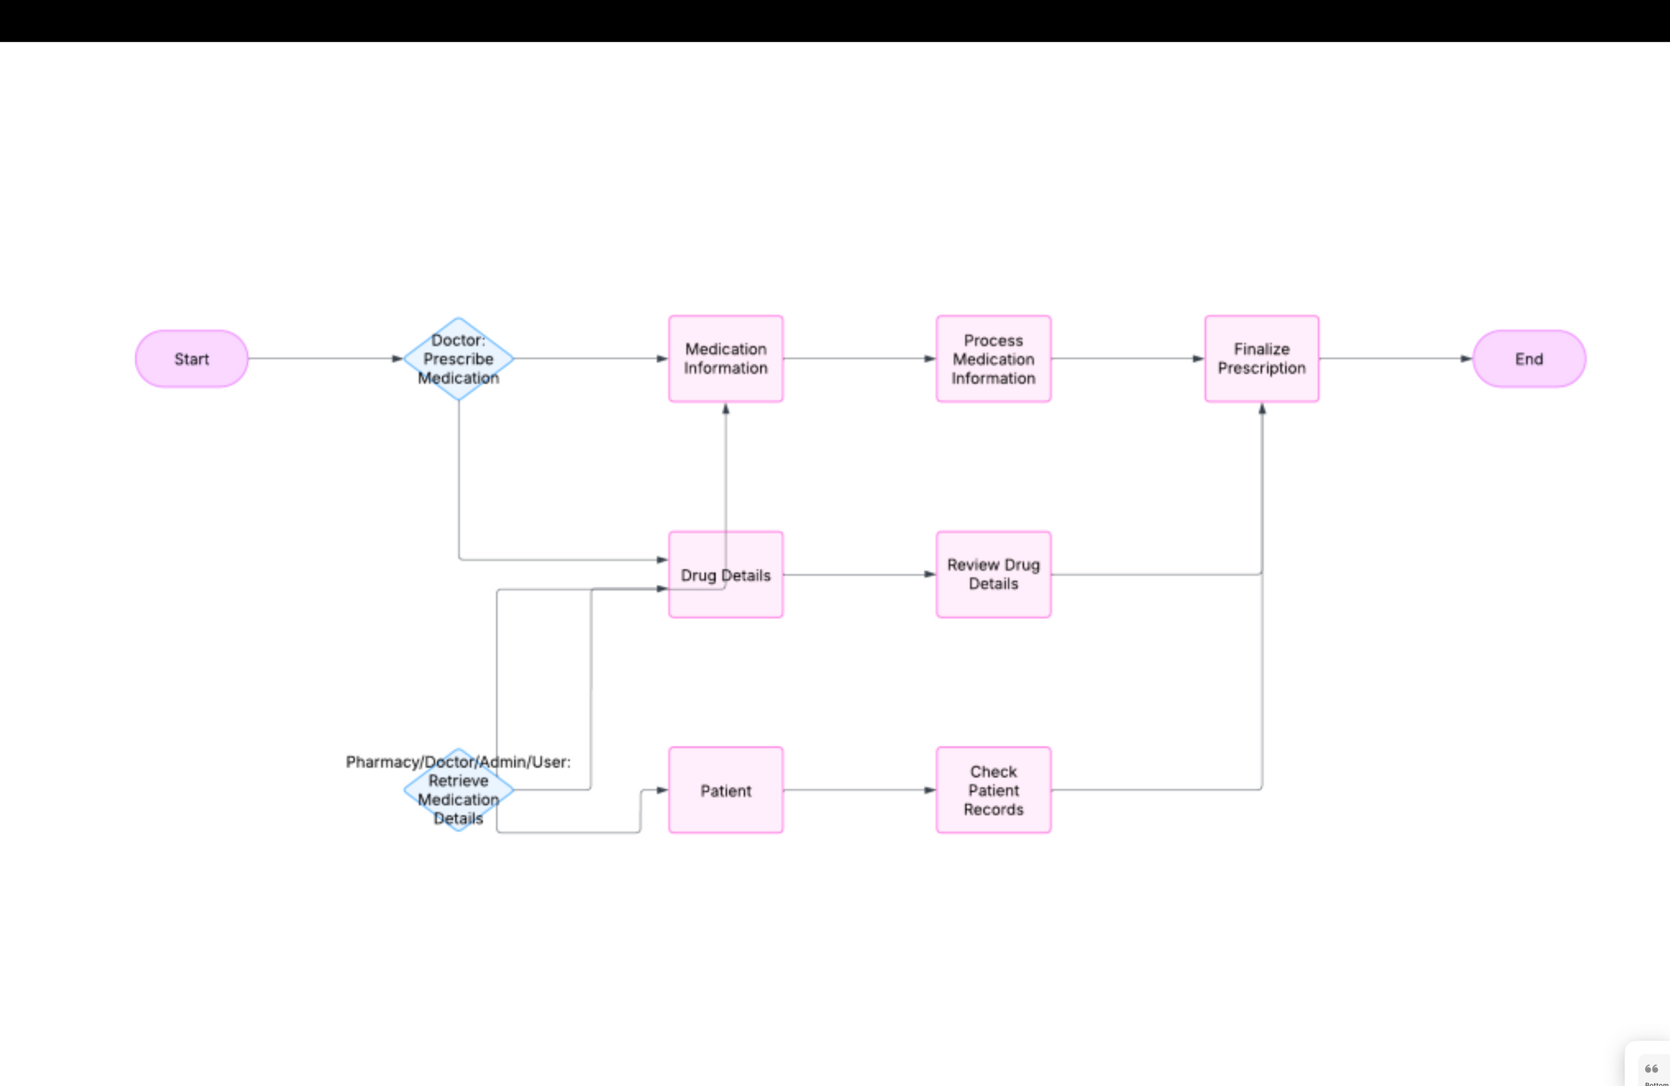
DOCTOR-PATIENT-DRUGS FLOW:

Slide 8
LET’S PROCEED TO THE DEMO DATA
THANK YOU!

