Slide 1





Web Scraping,
SQL Insights &EDA
Objective
Tools used
Extract book data, generate insights, and perform data visualization.
Jupyter Notebook, MySQL Workbench
Language used
Python, SQL
Data Source
Project Members
http://books.toscrape.com/
Tanmay Manna
Diya Shah
Prince Raj Gupta

Slide 2
Key Steps
Step 1: Web Scraping using requests, BeautifulSoup
Step 2: Data Cleaning and Preparation
Step 3: SQL-based Analysis using MySQL
Step 4: Exploratory Data Analysis (EDA)
Step 5: Visualizations with matplotlib and seaborn

Slide 3
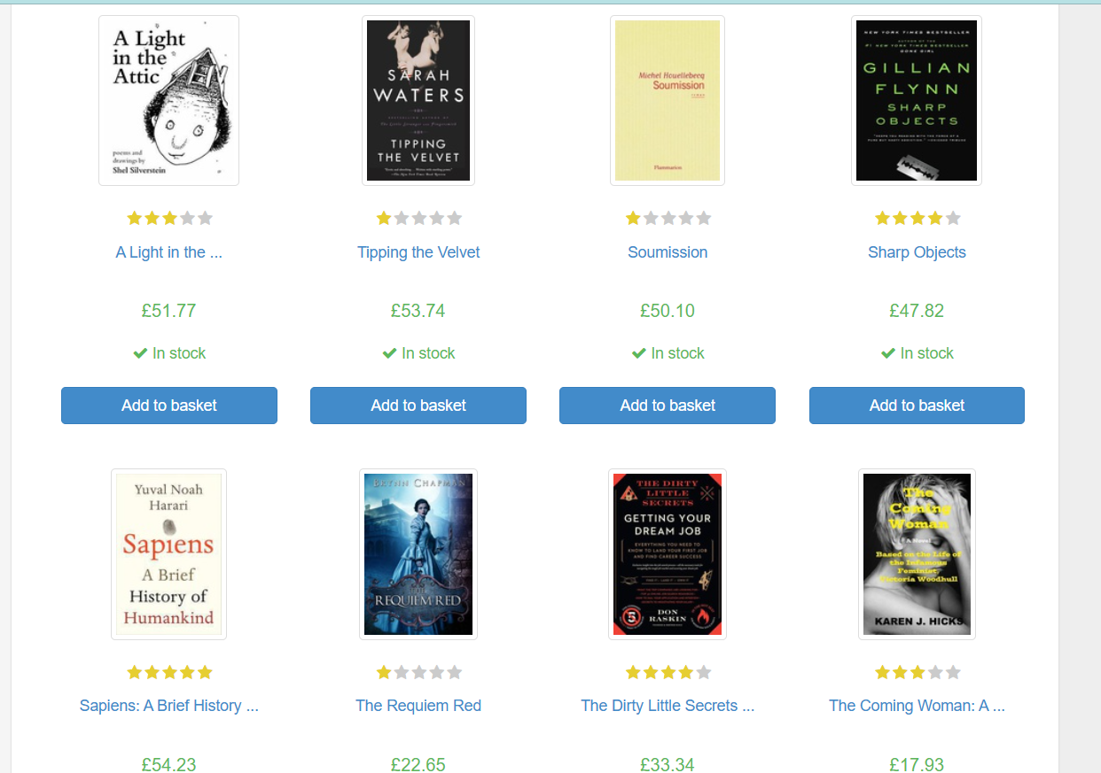
Web Scraping with Beautiful Soup
1
Target Elements
Identify book titles, prices, ratings.
2
Extraction
`find_all()` to get book titles.
3
Pagination
Scrape data from multiple pages.

Slide 4
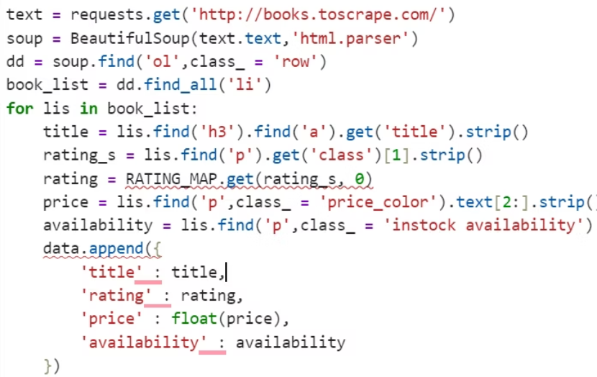
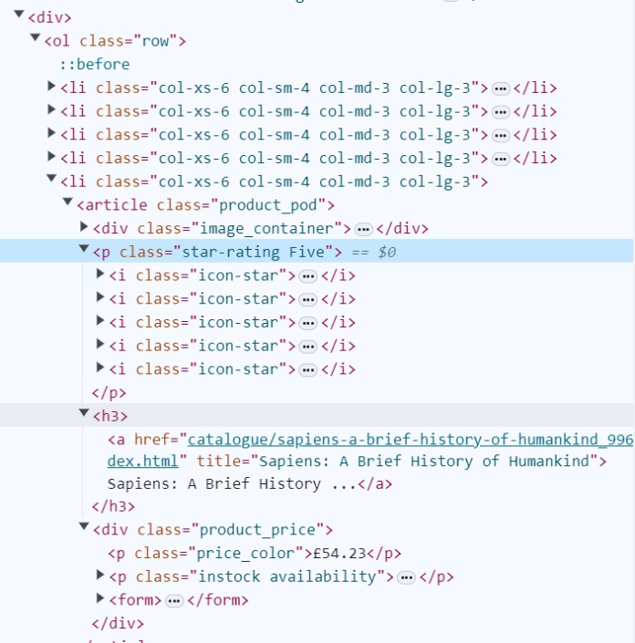
Python code to find views
Inspecting html elements

Slide 5
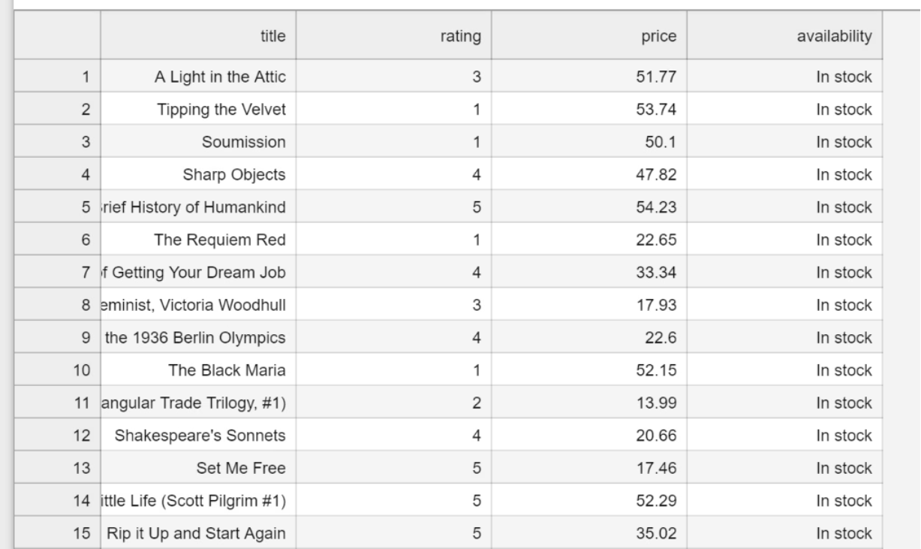
CSV file output after Scraping

Slide 6
Setting Up the SQL Database
SQL Database
Table Schema
MySQL Workbench
CREATE DATABASE bookstore
Library used :
Database Connection
pymysql
Between Jupyter Notebook and MySQL Workbench
mysql-connector-python
mysql.connector

Slide 7
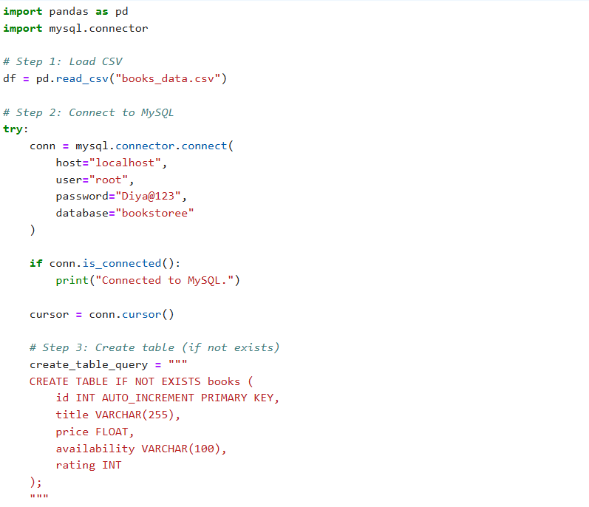
Jupyter Notebook python code for push the table data to MySQL Workbench bookstore database

Slide 8
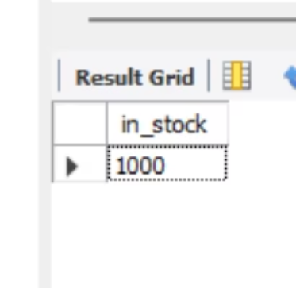
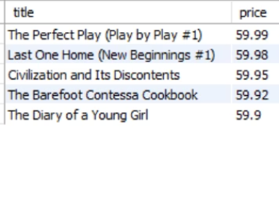
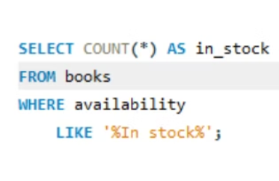
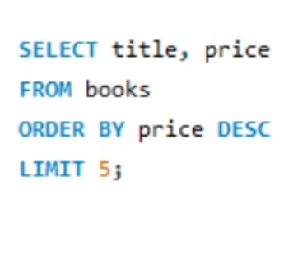
SQL Queries for Data Insights
The number of books available in stock
Query Output
List the top 5 most expensive books
Query Output

Slide 9
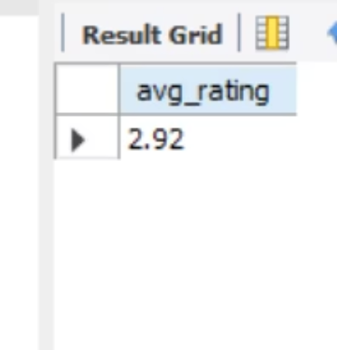
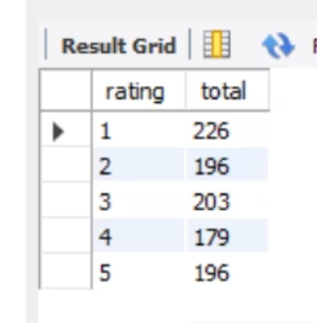
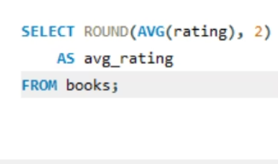
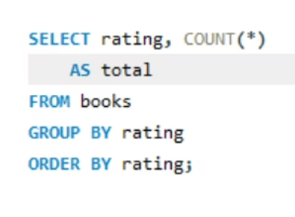
SQL Queries for Data Insights
The average rating of books
Query Output
The total number of books for each rating (e.g., 1-star, 2-star, etc.)
Query Output

Slide 10



Exploratory Data Analysis (EDA)
2
Read CSV file
Using pd.read_csv function
Importing Libraries :
pandas
1
matplotlib.pyplot
Data Analysis
3
With data visualization

Slide 11
EDA Key steps
Price distribution across all books.
Ratings frequency.
Availability overview.
Highlight outliers and patterns.

Slide 12
Data Visualizations
Bar plot: Number of books by category
Boxplot: Price distribution by rating
Pie chart: Availability status
Line/Histogram: Price distribution

Slide 13
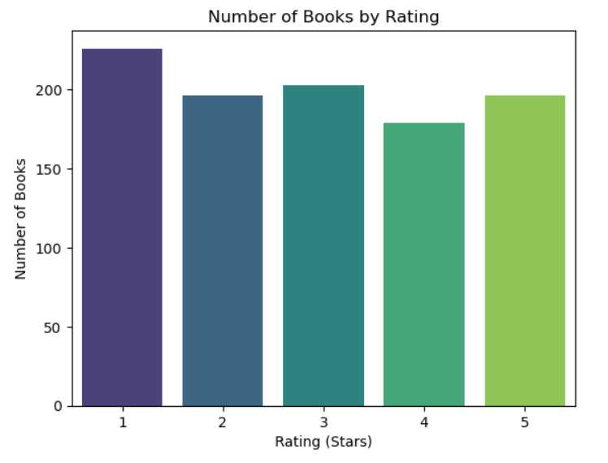
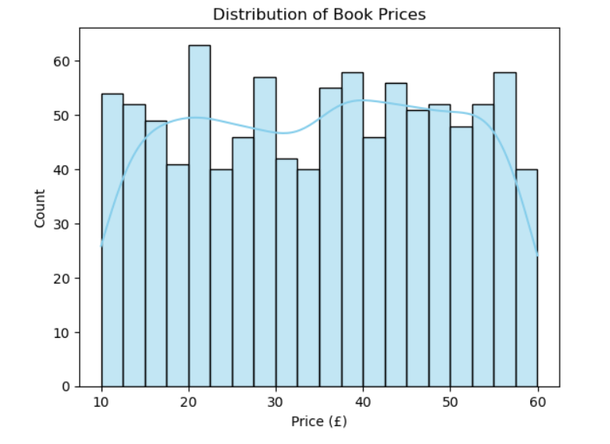

Slide 14
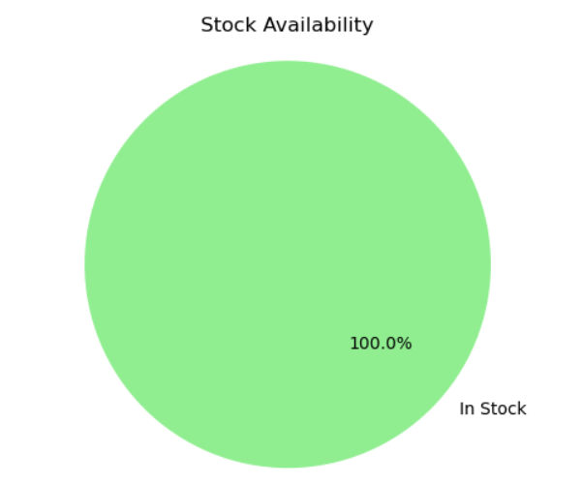
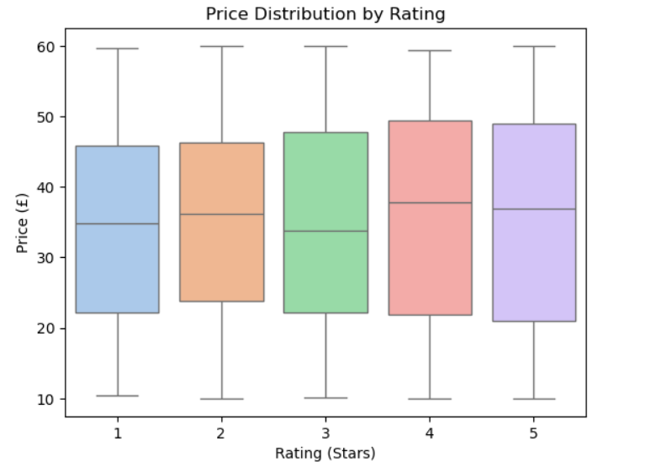

Slide 15
Outcomes and Findings
Majority of books priced under £30.
Most books have a 1 and 3-star rating.
Data shows full availability.
4 and 5-star rating books have higher price distribution.

Slide 16
Thank you

