Slide 1
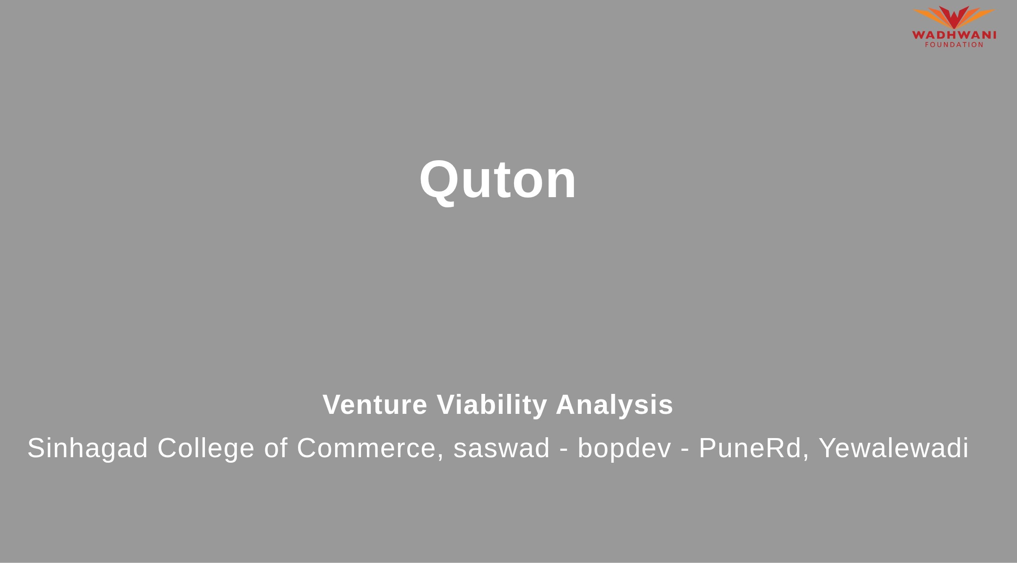

Slide 2



WA D H WA N I
We create customizable QR menus with interactive themes and silent staff alerts.
Sinhagad College of Commerce, saswad - bopdev - PuneRd, Yewalewadi

Slide 3


Slide 4
Problem Statement
WA D H WA N I
F O U N D A T I O N

Slide 5




Problem Statementflndustry
WA D H WA N I
Problem Being Solved
Supporting Data
this startup solves the problem of having to print-reprint
physical menus in restaurants and gives them a digital alternative for ordering food by scanning the QR code provided on the table and the menu can be updated in real
time
Digital menus reduce ordering errors by 30—45% and cut wait times by 20%, by ordering from QR codes.
Source: restaurants within Klang Valley, employing the Technology Acceptance Model (TAM) in 2024.
Area
Business Services
Industry
Social & Community Services
Domain
Community Services

Slide 6




Problem Analysis
WA D H WA N I
Affected Stakeholders | Impact on Stakeholders | Root Causes | Personal/Team Connect
the issue where shortage of | if some staff assigned by the | unanswered miscellaneous | by making our menu
staff or properly trained staff | restaurant isnt paying | needs of customers which | systems online we fix a huge
delay the customer's orders | attention to the customer's | goes unnoticed by lhe staff | problem of causing
or dont attend to them when | request after they've placed | which can be fixed by an | disturbance to other people
they need it, it solves the | an order, because people | online method of connecting | who are dining in the same
problem of calling a staff in | just doesnt order one thing | with lhe customer which | restaurant as us, and this
the ambience of restaurant | and six still, they order | doesn't require much but just | method makes ii customer to
and gathering unwanted attention to lhe costomer which may result in bad impression on costomer's end, which isnt ideal for costomer satisfaction. | miscellaneous things afterwards which could get unnoticed by the staff and cause bad impression on restaurant's end to fix that we presend digital menus | a QR code scan. | staff contact seamless which further increases customer's trust and appreciation towards the place

Slide 7


Target Customer Segments
Primary
Mid-scale and premium urban dine-in restaurants.
Secondary
average working class

Slide 8



Customer Segment & Persona
WA D HWANI
F O U N D A T I O N
Primary Segment
Mid-scale and premium urban dine-in restaurants.
Persona
Secondary Segment
average working class
john
Age in years: 24 Location: Suburban Organizational Role:
{Persona's primary role}
(if applicable)

Slide 9
Customer Profile
WA D H WA N I
Education: College pass out
Shopping Preference: Mostly Online
Gender: Male
Comfort with Technology: High
Occupation: Works for a private company
Favourite Social Media: discord, youtube
Interests/Hobbies: Gaming and Entertainment
Favourite Offline Gathering Spots: garden, restaurants, malls
Primary Source of Information: Other

Slide 10
Jobs-to-be-Done
WA DH WA N I
e
Functional JTBD
Emotional JTBD
Social JTBD
é-e
As an adult gets his order placed
As an adult - his little demands like water bottle or some extra soup were delivered to him without any delay of information transfer throug h customer and staff.
As an adult he avoided disturbing
without having to go throug h the
other people's peace who came to
hassle of calling the staff across the rOOm.
dine there.

Slide 11


Current Alternatives
WA D H WA N I
Current Alternatives
As an adult - his demands on the table are being catered on without any problem of communication with the staff.
Gaps in Current Alternatives
physical menus do not serve any purpose other then being there and assist the diner with the order and that's all there is, but digital menus can do so much more then just serve as a guide to the food menu, which is calling for staff for any kind of assistance around the order and much more.

Slide 12
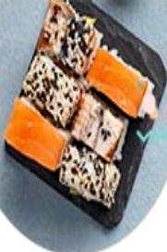
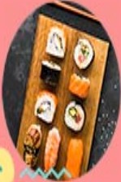

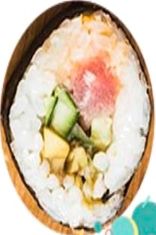
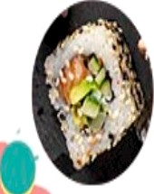
Our Solution
WA D H WA N I
F O U N D A T I O N
Solution
Dynamic Theme-Adaptive Menus — Implement interactive QR menus with customizable visual themes tailored to diner preferences and venue ambiance, while enabling seamless, silent staff requests.

Slide 13



Solution Design
WA D H WA N I
Our Sol ution | Key Features | Uniqueness
Dynamic Theme-Adaptive Menus — | Features include toggleable visual | Proprietary dynamic the ming engine
Implement interactive QR menus | UI themes, silent staff alerts (for | paired with discrete one-tap staff
with customizable visual themes | water, bill, etc.), real-time dish | paging, mood-curated food
tailored to diner preferences and | availability updates, allergen | recommendations, and zero-app
venue ambiance, while enabling | filtering, and mood-based menu | web accessibility via QR codes.
seamless, silent staff requests. | recommendations.
Solution Format:
Digital Service (Interactive QR Menu
Platform)
Core Technol ogies/ Methodo log ies:
Built us in g React.js and Tailwind CSS (theming), Node.js with Web Sockets (real-time staff alerts), Postgre SQL, and AWS.

Slide 14




Solution Benefits
WA D H WA N I
Functional
Benefits
Eliminate menu printing costs, update dish availability in real-time, instantly request staff without awkward waving, and safely filter menu items based on food allergies.
Emotional Benefits
Peace of mind regarding food allergies, relief from the social anxiety of flagging down busy staff, and delight in a personalized, modern dining experience.
Social Benefits
Enjoy uninterrupted conversations with dining companions without service disruptions, and impress peers or dates by effortlessly navigating a high-tech, premium dining vibe.
Macro Benefits
Eliminates paper and plastic waste from printed menus. It boosts restaurant economies through operational efficiency and protects public health by preventing severe food allergy emergencies.

Slide 15



Competitors
WA DHWAN I
Direct
Tabro, Menu360, QR Code Waiter, doXmenu FineDine, MenuVire, IAMenu, me&u
Indirect
Retekess, Syscall, Acrelec, Yodeck
Syscall, Global Payments Kiosks, JTECH, STRATACACH
Our UVP
Smart QR menus with silent staff alerts that eliminate restaurant printinq costs.

Slide 16





Competitors
WA D H WA N I
Direct Competitors
Tabro, Menu360, QR Code Waiter, doXmenu
Indirect
Competitors
Retekess, Syscall, Acrelec, Yodeck
Direct Competitors Globally
FineDine, MenuVire, IAMenu, me&u
Indirect Competitors Globally
Syscall, Global Payments Kiosks, JTECH, STRATACACHE

Slide 17
Macro Analysis
WA DH WA N I
Favourable Trends
AREA | DESCRIPTION
CIimate/Envi ronment | Rising eco-consciousness drives diners and eateries to cut paper waste via green digital menus.
Technot ogy | Widespread smartphone and QR adoption makes app-free mobile menu browsing a daily diner habit.
Unfavourable Trends
AREA | DESCRIPTION
Social | Diners increasingly reject QR-only menus as impersonal, feeling they shift labor onto the customer.
Demog rap hics | Older generations struggle with the tech gap of QR codes, risking alienating a key customer base.
Data Sources:
I based these trends on industry insights from the PYMNTS Intelligence and Paytronix "Digital Divide" report, as well as restaurant tech adoption data reported by Restaurant Dive and the National Rest

Slide 18

Back-of-the-Envelope Financial Projections |  |  |  |  |  | WA D | HWANI
Currency: Indian Rupee (INR)
Chosen Business Model: Subscriptions
AREA |  | YEAR 1 |  | YEAR 2 |  | YEAR 3
Revenues | 1200000 |  | 3600000 |  | 9000000
Total Expenses | 2500000 |  | 3010000 |  | 4000000
PFOGt | -1300000 |  | 590000 |  | 5000000

Slide 19
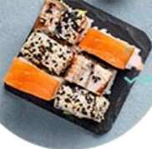

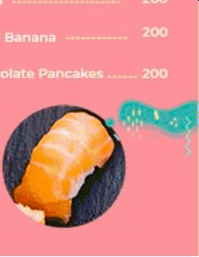
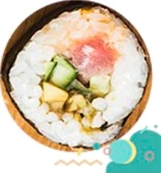

Prototype
WA D H WA N I
Prototype Format
An interactive web app prototype built in Figma to simulate the mobile
browser experience.
Functionality included in the Prototype
The prototype includes QR scanning to access a theme-adaptive digital menu, a silent staff alert button for diners, and a restaurant dashboard for real-time menu updates.
(Upload another picture}
Functionality NOT included in the Prototype
It will exclude live payment gateway integration, synchronization with existing restaurant POS systems, and advanced customer analytics to focus purely on the core menu experience.

Slide 20
Revenue Models / Pricing
WA D H WA N I
Revenue Model (Primary)
Saas (So ftwar e as a Se rvi c e) Mo de I
Revenue Model (Secondary)
Adve rtis ing M odel

Slide 21









Lean Canvas
WA D H WA NI
Problem traditional menus aren't bad but they can be better | Solution Dynamic Theme-Adaptive Menus — Implement interactive QR menus with customiz abl e vis uat the mes tailored to diner preferences and venue amb ian ce, whiIe en abling seam less, sit ent staff requests. | Unique value ProPosition Smart QR menus with silent staff alerts that eliminate restaurant |  | Unfair Advantage Proprietary theme-adaptive UI technology and high switching costs generated once restaurant waitstaft rely on our integrated silent alert system. | Customer Segment Mid-scale and premium urban dine-in restaurants. ,averag e
with the help of current |  | printing costs. |  |  | working class
technology
and make the
customer experience even better.
 | Key Metric |  |  | Channels
 | Monthly Recurring Revenue |  |  | Direct — via our Quton web
 | (MRR), Restaurant Churn |  |  | platform for seIf-serve
 | Rate, Customer Acquisition |  |  | onboardi ng. FieId Sat es —
 | Cost (CAC), Daily QR Menu |  |  | direct B2B outreach to
 | Scans, and Ad Click-Th rough Rates. |  |  | restaurant owners.
Cost Structure Platform development, cloud server infrastructure, core team salaries, and marketing mater ials (like physical NFC table standees) for customer acquisition. |  |  | Revenue Streams Saas (Software as a Service) Model, Advertising Model

Slide 22
Financials
WA D H WA N I
Revenue
Models/Streams
•Saas (Software as a Service) Model
•Advertising Model
Pricing
•Unit of Sale: MonthIy subscription
•Selling price per unit: T2,000 per month

Slide 23
Revenue Models I Pricing
WA D H WA N I
Revenue Model (Primary)
Saas (Software as a Service) Model
Unit of Sale
Sal e Price per Unit
Expected units to be soId in Year 1
Expected growth in m onthIy sales
MonthIy subscription
T2,000 per month
20 subscriptions
15% per month

Slide 24
Costs & Revenues: Key Assumptions
WA D H WA N I
A
Category
Revenue
B
Metric / Assumption
D
1
Value
Notes /Description
Pfimary UfiÏt 0f Sale
PiceperUnt
Monté 1 Sales V0lrme Monthly GfowtL Rate
Secondary Revenue
Monthly Subscription
f2000
20 suLscripti00S
SaaS lee per restaurant
Recurringm0î lee
Active restaurants at lames
6
15% Monté-over-m0ntL sales growtL Sponsored ad placement (Brands)
T500 per ad
Costs (Year 1)
SetupC0Us(One-Time) ?4,00,000
Plaäorm dev, initial brandinç Sâlaries, c0re cl0ud seners NFCsandeessewerscaing
10
Ü edC0SS(Annua) VafabeC0sS(Anccal
f18,00,000 f3,00,000

Slide 25


Profit & Loss Projections: Summary |  |  |  |  |  | WA | D | H | WA | N | I
 | ¢âtgğ0f} |  | Y0ar 1 | Year 2 | Year 3
! | TOtalRevenue(SaaS+ Ads) |  | 111,90,990 | ltt,90,999 | 19t,90,099
* | Vafİâ#It | 0Sîs(0nb0âf#İ5g, Sener scaling) | 11,00,000 | (7,00,000 | 1It,00,000
* | Fixed ¢0sts(Salaries, ¢0re infrastructure) |  | 118,00,000 | It1,00,000 | 110,00,000
* | Setup ¢0sts(One-tinedevl#randing) |  | 14,00,999 | IO | 19
s | T0taI Expenses(Fixed + Setup) |  | 111,00,000 | t11,00,000 | 110,00,000

Slide 26










Performance & Break-Even Analysis
WA D H WA N I
F 0 U M D A T 1 O N
Year 1 Revenues
T12,00,000
Gross Profits for Year 1
T9,00,000
Net Profits for Year 1
-T13,00,000
Break-even Month
Month 18

Slide 27


WA DH WAN I
F 0 U N D A T 1 0 N
Than
You!

