Slide 1

OFFLINE SEMANTIC SEARCH BROWSER EXTENSION
Department of Computer Science and Engineering
(Submitted to: Ms. Pooja Kumari)
Group Members
Name of Member | Roll Number | Role
Varun Attri | 2401331690064 | Project Lead & Documentation Head
Md. Sami Khan | 2401331690036 | Technical & Development Lead
Tanmay Singh | 2401331690056 | Design & Presentation Lead

Slide 2

Index
Introduction
Existing System
Problem Statement
Proposed Methodology
Flowchart and ER Diagram
Hardware and Software Requirements
Results and Conclusions
References

Slide 3
Introduction
In the digital world, a large amount of data is available in the form of webpages, PDFs, and documents. Finding relevant information quickly is a major challenge. Traditional search systems rely on keyword matching, which cannot understand the actual meaning of user queries.
Semantic search improves this by understanding context and intent using AI techniques.
Matches meaning instead of exact words
Provides more accurate and relevant results
Proposed system works offline using a lightweight model
Ensures fast performance and data privacy

Slide 4
Existing System
Different types of search systems are currently used to retrieve information. Keyword-based systems are simple and fast but fail to understand context. Cloud-based semantic search systems provide better accuracy but depend on internet connectivity.
Keyword search: fast but limited
Cloud-based search: accurate but not offline
Database search: works only on structured data
Limitations:
No semantic understanding in basic systems
Internet dependency in advanced systems
Privacy and cost issues

Slide 5
Problem Statement
Most existing systems either lack intelligence or depend on external services. Users often receive irrelevant results due to differences in wording. Cloud-based solutions solve this problem but introduce new challenges.
Inaccurate results in keyword search
Dependency on internet connection
Privacy risks due to data sharing
High computational requirements
Objective: To develop a system that provides offline, fast, and accurate semantic search while ensuring user privacy.

Slide 6
Proposed Methodology
The proposed system follows a structured approach to perform semantic search efficiently. It processes data step-by-step and stores it locally for faster retrieval.
Extract text from webpages and documents
Clean and preprocess the data
Split text into smaller chunks
Convert text into embeddings using AI model
Store embeddings in local database
Convert user query into embedding
Compare similarity using cosine similarity
Display ranked results

Slide 7
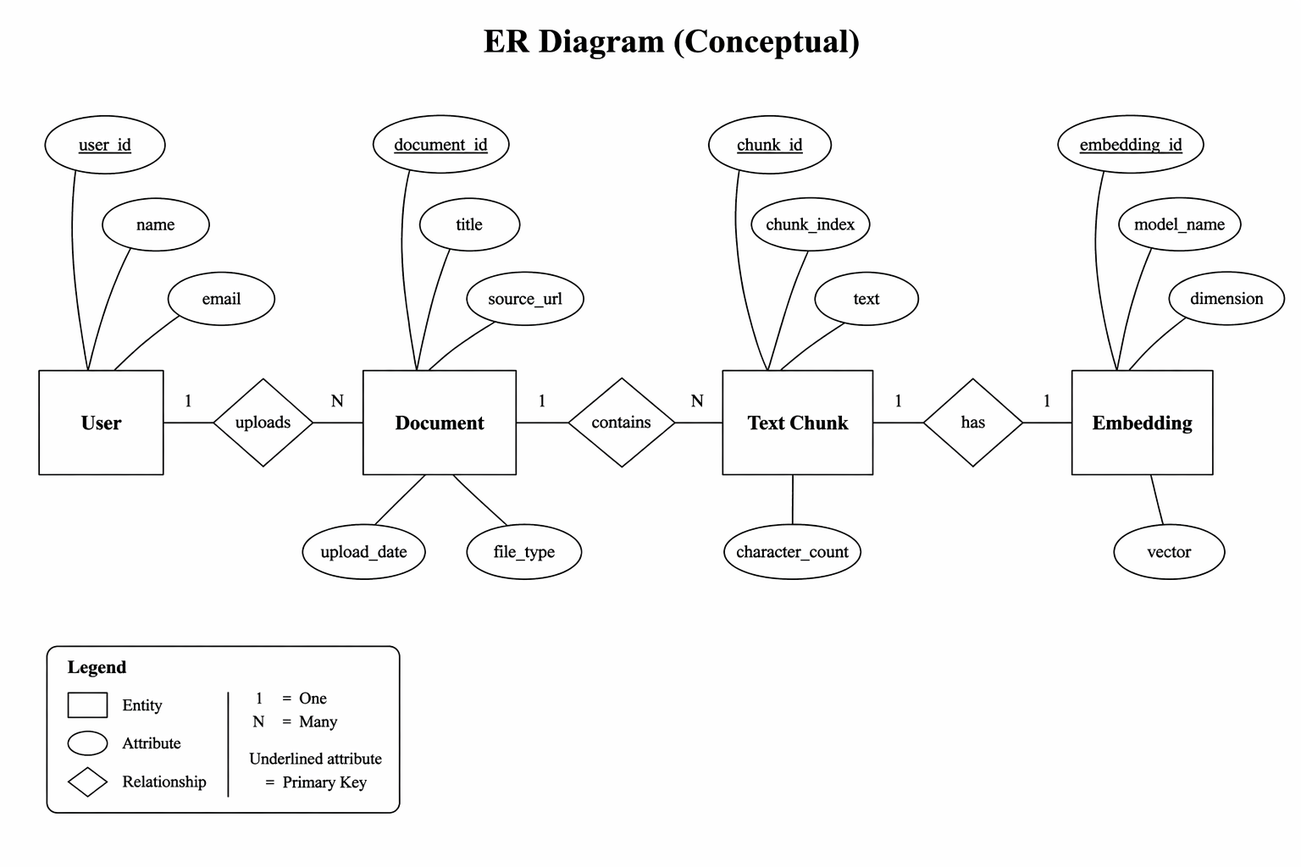
ER Diagram and Flow Chart
ER Diagram :

Slide 8
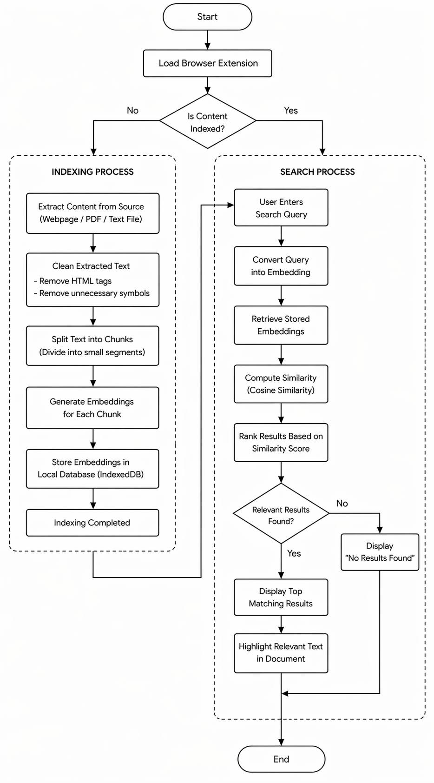
Flow Chart :

Slide 9
Requirements
The system requires basic hardware and commonly used software tools for development and execution.
Hardware:
Minimum 4GB RAM (8GB recommended)
Intel i3/i5 processor
Sufficient storage space
Software & Tools:
VS Code, Node.js
Chrome/Edge browser
JavaScript, React
ONNX Runtime, IndexedDB

Slide 10
Results & Conclusion
The system successfully performs semantic search without internet dependency. It provides accurate and fast results by understanding the meaning of queries.
Fast response time (less than 1 second)
Works completely offline
Accurate and relevant results
Ensures user data privacy
Overall, the project demonstrates an efficient and practical solution for modern search needs.

Slide 11
References
[1] T. Reimers, I. Gurevych, "Sentence-BERT: Sentence Embeddings using Siamese BERT-Networks", Proceedings of the 2019 Conference on Empirical Methods in Natural Language Processing, 2019.
[2] J. Devlin, M. Chang, K. Lee, K. Toutanova, "BERT: Pre-training of Deep Bidirectional Transformers for Language Understanding", NAACL-HLT, 2019.
[3] OpenAI, "Embedding Models for Semantic Search", OpenAI Documentation, 2023.
[4] Microsoft, "ONNX Runtime: Cross-platform, High Performance ML Inference and Training Accelerator", Microsoft Documentation, 2022.
[5] Mozilla, "IndexedDB API", MDN Web Docs, 2023.
[6] Mozilla, "Browser Extensions (WebExtensions API)", MDN Web Docs, 2023.

Slide 12
Thank You

Slide 13
Feedback from the Panel
The panel wants the team to :

