Slide 1
Stackoverflow answer time prediction
Team Members: Abhishek Madan (011408969)
Gaurav Misra (011449815)
Tanmay Bhatt (011499072)
CMPE 255
Professor David Anastasiu

Slide 2
Introduction
Background and Problem:
Stackoverflow is a platform where you can ask programming questions...But how long does it take to get a good answer???
So what’s the solution?
Using Regression to Predict the approximate time for getting a good answer

Slide 3
Data gathering
Google Cloud Platform - BigQuery Stackoverflow Dataset
14 million records in total
7 Million Questions with ‘Accepted answers’
We used Bigquery to join ‘posts_questions’ and ‘posts_answers’ and projected required columns to S3 Bucket.
https://bigquery.cloud.google.com/dataset/bigquery-public-data:stackoverflow?pli=1

Slide 4
Data preprocessing
Calculating the Time it took to receive accepted answer for questions by taking difference between ‘Accepted_answer creation time’ and ‘Question Creation time’
Storing Question Titles and Question Tags in Pandas Dataframe for generating feature vectors.
Storing Time-difference in Pandas Dataframe as Labels.
Separating list of tags.
Using Stemming, Lemmatization and NLTK libraries for removing Stop words and cleaning the data.

Slide 5
Data preprocessing
Calculating Word Frequency Distribution Matrices for Question Titles and Question Tags.
Generating training dataset vectors by appropriately weighting the vectors of Questions Title and Question Tags for each record and merging them together.
Final processed data generated was following:
Combined Question Titles and Tag Feature Vector matrix
List of Time differences

Slide 6
Training...Linear SVR
Goal:
find a function f(x) that has at most ε deviation from the actually obtained targets yi for all the training data.
For a linear kernel the model should be as flat as possible.
Dataset:
The data set for SVR was limited to 150,000.
Parameters:
Kernel : Linear , C: 1.0
Validation:
10fold validation was used to measure the accuracy.

Slide 7
Training...KNN
Goal:
Finding K-nearest neighbors of test record
Returns the proportion of highest proportion.
Dataset:
The data set for SVR was 2 million record
Parameters:
k=3, assigning weights based on distance
Validation:
10fold validation was used to measure the accuracy.

Slide 8
Training...PassiveAggressive
Goal and motivation:
Based on Large scale learning
Doesn’t require a learning rate
Dataset:
The data set for 2 million records
Parameters:
Epsilon = 0.1, Step-size = 1 (Regularization parameter)
Validation:
10fold validation was used to measure the accuracy and mean squared log error.

Slide 9
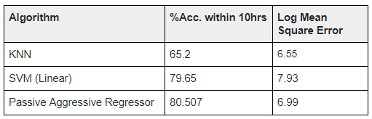
Prediction
All the Test records were predicted based on all 3 training models and were compared against actual time difference.
Average accuracy and average Mean Squared Log Error achieved from running 10 fold validations were as per following:

Slide 10
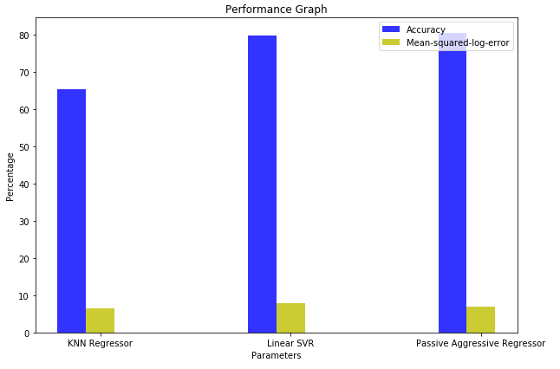
Evaluation
Our evaluation criteria was to use an average of 10 fold validation results for accuracy and Mean Squared Log Error.

Slide 11
Thank you

