Slide 1

Team Details
Team Name : FFDC
Team leader name : Vaidik Pandey
Problem Statement : Predict and Prevent - Use AI to foresee and mitigate issues, optimising efficiency and impact.

Slide 2
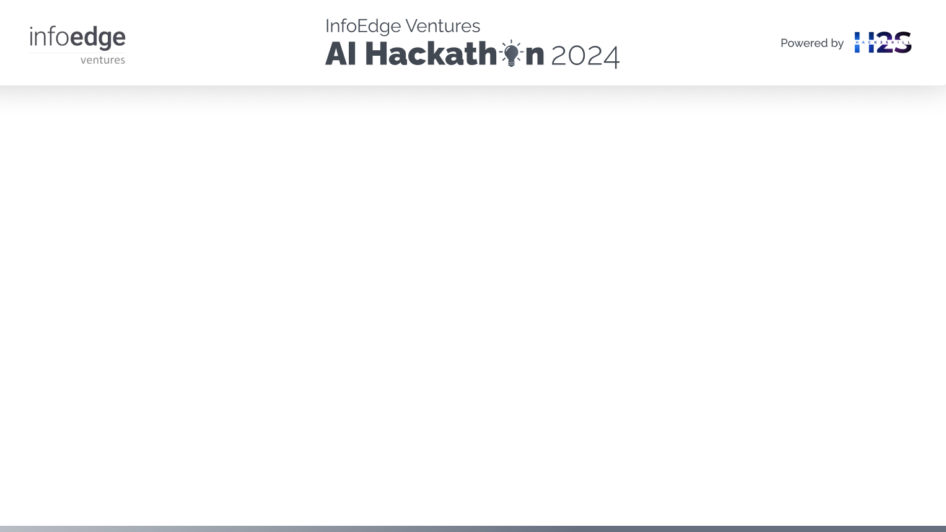
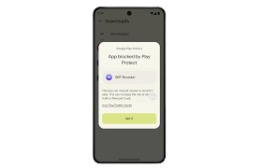
Brief about the idea
The detection of financial fraud is an area of paramount interest to any financial institution, business, and every consumer. It involves identifying and preventing such frauds as fraudulent activities, credit card fraud, insurance fraud, and money laundering. Machine learning and deep learning are powerful tools in enhancing the efficiency of fraud detection systems.

Slide 3
Brief about the idea
SMOTE + XGBoost Classifier
Collect historical financial data and categorize them as either fraud or non-fraud.
Employ the SMOTE technique to increase the number of minority fraud data points to an ideal ratio.
Utilize the XGBoost classifier to identify patterns within the data.
Validate the model by testing different sets of hyperparameters through grid search to determine the most effective parameters.
Evaluate the top model on the test data.
Implement the model on Render for customer access.
Autoencoders for Anomaly Detection
Utilize the labeled data (excluding SMOTE) to differentiate between non-fraudulent and fraudulent data based on the labels.
Employ the Keras API in TensorFlow to train an autoencoder neural network.
Utilize the reconstruction error to distinguish between fraud and legitimate transactions.
Visualize the distribution of the reconstruction error for fraud and valid data to estimate the threshold visually.
Adjust the threshold incrementally from 0 to a specific value to compute precision, recall, and F1 score.
Graph the precision, recall, and F1 score against the threshold to identify the optimal threshold and comprehend the balance between precision and recall.
Implement the model to detect fraudulent transactions and prevent them proactively.

Slide 4
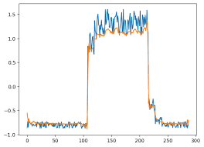
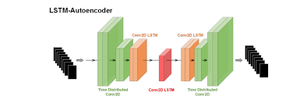
How will it be able to solve the problem?
XGBoost: Being a highly optimized algorithm, XGBoost can be easily trained and retrained on newly arrived data in case of data drift in the future. This makes it possible to constantly improve and monitor the performance of the model.
Autoencoder: As a neural network technique, the autoencoder can generalize the data to improve performance and reduce the chances of false positives.
Best Model: The best model, whether it be XGBoost, the autoencoder, or the transformer, can be deployed on the platforms handling transactions. This model can warn and possibly block transactions flagged as fraudulent by our system, thus avoiding fraud before it happens.

Slide 5


Feature of FFDC
Mapping of transactions using labels as fraud or normal transactions.
A pipeline to monitor transactions on financial platforms and block suspicious transactions.
Ability to implement one pipeline for various classes of financial transactions given a dataset containing transaction data of various types.
Graphical representation of how the number of attempted and successful fraud cases have varied over time, providing insights into our solution's performance.

Slide 6
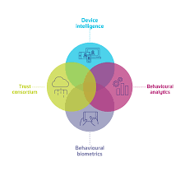
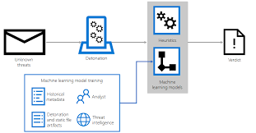
Process flow diagram or Use-case diagram

Slide 7
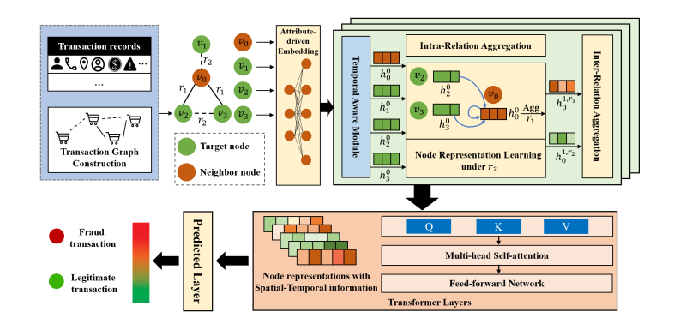
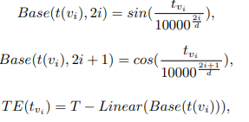
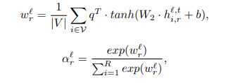
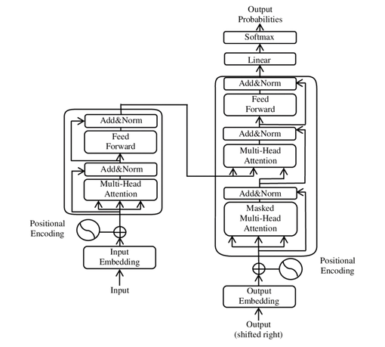
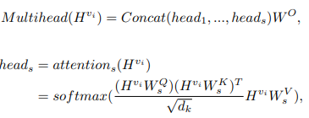
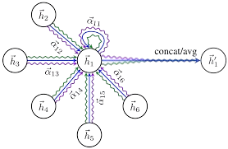
Spatial Temporal Aware Graph Transformer
Input Layer :
Graph Node Features : This layer processes the initial features of the nodes in the graph. It may include embedding layers to convert categorical features into dense vectors or normalization layers for numerical features.
Time Encoding: Adds temporal information to the node features, often through positional encoding or time-series embeddings to handle sequential data.
Activation Functions
Spatial Graph Attention Layer:
Graph Attention Mechanism: This layer leverages graph attention networks (GAT) to learn the importance of neighboring nodes for each node. It assigns different weights to different neighbors based on their features and the relationships (edges) between nodes.
Multi-head Attention: Multiple attention mechanisms are used in parallel to capture various aspects of the spatial relationships in the graph
Graphical Implementation
Temporal Attention Layer:
Self-Attention Mechanism: Applies self-attention to the sequence of node features to model temporal dependencies. Each node feature at a specific time step attends to all other time steps within the sequence.
Positional Encoding: Adds positional information to the sequence of features to help the model distinguish between different time steps.
Feedforward Network (FFN):
Dense Layers: Comprises one or more fully connected layers with non-linear activations to process the fused features and enable complex interactions between them.
Dropout: Applies dropout for regularization to prevent overfitting.

Slide 8

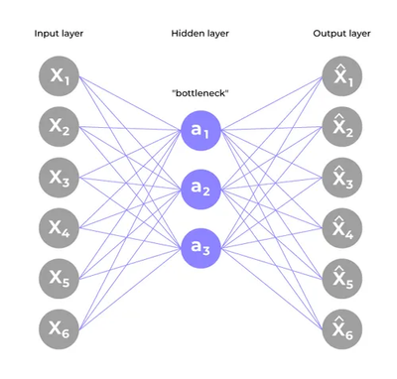
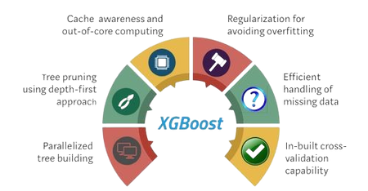
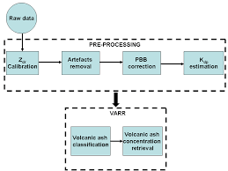
Technologies to be used in the solution
Machine Learning
XGBoost Classifier: An efficient and scalable implementation of gradient-boosted decision trees designed for speed and performance. It is used for identifying fraudulent transactions based on historical labeled financial transaction data.
Deep Learning
Autoencoders: A type of artificial neural network used for unsupervised learning. In this solution,
autoencoders are employed to map input data to labels,
identifying whether a transaction is fraudulent or genuine.
The model provides probabilities indicating the likelihood of each transaction being fraudulent.
Custom Transformer Architecture
A scalable transformer model specifically developed for this solution to handle large volumes of financial transaction data efficiently.

Slide 9
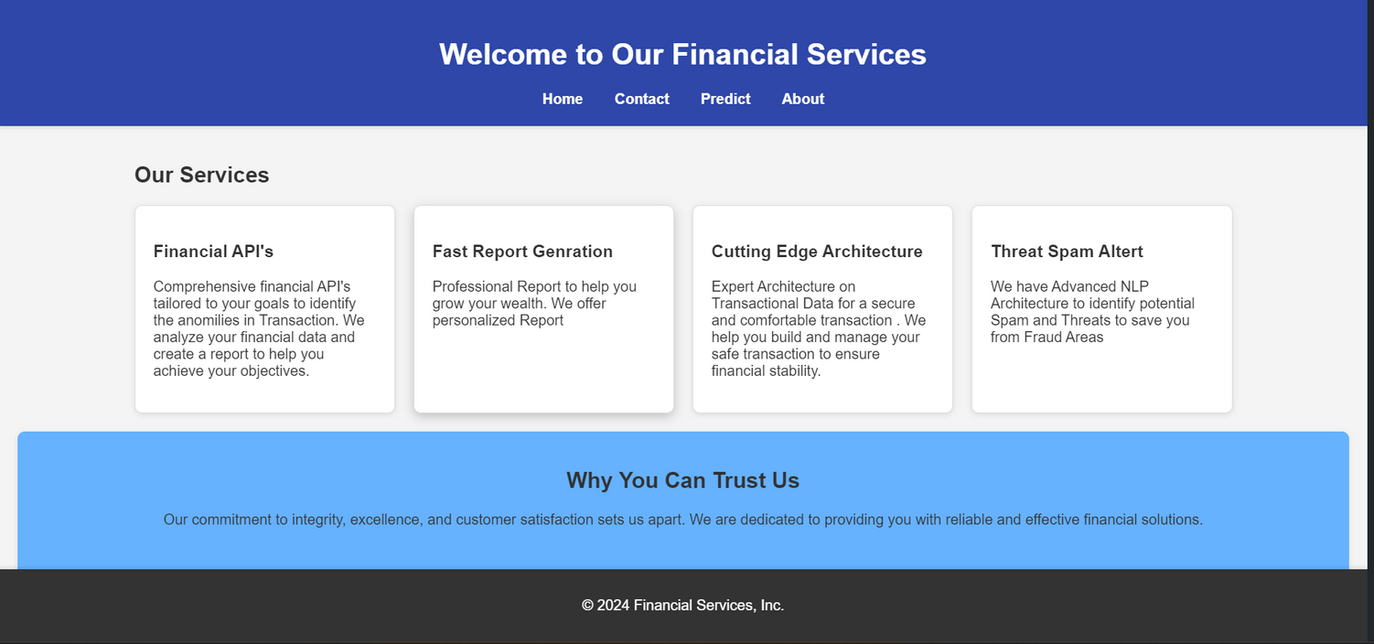
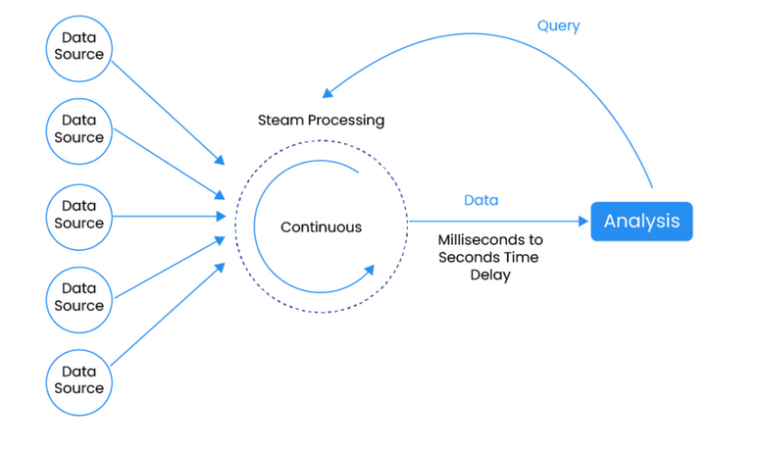
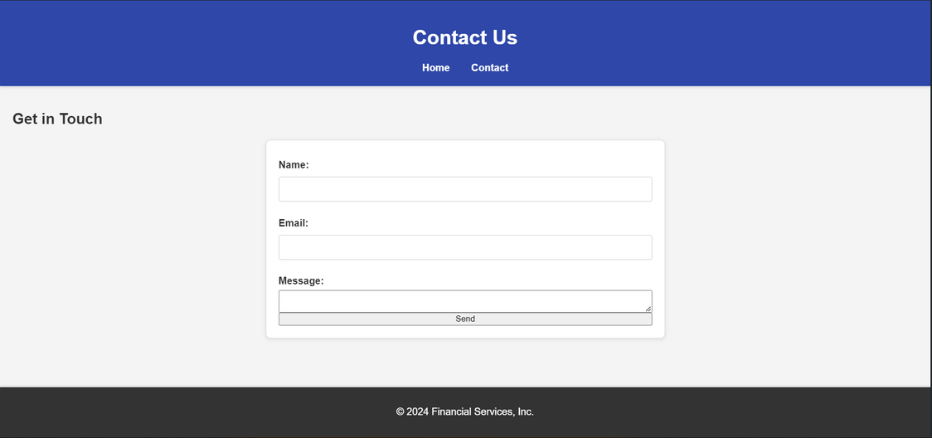
Snapshots of the prototype
Access it here
https://financial-fraud-detection-hackathon01-5.onrender.com

Slide 10

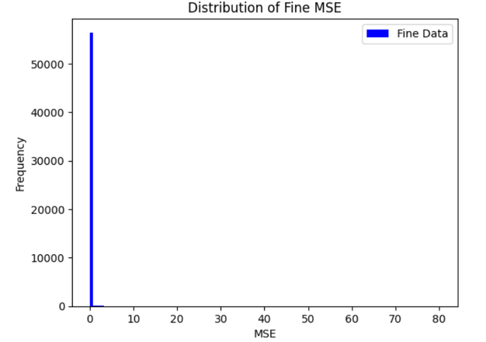
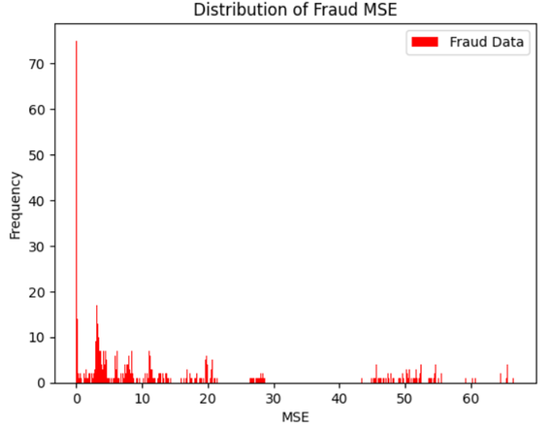

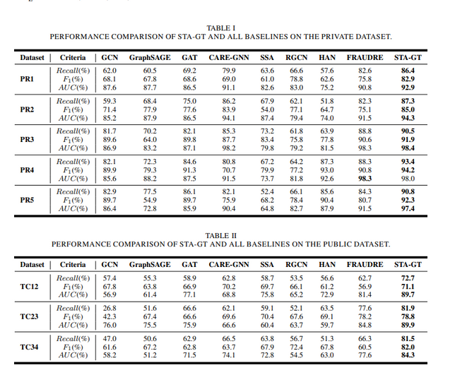
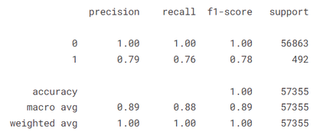

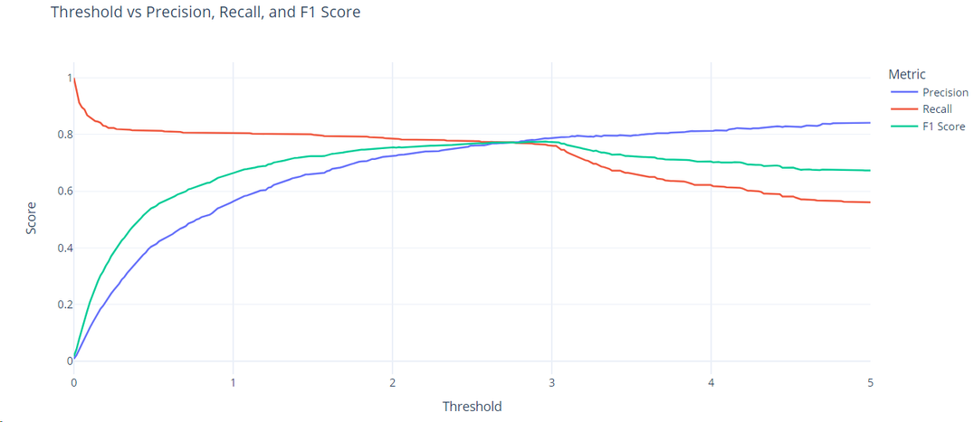

Prototype Performance report/Benchmarking
Classification Report of Autoencoder
Showing F1 score of 78%
The distribution plot of Mean Squared Errors of Fraud transactions shows that Reconstruction error is away from zero for most of the genuine transactions
The distribution plot of Mean Squared Errors of normal transactions shows that Reconstruction error is nearly zero for most of the genuine transactions
Variation of Precion, Recall, and F1-Score on test data for varieng Threshold.

Slide 11
Test It Here
https://financial-fraud-detection-hackathon01-5.onrender.com

Slide 12


