Slide 1


MEDIMIND
TEAM-5

Slide 2
PROBLEM
STATEMENT
Radiologists spend several hours daily manually reading and summarizing MRI, CT, and other diagnostic reports.
This leads to fatigue, reporting delays, and inconsistent report quality.
Existing AI tools mainly detect images but don’t help with textual report summarization or structured reasoning.
Hospitals need a faster, explainable, and reliable way to process medical reports efficiently.

Slide 3
WHY
MEDIMIND?
WHAT MAKES US UNIQUE
01
AI-Powered Report Summarization
MediMind automatically summarizes medical reports into clear, structured findings using AI.
It uses Retrieval-Augmented Generation (RAG), Gemini Embeddings, and PubMedBERT to extract key medical terms and generate explainable summaries.
Unlike other tools, MediMind focuses on medical text comprehension and explainability, not just image analysis — making it a unique and safe assistive solution.
02
Explainable & Reliable Output
03
Unique Domain-Specific Design

Slide 4

SOLUTION...
INNOVATION
MediMind automatically summarizes medical reports into clear, structured findings using AI.
It uses Retrieval-Augmented Generation (RAG), Gemini Embeddings, and PubMedBERT to extract key medical terms and generate explainable summaries.
Radiologists can quickly verify AI-generated summaries, saving time and improving consistency.
Unlike other tools, MediMind focuses on medical text comprehension and explainability, not just image analysis — making it a unique and safe assistive solution.

Slide 5
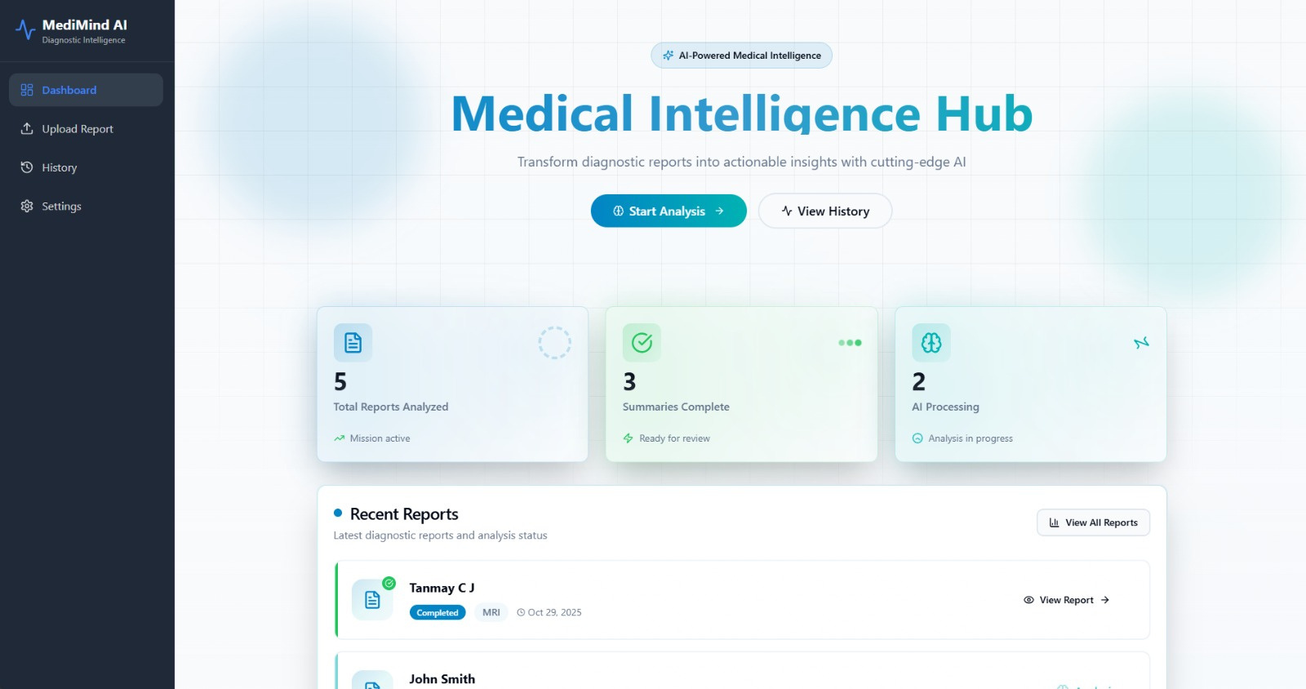

Slide 6
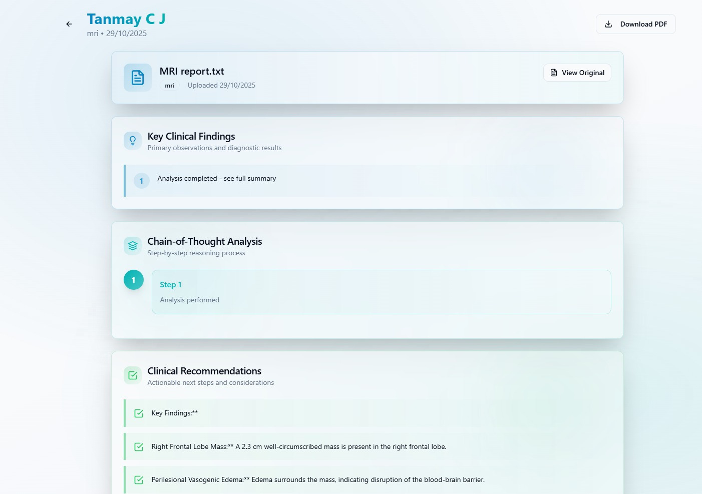

Slide 7
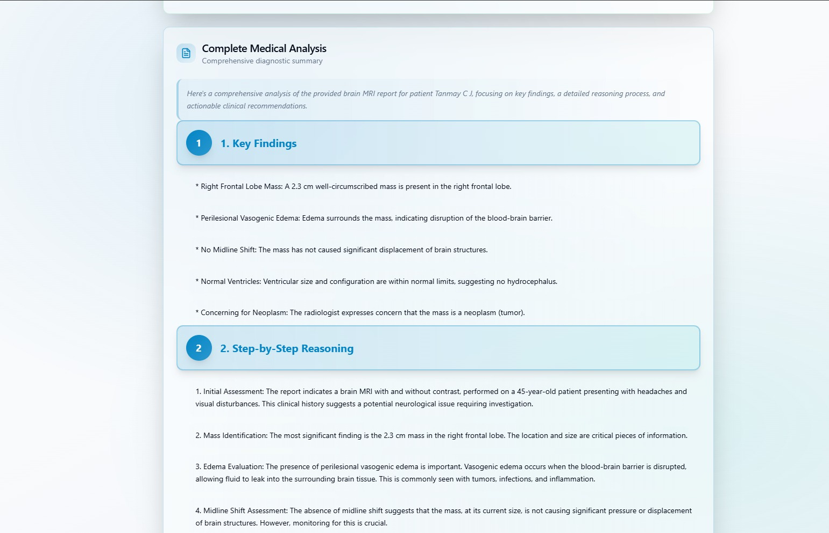

Slide 8
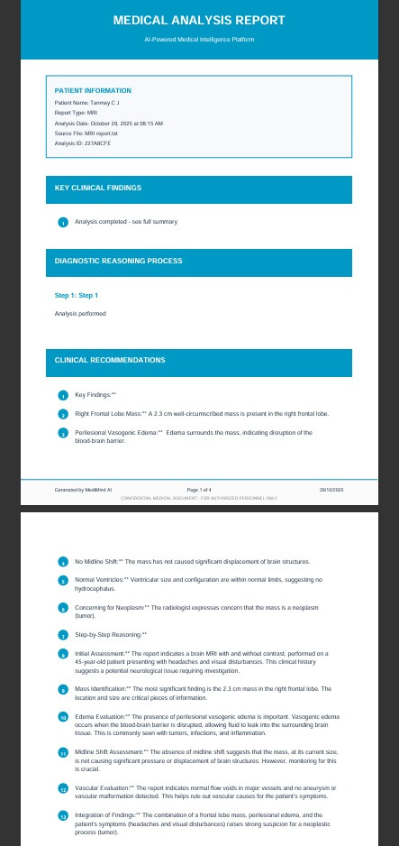
PDF
REPORT

Slide 9
Growing Market Demand
Target Market Potential
01
02
Focused on medium-to-large diagnostic centers and hospitals in India and Southeast Asia spending ₹10–25 lakh/year on AI and reporting tools.
The global medical AI software market is expected to exceed $12 billion by 2028, driven by the need for faster and more accurate diagnostic workflows.
Key Competitors
MediMind’s Uniqueness
03
Existing players include Qure.ai, Synapsica, and Ferrum Health, which focus mainly on medical imaging AI, not text-based report summarization.
04
Unlike competitors, MediMind specializes in AI-driven report summarization with explainable and traceable outputs, making it safer and easier to adopt in clinical workflows.
MARKET
LANDSCAPE

Slide 10
BUSINESS MODEL & STRATEGY
Revenue model
Subscription-based SaaS — ₹10,000–₹25,000/month per hospital depending on usage.
Business model
B2B (Business-to-Business) — targeting diagnostic centers and hospitals.
Distribution
Direct sales, hospital partnerships, and API licensing
Growth strategy
Start with pilots in Tier-1 cities → gather case studies → scale via hospital networks and radiology associations.

Slide 11
MILESTONE
1
2
Build MVP (upload → summarize → explain) – completed.
Integrate with PACS/RIS and improve UI – in progress.
3
4
Pilot with diagnostic center and gather feedback – planned.
Final product demo and commercialization – final phase (IA2/SEE).

Slide 12
THANK YOU
hello@reallygreatsite.com

