Slide 1
Interactive Sales
Dashboard
in Power BI

Slide 2
2
01
02
03
Track sales performance over time
Identify best-selling products
Understand regional revenue contributions
04
Make data-driven decisions using visual insights
Content
To design an interactive Power BI dashboard that enables business stakeholders to:

Slide 3
Dataset Overview
3
•Source: Sales Dataset
•Total Records: ~21,000 rows
•Columns: Product, Region, Order Date, Quantity, Unit Price, Total Revenue
•Time Range: Jan 2018 – Dec 2020
•Total Sales: $130.02M
•Units Sold: 469,345
•Avg. Price: $272

Slide 4
4
Technical Implementation
Tool:
Power BI
Data Cleaning: Excel
Data Model:
Star Schema
Visuals Used:
Bar Chart, Map, Cards, Line Chart, Tree
DAX Measures:
Total Sales, Quantity, Avg Price
Interactivity:
Slicers, Navigation Tabs, Tooltips

Slide 5
Key Features of the Dashboard
Sales by Product
& Region
• Monthly Sales Trend
• KPI Cards (Revenue, Units Sold, Avg. Price)
• Slicers (Date, Product Category, Region)
• Map Visualization with Tooltips
• Tab Navigation for different views
• Custom background, theme, and formatting
5

Slide 6
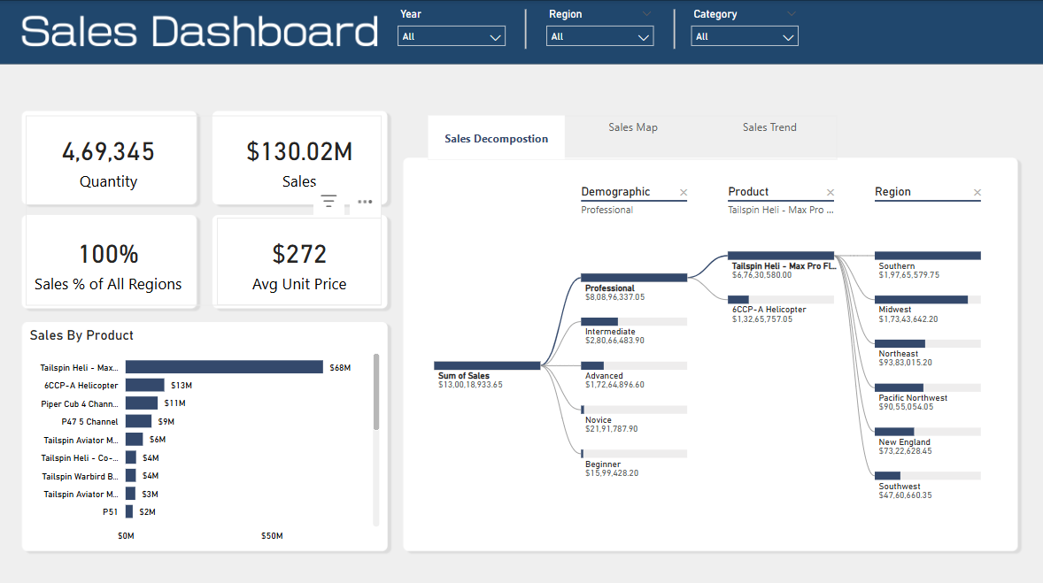
6
Comprehensive Sales Dashboard with detailed product-wise performance, regional distribution, demographics, and smart decomposition analysis for strategic insights.

Slide 7
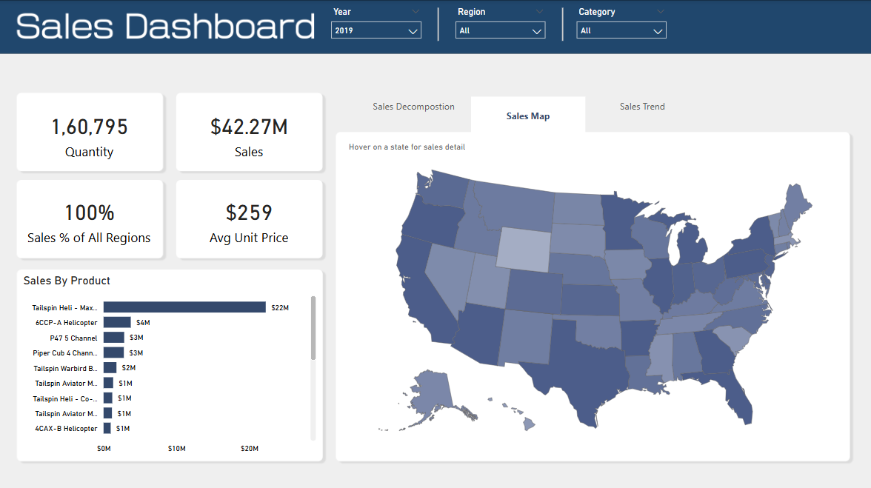
7
Comprehensive 2019 U.S. Sales Dashboard highlighting $42.27M in revenue, 160K+ units sold, and top-performing products across all regions.

Slide 8
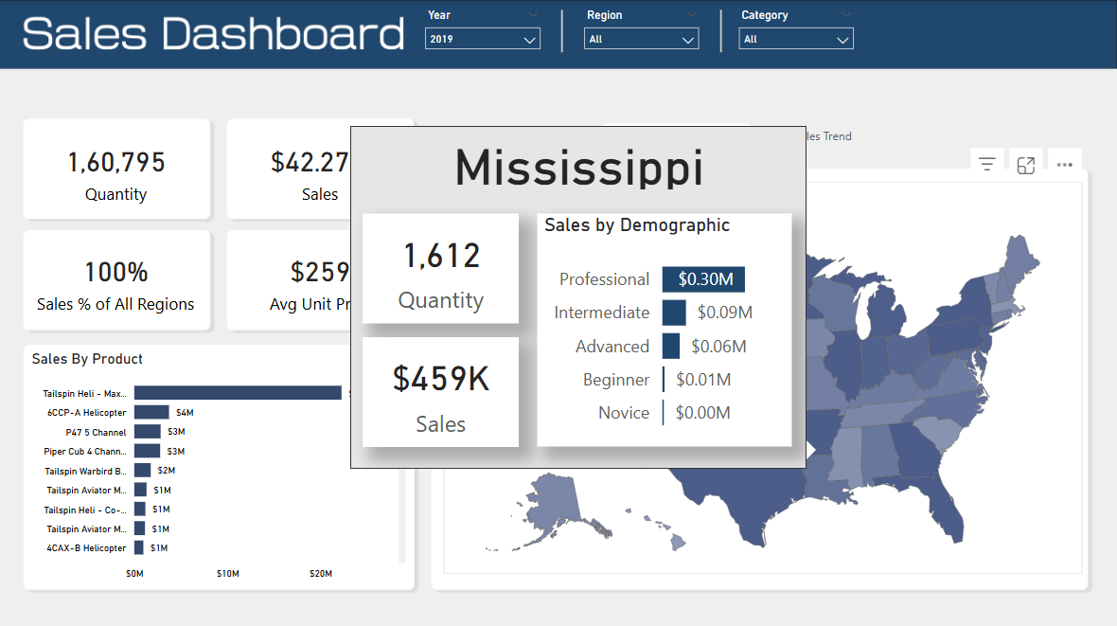
8
Featuring dynamic tooltips for state-wise insights, including demographic-wise sales breakdown, quantity sold, and revenue at a glance.

Slide 9
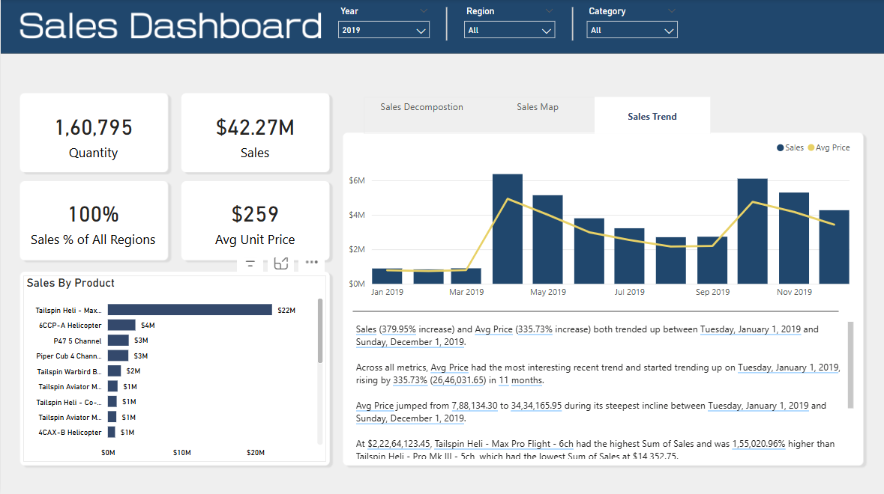
9
Sales surged by 380% and average price by 336% in 2019, with 'Tailspin Heli – Max Pro Flight' driving the highest revenue.

Slide 10
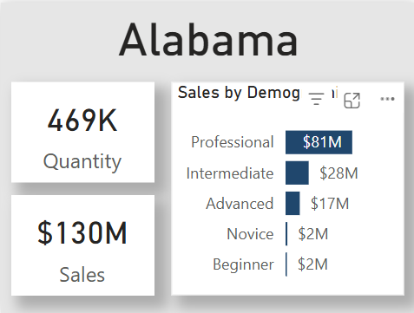
10
The dynamic tooltip provides an on-hover summary for each state, offering detailed insights into sales quantity, total revenue, and demographic-wise sales distribution—helping users quickly understand regional performance without navigating away from the main dashboard.

Slide 11
11
Product Sales
Insights
•Tailspin Heli - Max Pro Flight → $68M
•66CP-A Helicopter, Piper Cub 4 Channel also top performers
•Consistent demand in 2019–2020
•Helps focus marketing efforts on high-demand items
Regional Sales
Time Series
•Full state-wise sales coverage
•States like California and Texas top revenue contributors
•Underperforming regions identified for sales push
•Map tooltip shows state-wise stats on hover
•Sharp growth in sales starting mid-2020
•Sales peak in Q3–Q4 2020
•Avg. unit price increased by ~26.9% over time
•Suggests seasonal demand or campaign impact

Slide 12
12
•Real-time monitoring of sales KPIs
•Region & product-based strategy planning
•Better inventory and stock management
• Informs product development and pricing decisions
• Quick executive insights without raw data digging
Business Impact

Slide 13
13
Thank
you!

