Slide 1
Week 23
Does when the water arrives change the cascade?
Dynamic flood forcing in World 1 · twin CascadeGNN held-out result · GISSR review and audit
23 / 23
46 × 1,000
+21 – 58 %
exact-reduction gates passed — every dynamic number is a controlled difference from the frozen campaign
paired Monte Carlo runs: 23 storms × {static at peak, arrival-ordered}, same seeds and buffers
more failures, persisting to 15 days, in the saturated storms above 3.2 m at The Battery
Tanmay Jain · CERA Lab, NYU Tandon · August 28, 2026 · branch feat/dynamic-flood-maps
say: Last week we showed footprint decides whether the city crashes and grid physics decides the spread. This week: does the clock matter — when each node gets wet, not just whether.
Notes:
Frame: Week 22 = footprint decides IF, physics decides variance. Week 23 asks whether seed timing changes anything. Three numbers on the slide: the validation (23/23 gates), the scale (46k paired runs), the headline (+21–58% persistent above 3.2 m). Everything is paired: same seeds, same buffers, only the hour a node gets wet changes.

Slide 2
The week at a glance
Four tracks, all landed; everything on GitHub and reproducible from the handoff
Twin CascadeGNN
GISSR review
Timing in World 1
23-storm campaign
COMPLETED
20 / 20 maps audited
0.7 s / storm
≈ 25 min on Torch
6-epoch retrain inside the GPU policer window; held-out evaluation on 5 scenarios per arm. Closes Week 22's open item.
Gwen's model read and run end to end; reproduced to machine precision; every delivered map matched to its catalogue storm.
Arrival-ordered flood seeding through the existing scheduled-failure hook; reduces exactly to the frozen campaign when switched off.
46 CPU tasks, N = 1,000 each, 360-h horizon. Static-vs-dynamic across the whole S-curve, paired run by run.
Also this week: the two branches closed and cut (old branch tagged week22-twin-campaign) · Torch clean and on the new branch · memo and handoff in reports/
say: Two of these were on Tuesday's plan; the campaign and the World 2 wiring turned out to be cheap once the reduction gate was in place, so they came in the same week.
Notes:
Tuesday's plan: close old branch, twin GNN eval, GISSR review, Option A timing features. What happened: all four, plus the 23-scenario campaign and the GNN timing inputs, because the timing model is a one-line change once you have the hydrographs, and the reduction gate made every step safe to extend.

Slide 3
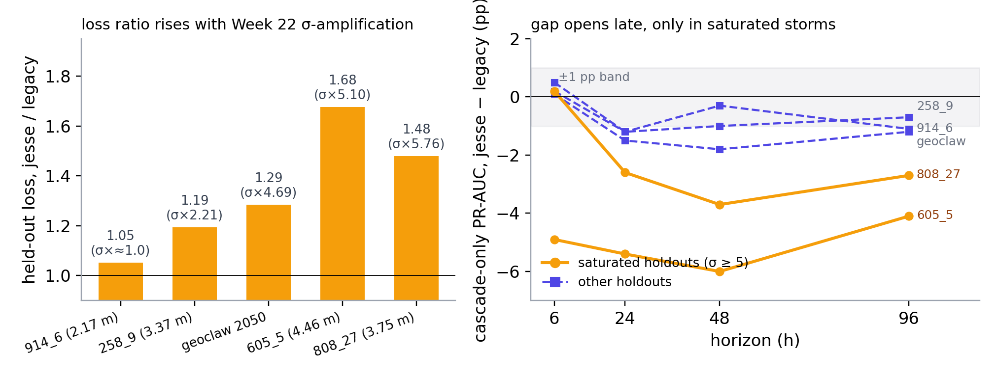
Twin CascadeGNN, held-out: physics labels are harder to learn, exactly where the variance grew
Same graph, seed, architecture and 5-way scenario holdout — only the label campaign differs (HAZUS vs grid physics)
Read it as
Loss ratio jesse/legacy 1.05 → 1.68 rises with Week 22's σ-amplification: the physics labels carry more irreducible entropy
Cascade-only PR-AUC within 1 pp at t6 everywhere; −3 to −6 pp at t24–96 only in 605_5 and 808_27
Task: given the direct-failure mask, predict every other node's failure by t
held-out | loss legacy | loss jesse | ratio | cascade PR-AUC t96: legacy / jesse
geoclaw_2050 | 0.141 | 0.181 | 1.29 | 0.981 / 0.969
syn 914_6 | 0.086 | 0.090 | 1.05 | 0.856 / 0.845
syn 258_9 | 0.125 | 0.149 | 1.19 | 0.978 / 0.971
syn 605_5 | 0.205 | 0.344 | 1.68 | 0.988 / 0.947
syn 808_27 | 0.140 | 0.207 | 1.48 | 0.984 / 0.957
Comms rule: these 0.95–0.98 values are the same metric as the earlier 0.73 on far fewer training scenarios — the learning-curve hypothesis, not yet a result. Best val: legacy 0.1082, jesse 0.1197, both at epoch 5 (job 16438671).
say: The prediction from last week was that BCE cannot go below the label noise floor; on held-out storms the floor rises with the variance amplification, and skill separates late and only in the saturated storms.
Notes:
Job 16438671 on l40s_public, 6 epochs, 1h10 / 1h11 per arm — under the ~2 h utilization policer. Loss ratio ordering matches the Week 22 σ ordering (914_6 ~1.0 → 258_9 2.21 → gc_2050 4.69 → 808_27 5.76 / 605_5 5.10). At t6 both arms 0.955–0.97 everywhere. Do not compare to the old 0.73 as an improvement: same metric family, different training-set size; that comparison is the learning-curve experiment.

Slide 4
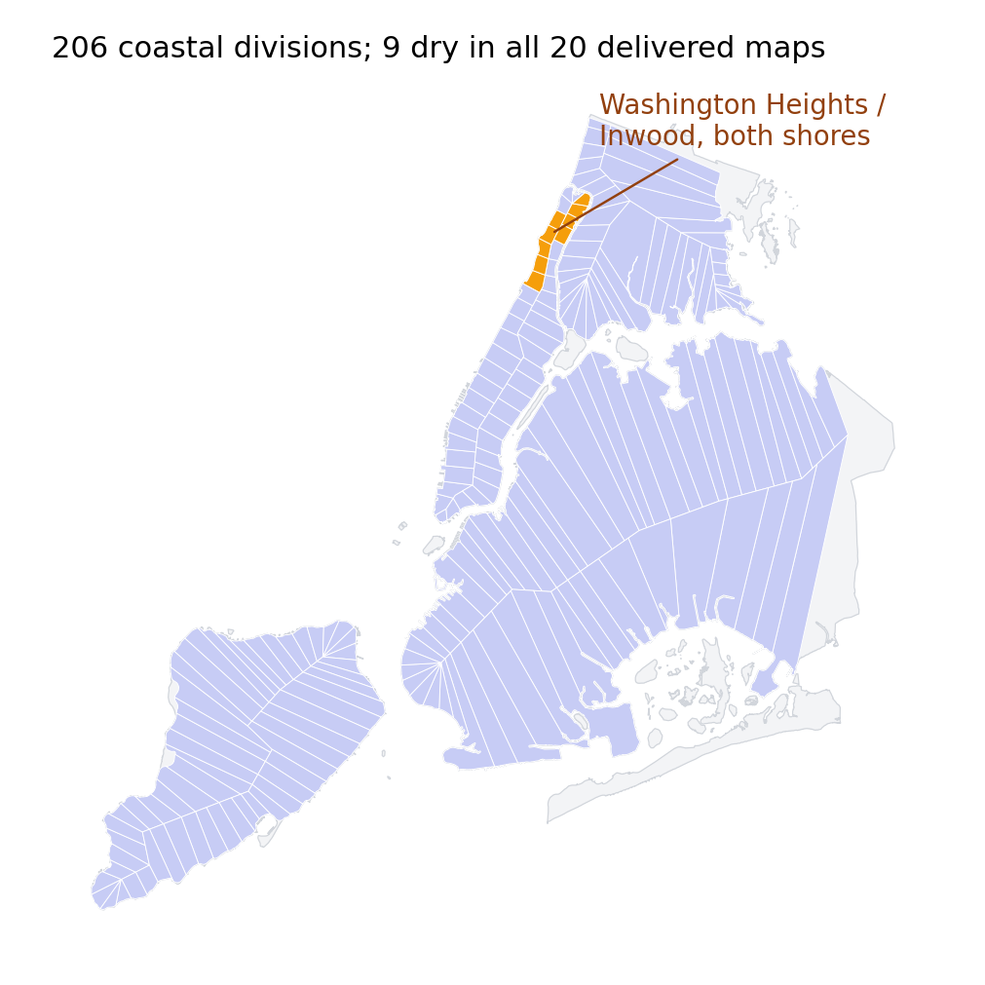
GISSR reviewed and run: a bathtub at the peak level in every division, once two data bugs are fixed
Gwen's generalized model (206 coastal divisions, 3,199 coastline segments) — read, reproduced to machine precision, and audited on the 20 delivered maps
1
Nine divisions dry in every map two coastline segments have empty elevations; the group sums turn NaN → zero height in 33, 36, 38–42, 44, 48 (Washington Heights / Inwood). ≈1 % of the Sandy footprint — no campaign rerun needed.
2
Divisions receiving the most water come out dry beyond the 7 m storage table the last curve fit goes negative and is clipped to 0. Visible in the delivered set as non-nesting in the 7 largest maps (132–5,259 cells).
3
The physics isn't binding at NYC scale coastline thresholds are segment minima (median 0.34 m) and Manning inflow is 20–270× the storage: with 1 and 2 fixed, all 206 divisions sit at the cap. Sandy extent 120 km² vs ≈130 observed.
4
Units and datum storage tables built with cell area in ft² (10.8× off, harmless given 3); NOAA file MSL vs DEM NAVD88 (−0.063 m); no SLR in catalogue water levels; depths up to 17.7 m on sub-zero DEM cells.
say: None of this changes the qualitative picture and the fixes belong in Gwen's repo; what it does tell us is what a GISSR map is — a bathtub at the peak Battery level — and that decides how we can use them.
Notes:
Method: read all 20 notebook cells, re-implemented the core, reproduced the notebook's Sandy heights (max diff 0.0) and the delivered raster bit-for-bit; ablated each fix. Message sent to Gwen with the facts. Synthetic branch of the saved notebook cannot run (48-point time axis vs 20-point storms) — reproduction of two delivered maps waits on her reply. Storm id convention pinned: label = surge peak (999_12 = water level; 463_29 = warm row 1; 156_15 label truncated).

Slide 5
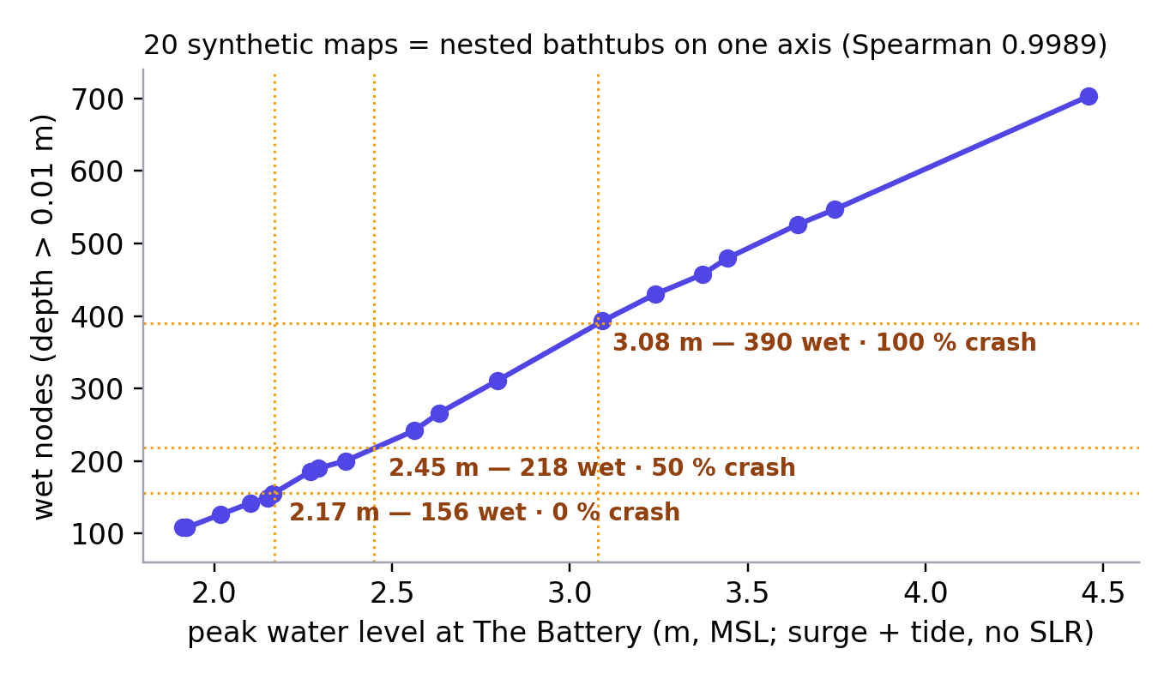
The 20 maps decoded: nested bathtubs on one axis, so the S-curve is a water level
Each map's true peak = surge + tide from Gwen's catalogue; wet-node count is monotone in it (Spearman 0.9989 vs 0.979 on the surge label)
What it gives us
The Week 22 gap explained: Spearman 0.998 on wet nodes vs 0.926 on the label, because the label omits the tide (808_27 hit at −0.47 m, 605_5 at +0.70 m)
Crash thresholds in metres: 0 % below 2.17 m, 50 % at ≈2.45 m, 100 % above 3.08 m — present-day sea level
With the 2080s middle-estimate SLR (0.72 m), the 50 % crash level needs only a 1.73 m storm tide: a cold-season 90th-percentile storm
Limit to state: more GISSR maps densify one axis; only the GeoClaw maps carry a spatial surge pattern.
say: Because every synthetic map is the same bathtub cut at a different level, the whole campaign collapses onto one axis — which is what makes the rest of this deck readable as a function of storm size.
Notes:
All 20 maps resolved to catalogue storms by their peak labels; 19 by the label directly, 156_15 by row. Water level = surge + tide, no SLR (verified: no trend by decade). Nestedness confirmed on the delivered rasters (12 smallest perfectly nested; 7 largest leak a few hundred to 5k cells = the overflow bug). SLR numbers from the group's papers: 0.406 m 2050s, 0.724 m 2080s, 0.9145 m 2100.

Slide 6
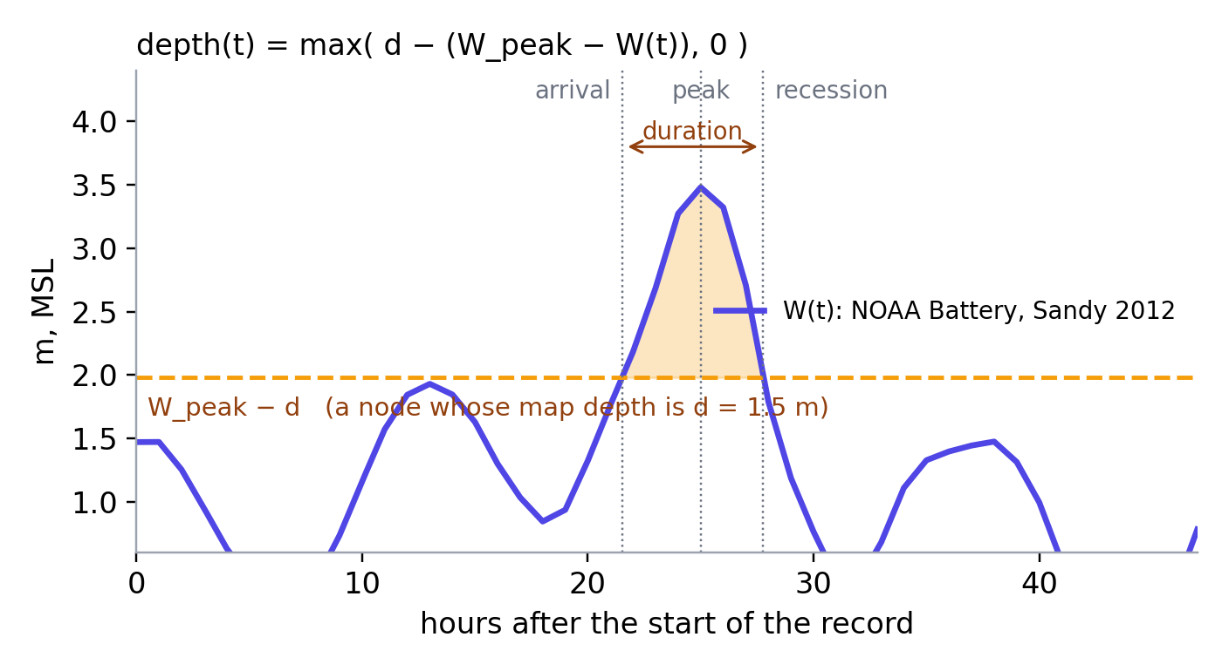
How timing enters: a node is under water when the coastal level is within its map depth of the peak
Valid because GISSR fills a division within the hour it is overtopped (verified) — the map is the truth at the peak, the hydrograph supplies the shape
Three additive changes, one gate
Per-node clock from hydrograph + map depth: arrival, duration, time-to-peak. Only differences of W enter → datum and SLR cancel; flat W reduces exactly to static
Flood seeds keep their fragility draw; they are scheduled at their hour through the Week 19 scheduled-failure hook (cause flood). Engine gains t_origin and an intra-clock origin, defaults unchanged
Records stay peak-relative → data.py, the compare script and the cascade-only mask read them unchanged
Exact-reduction gate static_peak reproduces the frozen campaign record-for-record: 23 / 23 scenarios × 1,000 runs (Torch job 16456615), 0 failures
config/dynamic_forcing.yaml enabled: false · DYNAMIC_FORCING=1 DYNAMIC_MODE=static_peak | static_onset | arrival | threshold · DYNAMIC_OFFSETS DYNAMIC_INTRA_CLOCK DYNAMIC_ARRIVAL_SHIFT_H
say: The important property is the last bullet plus the gate: with timing switched off, the code produces the frozen campaign byte-for-byte, so every dynamic number is a controlled difference, not a new model's opinion.
Notes:
Timing definition tested on real catalogue hydrographs; wet counts match the campaign (108–703) exactly under the same >0.01 m definition. Proven on toy graphs with a clock-dependent closure (18/18 translations exact), then on the real system at N=20/100/1,000 locally and 23/23 at N=1,000 on Torch. Sampler is prefix-consistent, so the first N draws of an N-run job equal the campaign's — that is what makes everything paired. Buffers on inter-layer edges start from each source's exact failure hour; the telecom demand-surge clock is handed the peak-relative time (frozen assumption) and a decayed clock before the origin.

Slide 7
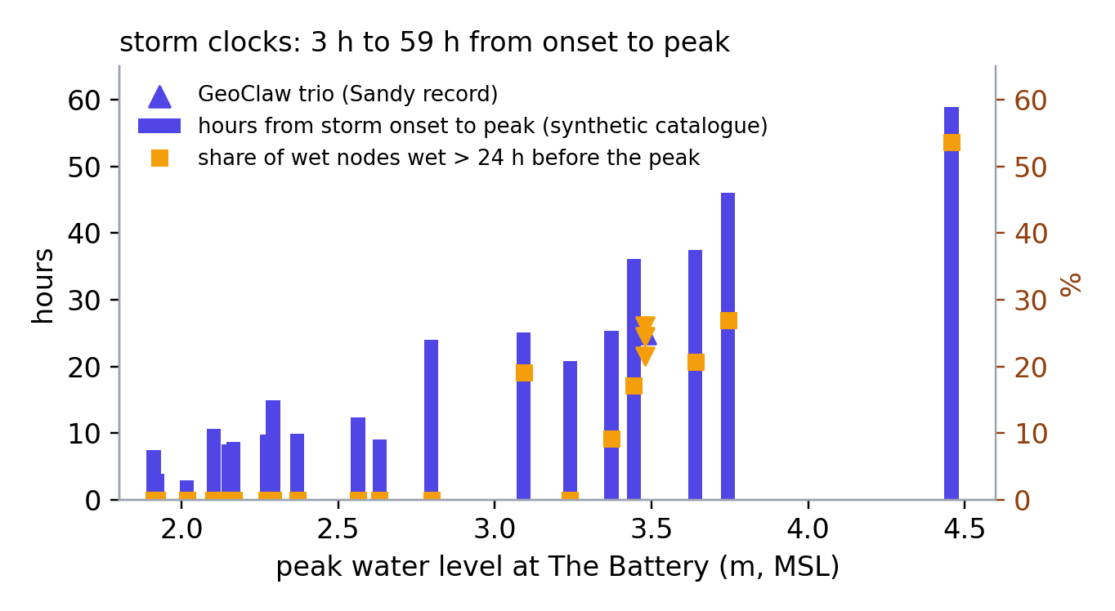
Storm clocks: big surges rise slowly, so half the city can be under water a day before the peak
Per-storm timing from the catalogue hydrographs (20 synthetic) and the Sandy tide-gauge record (GeoClaw trio)
storm | peak level | onset → peak | median arrival | wet >24 h pre-peak
syn 914_6 | 2.17 m | 8.7 h | 7.0 h | 0 %
syn 880_9 | 3.09 m | 25.1 h | 21.5 h | 19 %
geoclaw 2050 | 3.48 m | 25.0 h | 22.5 h | 25 %
syn 808_27 | 3.75 m | 46.0 h | 32.6 h | 27 %
syn 605_5 | 4.46 m | 58.9 h | 32.6 h | 54 %
Pre-registered expectation near-zero end-state change for the 13 fast-rising storms; effect confined to the tail; intermediate labels (t6, t24) shifting most in 808_27 and 605_5.
Caveats: Battery hydrograph applied citywide (no propagation delay); catalogue storms begin at the surge threshold, so small storms have many nodes wet at onset; the Sandy record starts with the water already at 1.47 m.
say: This is the table that told us where to look before any run: in 605_5 the median node is under water 26 hours before the peak — a telecom battery is gone a day before a hospital even sees water.
Notes:
Timing table: 23 scenarios, 6,941 wet node-scenario rows. Onset-to-peak 3–59 h; the Lopeman catalogue draws duration with peak height, so big surges rise slowly. GeoClaw trio uses the NOAA hourly verified record (MSL), peak 3.48 m at hour 25; its 'wet at hour 0' nodes are a window edge. These predictions were written down before the ablation ran.

Slide 8
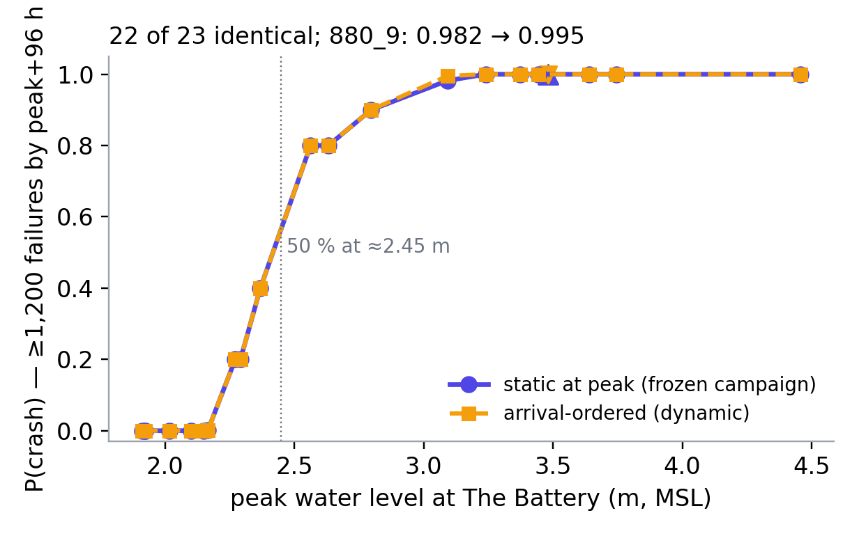
Result 1 — timing never changes whether the city crashes
Crash probability (≥1,200 failures by peak + 96 h), static at peak vs arrival-ordered, 23 storms × 1,000 paired runs
22 of 23 identical
storm by storm, to three decimals
880_9 (3.09 m): 0.982 → 0.995 — the only change, on the crash edge
Footprint decides IF. Week 22's finding survives the timing test completely: the crash S-curve in metres is the same curve under both clocks, 50 % at ≈2.45 m.
say: First result, and the one that protects everything we said in Week 22: when the water arrives has no say in whether the city tips over.
Notes:
Threshold 1,200 as in Week 22; findings were threshold-stable at 1,000/1,200/1,500 last week and the compare script reports all three. Both curves are from the same 1,000 seeds per storm.

Slide 9
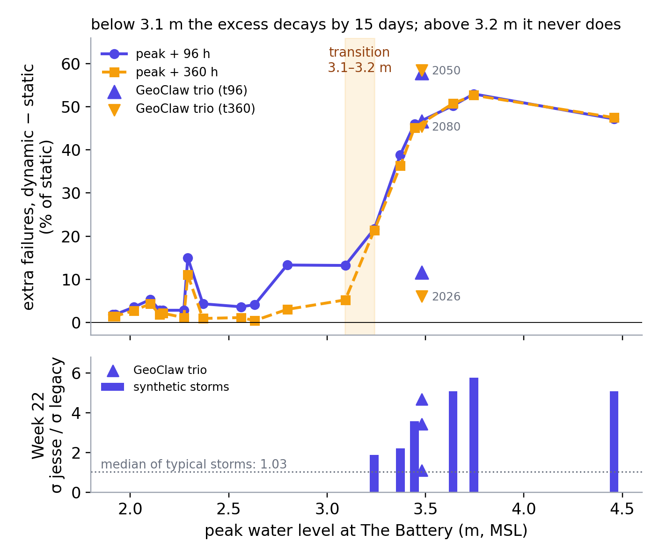
Result 2 — below 3.1 m timing changes when; above 3.2 m it changes where the city ends up
Extra failures, arrival-ordered minus static, as a share of the static total — at peak + 96 h and at peak + 360 h
≤ 3.1 m · same destination, reached sooner
+2 % to +15 % at peak + 96 h, decaying to +1 % to +5 % by 15 days
median node fails 0–6 h earlier (24 h in 880_9); crash probability unchanged
≥ 3.2 m · a different end state
+21 % to +58 % at peak + 96 h and unchanged at 15 days; every one of 1,000 runs worse; median node 14–40 h earlier
The transition (880_9 → 514_13) is where Week 22's σ-amplification switched on (×1.88 → ×5.76); the GeoClaw trio straddles it, so it is not a synthetic-map artifact
say: Same regime, two different mechanisms reading the same threshold: where the grid physics reopened the variance is exactly where the timing changes the destination.
Notes:
Numbers from the 23-row campaign table. Below 3.1 m: t96 excess 1.8–15% (463_29 is the 15-h storm), t360 0.4–11%. Above: 514_13 +22/+21, 258_9 +39/+36, 999_12 +46/+45, gc_2080 +47/+46, gc_2050 +58/+59, 914_26 +50/+51, 808_27 +53/+53, 605_5 +47/+48. gc_2026 converges (+12 → +6). gc_2050 persists at 368 wet nodes while 880_9 converges at 393 → spatial pattern matters, not only size.

Slide 10
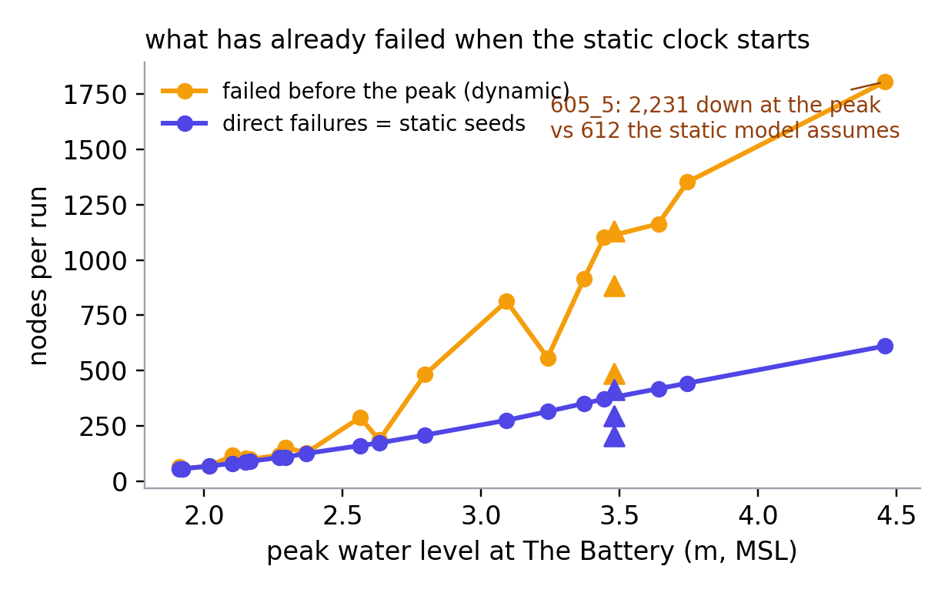
Result 3 — what the static model is missing: the cascade is already running when its clock starts
Nodes down per run at the moment of the peak, dynamic vs the static seed set; 605_5 deep dive at N = 1,000
syn 605_5 — 4.46 m, 59 h to peak, N = 1,000 paired
2,231 vs 612
nodes down at the peak, arrival-ordered vs static seeds (3.6×)
1,804
node-failures per run before the peak
−40 h
median node fails earlier; 98 % of nodes earlier
1,000 / 1,000
runs end worse; +1,306 at t360, KS 0.99
Control: syn 914_6 (2.17 m, 9 h to peak) — +7 nodes at t360 (2 %), median 2 h earlier, crash probability 0.001 → 0.001.
say: In a two-and-a-half-day storm the static convention throws away two days of buffer burn: by the time it starts, nearly four times its seed count is already down.
Notes:
Bracket at N=100: arrival lies between static_peak and static_onset in every storm (605_5: 2,554 < 3,735 < 3,784 at t96). Horizon: the frozen 96-h snapshot truncates an unfinished cascade even in the static world (+14–16% from t96 to t360 in the big storms) — Week 22 totals are 96-h snapshots.

Slide 11
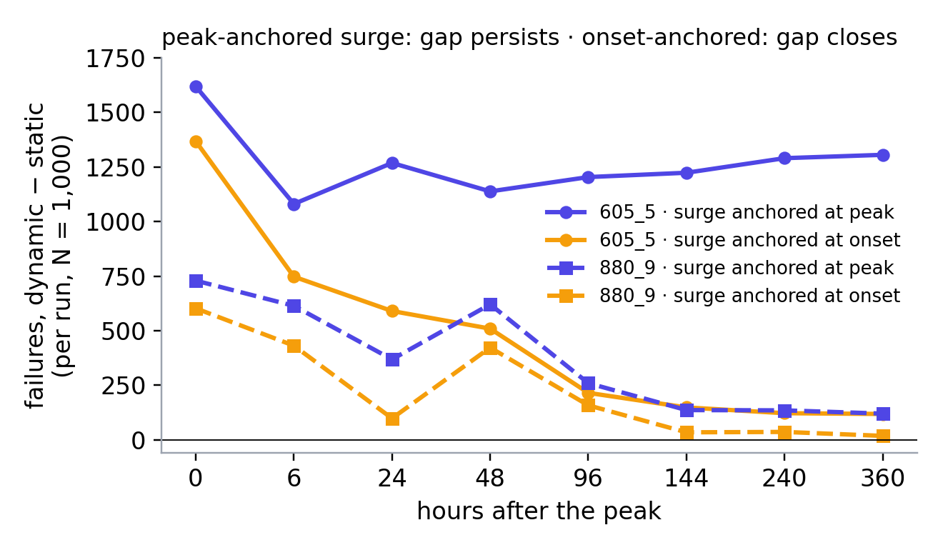
Why the end state differs — and the one assumption it rests on
605_5 decomposition at t360 (N = 100) and the horizon curves under the two demand-surge clocks (N = 1,000)
Same storm, surge anchored at onset: telecom +24, fuel +12, subway +7 — the persistent gap is the surge landing on a network that has already lost 4× the sites. Subway's +84 is the classic Motter-Lai order dependence; fuel and inter inherit from both.
Decision for Dr. Miura: anchor the telecom demand surge at the peak (Sandy-consistent → +21–58 % persistent) or at onset (mean-neutral, but 75–84 % of runs end smaller and 16–25 % much larger — σ 2–5× static, bimodal)?
say: Either answer is a finding — timing does to the tail what the grid physics did — but which one leads in December depends on when the call-volume spike happens, and that is a physical question, not a modeling one.
Notes:
Peak-clock decomposition (N=100, t360): causes inter +557, intra_telecom +392, intra_fuel +453, intra_subway +44; flood −181 (seeds reached by the cascade before their hour, relabelled). Onset-clock N=1,000: 880_9 +18 ± 205 (753/1000 smaller), 605_5 +118 ± 529 (838/1000 smaller). The elapsed-time effect at t0–t48 is clock-independent (605_5: +1,368 at the peak, +748 at t6 under onset); only the persistence depends on the clock. Sandy's call-volume record (spike at and after landfall) argues for peak-anchored.

Slide 12
World 2 and next week: the surrogate can now see when the water arrives
Timing inputs wired (input width 9 → 12, default build byte-identical); dynamic labels exist for all 23 scenarios
The 2 × 2
Decisions requested
Dr. Miura — demand-surge anchor (peak vs onset); approve the 2 × 2; GISSR: fixes in Gwen's repo, SLR by storm year, spatial diversity (GeoClaw ensemble vs gauge-scaled GISSR)
Dr. Lin — next reviewer checks (±3–6 h arrival perturbation is running; Sandy hindcast timeline; fgmax arrival times); N_MC for surrogate labels (200–300 vs 1,000)
static labels · mask only
static labels · mask + timing
the twin already trained (Week 22)
does timing help even without dynamic labels?
dynamic labels · mask only
dynamic labels · mask + timing
Next week
how wrong is a static-trained surrogate mid-event?
the cell that matters for December
World 2 2 × 2 on GPU · Jesse arm under dynamic forcing (re-derive his t = 6 floor as peak + 6)
Option B remainder: depth-duration fragility, recovery gated on recession · intra-infrastructure verification pass, starting with the fragility regime flag
Labels: legacy_v1_n1000 (static) vs dynamic_v1/arrival_h360. Inputs: initial-failure mask ± {arrival, duration, time-to-peak}/96 h. 6-epoch runs inside the policer window.
say: The intermediate labels the surrogate trains on move by hundreds of nodes in the big storms under either clock — a surrogate that only sees the peak map is wrong about the middle of the event even when it is right about the end.
Notes:
GNN patch: data.py loads the timing table once, tags runs with their scenario, concatenates 3 features after the mask; train.py input width +N_TIMING_FEATURES; env-gated. Smoke on real data: width 12; 605_5 telecom rows with timing 478 vs 433 mask ones. Dynamic campaign outputs on Torch $SCRATCH/results/dynamic_v1 and on the Mac. Handoff: reports/PROJECT_HANDOFF_Week23_end.md.

