Slide 1


Team Details
Case Study No. 1
Team RAG
Member 1: Shreyas Joshi
Member 2: Parth Malangave
Member 3: Tanmay Kangule

Slide 2


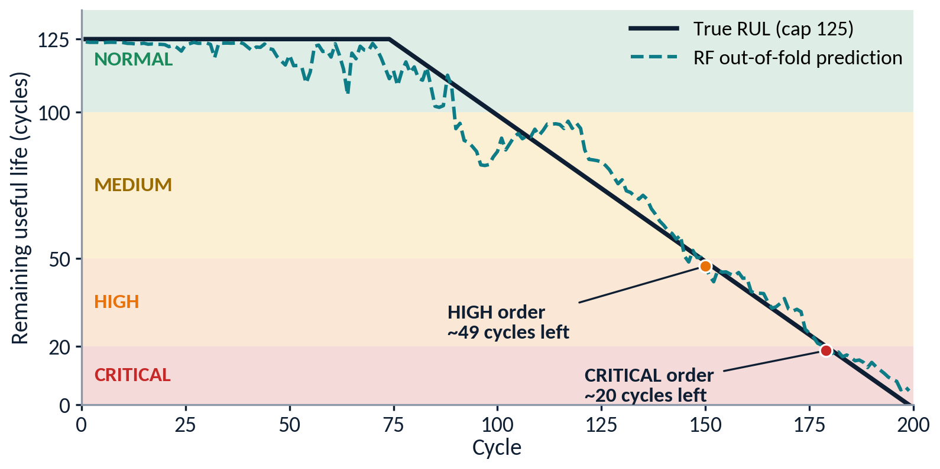
FleetGuard: Self-Healing Fleet Maintenance
Targets unplanned downtime: predict remaining life, auto-raise work orders, humans only for exceptions.
Team RAG
Teliport Season 4 | Case Study 1
13.4
RUL test RMSE, cycles (Ridge 16.2)
261
NASA score, lower is better (Ridge 390)
154
causal features from 14 of 21 sensors
60
automated tests passing
FD001
prototype: data and model stages working
1
DATA
2
CLEAN + FEATURES
3
ANOMALY + RUL
4
TRIAGE AGENT
5
WORK ORDER
NASA C-MAPSS turbofan fleet. FD001 now, FD002–FD004 next.
Fill gaps (past data only), smooth, drop 7 flat sensors, rolling stats + baseline delta.
RUL: Random Forest. Anomaly: Isolation Forest, no labels. Class weights for imbalance.
Rule-based severity from RUL lower bound, plus confidence gate. No LLM.
Auto-created, de-duplicated, escalate-only. JSON + SQLite log.
BUILT
BUILT
RUL BUILT
PLANNED
PLANNED
Triage agent: plain-Python rules
Why Random Forest
Per engine: RUL lower bound, anomaly score, RUL trend, confidence
Test RMSE 13.4 vs LightGBM 14.5 and Ridge 16.2. Picked on engine-grouped CV, not on test.
Severity (cycles of life left)
Closed-loop MLOps (planned)
CRITICAL ≤ 20
HIGH ≤ 50
MLflow registry. Challenger replaces champion only if better. PSI/KS drift triggers retrain. Streamlit monitor.
MEDIUM ≤ 100
NORMAL > 100
Confident?
YES: auto work order
Scale ladder
FD001
FD002
FD003
FD004
Engine 26, out-of-fold prediction vs true RUL. Zones and alert points are illustrative (point prediction; the agent will add a lower bound).
NO: human review
FD002/4: normalize per operating regime. FD003/4: two fault modes.
Notes:
SPEAKER / REVIEW NOTES (not shown on slide)
- Built so far (FD001): loading + checks, causal cleaning (EWMA alpha 0.3), 7 near-constant sensors dropped (std <= 0.01 on train), z-score scaling fit on train only, rolling mean/std/slope windows 5/10/30 + baseline delta (first 10 cycles) = 154 features, RUL capped at 125.
- Models: Ridge, RandomForest (n=100, depth 12, min leaf 5, max_features 0.7), LightGBM. 5-fold GroupKFold by engine, seed 42. Selected by pooled CV RMSE (RF 11.74, LightGBM 11.90, Ridge 15.61; CV uses capped true RUL).
- Test (last cycle per engine, RAW true RUL from RUL_FD001.txt): RF RMSE 13.40, MAE 9.94, NASA 261.4. LightGBM 14.52 / 11.19 / 299.9. Ridge 16.18 / 13.04 / 390.2. Final models refit on all 100 train engines.
- Top RF feature: sensor_11 baseline delta (51% importance), then sensor_4 baseline delta (14%).
- Chart: engine 26, out-of-fold predictions. Severity thresholds (20/50/100) are illustrative and will be tuned. Alert markers: first 3 consecutive predicted values below the threshold (HIGH ~49 cycles left, CRITICAL ~20 cycles left).
- Anomaly design: Isolation Forest fit on the healthy early-life window (no failure labels needed); binary 'fails within N cycles' flag with class weights for mild imbalance. Monitoring: Streamlit view of fleet RUL, work orders, MLflow model versions and drift. FD003/FD004 have two fault modes; FD002/FD004 have 6 operating regimes (per-regime normalization).
- NOT built yet: anomaly model, triage agent, work orders, MLflow, drift/retrain, dashboard, FD002-FD004. The RUL lower bound (prediction minus k x tree spread) is a design choice to be implemented and calibrated.
- Why late errors matter: NASA score penalizes predicting too much life more than too little, so the agent acts on a pessimistic bound.

