Slide 1




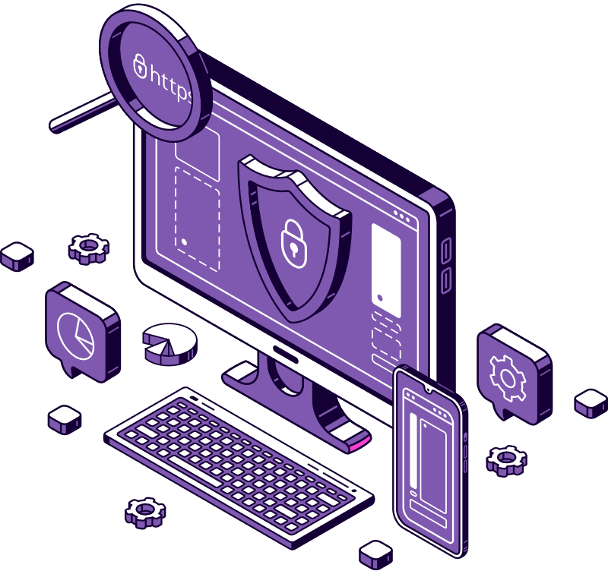
Rajasthan police
HACKATHON 1.0
-RookieTechies

Slide 2
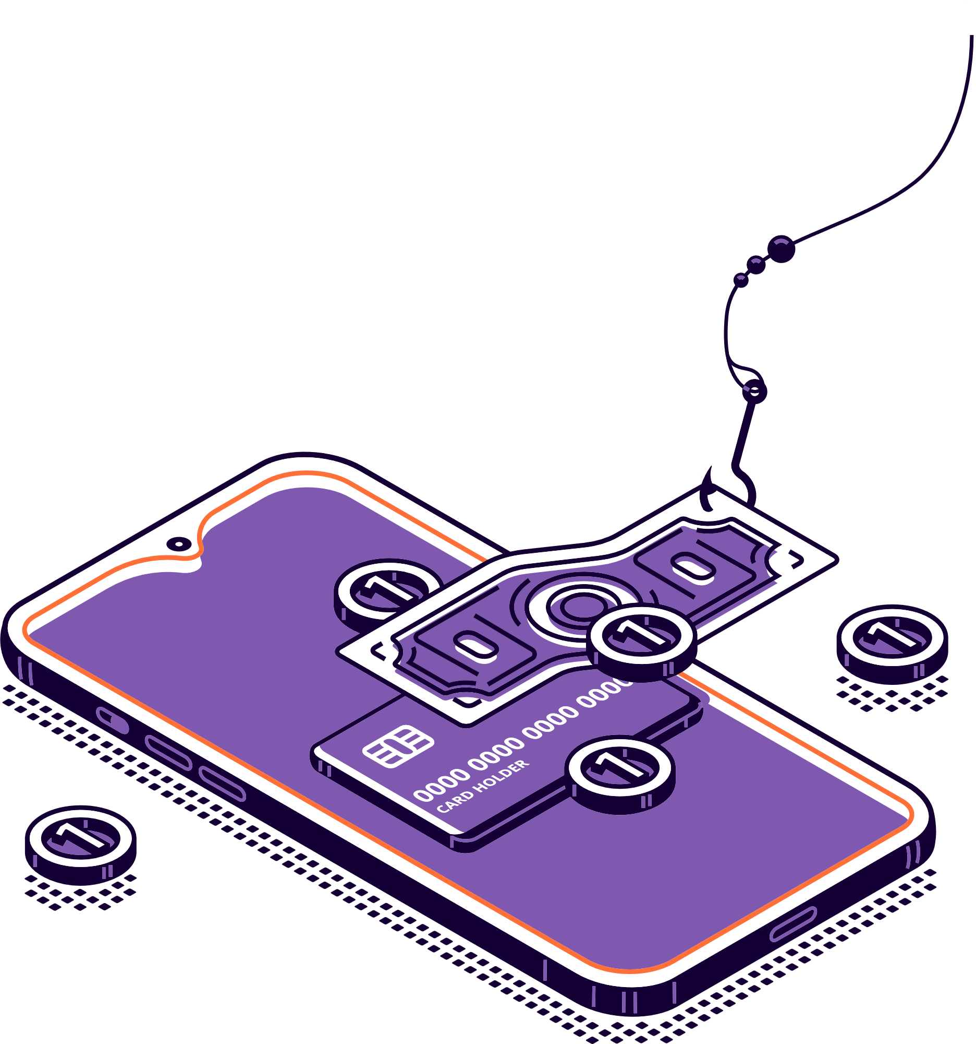
Probelm Statement
With the rapid growth of online platforms, there's a rise in fake websites, misleading ads, and scam customer care numbers. These activities can lead to financial losses and put user data at risk, making people lose trust in online services.
To fix this, we need an Automated AI/ML System for Detecting and Mitigating Online Fraud
69%
18%
65,983
increase in cybercrime victims
weekly increase in cyberattacks including spam calls
cybercrime cases registered (2022)

Slide 3






HackSurakhsha
In our pursuit to establish a safer online environment, we are developing a comprehensive solution that goes beyond traditional cybersecurity measures.
Our vision is to create a user-friendly website, equipped with browser extension capabilities, that empowers users to actively participate in the identification and prevention of online fraud.
Our Solutions

Slide 4

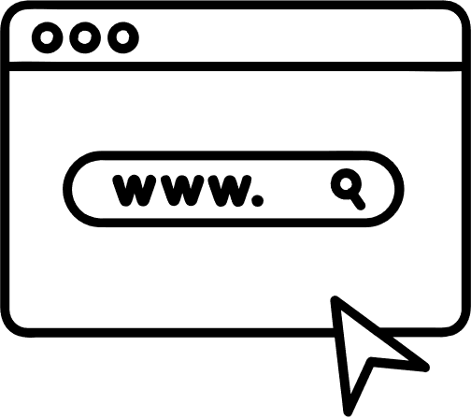
Website Authentication
We are leveraging advanced XG boost, Random Forest algorithms to scrutinise websites thoroughly. Our model considers multiple factors, including domain authenticity, SSL certificates, and a range of indicators such as URL red flags,, This holistic approach ensures a robust verification process.
Using authentication metheds used by browser
ML model

Slide 5
Ad Content Analysis
Employing cutting-edge Natural Language Processing . we are committed to assessing the authenticity and accuracy of online ad content. By analysing redirecting links , our system aims to provide users with insights into the legitimacy of advertisements they encounter during their online activities.
Webscrapping external links of website
authenticating all external links using ML model
creating a dashboard for field - phising, spam , authenticated

Slide 6

Customer Care Number Verification
Companies are invited to submit their customer care numbers for inclusion in our verified database.
Verification is conducted based on authenticated government-issued documents provided by the submitting companie
The database aims to ensure authenticity by accepting submissions only from verified companies with valid government documentation
Users can rely on our database for authenticated and trustworthy customer care numbers, enhancing overall service reliability

Slide 7

User Feedback Integration
To continuously enhance the system's accuracy, we encourage user participation through feedback mechanisms.
Users can actively report suspicious websites, ads, or spams. As a token of appreciation, cybersecurity officials will issue badges to users who contribute significantly to the identification and reporting of fraudulent activities, fostering a collaborative approach to online security.

Slide 8
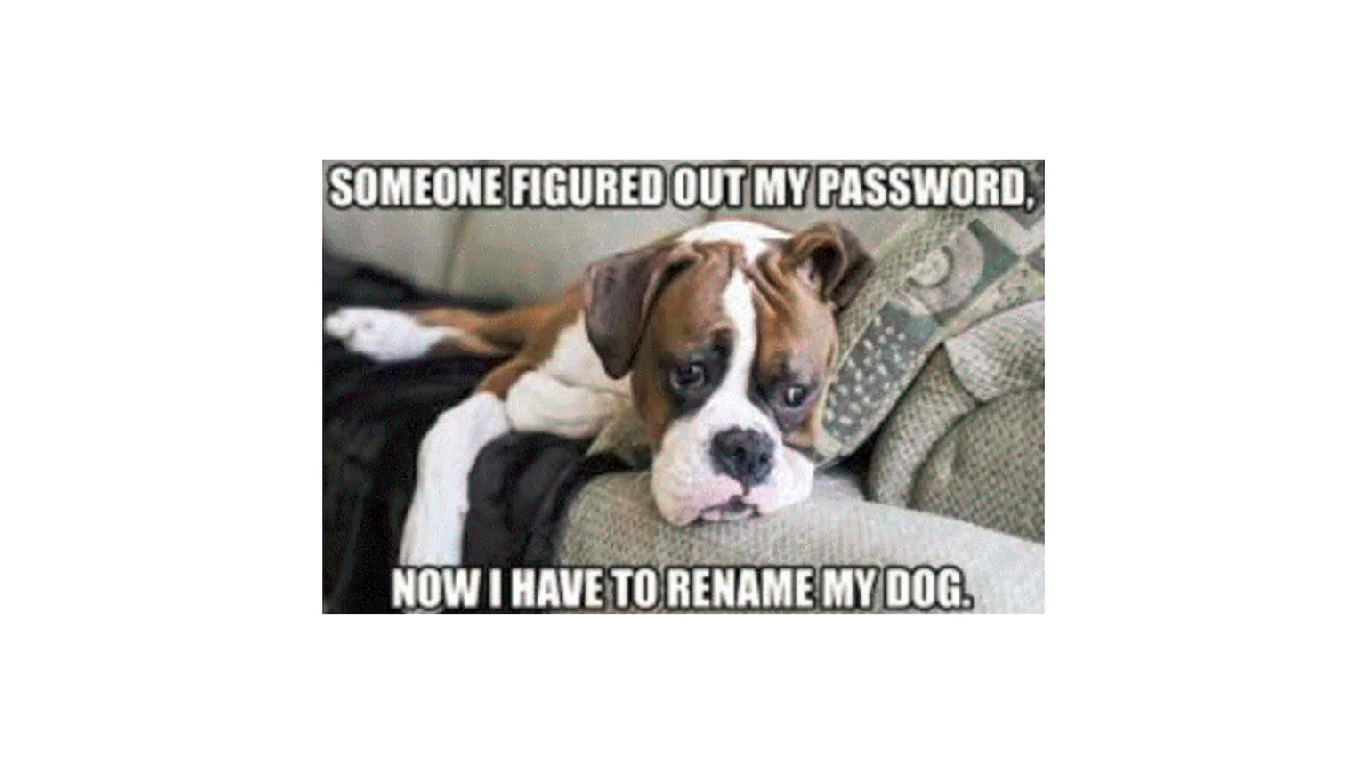
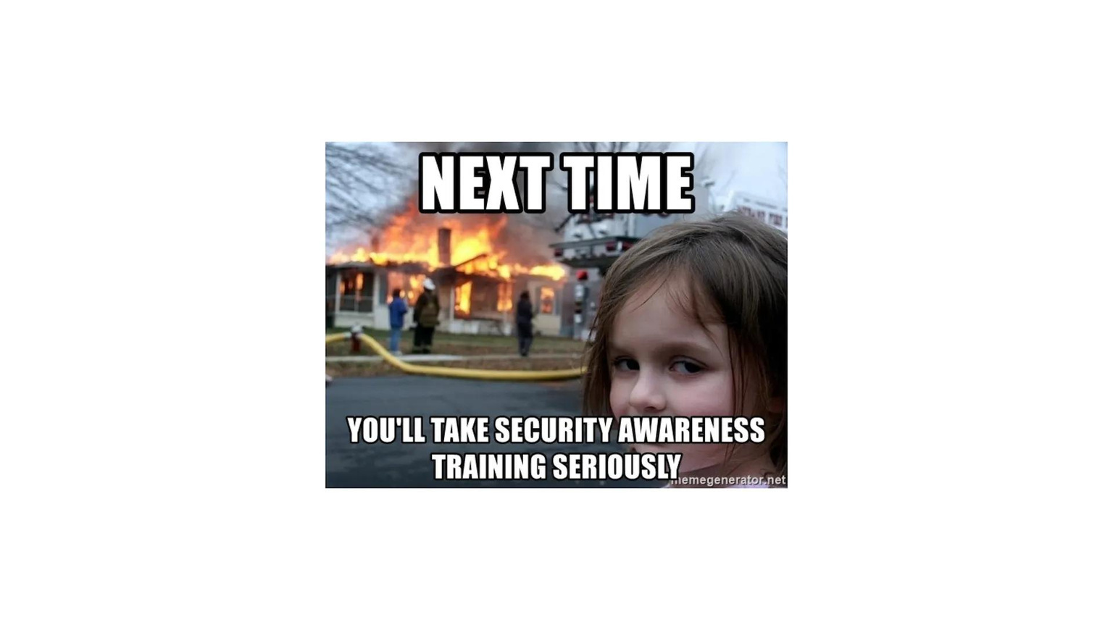

Consumer Awareness & Legal Rights
Recognizing the importance of consumer awareness, we aim to deliver information in an engaging manner. Through the creation of awareness memes, we intend to educate users on cybersecurity best practices and legal rights in a way that is both informative and entertaining.

Slide 9

Real-time Detection
Companies are invited to submit their customer care numbers for inclusion in our verified database.
The browser extension performs real-time analysis of online content, providing users with instant feedback on the legitimacy of websites.
By identifying and blocking potential threats in real-time, the extension efficiently mitigates security risks before they can impact the user.

Slide 10

Competition
VirusTotal
Works on URL analysis
PhishTank
HackSuraksha
check Phishing sites
Truecaller
All services at a Single platform
Depends on user feedback for number verification

Slide 11
Website
Website
Workflow
Customer awareness
Enter the Customer Care Number
Enter the URL
Ads analysis
User Feedback
ML-Based Website Authentication
Web Scrapping
Verifying the Report
Volunteers uploading Memes
Check in Database
Sharing Memes to GenZ
Not found (Not Verified )
found (Verified)
Malicious
Safe
ML Model
Implementing changes
Spam
Ham

Slide 12
Browser Extension Interaction
Extention
Workflow
Enter the Customer Care Number
Webite Authentication
Ads Analysis
User Feedback
Check in Database
ML-Based Website Authentication
Web Scrapping
Verifying the Report
Implementing changes
Not found (Not Verified )
Malicious
Safe
ML Model
found (Verified)
Spam
Ham

Slide 13

Future Vission
Global Collaboration for Datasets
Blockchain Integration for Data Integrity
IoT Security Integration
Enhanced User Feedback Mechanisms

