Slide 1
LZ77 Compression
An approach to efficiently implement the LZ77 algorithm better in time and space complexity than its couterparts from the family of LZSS Algorithms.
BY :
111903110 Tanmay Sudam Patil

Slide 2
Algorithm Implemented
A prefix match length less than MIN_MATCH_LEN is given len = 1, and is independently encoded with the prefix bit.
The match len between [MIN_MATCH_LEN, PAT_BUFSIZE] are mapped to codes from [0, PAT_BUFSIZE - MIN_MATCH_LEN]
if match len == 1 ? do not omit position in search and advance a byte.

Slide 3
Efficiency Basis
Returns the pair of (len, pos) as output.
  1.
    The search function always has a scope to be improved.
    Here I have used list search which is greedy in nature, so is efficient
    in a lot of cases where we have repetetive prefixes
  2.
    I have used a table or say list that has pointers for symbols in input buffer
    to hold the position for them in the window for the character
    Hence, search function can quickly skip through the placeholders.
  3.
    Lists are DLL, to make the deletions of node faster using prev and next pointer arrays
  4.
    Decompression is even faster as one needs to extract symbols from window on the basis of (len, pos)

Slide 4
Project Tree
project/
lzl.c & lzl.h
getbit.c & getbit.h
./
lz77.c
ppt/
lz77d.c
utps.h & Makefile
DSA_Project.odp

Slide 5
Project / utps.h
This is just an utility file that help in reducing the code I write
This header contains macros as follows:
  uint == unsigned int
  uchar == unsigned char
  ulong == unsigned long
That’s it !!

Slide 6
Project / lzl
lzl.h – This file has the external variables and function prototypes for DLL implementation using prev and next pointer arrays.
lzl.c – Has all functions defined from lzl.h

Slide 7
lzl.h
macros
functions
externs
int lzprev[];
int lznxt[];
LZ_NULL = -1
LZ_MAX_SYM = 256
LZ_MAX_BUFSIZE = 8192
void init_lzlist(void);
void insert_lznode(unsigned char c, int i);
void delete_lznode(unsigned char c, int i);

Slide 8
Project / getbit
getbit.h – This file has the external variables and function prototypes for input and output buffers and read - write from files.
getbit.c – Has all functions defined from getbit.h

Slide 9
getbit.h
macros
functions
externs
void init_buffer_sizes(unsigned int size);
void init_put_buffer(void);
void init_get_buffer(void);
void free_put_buffer(void);
void free_get_buffer(void);
void flush_put_buffer(void);
int gfgetc(void);
void pfputc(int c);
FILE *getin, *putout
uint put_bufsize, get_bufsize
uchar *put_buf
uchar *put_buf_start, put_count
uchar *get_buf, *get_buf_start
uchar *get_buf_end, get_count
uint put_buf_count, nfread;
uint bit_read, nbits_read;
ulong nbytes_out;
pset_bit()
put_one()
put_zero()
advance_buf()

Slide 10
Project / lz77.c
This is the main file with implementation of compression algorithm.
The algorithm works as follows :
  Returns the pair of (len, pos) as output.
  1. The search function always has a scope to be improved.
  Here I have used list search which is greedy in nature, so is efficient
  in a lot of cases where we have repetetive prefixes
  2. I have used a table or say list that has pointers for symbols in input buffer
  to hold the position for them in the window for the character
  Hence, search function can quickly skip through the placeholders.
  3. Lists are DLL, to make the deletions of node faster using prev and next pointer arrays
  4. Decompression is even faster as one needs to extract symbols from window on the basis of (len, pos)
  ALGO :
    A prefix match length less than MIN_MATCH_LEN is given len = 1, and is independently encoded
      with the prefix bit.
    The match len between [MIN_MATCH_LEN, PAT_BUFSIZE] are mapped to codes from [0, PAT_BUFSIZE - MIN_MATCH_LEN]
    if match len == 1 ? do not omit position in search and advance a byte.

Slide 11
lz77.c
macros
functions
structs
WIN_BUFSIZE 4096
NUM_POS_BITS 12
WIN_MASK 4095
PAT_BUFSIZE 18
NUM_LEN_BITS 4
MIN_MATCH_LEN 3
void copyright(void);
dpos_t search (uchar w[], uchar p[]);
dpos_t brutef_search (uchar w[], uchar p[]);
void put_codes(dpos_t *dpos);
Int main(int argc, char * const argv[]);
struct file_stamp
struct dpos_t

Slide 12
Project / lz77d.c
This is the main file with implementation of decompression algorithm.
Here we use the reverse principle to that of the compression algorithm :
  Read the codes from the compressed file window and then replace the respective placeholder symbols to the output buffers.
  This algo is quite fast as we can just skip off to the next element or position without actually traversing the whole window, this is faciliated with the use of the DLL ( Doubly Linked Lists ).
  Also DLLs are gamechanger when it comes to searching a particular pair of (len, pos) in the windows.

Slide 13
lz77d.c
macros
functions
structs
WIN_BUFSIZE 4096
NUM_POS_BITS 12
WIN_MASK 4095
PAT_BUFSIZE 18
NUM_LEN_BITS 4
MIN_MATCH_LEN 3
void copyright(void);
Int main(int argc, char * const argv[]);
struct file_stamp
struct dpos_t

Slide 14
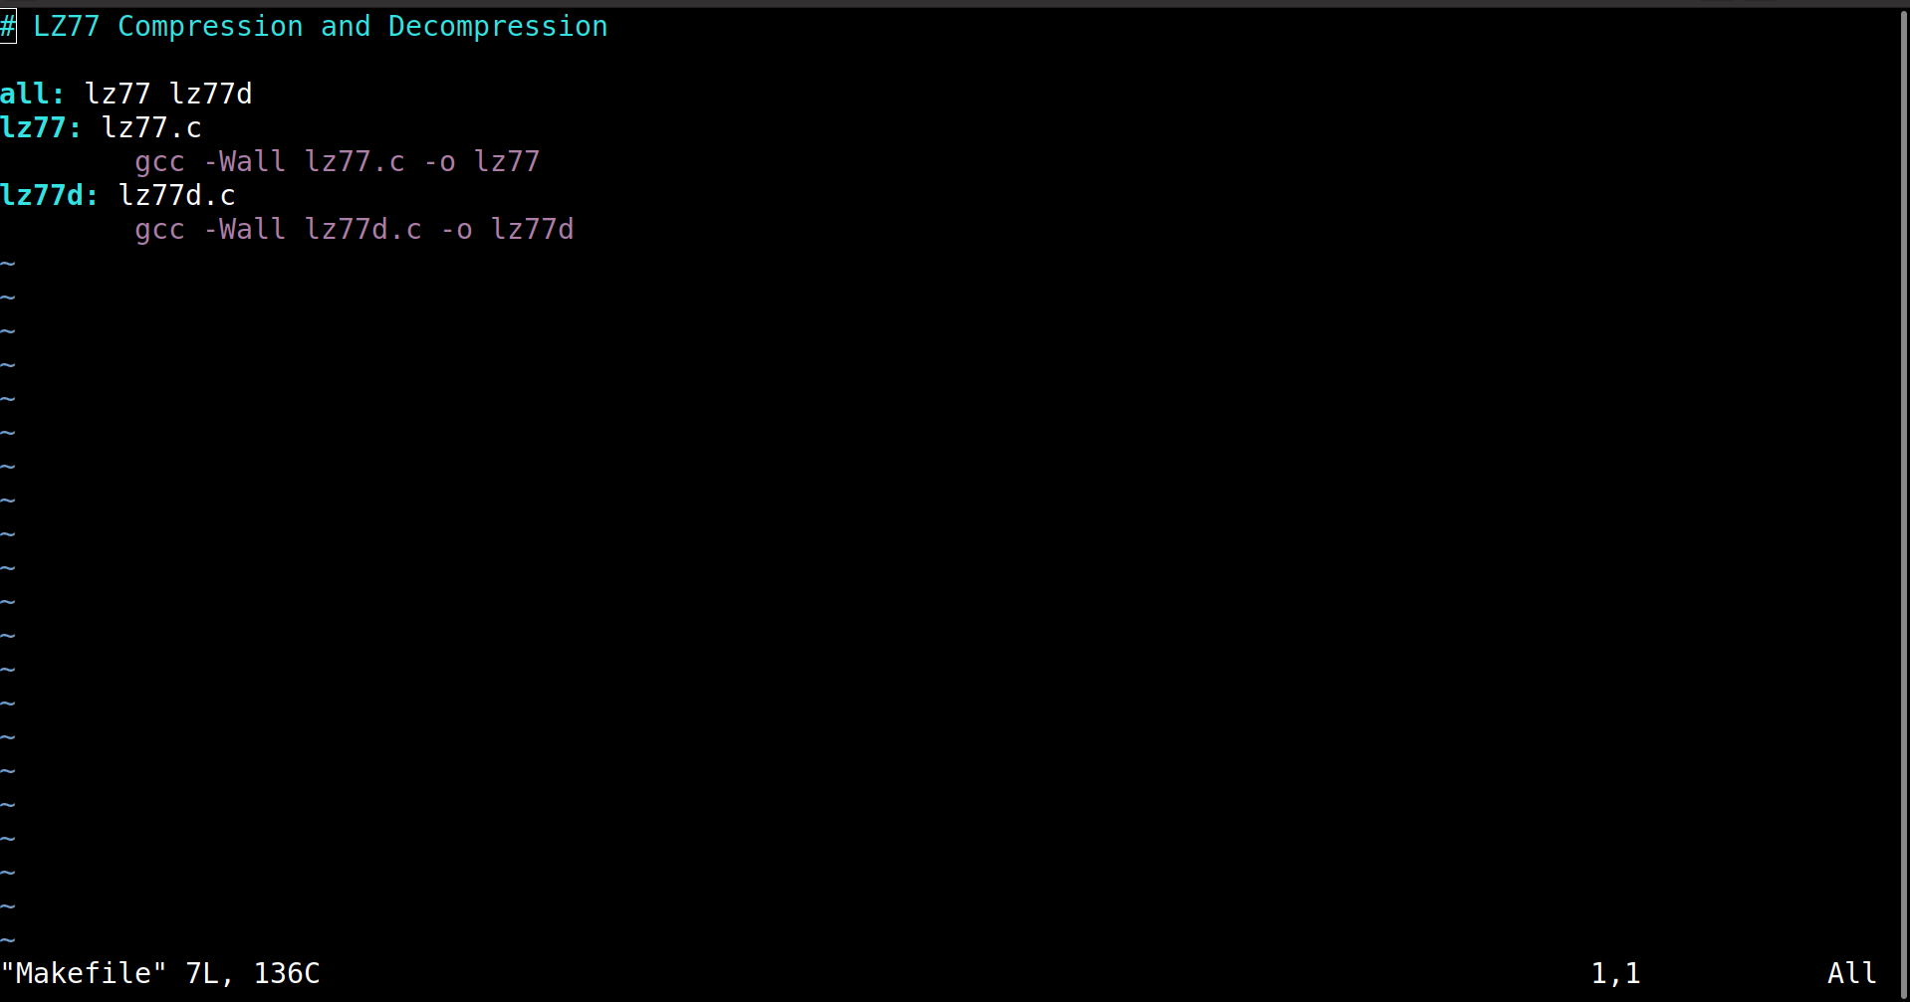
Project / Makefile
Relieves all the stress of compiling the files seperately, and comes in handy to use by making all the compilations for us.
Command : make -f Makefile
Generic command : make -f filename

Slide 15
./lz77 DSA_Project
LZ77 is lossless data compression algorithm.
This algorithm has great efficiency over all other compression algorithms when compared on the repeatability of the data and when the files are quite large too.
All Thanks to Our own DSA Faculty : Ashwini Ma’am, for motivating us all to move out of the way and choose such an interesting topic for project.

Slide 16
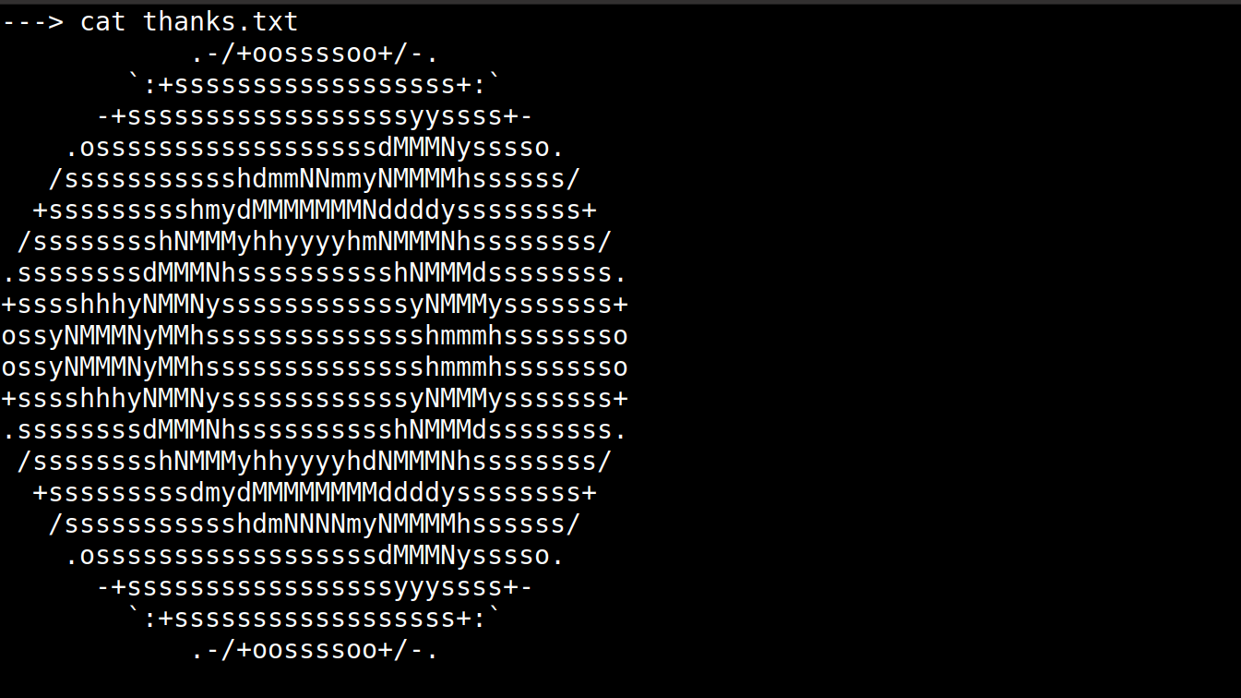
A sample run

Slide 17
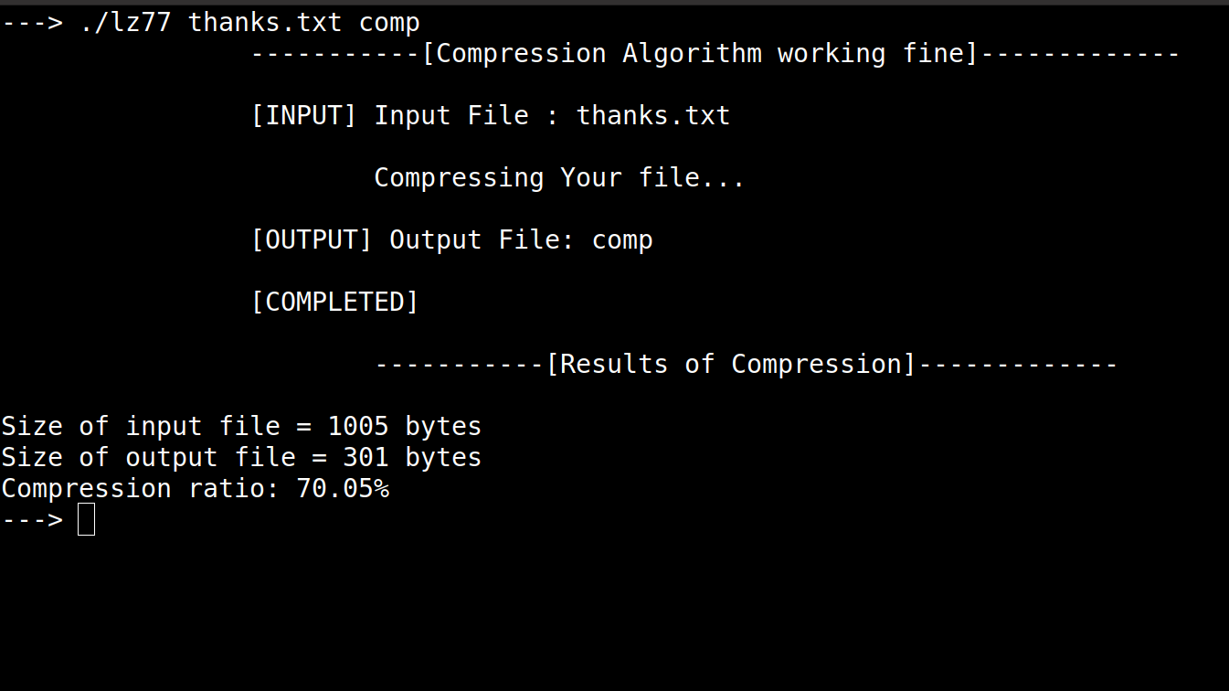
A sample run

Slide 18
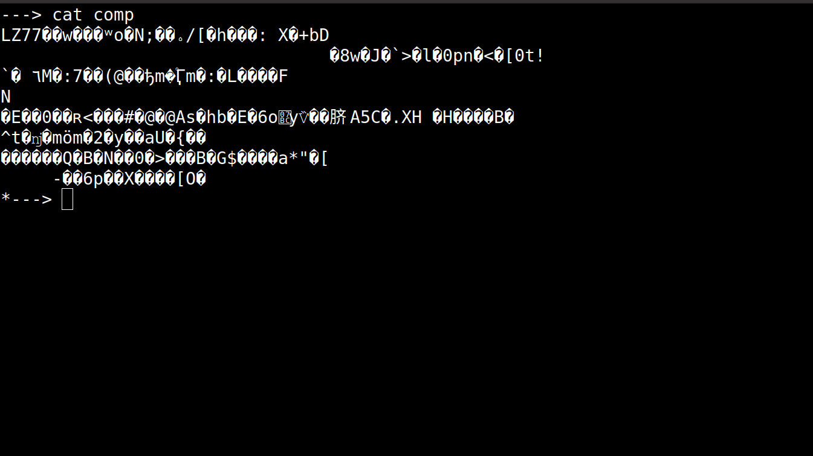
A sample run

Slide 19
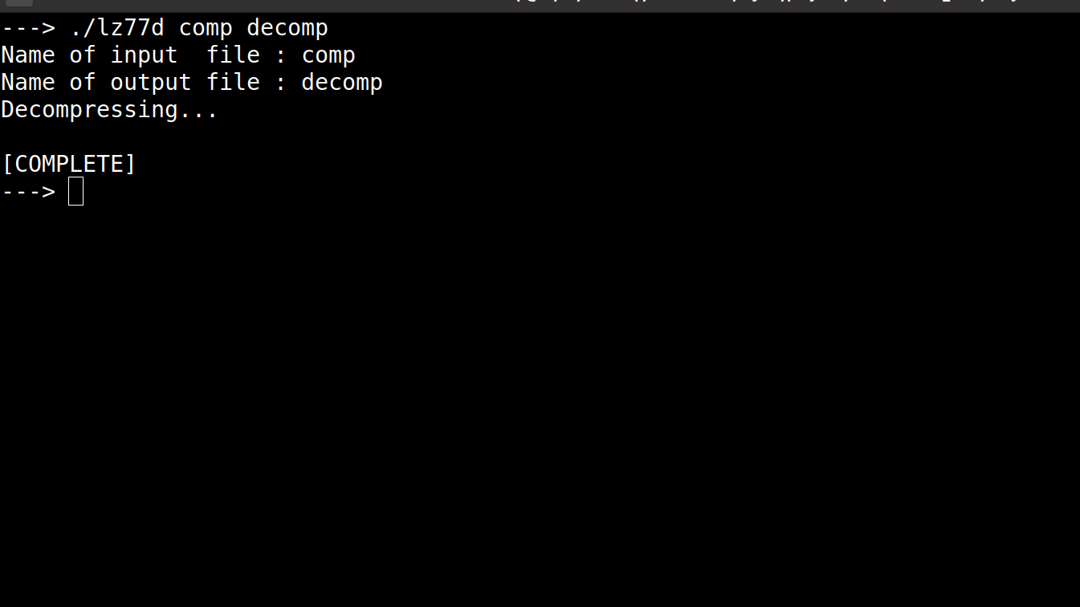
A sample run

Slide 20
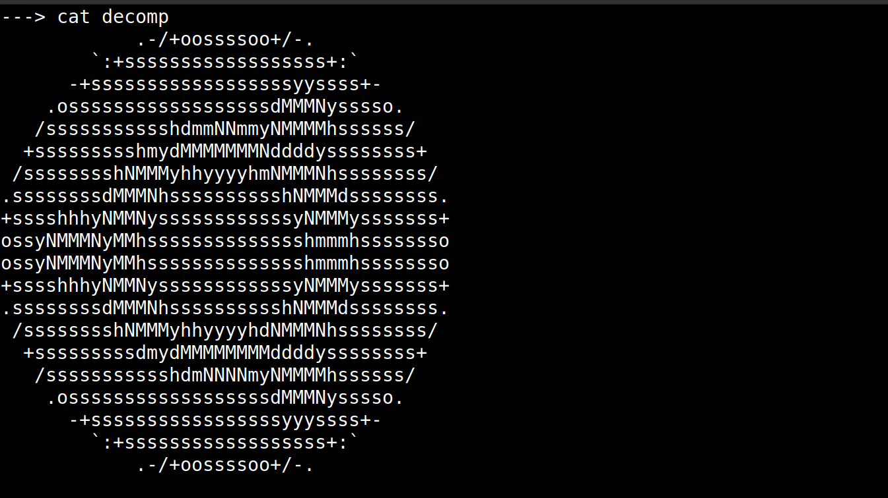
A sample run

Slide 21
Thank You

