Slide 1

IDS 575 Machine Learning & Statistics Threat-Matrix Global Terrorism Prediction
Group 10
Tanmay Rewari| Vinay Khandelwal| Kapil Singla| Pavithra Shetty

Slide 2
MOTIVATION
Respond
Respond to the alarming rise in global terrorism, exemplified by conflicts like Russia-Ukraine and Israel-Palestine.
Address
Address the tragic loss of human lives and the significant threat to global stability posed by these conflicts.
Harness
Harness data-driven insights and machine learning to contribute meaningfully to counterterrorism efforts.
Empower
Empower decision-makers with timely information for enhanced preparedness and response.
Work
Work towards a safer and more secure global environment through accurate predictive models.

Slide 3
OBJECTIVE
Develop a robust predictive model for forecasting global terrorist attacks.
1
Utilize the extensive Global Terrorism Database (GTD) with over 220,000 observations and 135 features.
2
Conduct thorough data cleaning, selection of features and exploratory data analysis (EDA) to enhance dataset quality.
3
Create a reliable system for early identification and understanding of potential global terrorism threats.
5
Empower intelligence agencies and security forces with proactive capabilities for threat mitigation.
6
Apply advanced machine learning techniques, including KNN, SVM, and PCA.
4

Slide 4
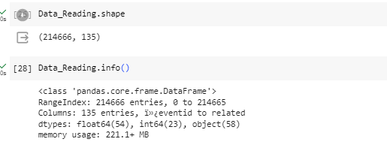
Dataset Overview: Global Terrorism Database (GTD)
Source: The dataset utilized is sourced from the Global Terrorism Database™ (GTD), an open-source database managed by the University of Maryland, a Department of Homeland Security Emeritus Center of Excellence, led by the national consortium for the study of terrorism and responses to terrorism (START).
Accessibility: The GTD is accessible at [https://www.start.umd.edu/gtd/](https://www.start.umd.edu/gtd/] and provides information on terrorist events globally from 1970 through June 2021, with planned annual updates for the future.
Scope: Unlike many other event databases, the GTD systematically records data on domestic, transnational, and international terrorist incidents. The database spans over 200,000 cases and includes details on the date, location, weapons used, target nature, casualties, and responsible groups or individuals for each incident.
Data Verification: The statistical information in the GTD is based on reports from diverse open media sources. Entries are added only after the credibility of sources is determined. Users are cautioned not to infer actions or results beyond what is presented, and updates may occur based on new documentation.
Purpose: The GTD is made available by the National Consortium for the Study of Terrorism and Responses to Terrorism (START) to enhance the understanding of terrorist violence for study and strategic efforts.

Slide 5
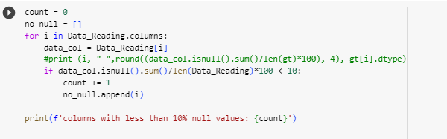

PRE-PROCESSING DATA
1. Missing Values:
- Identified features with missing values.
- Determined a threshold to guide the removal or imputation of missing values.
- Utilized appropriate imputation techniques for handling missing data.
2. Renaming Columns:
- Renamed columns for enhanced clarity and interpretation.
- Ensured that column names are descriptive, concise, and follow a consistent naming convention.
- Improved overall dataset documentation through meaningful column names.
.

Slide 6
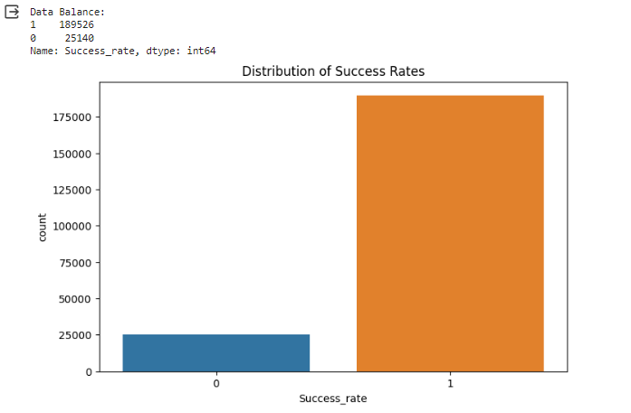
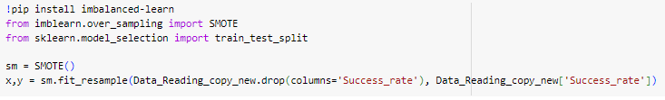
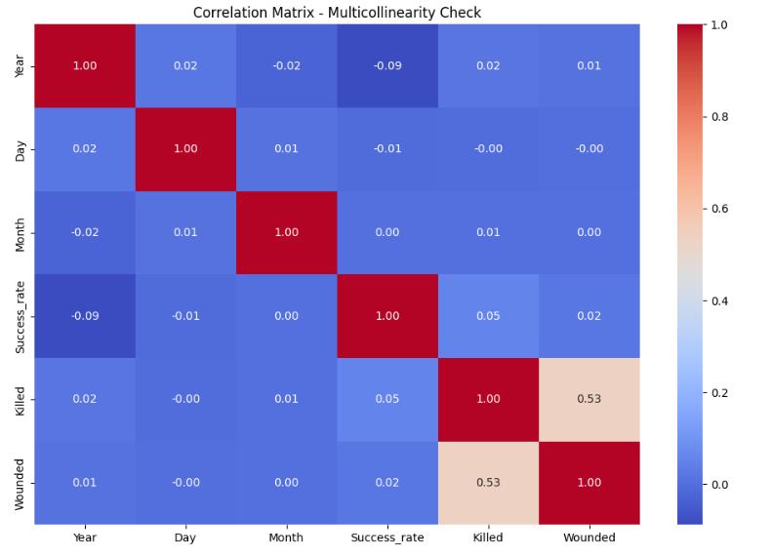
PRE-PROCESSING DATA
3. Class Imbalance:
- Identified an imbalance in the target variable ('Success_rate').
- Explored techniques to address class imbalance for more robust model training.
4. SMOTE for Oversampling:
- Applied Synthetic Minority Over-sampling Technique (SMOTE) to oversample the minority class.
- Discussed how SMOTE contributes to a balanced dataset for improved model performance.
5. Multicollinearity Check:
- Conducted a thorough check for multicollinearity among features.
- Explained the correlation matrix heatmap as a tool for visualizing multicollinearity.

Slide 7
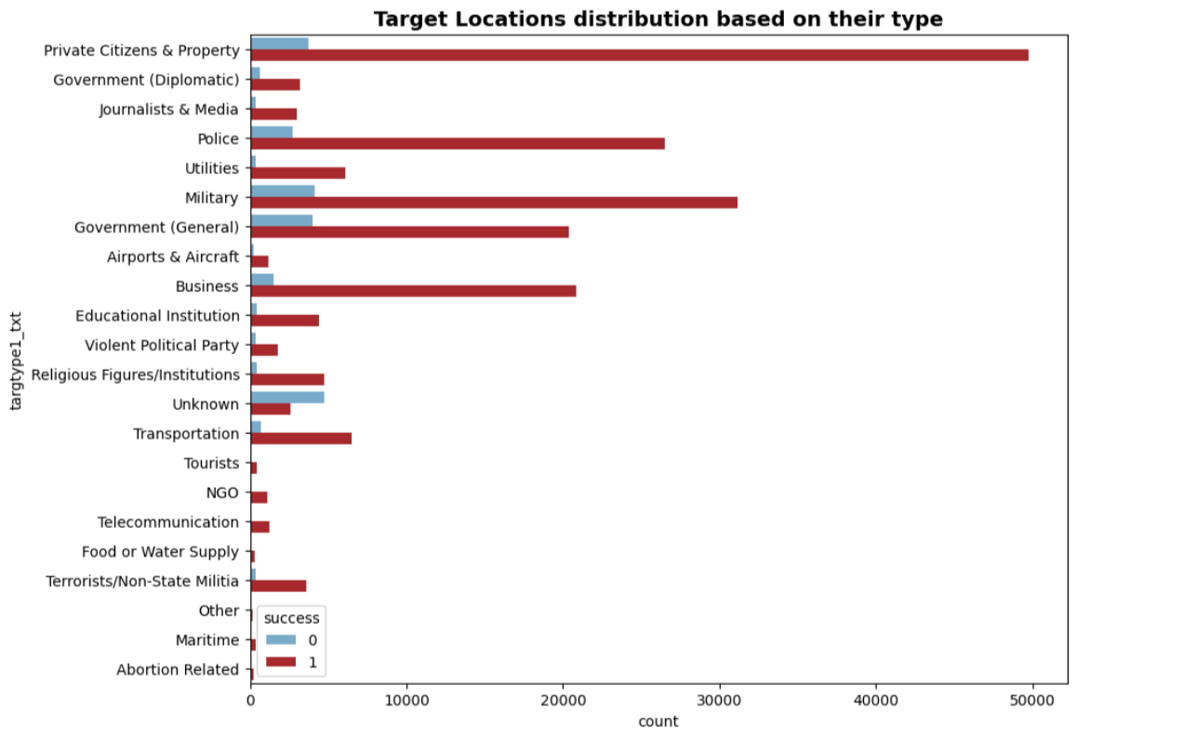
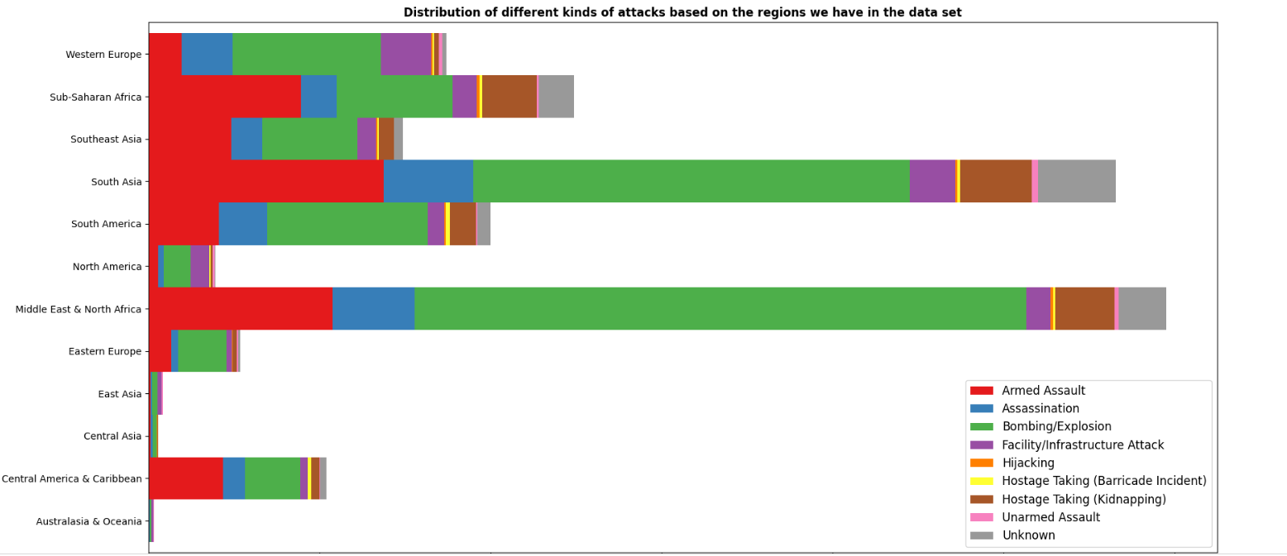
EXPLORATORY DATA ANALYSIS (EDA)

Slide 8
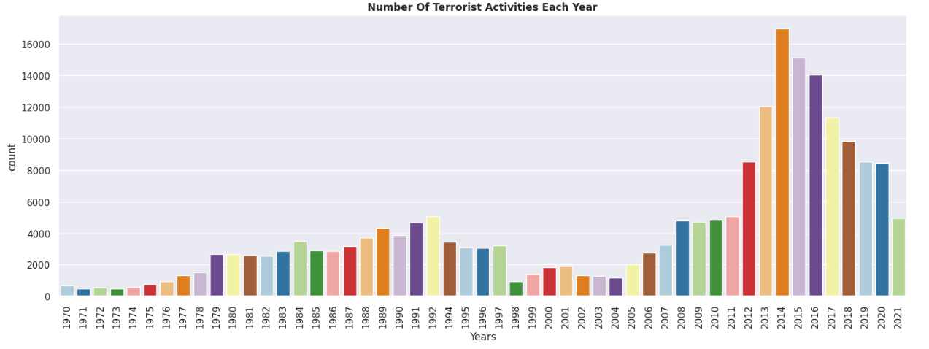
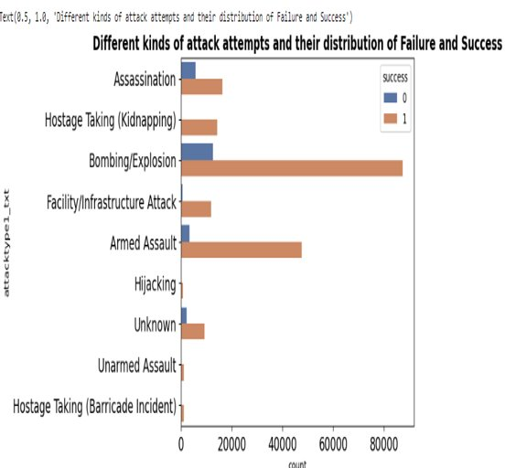
EXPLORATORY DATA ANALYSIS (EDA)

Slide 9
Useful Variables
After cleaning the data, we noticed that these are variables useful to perform models:
Year
Month
Day
Extended
Country
Vicinity
Multiple
Suicide
Attack Type
Target Type
Target 1
Attacker
Gun Certain
Weapon Type
Killed
Wounded
Is Host Kid
Causalities
N Class
Success

Slide 10
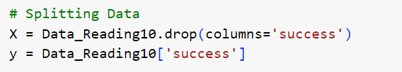
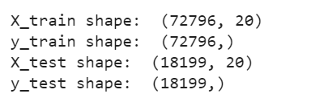
Splitting the Data Set
2 Data set is created namely X and Y
X has 20 variables except Success variable
Y has 1 variable: Success
X and Y are divided in Train and Test (Split 4:1)
X and Y Training dataset has 72796 observations
X and Y Test dataset has 18199 observations

Slide 11
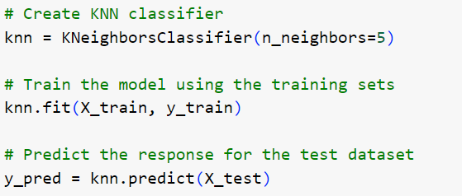
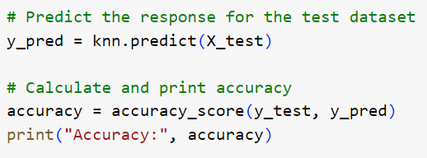
KNN Model (Base Model)
Making Prediction and finding Accuracy
Accuracy: 90.48%
Using K =5 Training the model

Slide 12
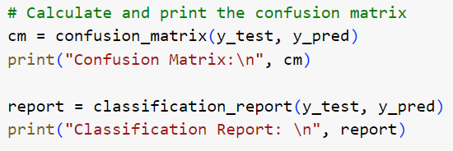
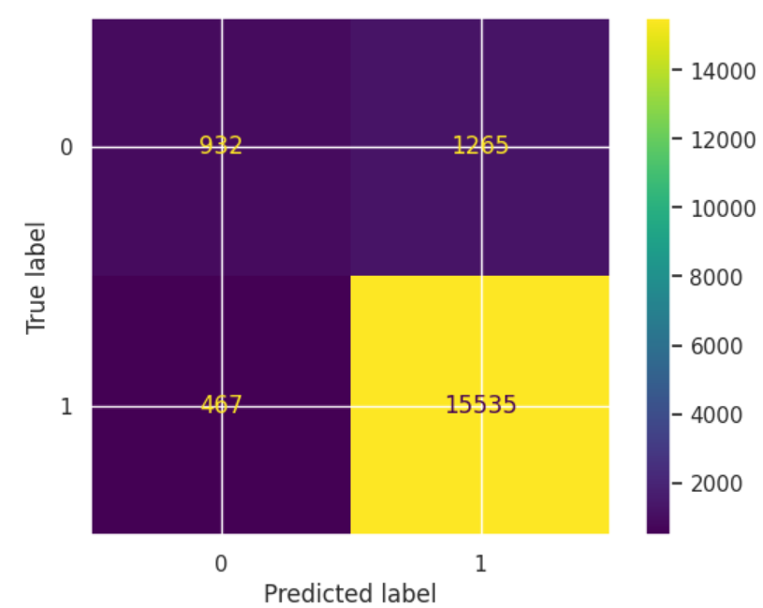
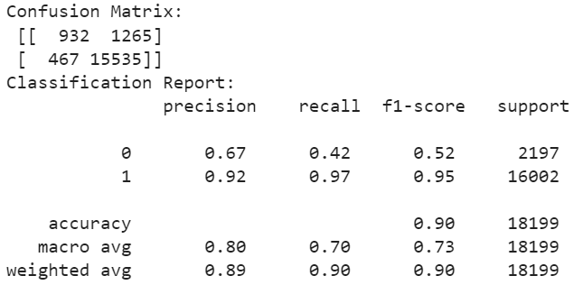
KNN Confusion Matrix
With the help of Y Testing dataset and Predicted Dataset we have created confusion matrix

Slide 13

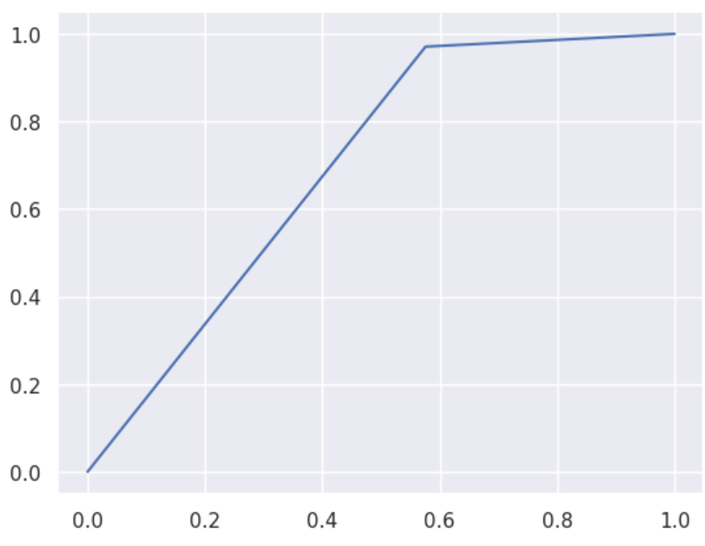

KNN ROC Curve
Finding out Area Under the Curve of the Receiver Operating Characteristic curve
Creating ROC plot

Slide 14
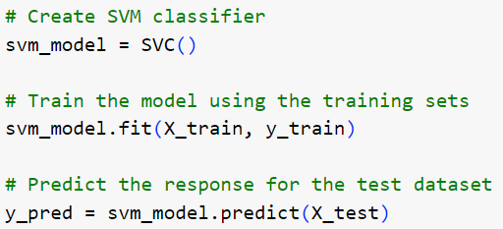
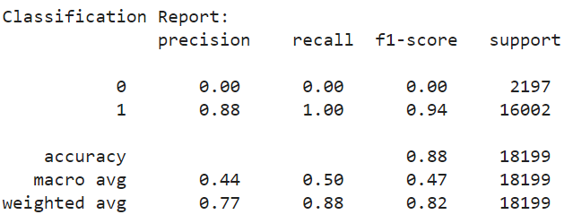
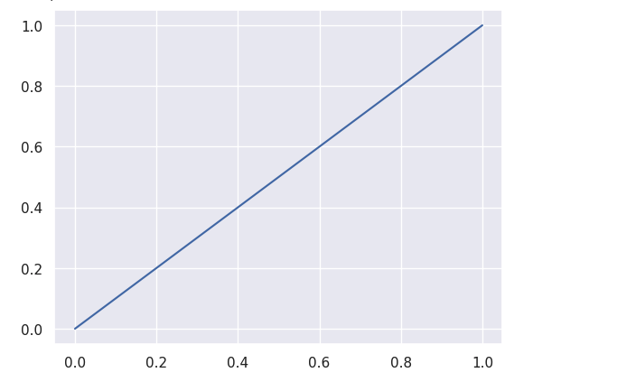

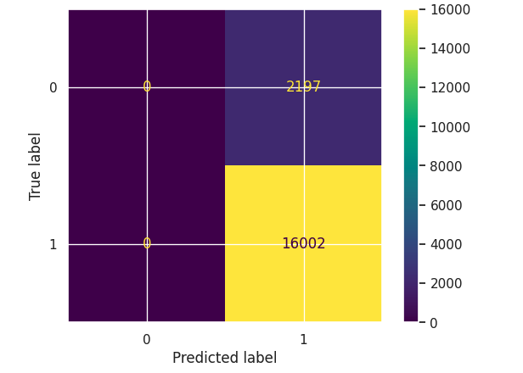
SVM Model (Second Model)
Creating Model and Getting Accuracy
Created Confusion Report, Matrix and ROC curve

Slide 15
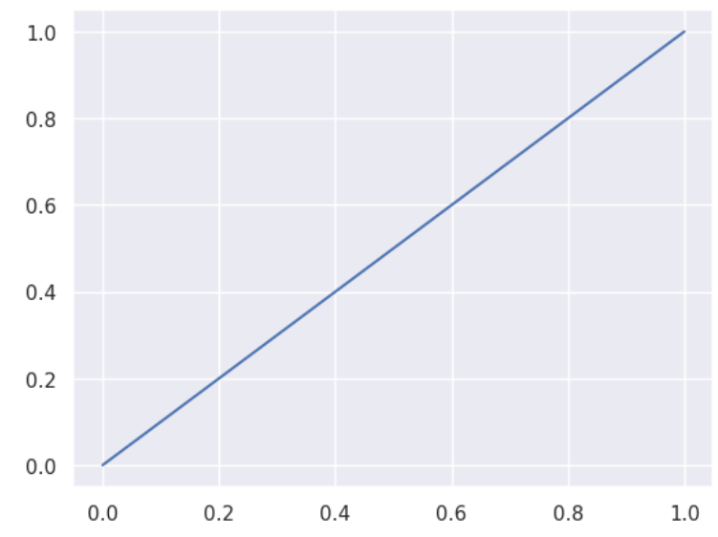
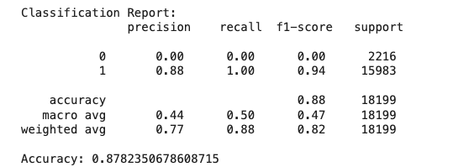
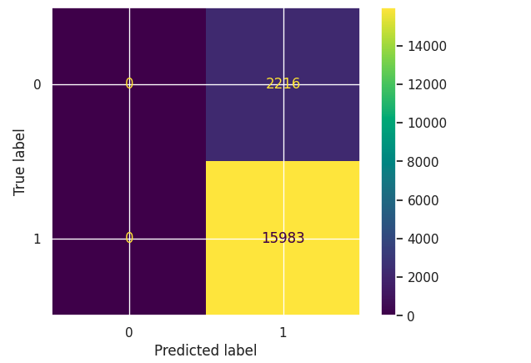
Applying PCA in SVM Model
After applying Principal Component Analysis with number of components as 2 into SVM Model (RBF Kernal) we created Confusion Report, Matrix and ROC curve

Slide 16
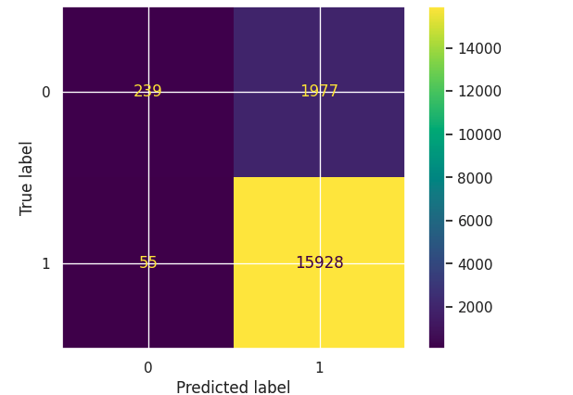
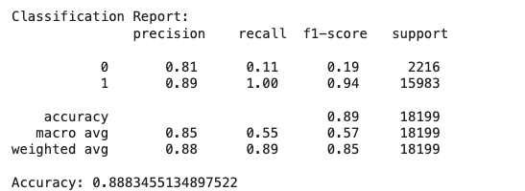
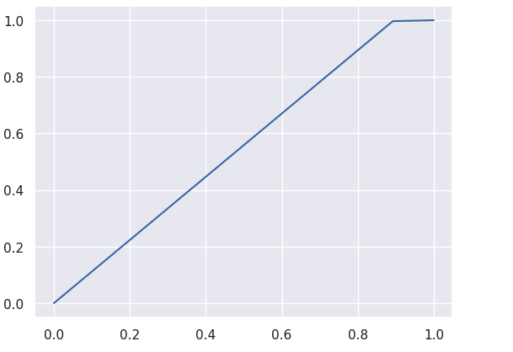
Applying PCA in SVM Model
After applying Principal Component Analysis with number of components as 3 into SVM Model we created Confusion Report, Matrix and ROC curve

Slide 17
Conclusion of KNN Model
Model Evaluation: The obtained accuracy stands at 90.48%, indicating overall good performance of the model.
Imbalance in Confusion Matrix: Notably, when classifying failures (label: 0), the model exhibits lower recall, precision, f-score, and support. Conversely, for successes (label: 1), all metrics demonstrate high values, suggesting that the model struggles particularly with predicting failures.
ROC Score Insights: The ROC score for the KNN model is approximately 0.7, surpassing the threshold of 0.5. This signifies that for every seven true positive predictions, only one false positive is encountered, indicating a relatively acceptable trade-off between true and false positives.

Slide 18
Thank you.
Questions?

