Slide 1


Power Apps Presentation

Slide 2





What is Power Apps?
Power Apps is a suite of apps, services, and connectors, as well as a data platform, that provides a rapid development environment to build custom apps for your business needs. Using Power Apps, you can quickly build custom business apps that connect to your data stored either in the underlying data platform or in various online and on-premises data sources (such as SharePoint, Microsoft 365, Dynamics 365, SQL Server, and so on).

Slide 3
Power Apps is a high-productivity development platform for business apps, and has four major components:
Canvas apps
Model-driven apps
Portals
Microsoft Dataverse
Let's learn more about each of these.
Canvas apps
Canvas apps start with your user experience, crafting a highly tailored interface with the power of a blank canvas and connecting it to your choice of more than 200 data sources. You can build canvas apps for web, mobile, and tablet applications.
Canvas apps give you the flexibility to arrange the user experience and interface the way you want it. Allow your creativity and business sense to guide how you want your apps to look and feel.

Slide 4
2. Model-driven apps
Model-driven apps start with your data model – building up from the shape of your core business data and processes in the Dataverse to model forms, views, and other components. Model-driven apps automatically generate great UI that's responsive across devices.
When you create a model-driven app, you can use all the power of the Dataverse to rapidly configure your forms, business rules, and process flows. You create a model-driven app from the Power Apps site.
3. Portals
Portals help you create external-facing websites that allow users outside your organization to sign in with a wide variety of identities, create and view data in Dataverse, or even browse content anonymously.
4. Dataverse
Dataverse is the data platform that comes with Power Apps and allows you to store and model business data. It's the platform on which Dynamics 365 apps (such as Dynamics 365 Sales, Customer Service, Field Service, Marketing, and Project Service Automation) are built. If you’re a Dynamics 365 customer, your data is already in Dataverse.
Dataverse allows you to securely store and manage data within a set of standard and custom tables, and you can add columns to those tables when you need them.

Slide 5
Microsoft Power Apps features
App Creation
App Sharing
App Running
Cloud-Based Services Integration
Premium Connectors Integration
Workflow Automation
Office 365 & Dynamics 365 Services Connection

Slide 6
Microsoft Power Apps Benefits
The main benefits of Microsoft Power Apps are its stable functionalities, accessible on multiple platforms, and great integration. Here are more details:
Solution Maker
Microsoft Power Apps can become your bridge to provide new solutions to your current problems. The service allows you to design apps from scratch using the web or mobile devices. With this capability, you can create a tailor-made solution for your audience.
Accessible On Different Platforms
Each app developer has a preferred working environment and this is something the software understands. Therefore, Microsoft Power Apps makes sure that it is accessible on multiple platforms, including iOS, Android, and Windows devices.

Slide 7
Integrated Information Pull
With the help of Microsoft Power Apps, each user can use the information from Microsoft and other third-party systems to be used in the process of app development. This capability is made possible by the Microsoft Power Apps’ premium connectors and extensive integrations.
Workflow Automation
Because Microsoft Power Apps is a part of the business app network of Microsoft, users can further improve the app development process by connecting it with different apps. For instance, they can speed up their workflow by establishing workflow automation using Microsoft Flow. They can even understand their target markets as well as business operations through Power BI

Slide 8
How Does Microsoft PowerApps Work?
PowerApps works similarly to other Microsoft applications; it is a tool for creating apps in the same way that you use Excel for spreadsheets, Word for documents, and PowerPoint for presentations. Once you login, you’ll see that PowerApps even features the same type of ribbons and menu structure as Excel and PowerPoint.
PowerApps also runs as an application on mobile devices, meaning that you can install and use it on any Android, IOS, or Windows device, while also using it on any web browser.

Slide 9
From here onwards the Omkar will continue our presentation.

Slide 10

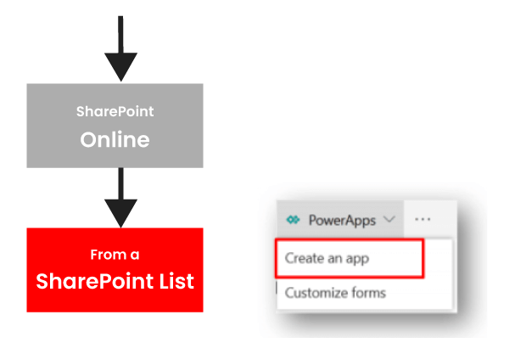
How to build an App with PowerApps?
The easy way to build an app with PowerApps is to start from the data source.
First, start from the SharePoint list that store the consulting interventions.
Next, select create an app option in the PowerApps menu as below:

Slide 11
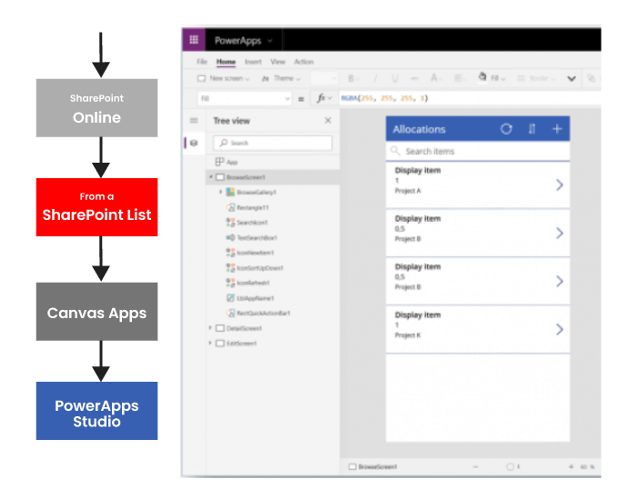
it takes us to a PowerApps Studio

Slide 12
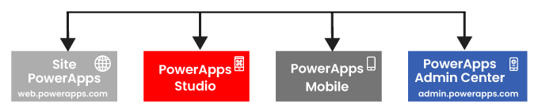
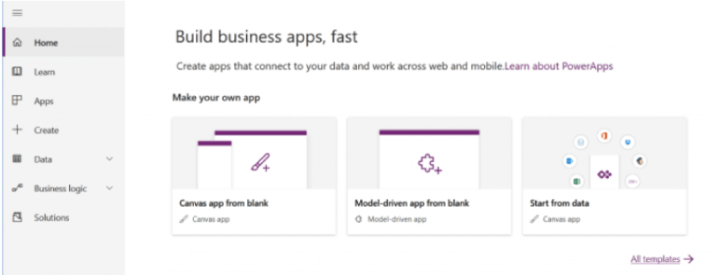
The below steps guide you on how to build an app using PowerApps.
Step 1) Select Your Environment
There are four environments that you can work with PowerApps, and they have their capabilities.
PowerApps Website
This is where you can create and manage apps

Slide 13
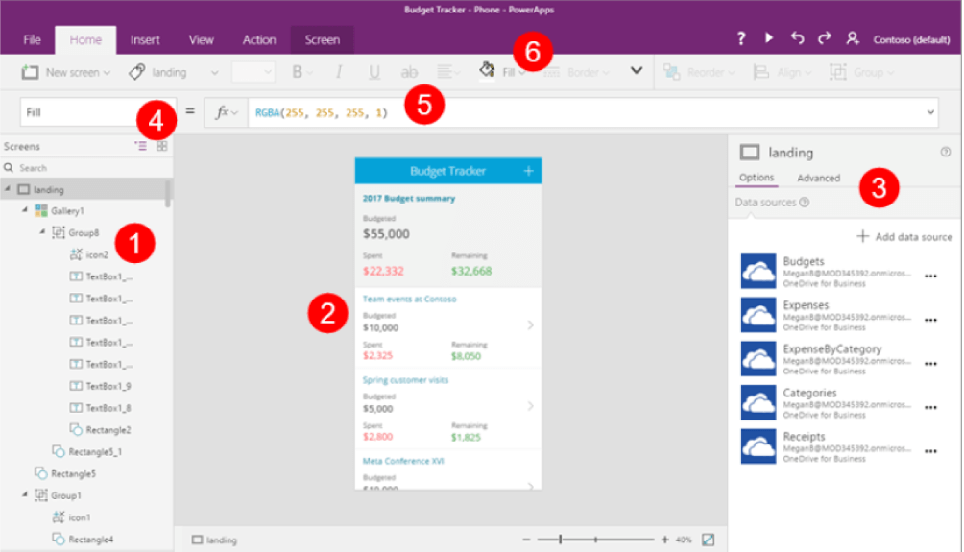
PowerApps Studio
It allows you to design and adapt apps that you create to specific business needs.

Slide 14
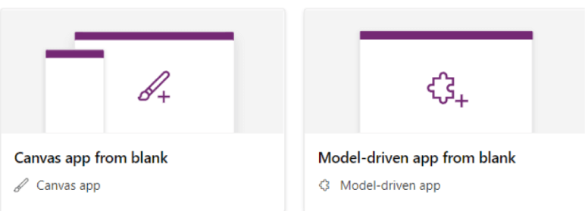
PowerApps Mobile
This is available handy on both mobiles and tablets and enables you to execute all your PowerApps apps.
PowerApps Admin Center
Admin.powerapps.com allows you to create and manage environments, Data Loss Prevention (DLP) strategies, and user roles.
Step 2) Select your PowerApps Application Type
PowerApps supports two types of apps - Canvas and Model-driven.
Canvas apps allow you to interface easily with positioning controls and fields in a “pixel-perfect” user experience. It targets lightweight apps.
Model-driven apps are built on top of CDS (Common Data Services) to rapidly create processes, forms, and business rules. It focuses on building heavier apps.

Slide 15
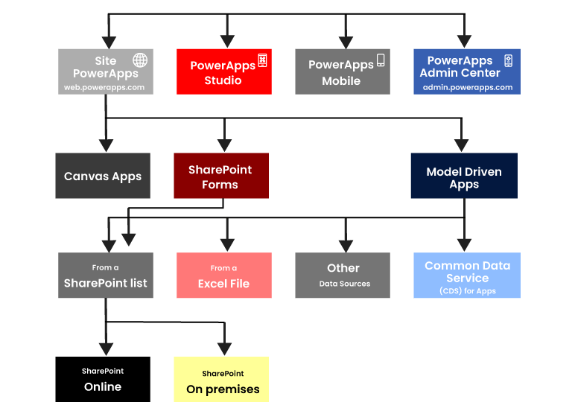
Step 3) Select your Storage Type
Choosing the right data source is impactful while designing an app.
Step 4) Connect the app to on-premise Data Source or online.
PowerApps is born in the cloud and can connect natively to any cloud data source. For that to happen, you need to configure the on-premises data gateway. For this, you need to use a data source from one of the following - SQL Server, Oracle, SharePoint, Informix, Filesystem, and DB2.

Slide 16
PowerApps Limitations
With PowerApps, you can retrieve a max of 500 items by default, but extendable up to 2000 (performance reduces)
Only one developer can work at a time if operating on the Canvas Application.
If SharePoint runs in the back end, attachment control will work fine. But if custom SQL runs in the backend, then attachment control will be disabled.
JavaScript integration is not possible in PowerApps forms.
PowerApps cannot be shared with external users of your organization. It is designed to be used internally for your business purposes.

Slide 17
From here onwards the Pratik will continue our presentation.

Slide 18

All inputs controls & properties

Slide 19
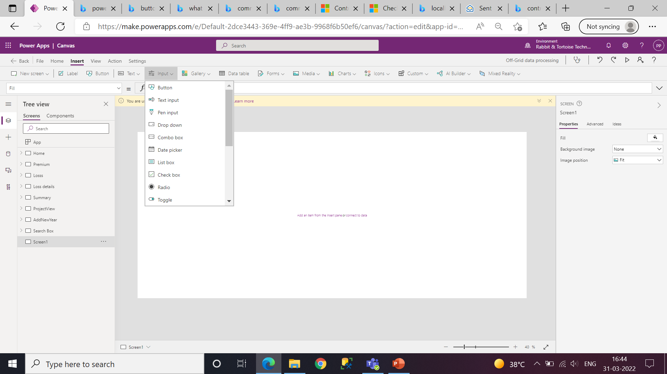

Slide 20
Common properties by category
Color and border – Configure the color and border of a control that can change as a user interacts with it.
Core – Configure whether the user can see and interact with a control.
Image – Configure what image is shown and how it fills the control.
Size and location – Configure how big a control (or an element of a control) is and where it is in relation to the screen it's on.
Text – Configure how text appears in controls, such as font characteristics, alignment, line height.

Slide 21
Screen:
Most apps have multiple Screen controls that contain Label controls, Button controls, and other
controls that show data and support navigation. Key properties
Background Image – The name of an image file that appears in the background of a screen.
Fill – The background color of a control.
Input text:
The user can specify data by typing into a text-input control. that data might be added to a data source.
Key properties
Default – The initial value of a control before it is changed by the user.
Text – Text that appears on a control or that the user types into a control.

Slide 22
LABEL:
A label shows data that you specify as a string of text. A box that shows data such as text, numbers, dates, or currency.
Key properties
AutoHight – Set to true to allow the label to auto-grow its height to show all text. Set to false to truncate the text to the height assigned.
Color – The color of text in a control.
Font– The name of the family of fonts in which text appears.
Text– Text that appears on a control or that the user types into a control.
BUTTON:
A control that the user can click or tap to interact with the app
Key properties:
OnSelect– Actions to perform when the user taps or clicks a control.
Text – Text that appears on a control or that the user types into a control.

Slide 23
DROP-DOWN:
A list that shows only the first item unless the user opens it.
Key properties
Default – The initial value of a control before the user specifies a different value.
Items – show the values on database Table to select the Column.
Value – The column of data that you want to show in the control (for example, if a data source has multiple columns).
Selected – The data record that represents the selected item.
COMBO-BOX:
A Combo box control allows you to search for items you will select. The search is performed server-side on the SearchField property so performance is not affected by large data sources.
Key properties
Items – The source of data from which selections can be made.
DefaultSelectedItems – The initial selected item(s) before the user interacts with the control.
SelectedItems – List of selected items resulting from user interaction.
SelectMultiple – Whether the user can select a single item or multiple items.
IsSearchable – Whether the user can search for items before selecting.
SearchFields - The data fields of the data source searched when user is entering text.

Slide 24
DATE PICKER:
If you add a Date Picker control instead of a Text input control, you help ensure that the user specifies a date in the correct format.
Key properties
DefaultDate – The initial value of a date control unless the user changes it.
SelectedDate – The date currently selected in a date control. This date is represented in local time.
LIST BOX:
A List Box control always shows all available choices and in which the user can choose more than one item at a time.
Key properties
Default – The initial value of a control before it is changed by the user.
Items – The source of data that appears in a control such as a gallery, a list, or a chart.
Selected – The data record that represents the selected item. You can only have one default selected item. If you need multiple selected items please use the Combo Box control.

Slide 25
Check-Box:
A control that the user can select or clear to set its value to true or false.
Key properties
Default– The initial value of a control before it is changed by the user.
Text – Text that appears on a control or that the user types into a control.
Value – The value of an input control.
Radio:
An input control that shows multiple options, of which users can select only one at a time.
Key properties
Default – The value of a control before the user changes it.
Items – The source of data that appears in a control such as a gallery, a list, or a chart.
Layout – Whether the options are laid out vertically or horizontally.
Value – The value of an input control.
Selected – The data record that represents the selected item.

Slide 26
From here onwards the Ankita will continue our presentation.

Slide 27
Variables
Power app gives us Ability to use variables
We disccus here two tyapes of variables

Slide 28
Types of Variables
1. Local variable
2. Global variable

Slide 29
Local variable
A local variable is a single row variable that exists only one specific screen.
Because this variable cannot be used across your entire Power App.
how to set variable??
You can set variable using the UpdateContext() function:
Syntax:- UpdateContext({varLocal:"Local variable"})
in the above example, the variable is called varLocal.
in the above example, the value is Local variable
If you want to store a record in a table using variable you have to give value and column Name
Syntax:- UpdateContext({varLocalRecord:{ColumnName:"value",ColumnName:"Value"}})
if you want to set more than one local variables at once, you can split them with a comma
Syntax:- UpdateContext({varLocal:"Local variable", varLocalSecond:"Second local variable"})

Slide 30
2. Global variable
A global variable is a single row variable that exists within your entire Power Apps, so this variable can be used within all screen across your entire Power App.
how to set variable??
You can set these variables using the Set() function:
Syntax:- Set(varGlobal,"Global variable")
In this varGlobal is our variable name GlobalVariable is our value
The method of storing a record inside your global variable works in the same way you store it in a local variable:
Syntax:- Set(varGlobalRecord,{ColumnName:"Value",ColumnName:"Value"})
You cannot set more than one global variable within a single Set() command. If you need to set more than one global variables, you need to use the Set() function multiple times:
Set(varGlobal,"Global variable"),
Set(varGlobalSecond,"Second global variable")

Slide 31
The SubmitForm function is used to submit a single one form data back to related data source.
SubmitForm
Use the SubmitForm function in the OnSelect property of a Button control to save any changes in a Form control to the data source.
Only limited for that page
Syntax
SubmitForm( FormName )
Explanation
FormName - Required. Form control to submit to the data source.

Slide 32
Gallery control in Power Apps
A Gallery control can show multiple records from a data source, and each record can contain multiple types of data.
There are two types of gallery
1. Horizantal
2. Vartical
Key properties
Default – The item or record from the data source to be selected in the gallery when the app starts up.
Items – The source of data that appears in a control such as a gallery, a list, or a chart.
Selected – The selected item

Slide 33

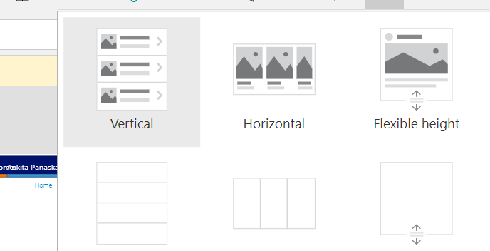



Gallery

Slide 34
From here onwards the Akash will continue our presentation.

Slide 35
function
1).Filter: The Filter function finds the records in a table. It must satisfy a formula. We can use Filter to find a set of records with the conditions. If the condition becomes true, it displays the records
•Syntax: Filter(Table Name/collection Name, Condition).
•Example: Filter (Emp, Role=”Technology” && Area=”Pune”)
•2).Lookup: The Lookup function finds the first record in a table that satisfies a formula. Use Lookup to find a single record that matches one or more criteria.
•Syntax: Lookup(Table Name/collection ,Condition)
•Example: Lookup(tblEMP,EmpID=1,EmpName)

Slide 36
5).PATCH FUNCTION
• Use Patch with the Defaults function to create records.
• Modify one or more records of a data source.
• Update the records in a data source without affecting other properties.
• Use the ForAll function to update or create multiple records using the Patch function
• Syntax: Save Patch
• Patch(TableName, Default(TableName),{columnsName1:textinput.text, columnsName2:textinput2.text})
• Syntax: Patchupdate
• Patch(TableName, gallery.selected,{columnsName1:textinput.text, columnsName2:textinput2.text})
PATCH FUNCTION

Slide 37
ForAll
The ForAll function evaluates a formula for all the records in a table. The formula can calculate a value and/or perform actions, such as modifying data or working with a connection. Use the With function to evaluate the formula for a single record
Syntax- ForAll(Table, Formula)
Distinct
The Distinct function evaluates a formula across each record of a table and returns a one-column table of the results with duplicate values removed. The name of the column is Result.
syntax- Distinct(TableName,CollumnName
Search
search function to find records from a table that contains a string value in any of the columns. The search string can be presented anywhere in the columns.
• Syntax : Search( Table, SearchString, Column1 [, Column2.. ] )
• Example: Search(‘Student', SearchBox.Text, “StudentName")

Slide 38
From here onwards the Tanmay will continue our presentation.

Slide 39
Data sources for a PowerApps
In Power Apps, most canvas apps use external information stored in cloud services called Data Sources.
The most common data sources are tables, which you can use to retrieve and store information.
You can use connections to data sources to read and write data in Microsoft Excel workbooks, lists created using Microsoft Lists, SharePoint libraries, SQL tables, and many other formats, which can be stored in cloud services such as OneDrive for Business, DropBox, and SQL Server.

Slide 40
Local data sources
Collections are a special kind of data source. They are local to the app and not backed by a connection to a service in the cloud, so the information can not be shared across devices for the same user or between users.
Collections can be created dynamically with the Collect function.
The columns of a collection can be modified at any time using the Collect function.
Collections allow duplicate records. More than one copy of the same record can exist in a collection.
You can use the SaveData and LoadData functions to save and reload a copy of the collection.
The information is stored in a private location that other users, apps, or devices can't access.
You can use the Export and Import controls to save and reload a copy of the collection to a file that the user can interact with.

Slide 41
Collect:- The Collect function adds records to a data source,
Allows you to store records in the local cache,if we have no connection.
Syntax : Collect( DataSource, Item, ... )
Example:
Collect(
ProductList,
{
Product: ProductName.Text,
Color: Colors.Selected.Value
}
)

Slide 42
Remove:- Functions such as Remove will operate on the first match they find,
unless the All argument is supplied.
Syntax: Remove( DataSource, Record1 [, Record2, ... ] [, All ] )
Example:- Remove(ProductList, ThisItem)
remove that Perticular item from the collection
Clear:- The Clear function deletes all the records of a collection. The columns of the collection will remain.
Syntax:Clear( Collection Name)
Example:Clear(ProductList)
ClearCollect:- The ClearCollect function deletes all the records from a collection. And then adds a different set of records to the same collection.
With a single function,ClearCollect offers the combination of Clear and then Collect.
Syntax:ClearCollect( Collection, Item, ... )

Slide 43
Connecting PowerApps to External Data
Connect to the Data Sources is the biggest advantage of using Power Apps.
PowerApps has great support to connect to data from other systems.
Power Apps provides many connectors to easily connect to standard data services.
There are already more than 180 connectors available.
Examples of the most common ones are given below:
1.Comman Data Service
2.Office 365 Outlook
3.Share Point
4.Excel
5.SQL Server
6.One Drive

Slide 44
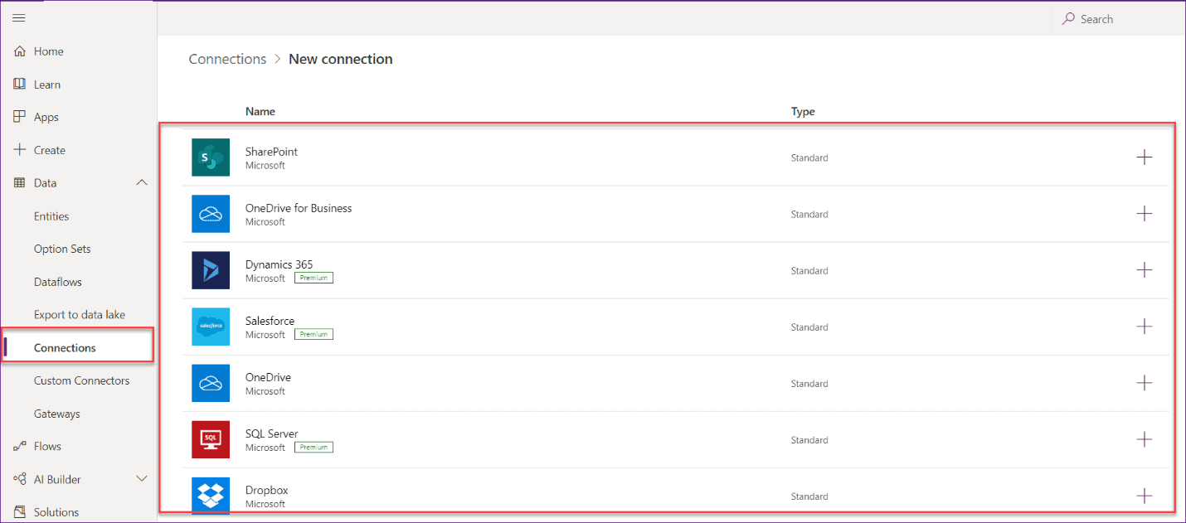
Once you will go to the Connections section and click on a new connection,
then you can see all the connectors will be available

Slide 45
Publishing and Sharing your PowerApp
When your PowerApp is ready, give it a good name,icon and description and then publish it.
After publishing don’t forget to share it with the correct users so they can access it from their
PowerApps app on their mobile device.
PowerApps also has versioning enabled, which means users will only be able to view and access published versions.This means you can make changes to your app in the background without affecting their use of the tool.
For example, you could work your way up from version 1.0 to version 1.7 before publishing this to version 2.0. Users would continue to use version 1.0 of the app until version 2.0 was made available to them.

Slide 46
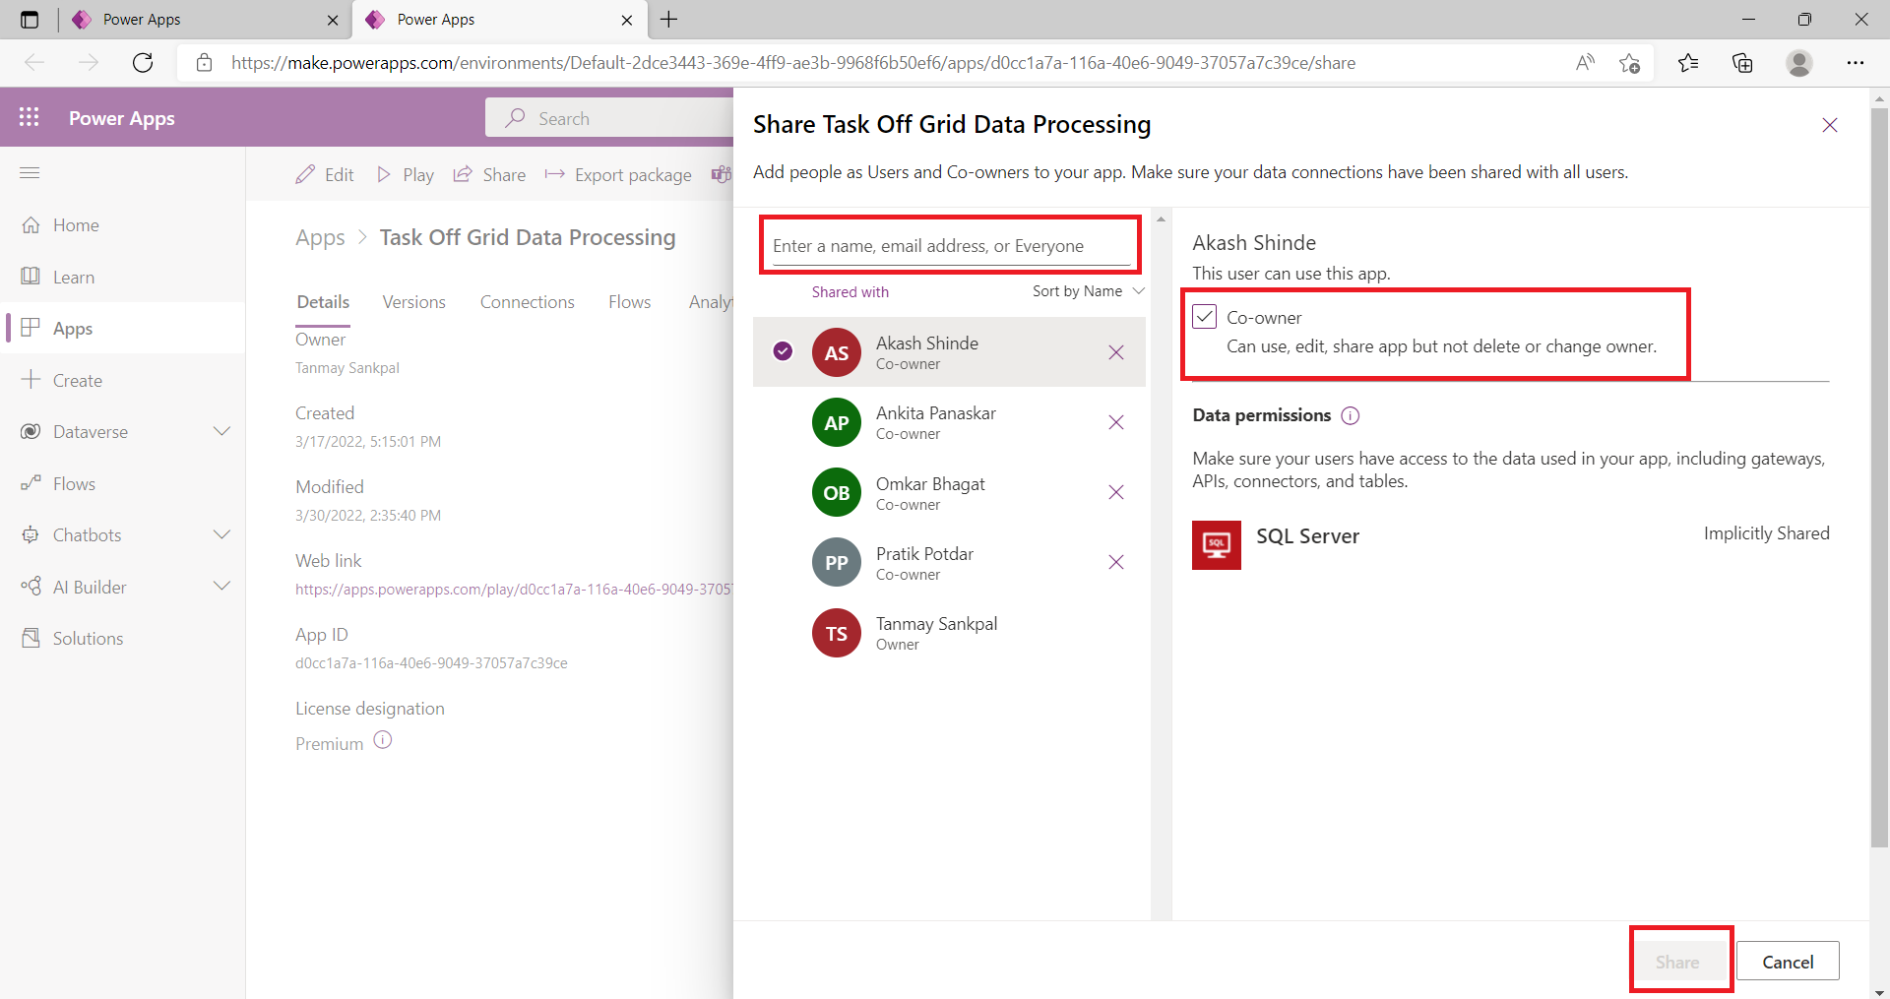
This is how to share a Power Apps app with a user, and you can make a user as co-owner of the Power Apps app.

Slide 47

Thank You

