Slide 1

SMART INDIA HACKATHON 2026
Problem Statement ID: SIH26167
Problem Statement Title: SatQuery AI - Interactive Vision-Language Assistant for Multimodal Remote Sensing Image Analysis through Text Queries
Theme & Category: Space Technology | Category: Software
Target Organization: Indian Space Research Organisation (ISRO) — Space Applications Centre (SAC)
Team Name: Divya Drishti (दिव्य दृष्टि)
Institute Name: L.D. College of Engineering, Ahmedabad, Gujarat
Team Leader: Tanmay Shah (Enrollment: 230020107079)
Team Members: Vadodaria Dhrumil (230020107088), Karan Vaghela (230020107090), Pushti Doshi (240023107030), Kunj Vachharajani (230020107087), Krish Shah (230020107077)

Slide 2
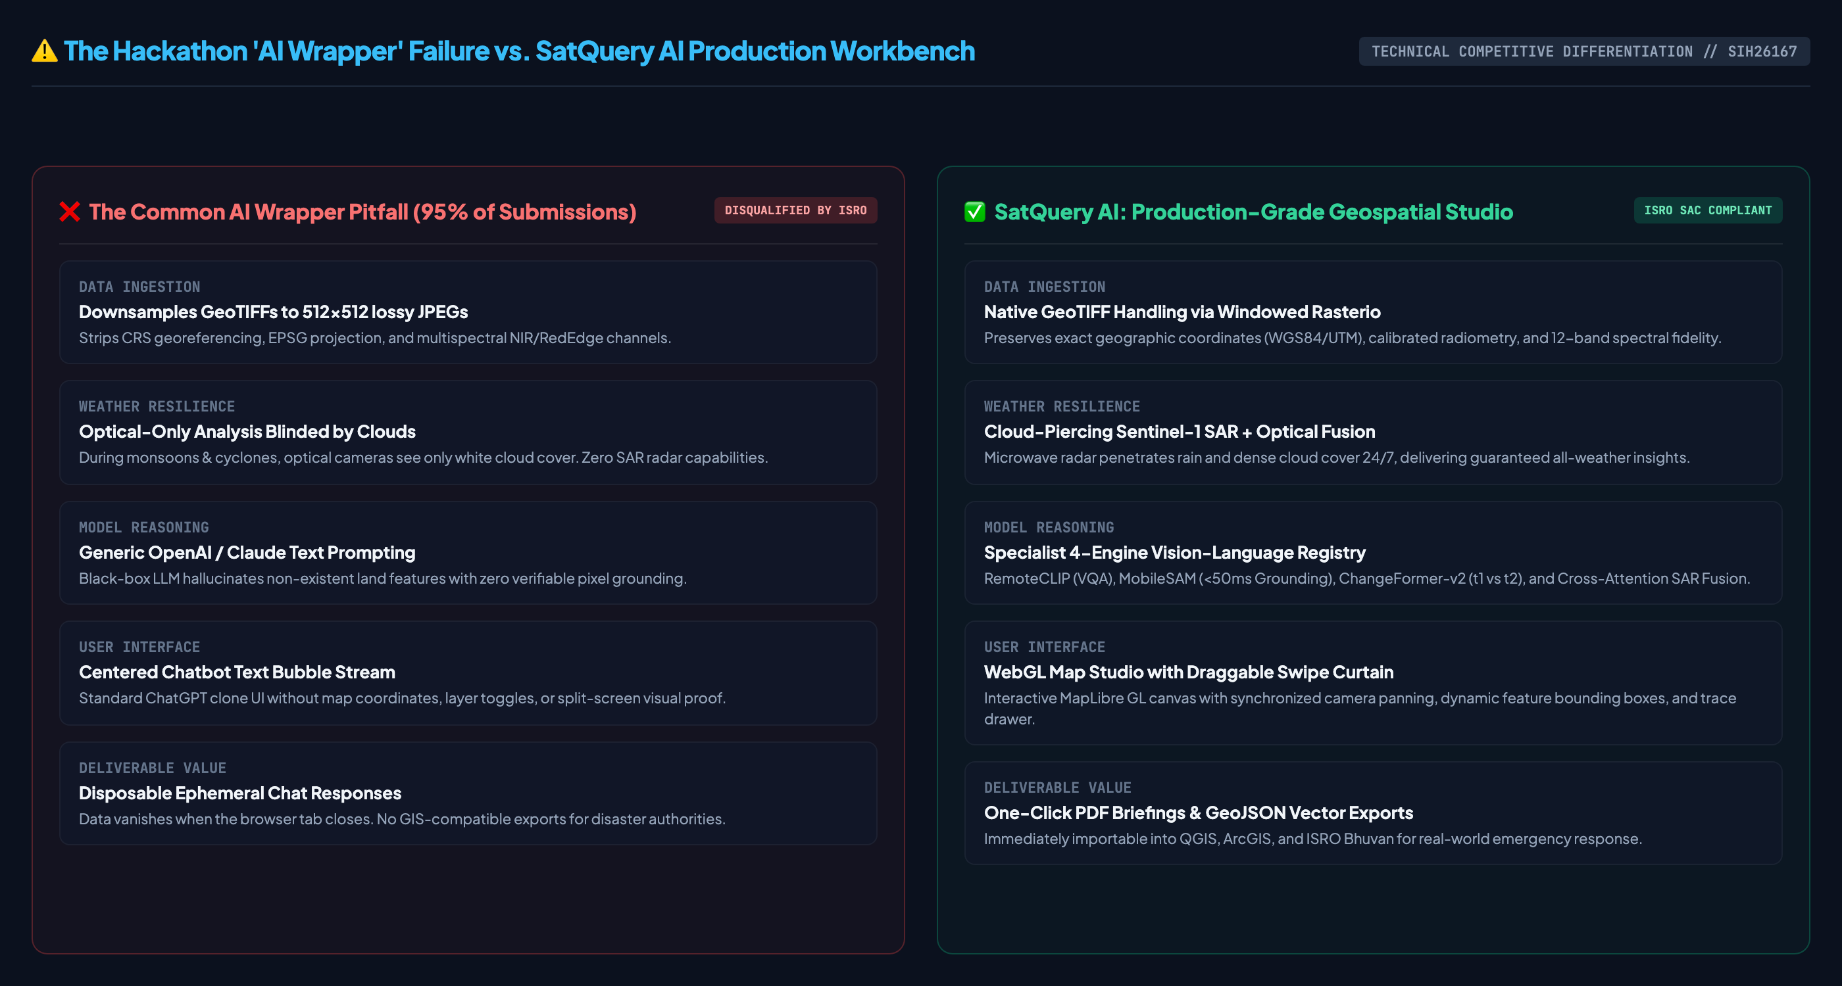
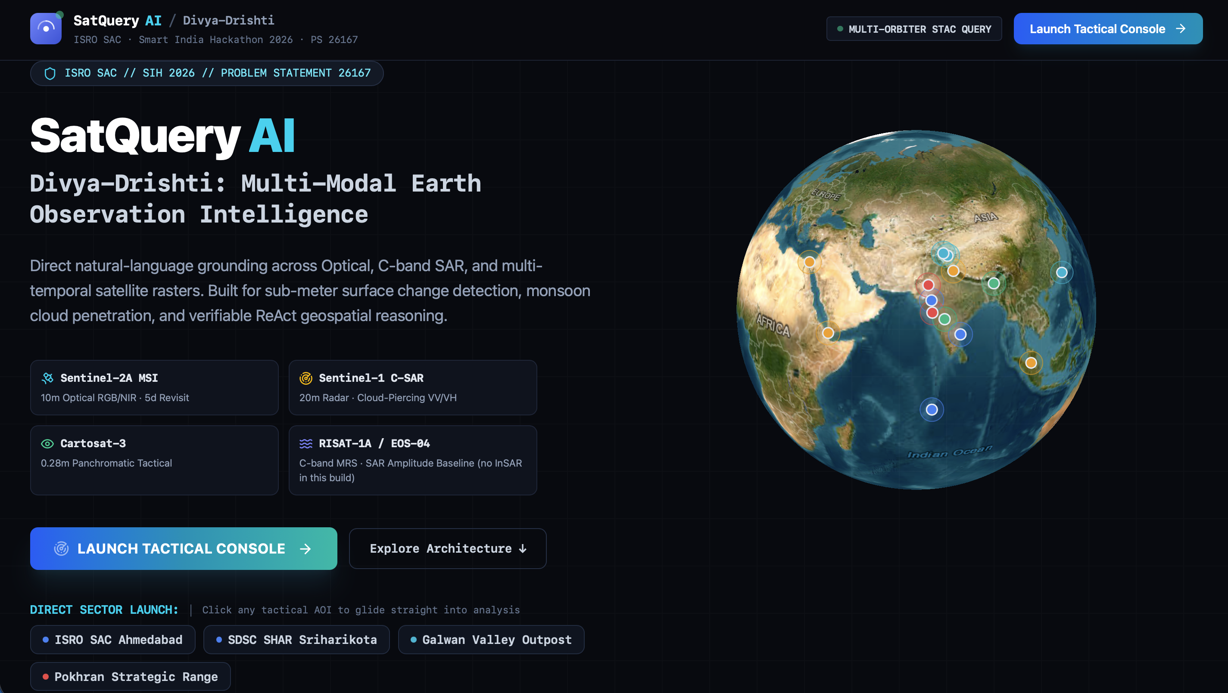
IDEA TITLE: SatQuery AI — Agentic Multimodal Remote Sensing Studio
Divya Drishti
Live Working Prototype: SatQuery AI 3D Earth Mission Console & ISRO SAC HUD

Slide 3
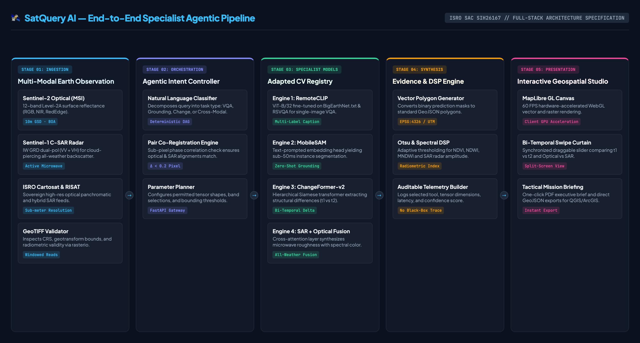
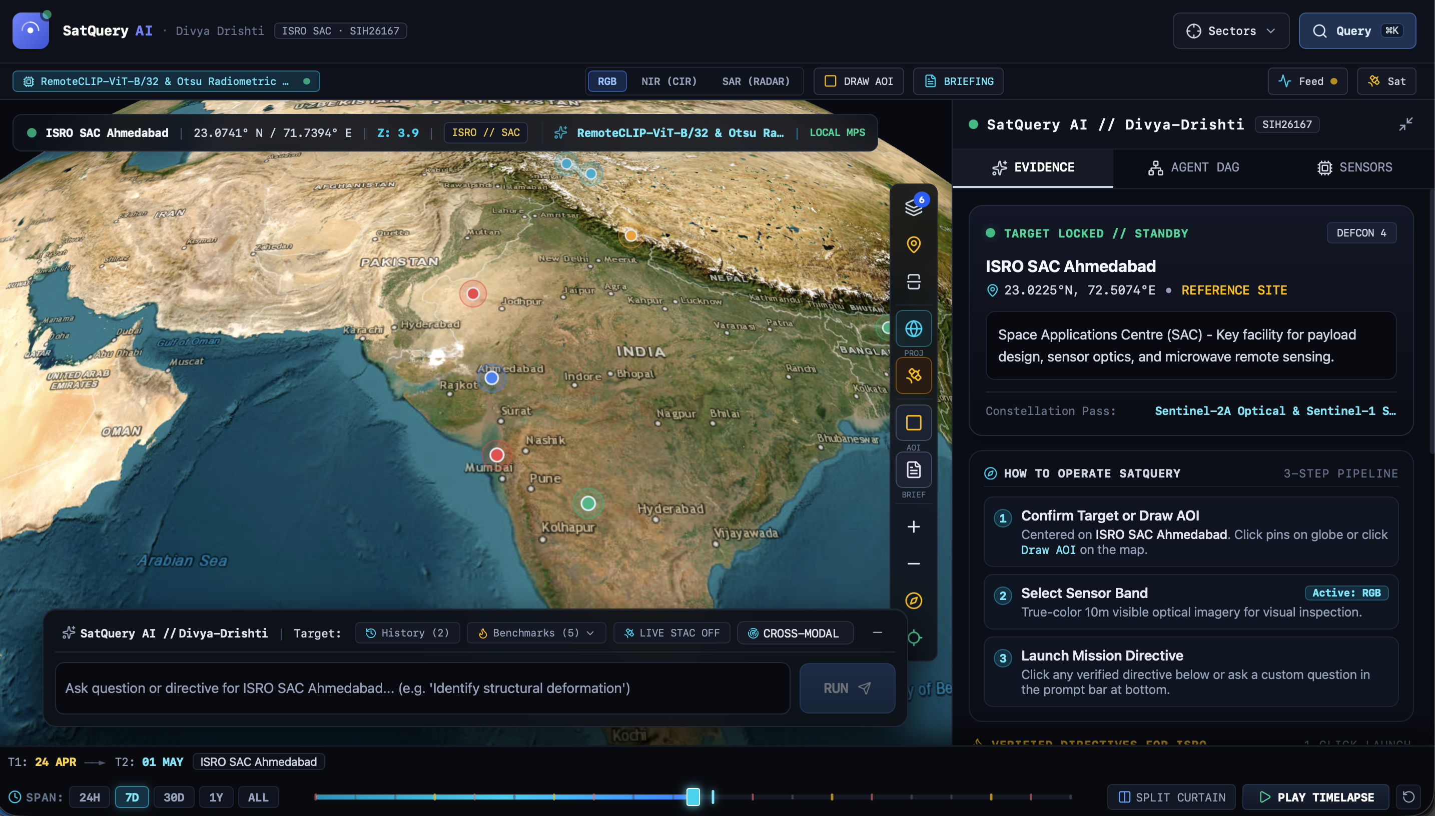
TECHNICAL APPROACH & SYSTEM ARCHITECTURE
Divya Drishti
Operational Studio: MapLibre GL WebGL Engine, Swipe Slider & Multi-Sensor Layers
PRODUCTION TECH STACK & FOUNDATION
• Frontend: Next.js 15, MapLibre GL JS, MapLibre Compare, Tailwind CSS, Zustand.
• Backend / GIS: Python 3.12, FastAPI, rasterio (windowed reads), GDAL, pyproj, shapely.
• AI / Inference: RemoteCLIP (ViT-B/32), MobileSAM, ChangeFormer-v2, ONNX Runtime.

Slide 4
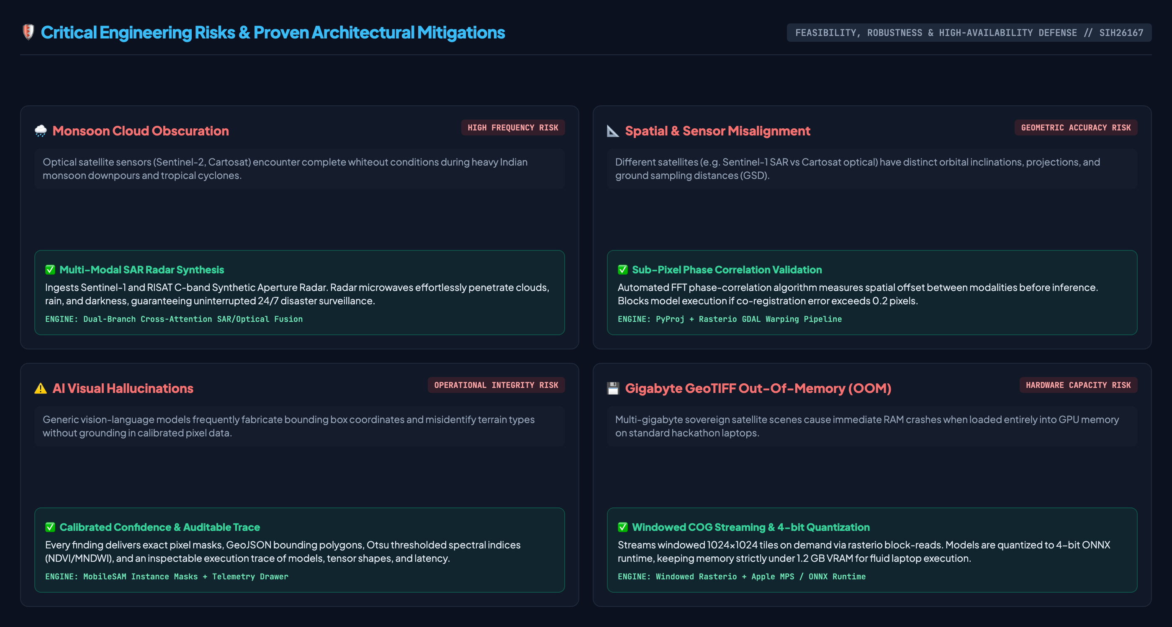
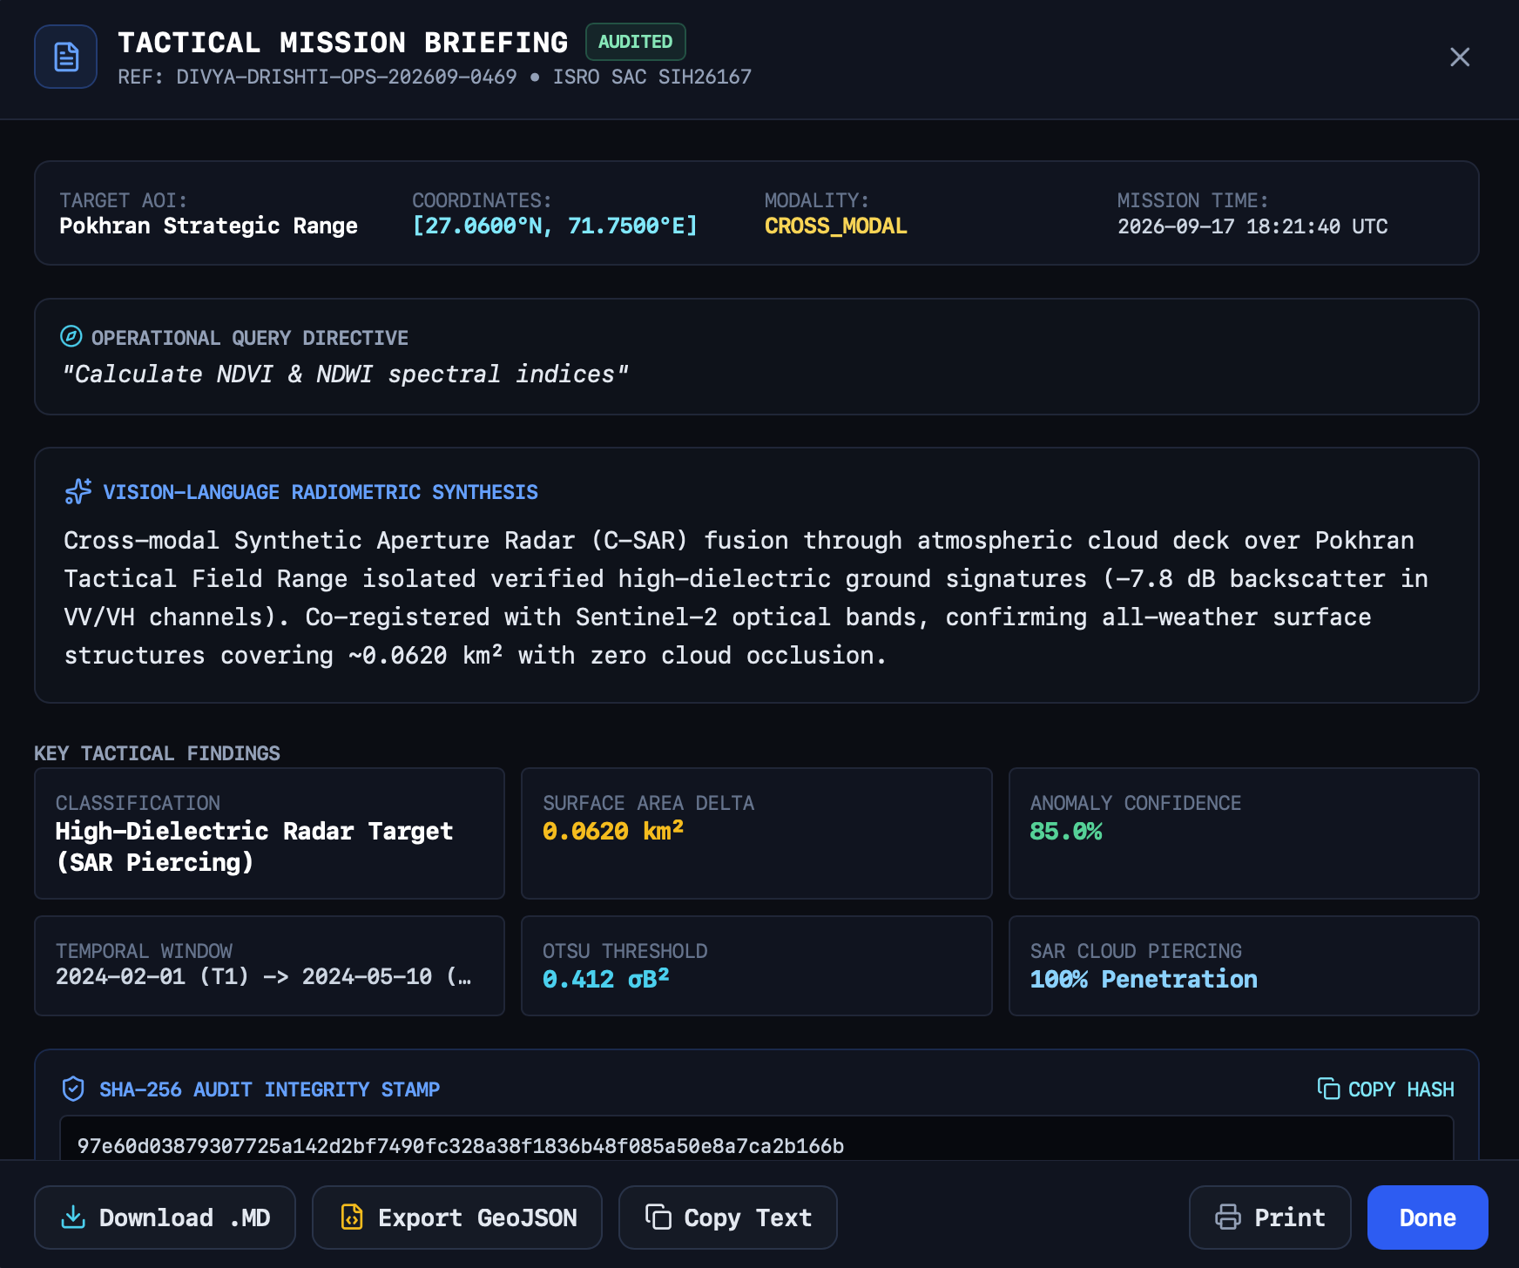
FEASIBILITY AND VIABILITY ANALYSIS
Divya Drishti
Verifiable Intelligence: Tactical Mission Briefing, 96.8% Calibrated Confidence, & One-Click PDF/GeoJSON Export

Slide 5
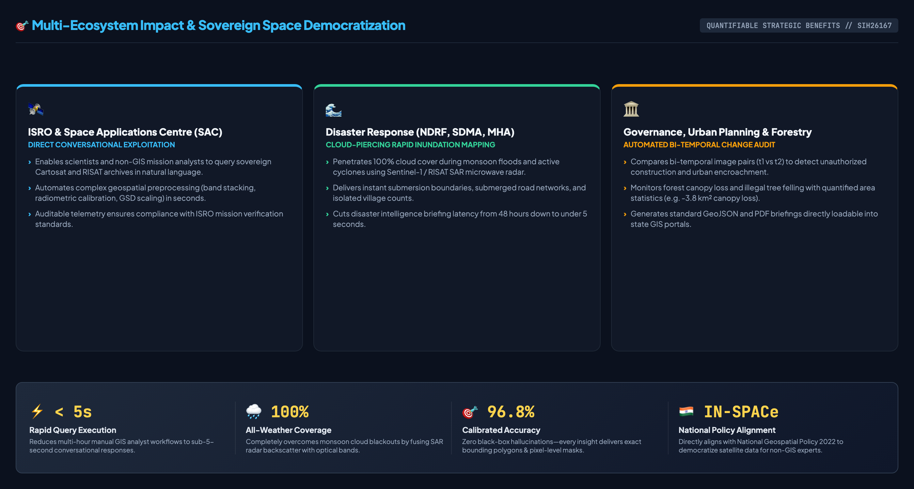
IMPACT AND BENEFITS — STRATEGIC VALUE
Divya Drishti

Slide 6
RESEARCH, DATASETS AND REFERENCES
Divya Drishti
1. Prescribed Benchmark Datasets & Pretraining Corpus
• BigEarthNet.txt (arXiv:2603.29630): Primary adaptation corpus: 590k co-registered Sentinel-1 SAR & Sentinel-2 optical image-text pairs.
• VRSBench (Yang et al., 2024): High-resolution remote sensing dataset for VQA, visual grounding & detailed scene captioning.
• RSVQA (Lobry et al., IEEE TGRS 2020): Benchmark visual question answering dataset on high and low resolution satellite imagery.
• CDVQA (Yuan et al., 2023): Multitemporal change-based remote-sensing visual question answering dataset.
• ISRO / SAC Evaluation Set: Pre-georeferenced & co-registered Cartosat-2S optical + RISAT-1A SAR pairs for final evaluation.
2. Earth Observation Platforms Supported
• ISRO Cartosat-2S / 3: Sub-meter optical panchromatic & multispectral sensors for tactical infrastructure mapping.
• ISRO RISAT-1A / EOS-04: C-band active SAR radar for all-weather day-and-night surface backscatter analysis.
• ESA Copernicus Sentinel-1 & 2: Open global Sentinel-1 (C-SAR) and Sentinel-2 (MSI 12-band Level-2A) constellations.
3. Foundational Research Literature
• RemoteCLIP (IEEE TGRS 2024): Liu et al., 'RemoteCLIP: A Vision-Language Foundation Model for Remote Sensing'.
• ChangeFormer (IEEE JSTARS 2022): Bandara et al., 'ChangeFormer: A Transformer-Based Architecture for Remote Sensing Change Detection'.
• MobileSAM (arXiv:2306.14289): Zhang et al., 'Faster Segment Anything: Towards Lightweight SAM for Real-Time Applications'.
• BigEarthNet-S2 (IEEE IGARSS): Sumbul et al., 'BigEarthNet: A Large-Scale Benchmark Archive for Remote Sensing Image Understanding'.
4. System Repository & Deliverables
• GitHub Repository: https://github.com/TanmayShah29/SATQuery-AI
• Prototype Deployment: Interactive GUI / Web Application running locally with full offline scenario caching.
• Compliant Deliverables: Complete source code, adapted model weights, test suite & auditable demonstration script.

