Slide 1


SMART INDIA HACKATHON 2025
Problem Statement ID – 25040
Problem Statement Title- FloatChat - AI-Powered Conversational Interface for ARGO Ocean Data Discovery and Visualization
Theme - Miscellaneous
PS Category - Software
Team ID -
Team Name - Howlers
PS Approach Explainer. YouTube video. Available at: https://youtu.be/-iJX43oWRXY
55937

Slide 2
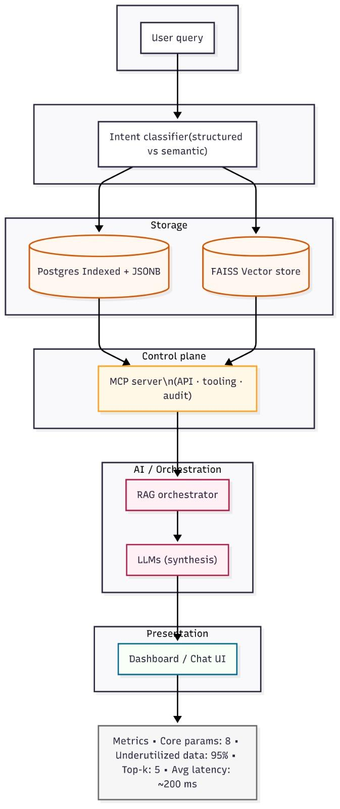
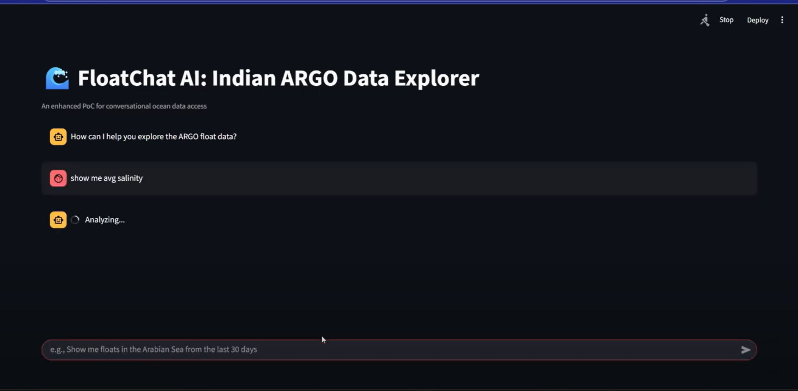
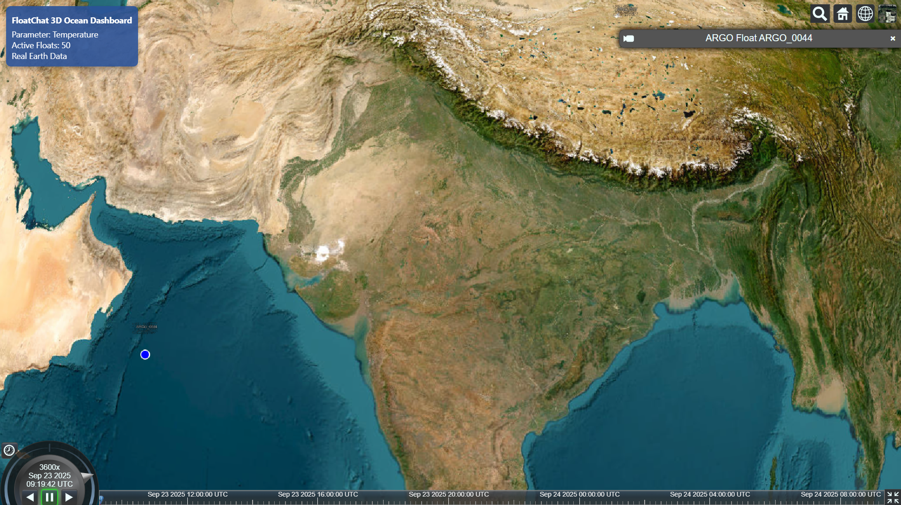
FloatChat — Conversational Argo Data Explorer
Natural-language queries + verifiable visualizations for Argo floats
HOWLERS
Proposed Solution:-(Approach)
Chat Interface
Unlocks Argo / INCOIS NetCDF
Ingests and normalizes NetCDF files into searchable, tabular records.
Example: query salinity by depth/time without writing NetCDF code.
Natural-language queries + visuals
Translate plain-English questions into filters and instant plots (maps, profiles, time-series).
Result: get a ready visualization in seconds instead of scripting.
Hybrid storage: SQL + vector index
Numeric data served from Postgres; semantic metadata in a vector store.
Benefit: precise calculations via SQL and contextual search via vectors.
Empowers non-experts
Policymakers, students and scientists can explore data with no coding required.
Outcome: faster insights and broader use of ocean datasets.
Verifiable results with provenance
RAG+LLM returns synthesized answers plus the exact SQL/query and source file IDs.
Trust: every result links back to the original Argo files and query used.
Plotting using Cesium.js

Slide 3
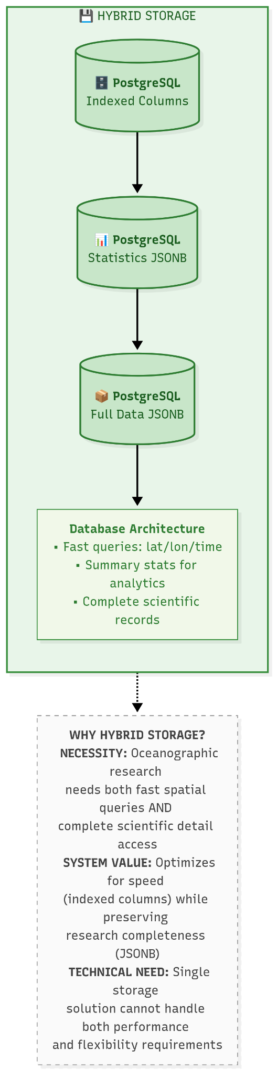
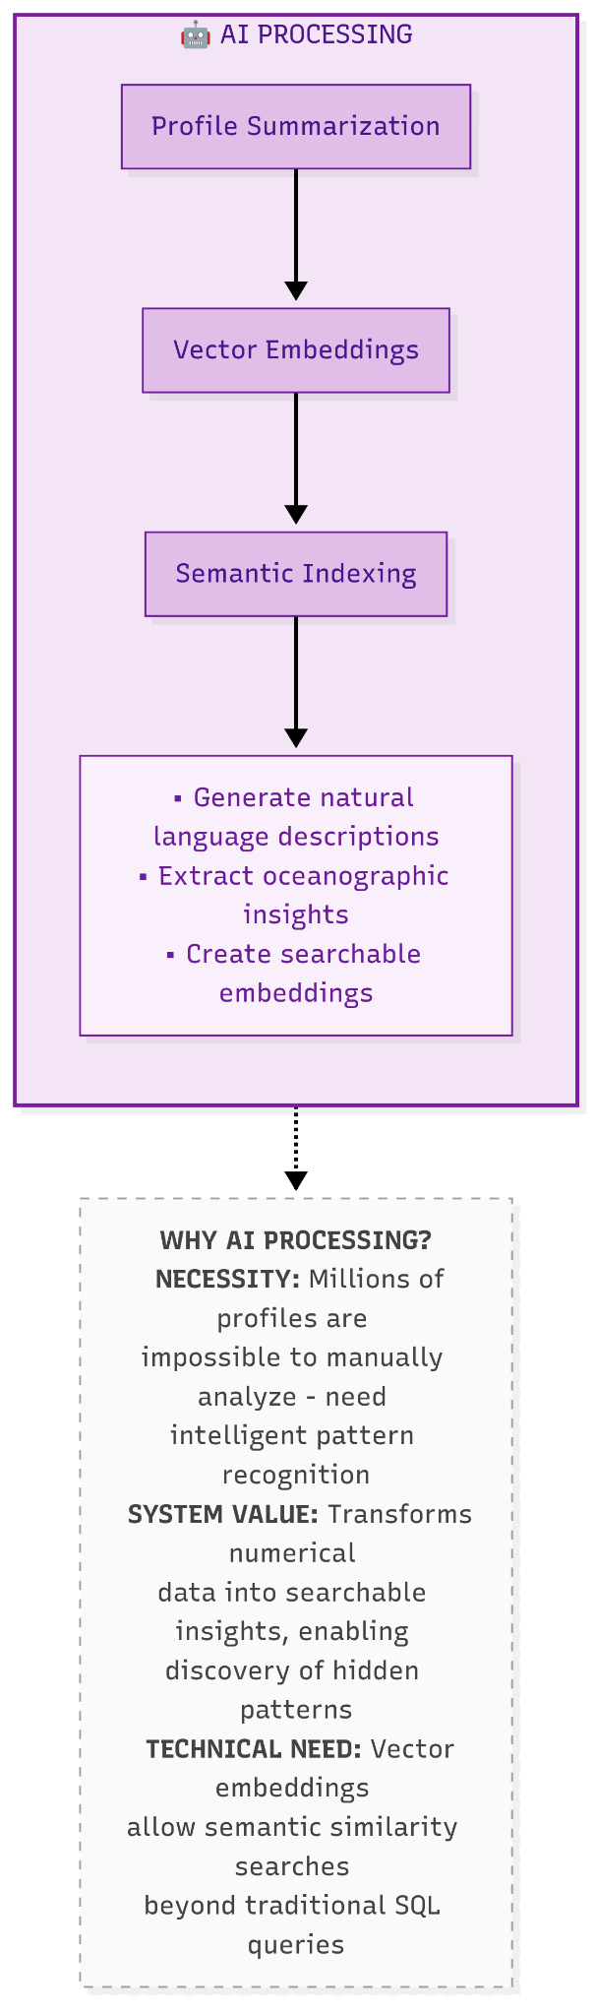
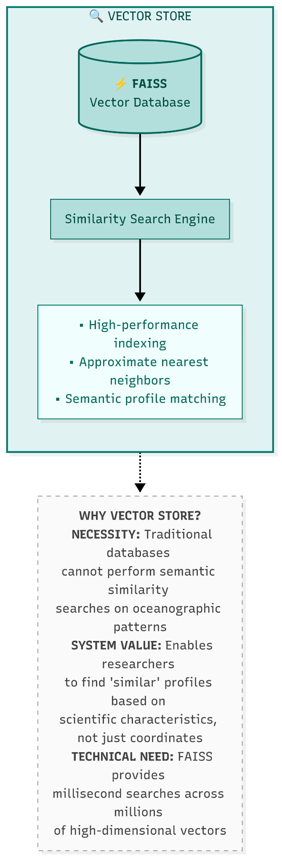
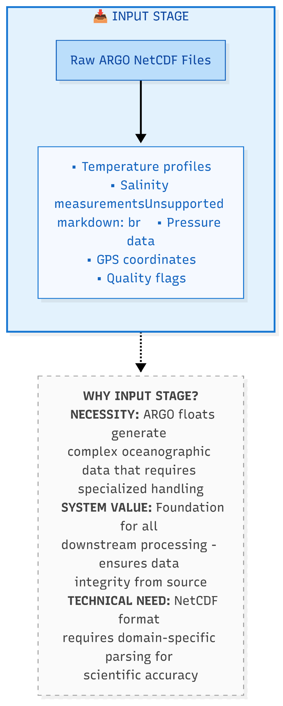
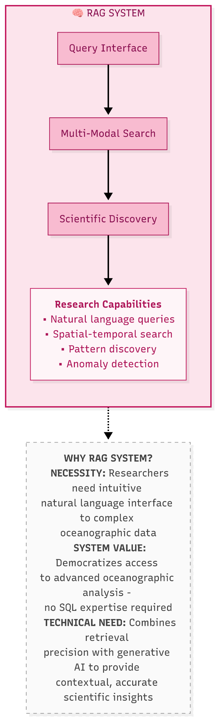

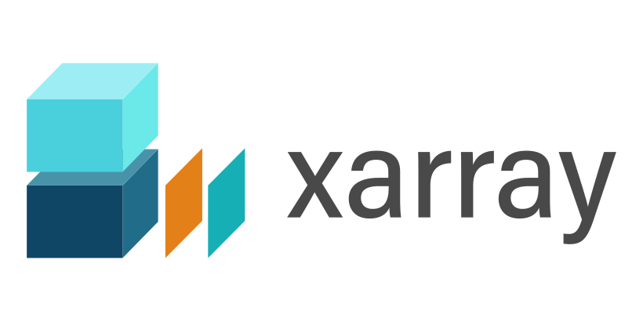

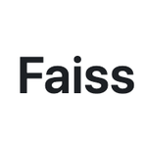
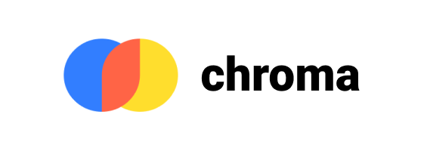
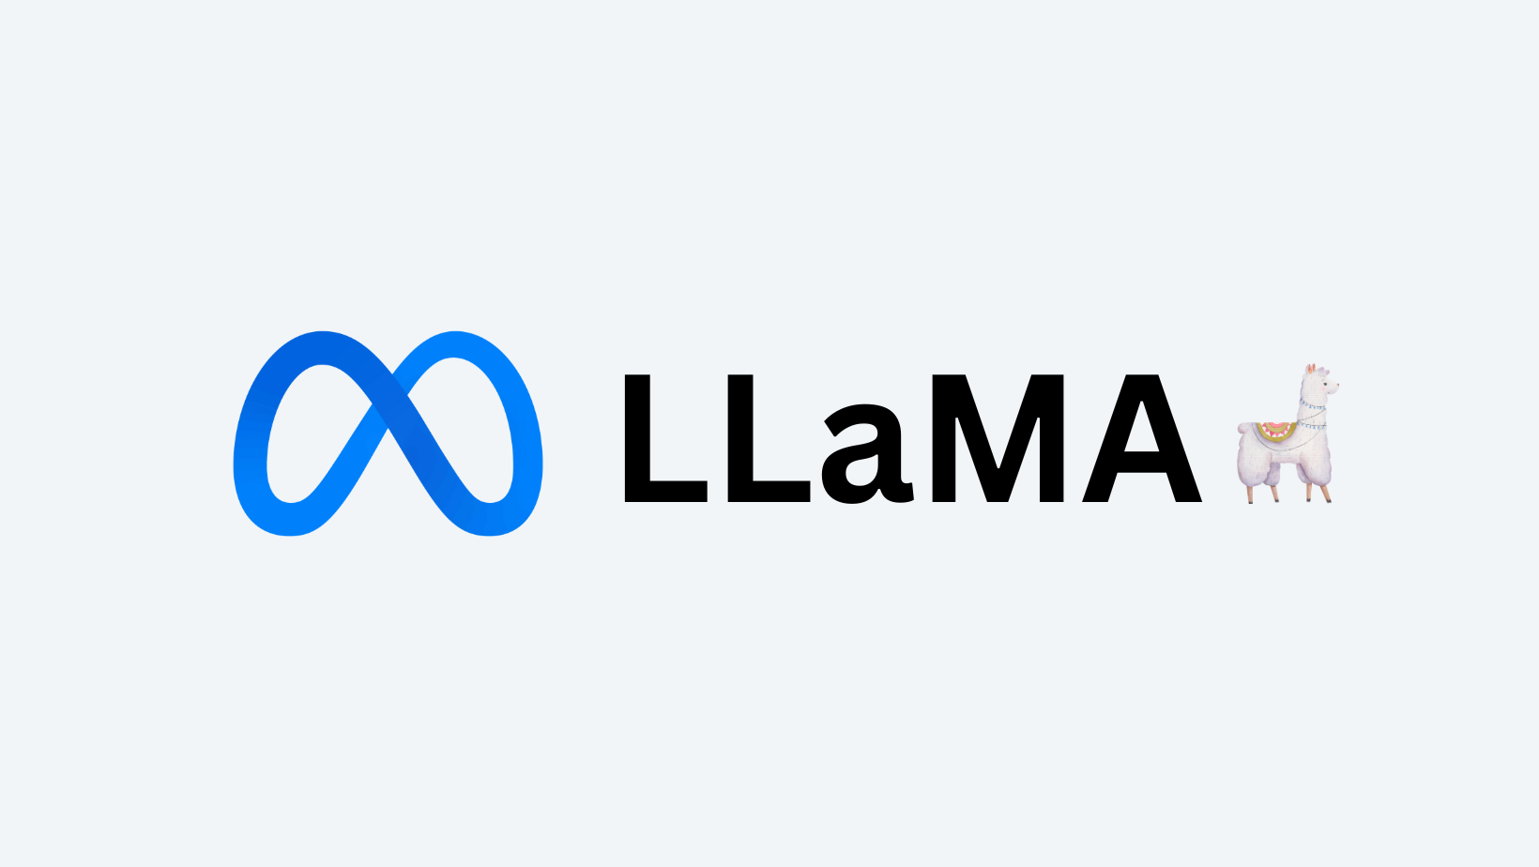
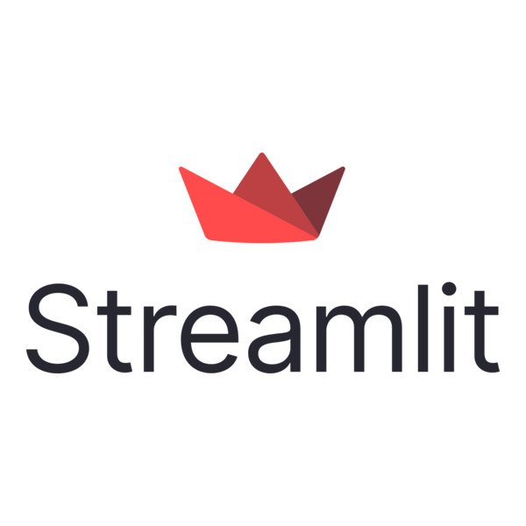
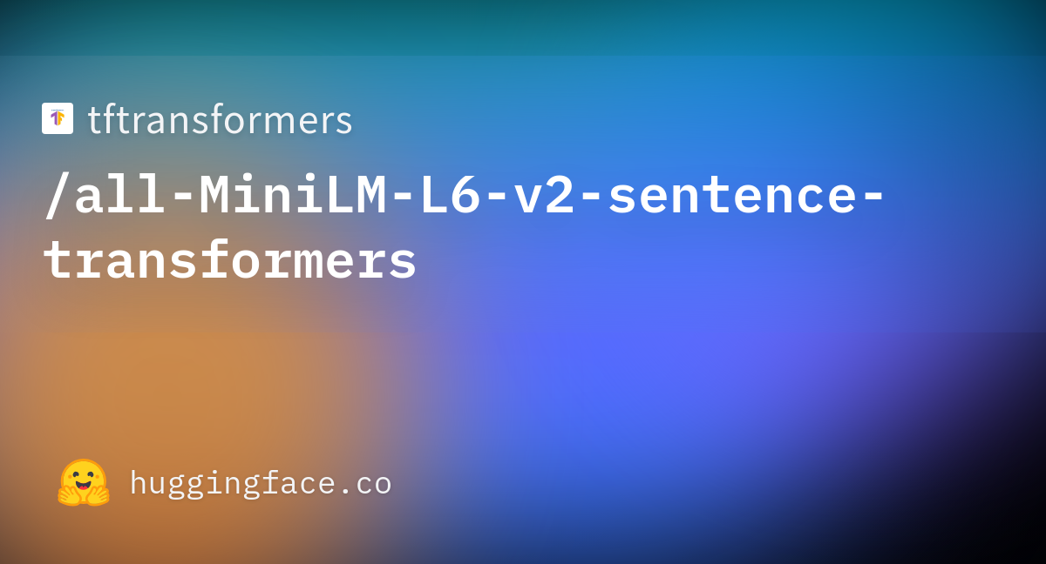

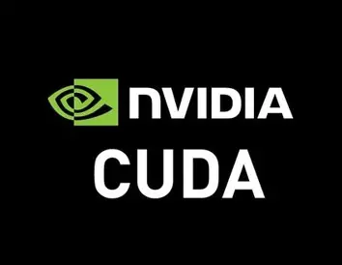
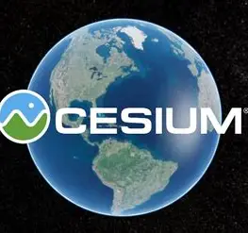
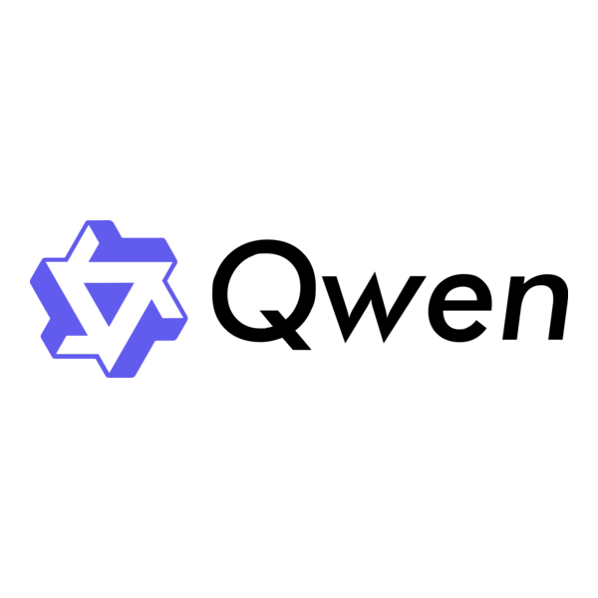

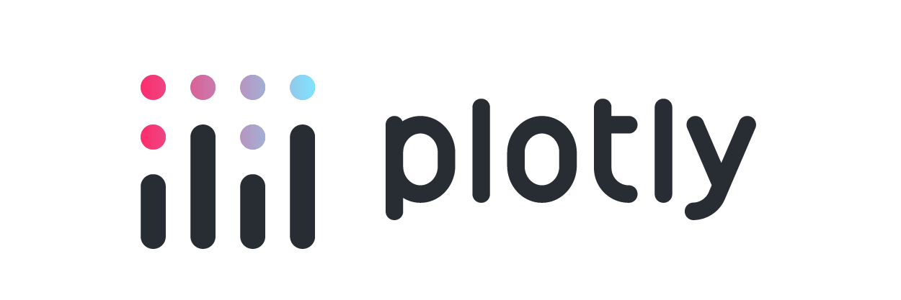
TECHNICAL APPROACH Working Demo(link)
HOWLERS

Slide 4
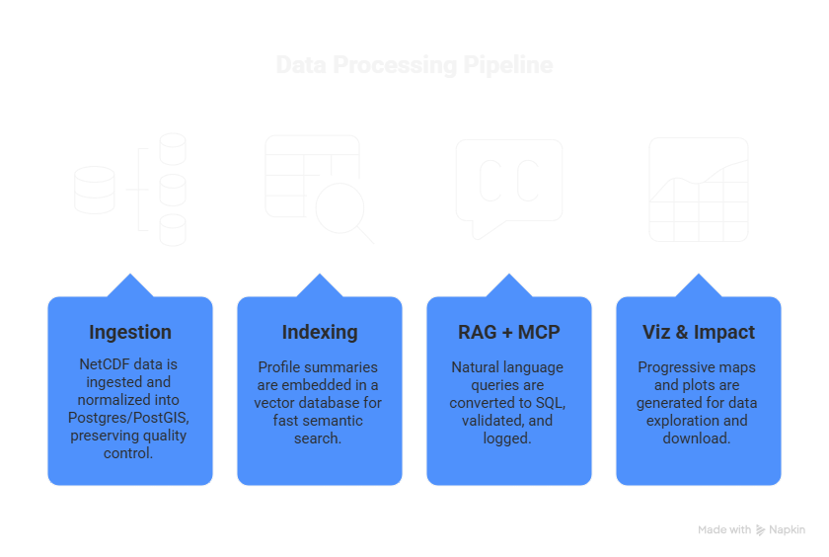
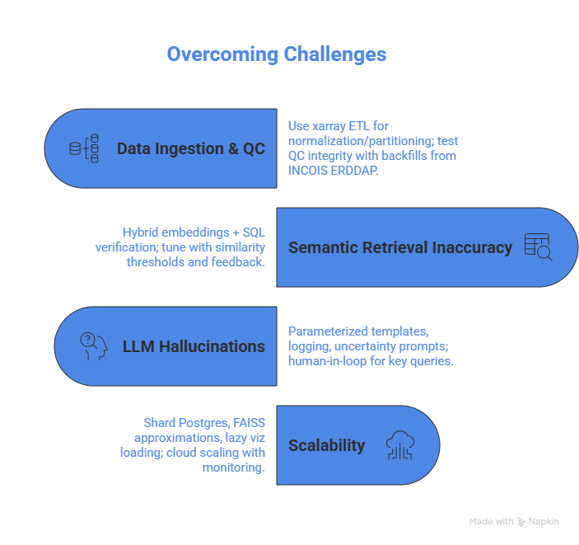
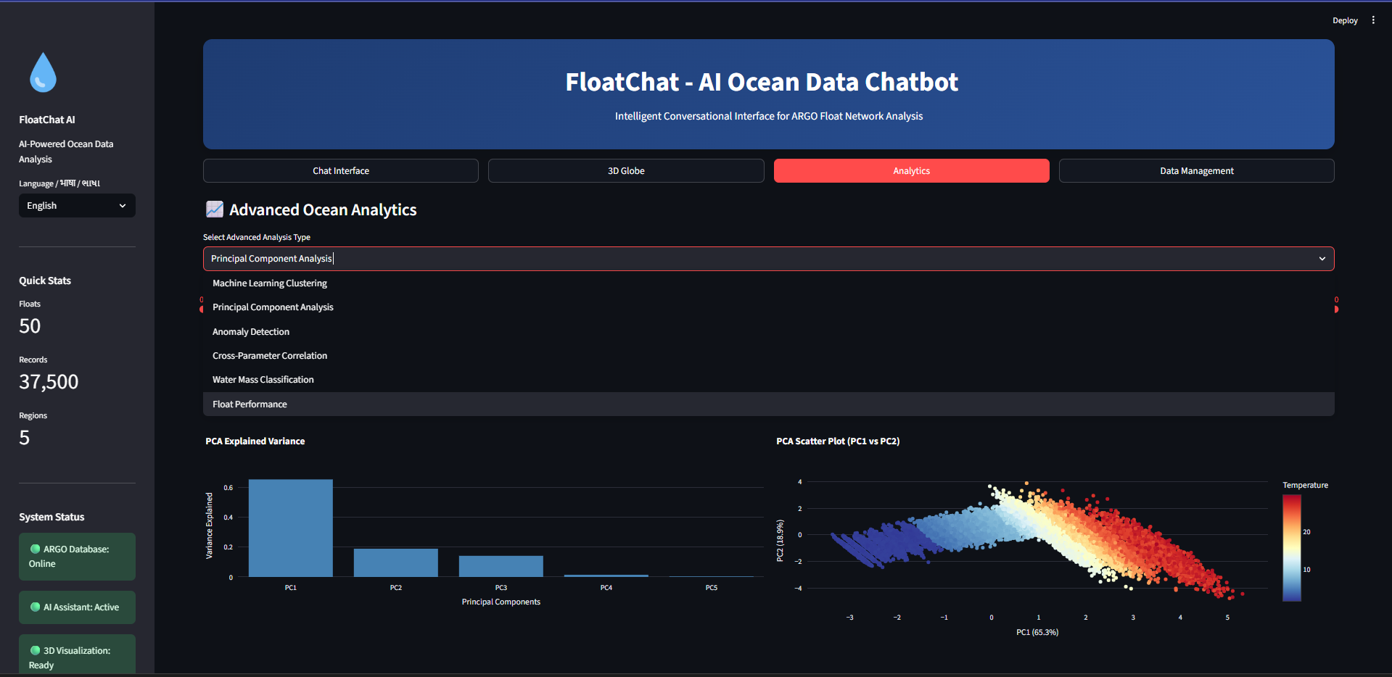
FEASIBILITY AND VIABILITY
Howlers
Analysis of the feasibility of the idea
Overcoming Challenges
Chat Interface [Streamlit Frontend]

Slide 5
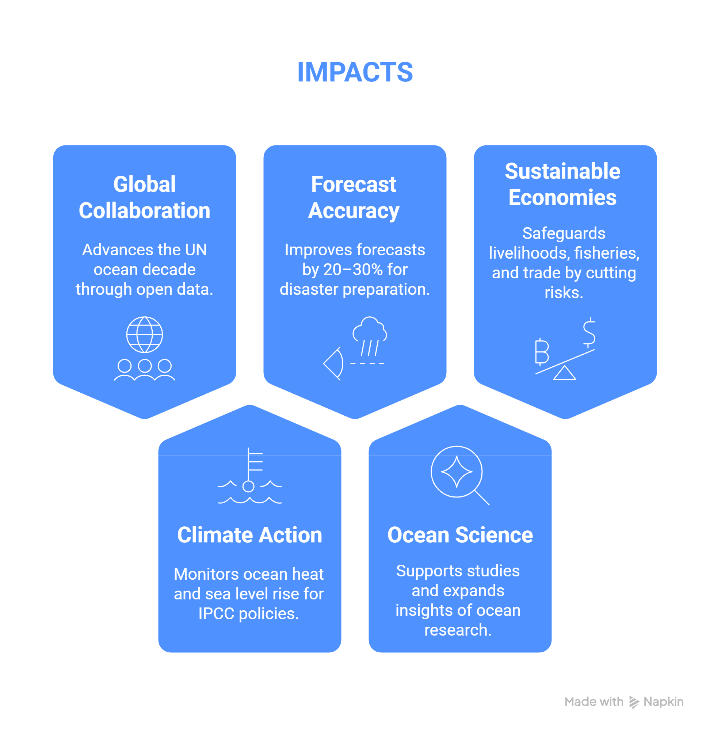
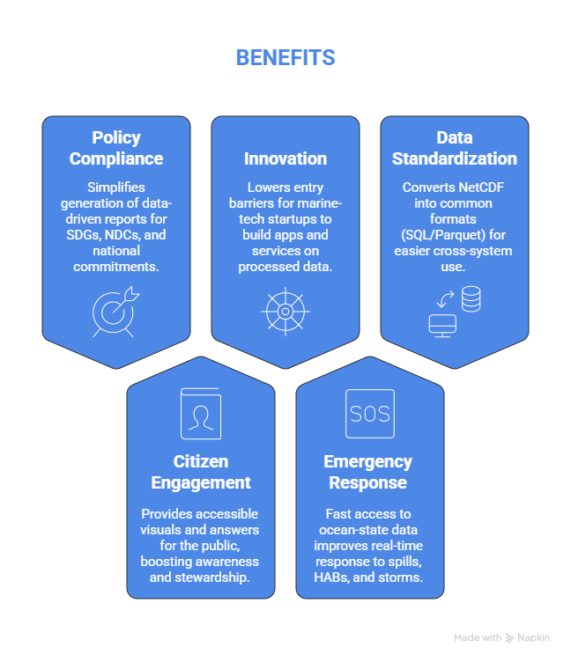
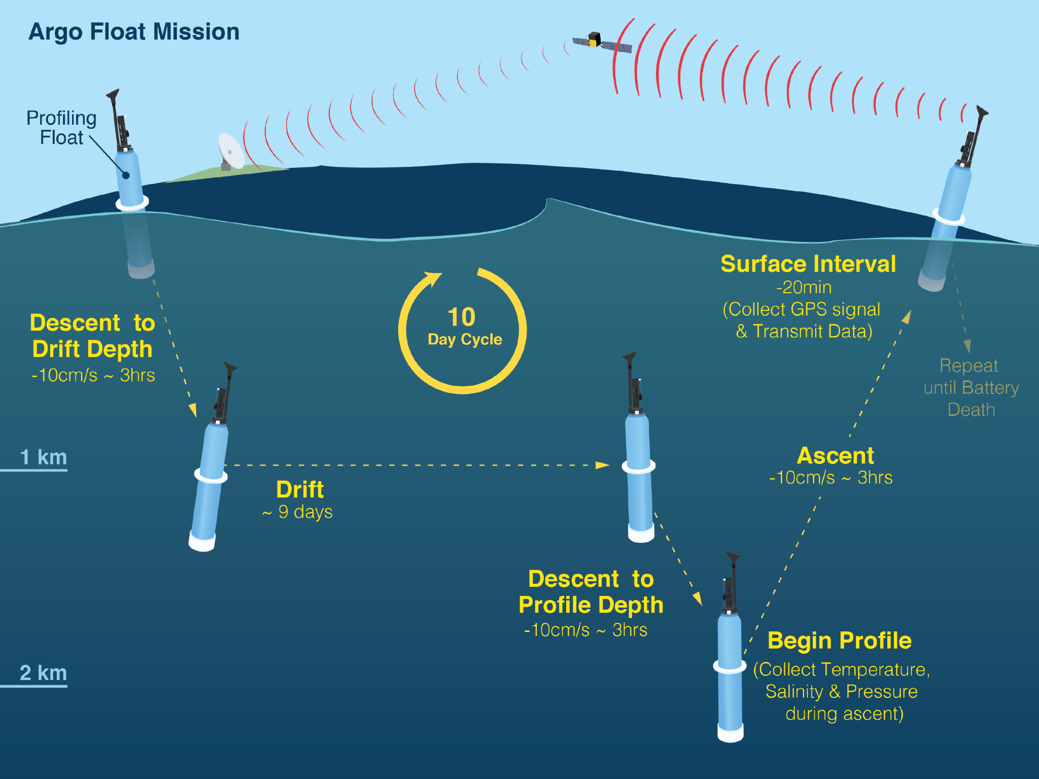

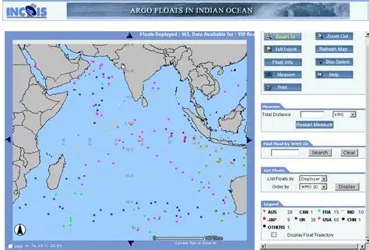
Howlers
IMPACTS AND BENEFITS
5

Slide 6
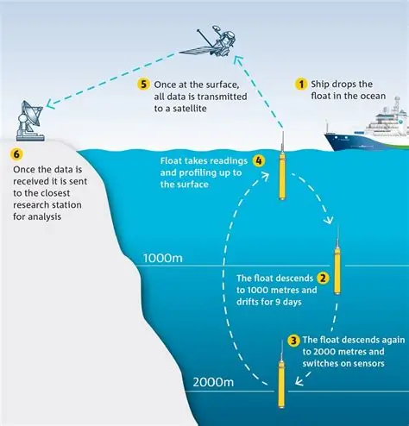
RESEARCH AND REFERENCES
Howlers
Details / Links of the reference and research work
PS Approach Explainer. YouTube video. Available at: https://youtu.be/-iJX43oWRXY
POC of FloatChat AI (Demo). YouTube video. Available at: https://youtu.be/_Ln-5-LXG-w
FloatChat AI Documentation. Google Drive folder. Available at: https://drive.google.com/drive/folders/1wPG_MvJKRtRW4MLE1Y2JtUj7BjoNSrZ8?usp=drive_link
ARGO Program (Global Ocean Observing System): https://argo.ucsd.edu
Coriolis Global Data Assembly Center (GDAC): https://www.coriolis.eu.org/ – Provider of global ARGO NetCDF files and metadata.
Key Tools, Libraries, and Frameworks
Data Handling: xarray https://docs.xarray.dev, pandas https://pandas.pydata.org, netCDF4.
Databases: SQLite3 https://www.sqlite.org/docs.html
Vector Databases: FAISS https://faiss.ai, Chroma https://www.trychroma.com.
AI Pipelines: LangChain https://www.langchain.com, Ollama https://ollama.ai.
Visualization & Dashboards: Streamlit https://streamlit.io, Plotly Dash https://dash.plotly.com, Leaflet.

