Slide 1
Team Name
BrainWave
Problem Statement
Method Trace Analyzer

Slide 2
Project analysis slide 2
Tools
And
Technology Used
Eclipse Photon
Xtrace
PROJECT
Window Builder
Jacktrace
Open JDK
OpenJ9

Slide 3
Project analysis slide 3
Modules
IbmGuiWindow.java
LogAnalysis.java
Sync.java
Abcd.java
Abcdex.java
Includes java code for GUI
Includes java code for implementation of Method-Trace Analyser
Supporting doc for running Xtrace commands in Command Prompt through Java
Passing Class
Failing Class

Slide 4
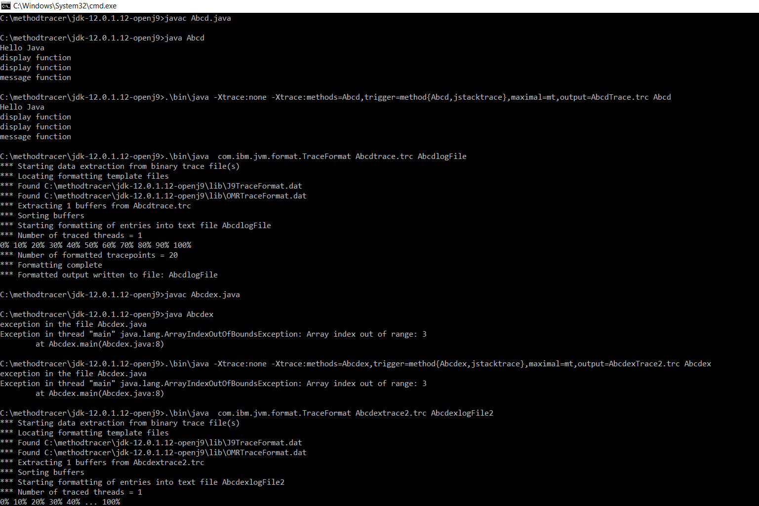
Project analysis slide 4
Console

Slide 5
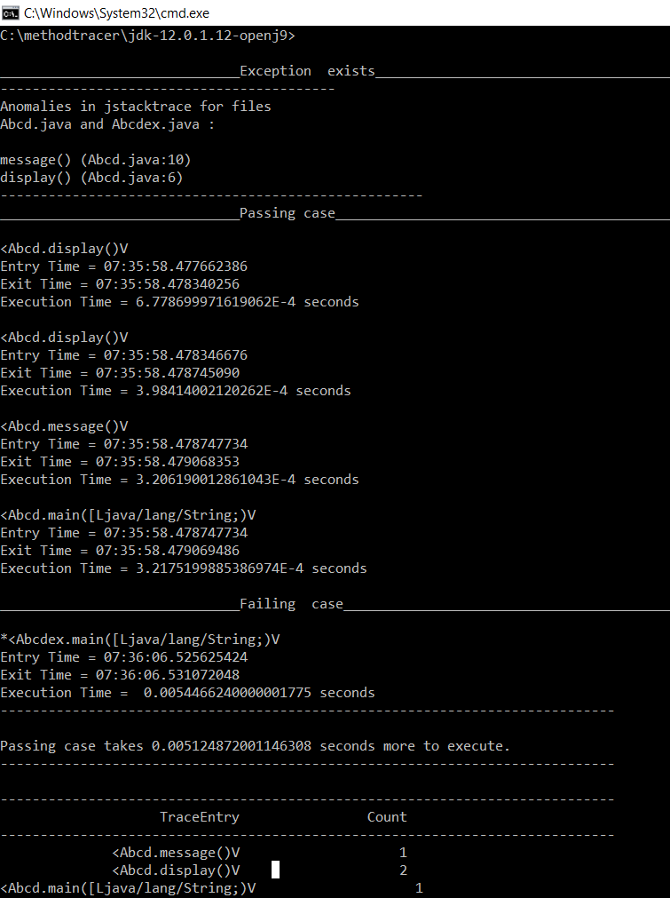

Slide 6
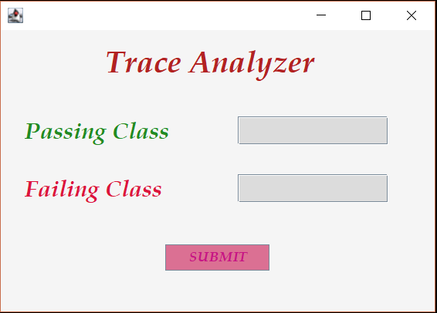
Project analysis slide 4
GUI Window

Slide 7
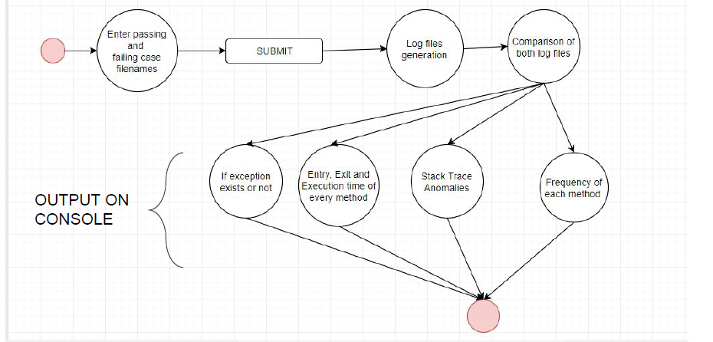
Project analysis slide 4
Flow Chart

Slide 8
Thank You
Team Members:

