Slide 1
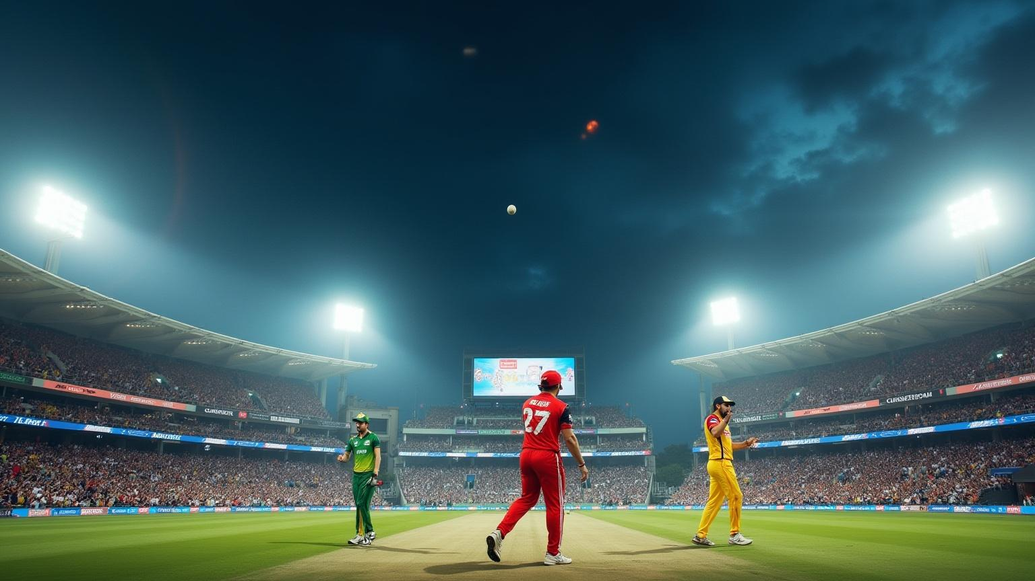
IPL MATCH WINNER PREDICTOR USING MACHINE LEARNING
Presented by: Sreekanth A S
Thiagarajar College of Engineering
Madurai,Tamil Nadu

Slide 2

Subtitle: A predictive analytics approach with Random Forest & team performance data
Objective To predict the winning team of an IPL match using historical match and ball-by-ball performance data.
Problem Statement Can a machine learning model accurately forecast the outcome of a match based on team stats, toss decisions, and venue?

Slide 3
Tools & Technologies Used:
Technology | Purpose
Python | Core programming language
Pandas | Data manipulation and analysis
NumPy | Numerical operations and arrays
scikit-learn | Machine learning library
Matplotlib | Data visualization
Seaborn | Statistical plotting
Flask | Lightweight Python web framework
HTML | Structure for the web interface
Tailwind CSS | Styling framework for responsive UI
Jinja2 | HTML templating engine in Flask
joblib | Save and load ML models and Python objects

Slide 4

Dataset Overview
Data Sources
matches.csv: Match-level data (e.g., teams, venue, toss winner, match result)
deliveries.csv: Ball-by-ball data (e.g., runs, dismissals, bowler stats)
Merged Dataset
Joined using matches.id = deliveries.match_id
Result: 179K+ rows capturing every delivery of every match
Why Both?
Match data gives outcome
Delivery data provides granular team performance

Slide 5
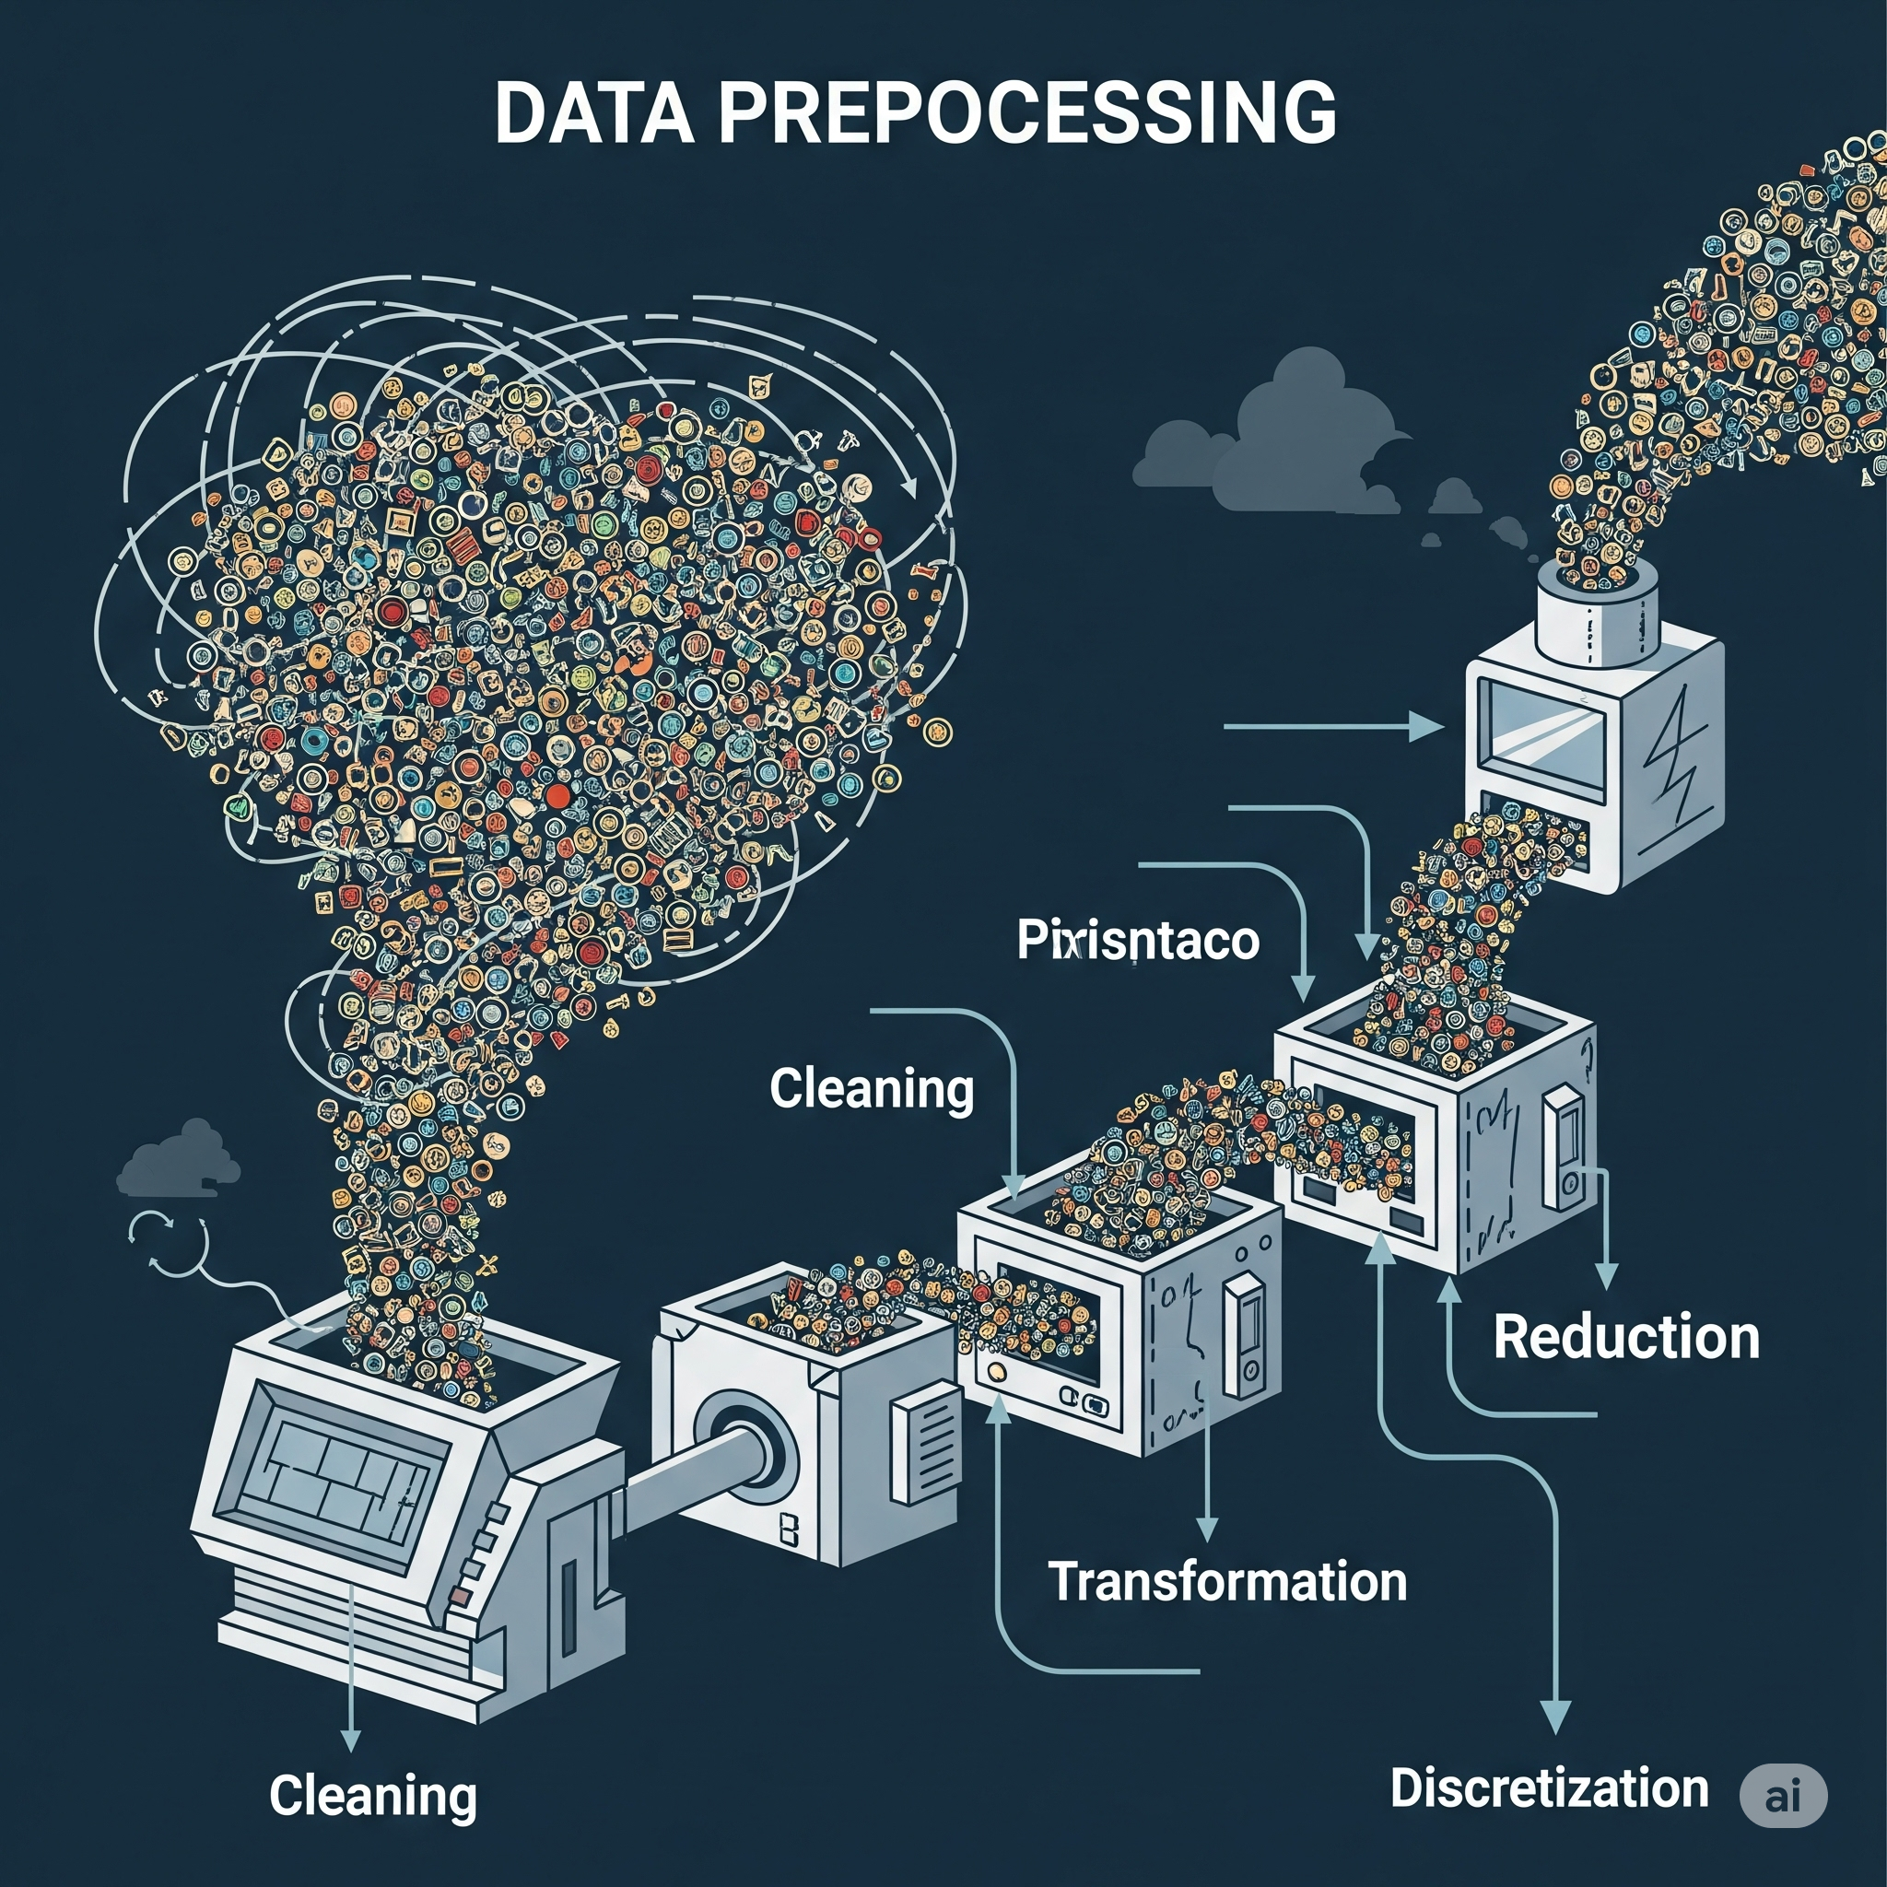
Data Preprocessing
Steps Taken:
Filled missing values:
city → 'Unknown', winner → 'No Winner', dismissal_kind → 'None'
Standardized:
Team names (e.g., “Delhi Daredevils” → “Delhi Capitals”)
Text fields → Title Case
Result
Clean, consistent dataset ready for ML training

Slide 6
Feature Engineering
New Features Added:
Batting Strength Avg runs per ball → scaled to runs per over
Bowling Strength Avg wickets per ball → scaled to wickets per over
Head-to-Head Win Ratio Team A vs Team B win % from match history
Why Important? These engineered features reflect real team performance trends beyond raw stats.

Slide 7
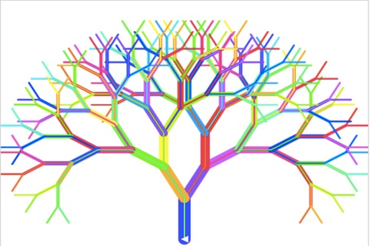
Model Architecture
Model Used: RandomForestClassifier
Reasons:
Handles categorical + numeric features
Resistant to overfitting
High performance on structured datasets
Pipeline Overview
Preprocessing
OneHotEncoding for teams, venue, toss
Pipeline
Combines preprocessing and model
Training
Random Forest with 100 trees
Frameworks: scikit-learn, pandas, Pipeline, ColumnTransformer

Slide 8

Model Training & Evaluation
Training Approach:
Train/Test Split: 80/20 using train_test_split
Stratified sampling to balance team representation
Metrics:
Accuracy: ~[Insert score, e.g., 78%]
Classification Report:
Precision, Recall, F1-Score per team
Observations:
Higher accuracy on frequent matchups
Slight drop on rare team combinations

Slide 9
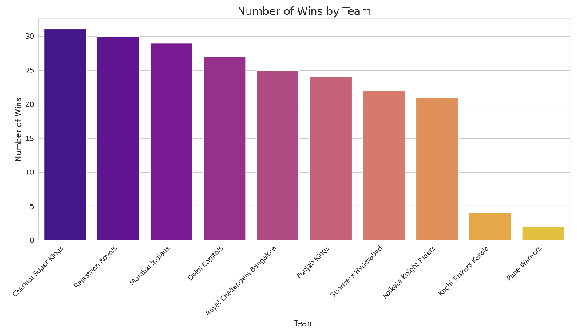
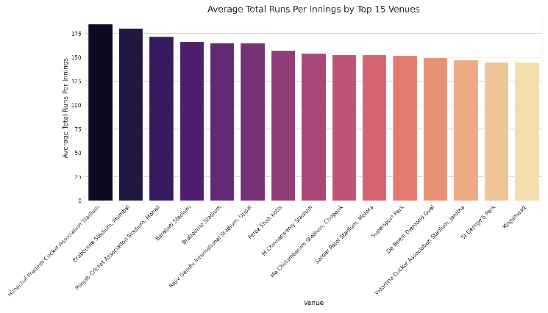
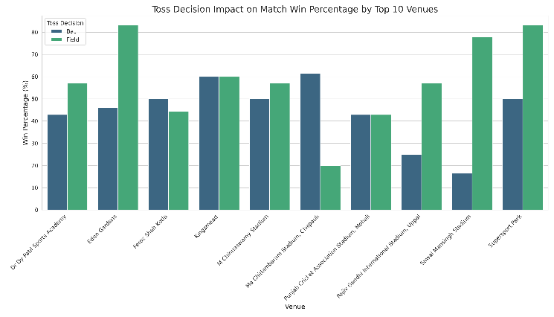
Exploratory Data Visualization
Top 10 Winning Teams (bar plot)
Average runs per venue
Toss Decision Impact in each venue
Insights:
Toss decisions affect win rate (~60% for fielding first)
Home ground advantage visible
MI and CSK are top winners historically

Slide 10
Sample Prediction Output
Example Input:
Venue: Wankhede
Team1: Chennai Super Kings
Team2: Mumbai Indians
Toss Winner: MI
Toss Decision: Field
Model Output:
Predicted Winner: CSK
Stats Displayed:
Batting Strength (runs/over)
Bowling Strength (wickets/over)
Head-to-head win ratios

Slide 11
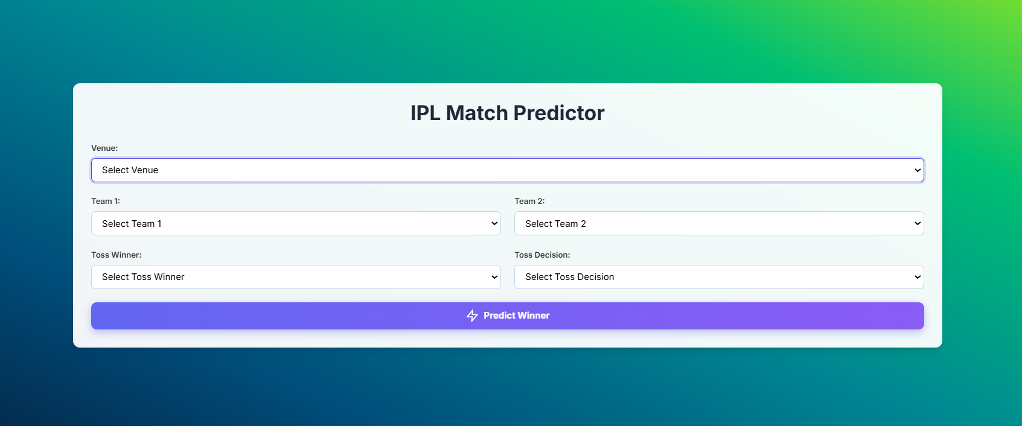
This the webpage developed

Slide 12
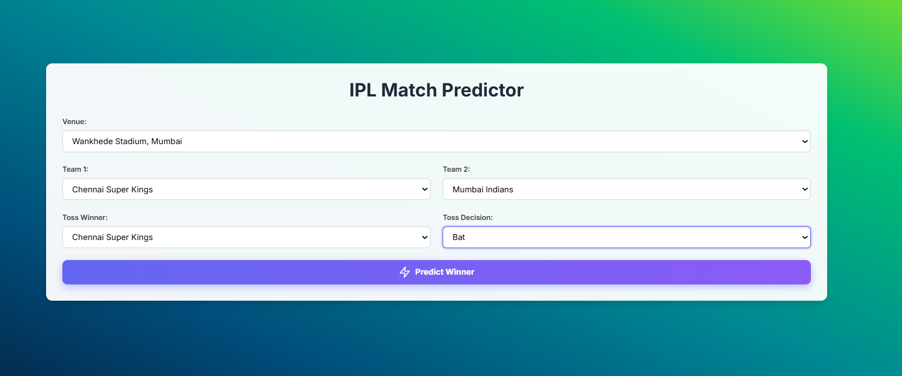
Details are entered

Slide 13
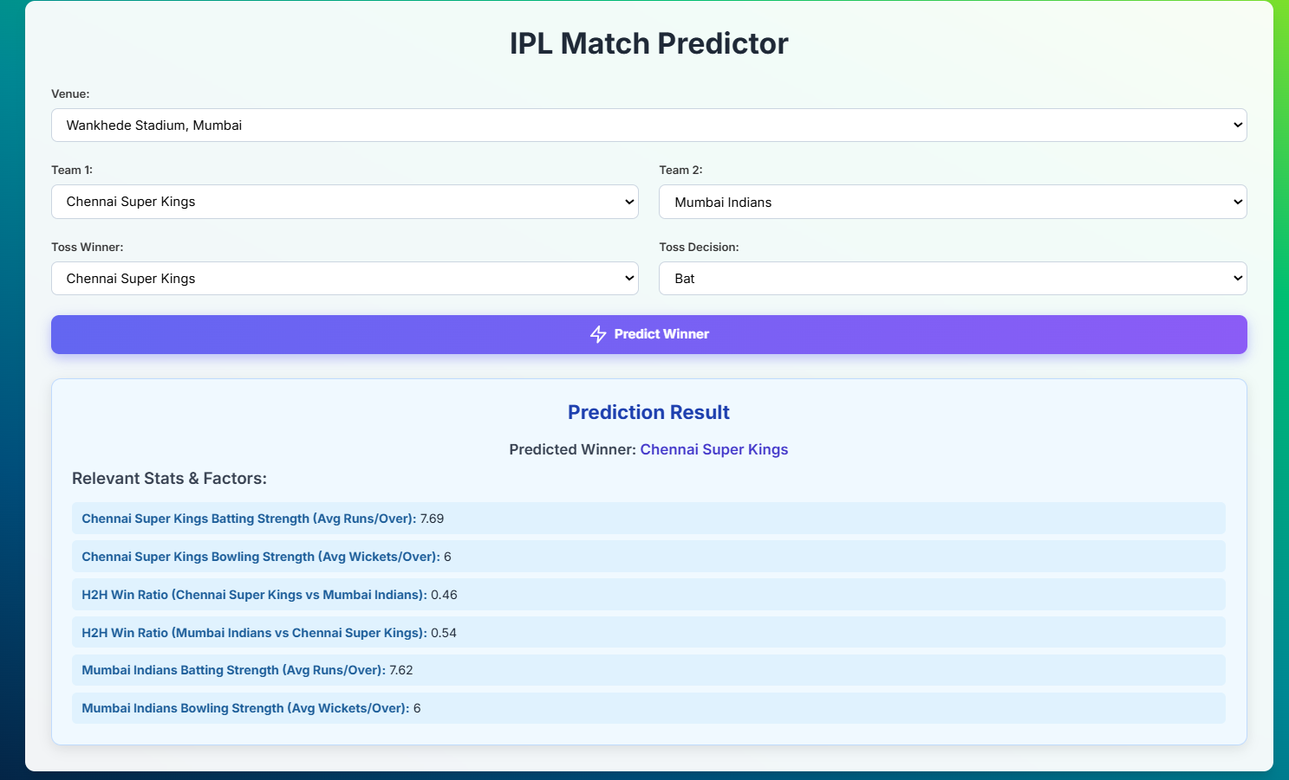
Model predicted the match result and displays the stats

Slide 14
Conclusion
Conclusion
Successfully built a working IPL match winner predictor
Used real stats, engineered features, and a robust ML model
End-to-end integration with a Flask-based UI
Thank you!

