Slide 1
INDUSTRIAL TRAINING PRESENTATION
By-Tanmay Thapliyal
Register number-RA1611003010817
Department of Computer Science and Engineering, SRMIST

Slide 2
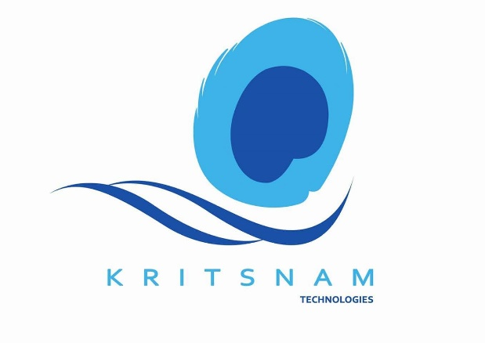
Kritsnam Technologies
Kritsnam Technologies is a company in the field of IoT with focus on water resource management systems. There main goal is to provide minimal cost, lightweight and efficient infrastructural devices that can monitor and handle water resources, be it natural or man-made. Their vision is to empower developing nations with cost effective and data-driven water resource management techniques.
To provide, implement and sustain these holistic solutions, the company will engage in multi-disciplinary collaboration with academia, governmental agencies and industries working in field of water resources.

Slide 3
Current Projects
Continuous Discharge measurement using ultrasonic tomography-
Non-intrusive
Cost-effective and real-time
Very accurate velocity profiles
Deployable on pipes, rivers and canals
Wireless communication infrastructure for Rural Settings:-
LPWAN standards: Proprietary and LoRa
Low-cost long-range nodes and gateways (DCU)
Low-power nodes (2 Years on 2 AA batteries)
Bidirectional communication
Maintenance free monitoring and automation

Slide 4
Current Projects
Low-cost Low-power water quality monitoring infrastructure:-
Low-cost but well calibrated accurate sensors
pH, conductivity, turbidity, absorbance, dissolved oxygen, trace metals, micro-organisms and bacteria
Tracking water quality with backend analytics for timely alerts and triggers
Pilot Project : Real-time water level and soil moisture monitoring infrastructure
First Critical Zone Observatory (CZO) in the Ganga basin
Water levels in ponds, canals, open/bore wells and small streams.
Soil moisture readings from agricultural fields & canal banks
Extremely cost-effective compared to GSM/GPRS based solutions

Slide 5
Executive Summary
During my work as an intern in the company, I worked on developing an android app for a handheld device, which would collect data from four different sensor on it namely PH, Dissolved Oxygen, Temperature and Electrical Conductivity sensors .It would then display the collected data for four sensors along with the one point or two point calibration as per the users choice.
It also plots a real time graph between the stream of the current calibrated reading versus time, and allows the user to generate the coordinates of the place where the readings are being taken.
One can also take a snapshot of the location where the readings are being taken.

Slide 6
Internship Plan
The task at hand was to develop an android application for receiving data for four different sensors namely Phsensor, Electrical Conductivity, Temperature and Dissolved Oxygen sensors and display the data with calibration.
The basic functionalities for Phsensor with one point calibration and graph mapping were already added by the person previously working on the project.
I worked on the Graphic User Interface (GUI) for every activity on the app.
Developed two point calibration feature for the phsensor.

Slide 7
Contd.
Added functionalities for Electrical Conductivity, Dissolved Oxygen and Temperature sensors.
Provided implementation to store one point and two point calibration values for all the four sensors in different ‘shared preferences’ so that when the app is closed and restarted later , the calibration values for each sensor are stored so that the user doesn’t have to recalibrate the app.
Added extra feature to take coordinates of the location where the readings are being taken

Slide 8
Weekly Report
Week 1:-
Worked on the basic GUI of the app.
Studied how two point calibration works and added its implementation.
Week 2:-
Added the implementations for other 3 sensors.
Used Shared Preferences to store the required calibration data for different sensors.
Week 3:-
Added the location and camera feature to the app.
Removed bugs pertaining to fixed two point calibration feature.
Week 4:-
Further improvements in the app.
Office Presentation.

Slide 9
Delivered Outcomes
The app is working perfectly displaying data from the dummy servers for four different sensors , with the assigned calibrations for the sensors.
Location feature is working properly displaying the coordinates where the readings are being taken. Camera still needs storage of clicked images to be implemented.

Slide 10
Conclusion
The internship at Kritsnam Technologies helped me to further learn and clear my concepts of programming in android and also to implement them in real time. They also helped me to acquire a real time experience about the company workspace environment which is for sure going to help me in my future endeavour.

Slide 11
References
Android Developers site (Documentation)
StackOverflow
Udacity Online Course for Android App Development
Swaroopch.com for Python
Django official site for Django documentation and tutorials
Link to Github Server :- https://git.kritsnam.in/summer18/programming/wq-handheld-androidapp

