Slide 1
Efficient Prescription Data Entry in EMR Software Project Guide – Dr. Pradeep S Team – Tanmay Shukla ( RA2011003010119 ) Khushi Suri ( RA2011003010129 )

Slide 2
Introduction
Efficient prescription data entry is crucial for modern healthcare, yet current EMR software often lags behind handwritten methods in speed. This study introduces a solution to align electronic prescription input with the swiftness of handwritten approaches. By analyzing the cognitive flow of manual prescription creation, the software's interface will be redesigned to replicate this process digitally. Predictive algorithms and tailored templates will anticipate and minimize data entry, resulting in quicker input. This not only enhances workflow efficiency but also improves patient care, pharmacy operations, and research. This project aims to bridge the convenience of handwritten prescriptions with digital EMR advantages, ensuring rapid and accurate prescription data entry while maintaining usability and effectiveness.

Slide 3
Problem Statement
Increase operational efficiency and expedite the process of prescription entry into a software platform by leveraging structured data, thereby reducing the time required in comparison to the traditional method of handwritten prescriptions.

Slide 4
Abstract
This presents a novel solution to enhance electronic prescription data entry efficiency in healthcare by aligning it with the speed of handwritten methods. Leveraging an analysis of the cognitive process behind manual prescription creation, our approach involves a digital interface redesign. Predictive algorithms and customized templates will streamline data entry, resulting in faster input. This not only optimizes workflow but also benefits patient care, pharmacy operations, and research. We will follow an iterative process involving analysis, design, and testing to develop and evaluate a prototype compared to traditional methods. Our research seeks to seamlessly combine the convenience of handwritten prescriptions with the advantages of digital EMR, ensuring swift and precise data entry while maintaining usability and effectiveness.

Slide 5
Objectives
The major goal of this MERN project is to improve prescription data entry within Electronic Medical Record (EMR) software, with the goal of considerably increasing speed and efficiency over old handwritten approaches. Our project aims to provide a streamlined, user-friendly solution that optimizes the prescription entry process, ultimately improving healthcare workflow, patient care, and the overall efficiency of the healthcare ecosystem by addressing the complexities and challenges of healthcare data, data security, and user adaptation.

Slide 6
Motivation
In today's healthcare environment, effective prescription data input is critical for providing high-quality patient care, optimizing pharmacy operations, and advancing medical research. Unfortunately, current EMR software frequently falls short of the speed associated with handwritten approaches, resulting in inefficiencies that affect both healthcare personnel and patients. This initiative was inspired by the urgent need to bridge the gap between traditional and computerized prescription processes. We hope to improve the overall quality of healthcare services by painstakingly examining the cognitive flow of manual prescription preparation and implementing novel software alternatives. Our project promises to transform prescription data entry, providing quick and accurate input while maintaining user-friendly interfaces and efficacy.

Slide 7
Literature Review
The present literature emphasizes the ongoing difficulty of electronic prescription data entry in healthcare. While electronic medical record (EMR) systems have many advantages, the speed and convenience of handwritten prescriptions remains unparalleled. This disparity has raised concerns about workflow efficiency, potential errors, and overall patient care quality. Several studies have stressed the significance of enhancing EMR interfaces to better reflect the cognitive processes required in manual prescription preparation. To simplify data entry, many prediction algorithms and customized templates have been developed. Our idea is inspired by these findings, with the goal of combining the convenience of handwritten prescriptions with the benefits of digital EMR, hence improving efficiency and patient care in the healthcare ecosystem.

Slide 8
Challenges
User Experience (UX): It is critical to design an intuitive and user-friendly interface for healthcare providers to submit prescription data efficiently. A big UX difficulty is ensuring that the system matches with clinician workflows.
Integration of Decision Support: EMR systems often incorporate decision support tools. Integrating these tools to assist with prescription accuracy and safety can be challenging.
Customization: Each healthcare facility may have its own workflow and set of requirements. It can be challenging to provide customization options while maintaining system integrity.

Slide 9
Limitations
Healthcare Data Complexity: Healthcare data is complicated and frequently unstructured. Dealing with various forms of data (for example, clinical notes, test findings, medication lists) can be difficult for data modeling and organization.
User Training and Adaptation: Healthcare personnel frequently have a limited amount of time to devote to training and adjusting to new systems. The learning curve may hamper a seamless transfer.

Slide 10
Innovative Idea
We are redefining prescription data entry within Electronic Medical Record (EMR) software in this pioneering endeavor. Our novel solution makes use of the RxNorm API's capability, allowing us to quickly acquire comprehensive pharmaceutical data. But we're not done yet; we've created an all-encompassing system that includes doctors, patients, and a dynamic pricing mechanism, providing a complete and efficient healthcare experience. Furthermore, our user validation mechanisms assure the highest level of accuracy and security. This comprehensive system promises to not only speed up prescription entry but also to reshape healthcare delivery.

Slide 11
Scope
This project's scope includes the creation of a full Electronic Medical Record (EMR) system for prescription data entry. It will incorporate the RxNorm API to retrieve pharmaceutical data, allowing for rapid and accurate prescription generation. Modules for doctors and patients will be included in the initiative, encouraging a collaborative healthcare environment. A variable price plan will also aid in scalability. Data integrity will be ensured by stringent user validation and security mechanisms. This initiative aims to improve healthcare operations and patient care by redefining prescription entry within EMR software.

Slide 12
Application
This project's applicability in the healthcare industry are extensive. It will improve productivity and reduce the likelihood of errors by streamlining prescription data entry for medical practitioners. An integrated system that improves communication with healthcare providers will benefit patients. The dynamic pricing approach allows healthcare facilities to be scalable and cost-effective. Furthermore, by strengthening data accuracy and security, this project has the ability to transform the prescription process, thereby improving patient care and healthcare operations.

Slide 13
Methodology
In the implementation of our Electronic Medical Records (EMR) software using the MERN stack, our methodology revolves around creating a seamless and efficient prescription data entry system. We began by designing an intuitive user interface for healthcare professionals, ensuring ease of use and quick access to patient records. Leveraging the power of the MERN stack, we integrated robust databases for secure data storage and retrieval. The implementation also involved rigorous testing and fine-tuning to guarantee data accuracy and system reliability. Overall, our system prioritizes precision, accessibility, and the utmost security for managing prescription data within the healthcare ecosystem.

Slide 14
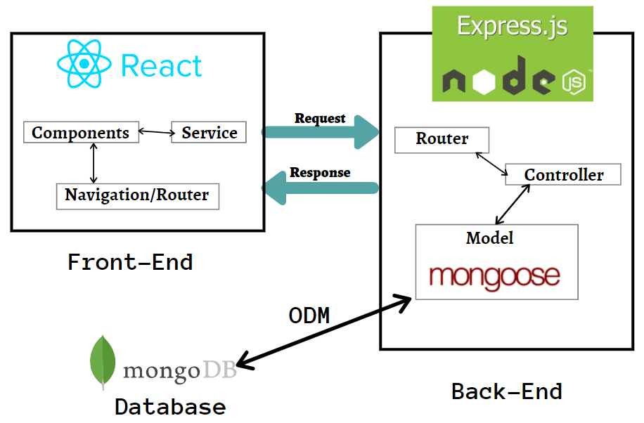
Architecture
The architecture of the project is based on a MERN stack, which includes a MongoDB database for storing healthcare data, Express.js for server-side logic, React for a user-friendly frontend, and Node.js for server operations. The RxNorm API integration retrieves drug information. The system features user modules for doctors and patients that allow them to create prescriptions and access medical records. Scalability is provided by a price module. This design seeks to provide a comprehensive, efficient, and secure solution that aligns prescription data entry in EMR software with the changing needs of healthcare.

Slide 15
Modules and Algorithms
Medication Data Module: This module retrieves detailed medication information from the RxNorm API. Algorithms are used to standardize and arrange drug data in order to facilitate retrieval and prescription generation. Application: Provides correct drug information to doctors, guaranteeing safe and successful prescribing practices.
Doctor-Patient Interaction Module: This component ensures secure contact between healthcare professionals and patients by utilizing encryption methods to protect data privacy. It enables doctors to enter prescription information and patients to view their medical records. Application: Improves patient involvement and information exchange in real time.

Slide 16
Modules and Algorithms
User Validation and Security Module: Enables data security and user validation by implementing user authentication techniques. To safeguard sensitive healthcare data, it incorporates encryption and access control techniques. Application: Protects patient information and keeps the healthcare system running smoothly.

Slide 17
Result & Discussion
Finally, this project marks an important development in healthcare technology. We developed a full MERN-based solution for efficient prescription data entry within EMR software by smoothly integrating RxNorm API, doctor-patient interaction, pricing models, and solid security. Our approach speeds up the prescription process and promotes better patient care and teamwork. We are on the path to rethinking healthcare workflows, assuring data accuracy and security, and ultimately increasing healthcare quality delivery.

Slide 18
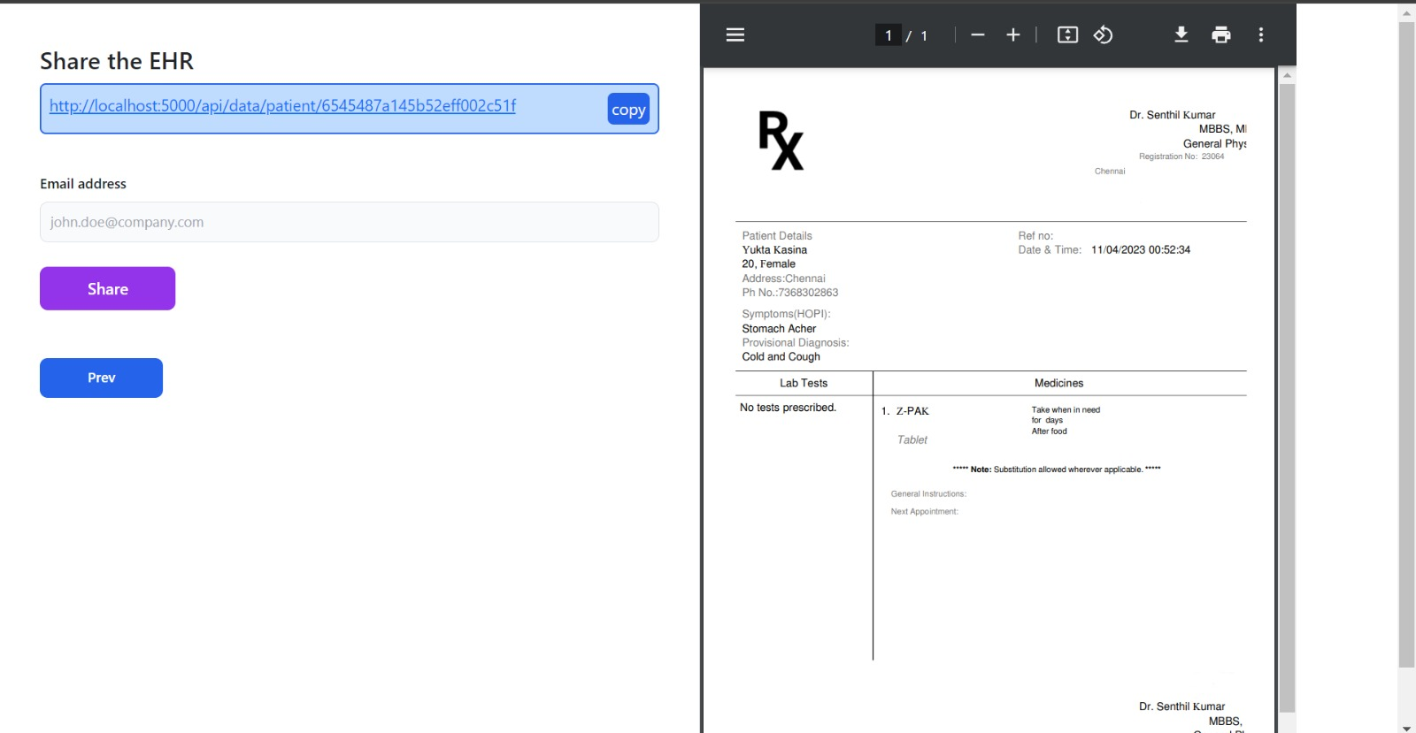
Output Screenshots

Slide 19
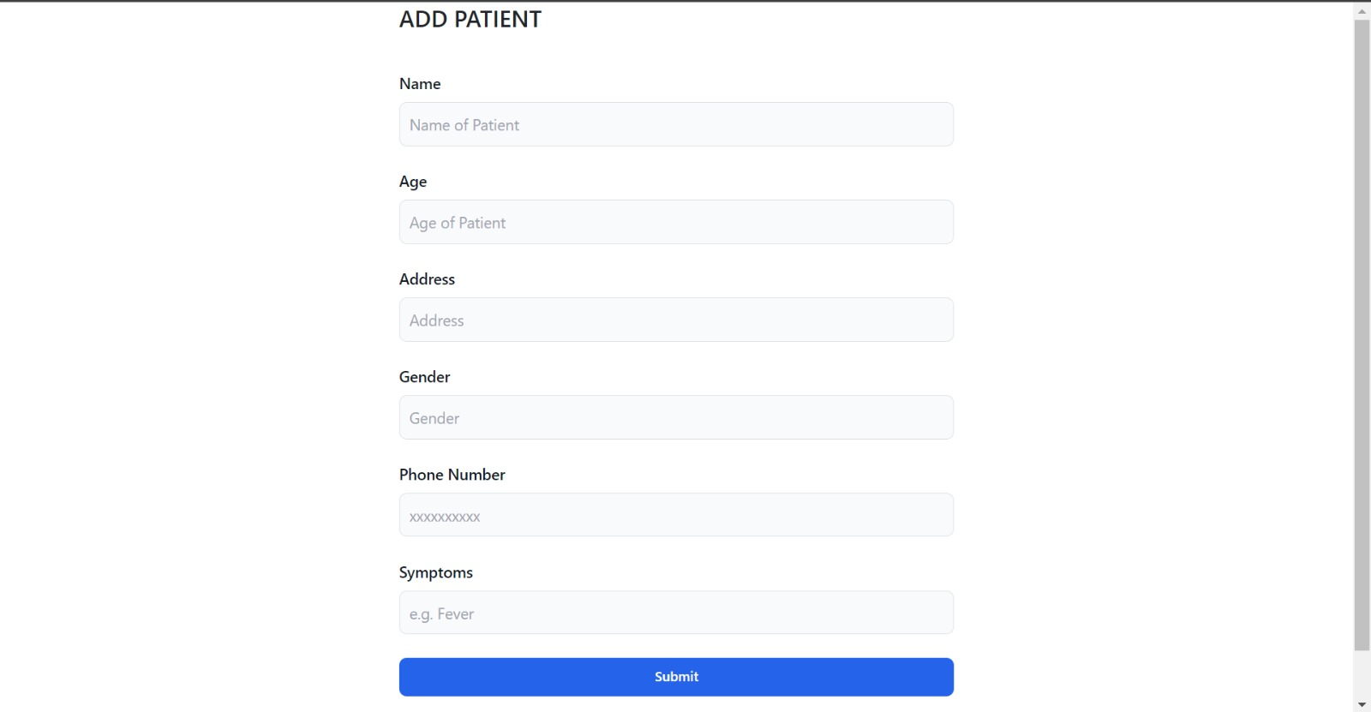
Output Screenshots

Slide 20
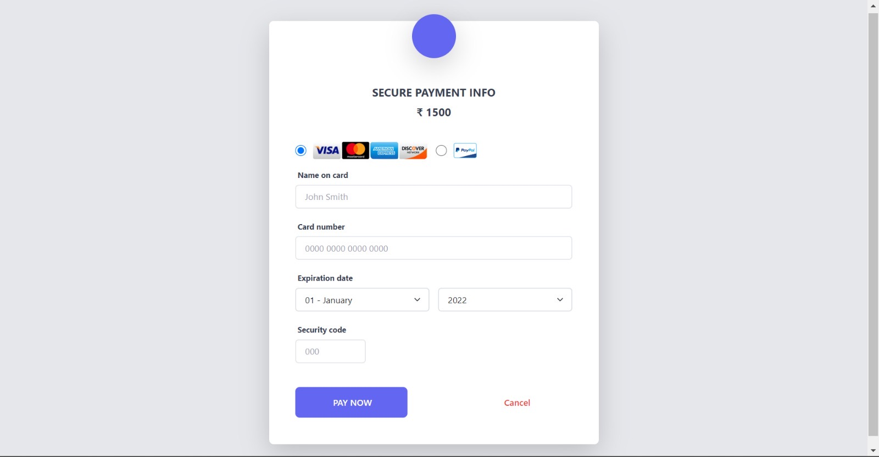
Output Screenshots

Slide 21
References
George Linn, Yung-Hsiang Ying, & Koyin Chang. (2018). Does Computerized Physician Order Entry Benefit from Dynamic Structured Data Entry? A Quasi-Experimental Study.
Salem Albagmi. (2021). The effectiveness of EMR implementation regarding reducing documentation errors and waiting time for patients in outpatient clinics: a systematic review.
Santosh G. Honavar. (2020). Electronic medical records – The good, the bad and the ugly.

Slide 22
Thank You!

