Slide 1
Serialization
In Java

Slide 2
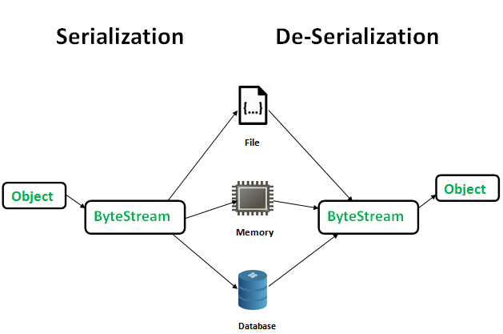
Serialization in Java
Serialization is a mechanism of converting the state of an object into a byte stream. Deserialization is the reverse process where the byte stream is used to recreate the actual Java object in memory. This mechanism is used to persist the object.

Slide 3
The byte stream created is platform independent. So, the object serialized on one platform can be deserialized on a different platform.
To make a Java object serializable we implement the java.io.Serializable interface.
The ObjectOutputStream class contains writeObject() method for serializing an Object.
Declaration:
public final void writeObject(Object obj) throws IOException
The ObjectInputStream class contains readObject() method for deserializing an object.
public final Object readObject() throws IOException, ClassNotFoundException

Slide 4
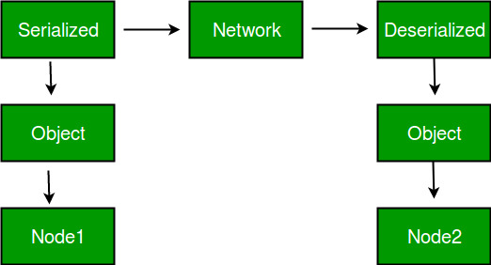
Advantages of Serialization
To save/persist state of an object.
To travel an object across a network.

Slide 5
Only the objects of those classes can be serialized which are implementing java.io.Serializable interface. Serializable is a marker interface (has no data member and method). It is used to “mark” java classes so that objects of these classes may get certain capability.

Slide 6
Points to remember
If a parent class has implemented Serializable interface then child class doesn’t need to implement it but vice-versa is not true.
Only non-static data members are saved via Serialization process.
Static data members and transient data members are not saved via Serialization process.So, if you don’t want to save value of a non-static data member then make it transient.
Constructor of object is never called when an object is deserialized.
Associated objects must be implementing Serializable interface.

Slide 7
Transient Keyword
transient is a variables modifier used in serialization. At the time of serialization, if we don’t want to save value of a particular variable in a file, then we use transient keyword.
When JVM comes across transient keyword, it ignores original value of the variable and save default value of that variable data type.
transient keyword plays an important role to meet security constraints. There are various real-life examples where we don’t want to save private data in file.
Another use of transient keyword is not to serialize the variable whose value can be calculated/derived using other serialized objects or system such as age of a person, current date, etc.
Practically we serialized only those fields which represent a state of instance, after all serialization is all about to save state of an object to a file. It is good habit to use transient keyword with private confidential fields of a class during serialization.

Slide 8
Example
class Test implements Serializable
{
// Making password transient for security
private transient String password;
// Making age transient as age is auto-
// computable from DOB and current date.
transient int age;
// serialize other fields
private String username, email;
Date dob;
}

Slide 9
transient and static : Since static fields are not part of state of the object, there is no use/impact of using transient keyword with static variables. However there is no compilation error.
In case of static Variables:- A variable defined with static keyword is not serialized during serialization process.This variable will be loaded with current value defined in the class during deserialization.
transient and final : final variables are directly serialized by their values, so there is no use/impact of declaring final variable as transient. There is no compile-time error though.

