Slide 1
Remote Diagnostic Center
Packaging Machines
Prepared by: AB

Slide 2



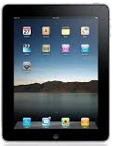


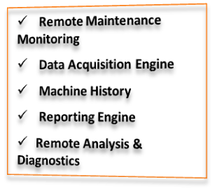
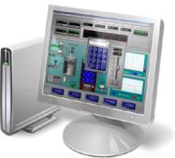
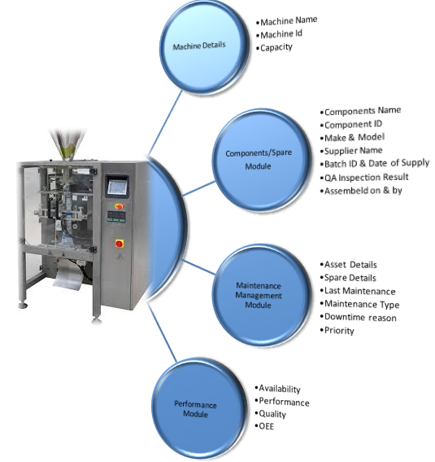


Typical RDC Architecture
Secured Connectivity
Wi-Fi
Smart Devices
Client 1 & 2
DB Engine
RDC Server
Smart Machine
Virtual Support Engineer

Slide 3
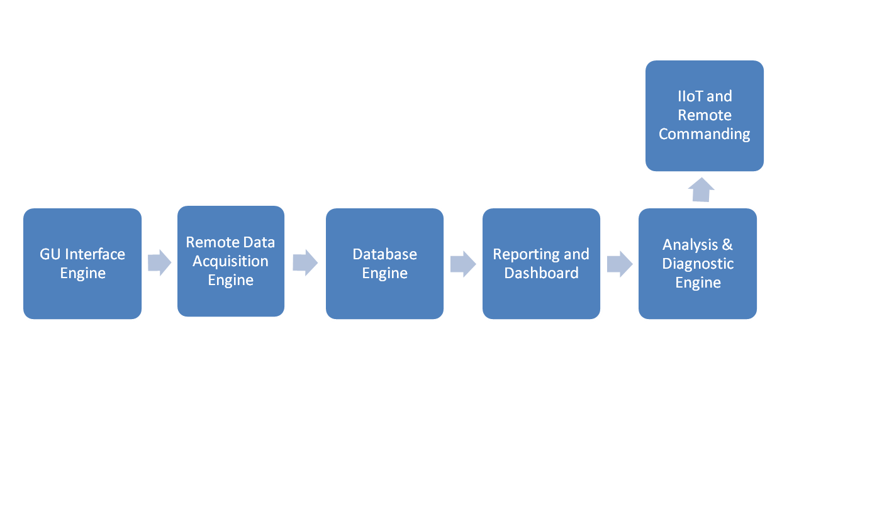
RDC Server High level Architecture

Slide 4
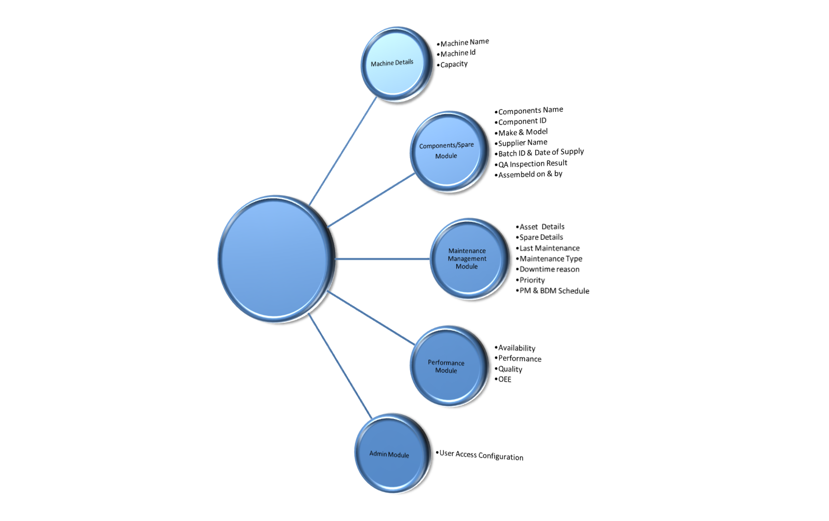
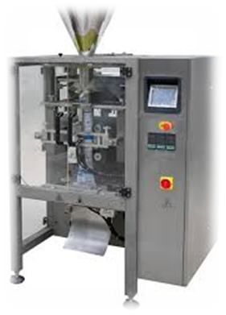
Packaging Machine – Sample Object Model

Slide 5











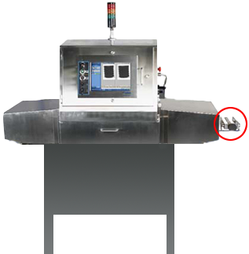

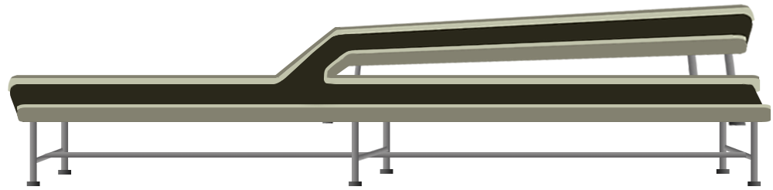


Plant - Remote Support & Diagnostics
Remote Diagnostic Center
Diagnostic Commands
Machine X Failed

Slide 6
Thank you

