Slide 1
EMPATHY AI: Personalized Virtual Companion for Emotional Support and Guidance
PIP2001 Capstone Project
Review-1
Batch Number: 176
Under the Supervision of,
Mr. Amarnath J.L
School of Computer Science and Engineering
Presidency University
Roll Number | Student Name
20211CSE0288 20211CSE0297 20211CSE0697
 | TANMAYEE HN
 | KUSHIE P GOWDA
 | RITU JAISWAL R
Name of the Program: CSE
Name of the HoD: Dr. Asif Mohammed H.B
Name of the Program Project Coordinator: Mr. Amarnath J.L & Dr. Jayanthi. K.
Name of the School Project Coordinators: Dr. Abdul Khadar A

Slide 2
Content
Introduction
Literature Review
Proposed Method
Objectives
Methodology
Timeline of the Project
Expected Outcomes
Conclusion
References

Slide 3
Introduction
In today's digital age, AI has opened new avenues for enhancing emotional well-being. Empathy AI is an innovative virtual companion designed to support individuals in managing their mental health. By using emotion detection technologies like facial recognition, text analysis, and voice sentiment analysis, Empathy AI offers personalized, real-time emotional support. It addresses the growing demand for accessible and scalable mental health solutions by providing adaptive suggestions based on users' moods and mental states.

Slide 4
Literature Review
1. Emotion Detection Technologies:
Early research by Ekman (1972) on facial expressions laid the foundation for emotion recognition.
Zeng et al. (2009) explored multimodal emotion recognition using facial, voice, and text cues for improved accuracy.
2. AI and Mental Health:
Woebot (Fitzpatrick et al., 2017) demonstrated AI's effectiveness in delivering cognitive behavioral therapy (CBT).
Fiske et al. (2019) emphasized the importance of empathetic, adaptive AI systems in mental health support.
3. AI for Emotional Companionship:
Friedman et al. (2020) highlighted the role of virtual agents in providing companionship for the elderly.
Hwang et al. (2021) showed AI's potential in helping users regulate emotions through adaptive conversations.

Slide 5
Proposed Method
1. Emotion Detection Module:
Utilizes facial recognition, voice analysis, and text sentiment analysis.
CNNs for facial recognition, RNNs for text, and speech analysis detect user emotions.
2. Personalization Engine:
Uses user history and detected emotions to generate tailored responses.
Reinforcement learning adapts responses based on user feedback for empathetic interaction.
3. Feedback & Suggestion Module:
Provides real-time advice, mood-boosting activities (e.g., mindfulness, journaling, music).
Offers conversational prompts to promote emotional awareness and self-reflection.

Slide 6
Objectives
Accurate Emotion Detection: To develop a system capable of accurately detecting user emotions from facial expressions, voice tones, and text analysis.
Personalized Emotional Support: To create a system that offers individualized emotional support and guidance based on real-time detection and user history.
Adaptation and Learning: To design an AI that improves over time by learning from user feedback and adapting its responses to align with the user’s emotional needs.
User Engagement: To provide a user-friendly, empathetic interface that encourages continuous engagement and emotional reflection.

Slide 7
Methodology
Data Collection:
Facial Expression Data: A dataset of facial expressions (e.g., FER2013) will be used to train the facial emotion detection model.
Speech and Text Data: Publicly available emotional speech and text datasets (e.g., IEMOCAP, Sentiment140) will be utilized to train the voice and text sentiment analysis models.
Model Development:
Emotion Detection: The system will use CNNs for facial recognition, Mel-Frequency Cepstral Coefficients (MFCCs) and RNNs for voice analysis, and Transformer models for sentiment detection in text.
Response Generation: A Transformer-based model (similar to GPT) will be used to generate empathetic, context-aware responses.

Slide 8
Methodology
3.Evaluation:
User testing will be conducted to assess the system’s accuracy in emotion detection and the appropriateness of generated responses.
A/B testing will help fine-tune the personalization engine and gauge user engagement.
4.Implementation:
The application will be developed as a web-based platform, accessible via both desktop and mobile interfaces. Python and Flask will be used for backend development, while React will handle frontend tasks.

Slide 9
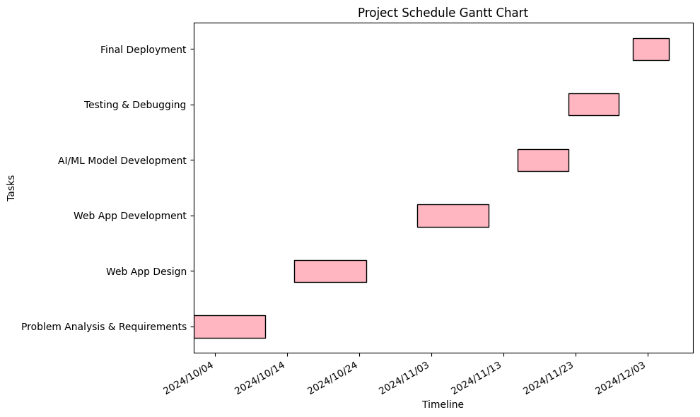
Timeline of the Project (Gantt Chart)

Slide 10
Expected Outcomes
High Emotion Detection Accuracy: The system is expected to achieve an emotion detection accuracy of over 80% by integrating multimodal data from facial expressions, voice, and text inputs.
Effective Emotional Support: By offering personalized, context-aware responses, the system will provide meaningful emotional support, leading to improved user satisfaction and engagement.
Learning and Adaptation: Over time, Empathy AI will adapt to individual users’ emotional patterns, becoming more effective in providing relevant and helpful guidance.
Enhanced Emotional Awareness: Users will gain better insight into their emotional state and learn strategies for emotional regulation through real-time feedback.

Slide 11
Conclusion
Empathy AI represents an innovative step in using artificial intelligence for emotional well-being. By combining state-of-the-art emotion detection and natural language generation, the system acts as a personalized virtual companion, offering emotional support and guidance. As emotional well-being becomes an increasingly important area in public health, AI systems like Empathy AI have the potential to offer scalable, accessible, and meaningful assistance to users in need. With further research and development, such systems could be pivotal in transforming how emotional support is delivered in the digital age.

Slide 12
References
Zeng, Z., Pantic, M., Roisman, G. I., & Huang, T. S. (2009). A survey of affect recognition methods: Audio, visual, and spontaneous expressions. IEEE Transactions on Pattern Analysis and Machine Intelligence, 31(1), 39-58.
Fiske, S. T., Cuddy, A. J. C., & Glick, P. (2019). The humanizing of machines: How robots and AI might serve as companions. Annual Review of Psychology, 70, 129-154.
Friedman, B., Kahn, P. H., & Borning, A. (2020). Human agency and AI systems: A study of human-computer interaction and emotional well-being. ACM Transactions on Human-Computer Interaction, 27(3), 15.
Hwang, T. I., Wu, S., & Tang, C. (2021). Emotional regulation through artificial intelligence: A review of current methods. Journal of Affective Computing, 14(4), 1098-1112.

Slide 13


