Slide 1
EMPATHY AI: Personalized Virtual Companion for Emotional Support and Guidance
PIP2001 Capstone Project
Review-0
Batch Number: 194
Under the Supervision of,
Dr . Amarnath J.L
School of Computer Science and Engineering
Presidency University
Roll Number | Student Name
20211CSE0288 20211CSE0297 20211CSE0697
 | TANMAYEE HN
 | KUSHIE P GOWDA
 | RITU JAISWAL R
Name of the Program: CSE
Name of the HoD: Dr. Asif Mohammed H.B
Name of the Program Project Coordinator: Mr. Amarnath J.L & Dr. Jayanthi. K.
Name of the School Project Coordinators: Dr. Abdul Khadar A

Slide 2
Content
Problem Statement
GitHub Link
Analysis of Problem Statement
Timeline of the Project
References

Slide 3
Problem Statement
In today's fast-paced world, mental health issues and emotional well-being often go unnoticed or unaddressed due to the lack of timely support and understanding. Traditional AI assistants focus on functional responses, but there is a growing need for systems that can provide emotional support and personalized suggestions. Empathy AI seeks to fill this gap by creating an AI assistant capable of detecting and tracking a user’s mood, offering emotionally intelligent responses, and acting as a supportive, friendly companion.

Slide 4
Problem Statement Number:
Category : Software
Problem Description:
Empathy AI is a web-based assistant designed to detect and track users' emotional states, providing real-time responses and personalized suggestions based on mood. The project aims to create a responsive AI that acts as a virtual friend, helping users manage their emotions by offering recommendations and insights. By integrating AI/ML models for emotion detection and a real-time web interface, the project addresses the growing need for emotional well-being assistance through technology.
Difficulty Level: Complex

Slide 5
GitHub Link
GitHub Link:

Slide 6
Analysis of Problem Statement
Lack of Emotional Awareness in Existing AI Systems: While current AI assistants excel in providing information and task automation, they do not understand or respond to user emotions.
Emotional Support Demand: With rising mental health awareness, there is an increasing demand for empathetic, non-intrusive support systems that offer comfort, advice, and emotional connection.
Feasibility of AI-Driven Mood Detection: Using machine learning algorithms, NLP, and sentiment analysis, it is possible to develop systems that analyze voice tones, text patterns, or even facial expressions to gauge a user’s emotional state.
Potential Ethical Concerns: Empathy AI must address privacy concerns related to data collection, the accuracy of emotional interpretation, and ethical handling of sensitive emotional information.

Slide 7
Analysis of Problem Statement (contd...)
Technology Stack Components:
Software Requirements:
Frontend: HTML, CSS, JS , React
Backend: NodeJS,
Database: Firebase
AIML Frameworks : Natural Language Processing (NLP), BERT & GPT for sentiment analysis and dialogue generation, OpenCV and Deep Learning.

Slide 8
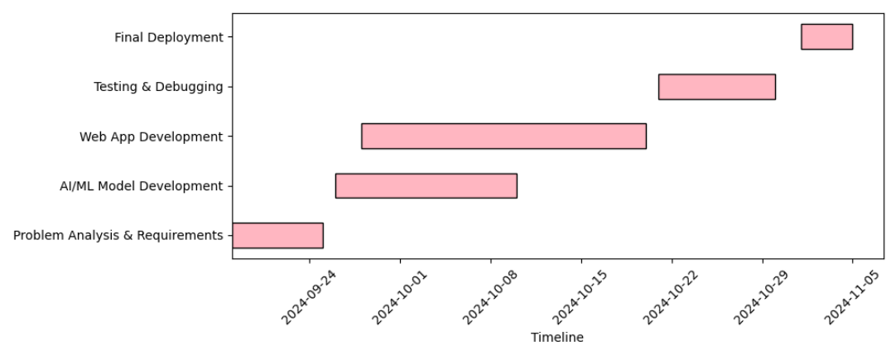
Timeline of the Project (Gantt Chart)

Slide 9
References
Mehta, D., Siddiqui, M. F., & Javaid, A. Y. (2019). Facial emotion recognition: A survey and real-world user experiences in mixed reality. Sensors, 19(3), 533. - A comprehensive survey on facial emotion recognition technologies, offering insights into practical applications in real-world scenarios
Picard, R. W. (1997). Affective Computing. MIT Press: This foundational book on affective computing discusses how computers can recognize and simulate human emotions, laying the groundwork for emotion AI technologies.
Building Machines That Learn and Think Like People by Josh Tenenbaum et al : This paper discusses advances in AI that aim to replicate human-like understanding and reasoning, which could be relevant when designing systems to detect and respond to empathy.

Slide 10


