Slide 1
IBM University Engagement Project Submission
“Exploring the Power of Agentic AI with IBM Granite and LangFlow”

Slide 2
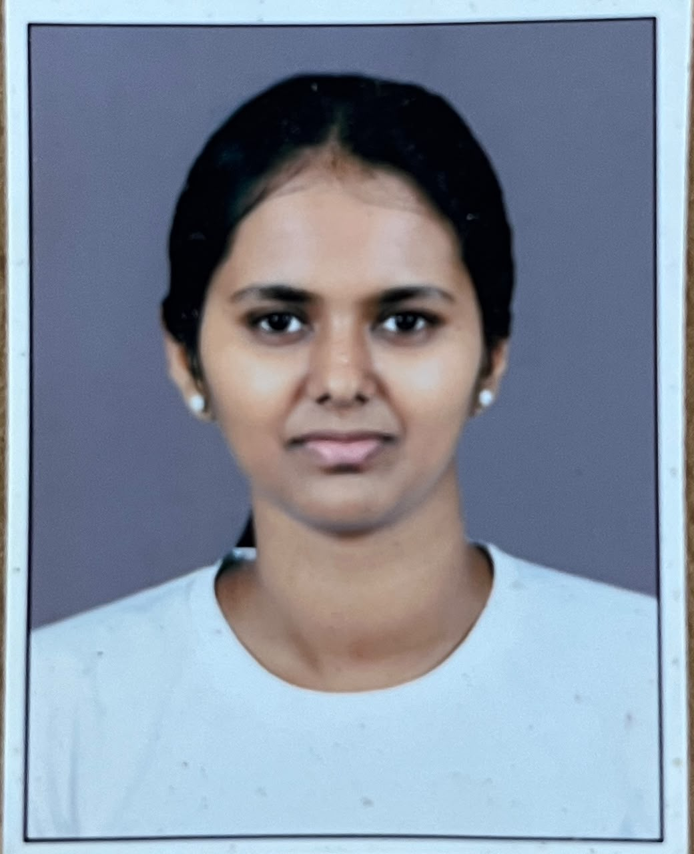
Project Tile – [Research Agent]
Domain of Project – [Healthcare/Education/Business/Finance]
Student Name | Recent Passport Photo | Email ID | Mobile number [WhatsApp]
Tanmayi Rahul Salunkhe |  | salunkhetanmayi328@gmail.com | 7499397045

Slide 3
Problem Statement -
Problem Statement : Research Agent
The Challenge
Researchers, students, and professionals often deal with scattered academic papers, technical articles, and experimental data spread across multiple platforms. Filtering relevant knowledge, summarizing insights, and keeping track of the latest developments is time-consuming and inefficient. The challenge is not just to collect references but to synthesize, analyze, and generate actionable research insights in real time.
The Objective
1. Fuse Academic Sources: Aggregate data from research papers, journals, preprints, and knowledge repositories, then synthesize them into clear, concise literature reviews.
2. Enable Multimodal Research Input: Accept user queries, notes, charts, or even PDFs, and convert them into structured insights, references, and summaries.
3. Create a Predictive & Agentic Layer: Highlight emerging trends, detect citation gaps, and predict promising directions for future research in a given domain.

Slide 4
Proposed Solution -
The proposed solution is to develop an AI-powered Research Agent that automates the process of searching, analyzing, summarizing, and organizing research information from multiple trusted sources. Instead of manually browsing numerous websites and papers, users can enter a research topic or question, and the agent will generate a comprehensive report with key insights, references, and summaries.
The Research Agent uses Natural Language Processing (NLP) and Large Language Models (LLMs) to understand user queries. It retrieves relevant information from academic databases, journals, trusted websites, and other online resources using AI-powered search techniques. The collected information is then filtered to remove duplicates and irrelevant content before being summarized into a concise and easy-to-read format.
The system also provides:
AI-generated summaries of research papers.
Comparison of different research papers and viewpoints.
Citation and reference generation in standard formats (APA, IEEE, MLA).
Keyword extraction and topic classification.
Interactive chatbot interface for asking follow-up questions.
Downloadable research reports in PDF or Word format.
Search history and saved research projects for future reference.

Slide 5
Technology Used
Langflow platform -For designing and orchestrating multi-agent workflows visually
IBM Granite model - for eg – ibm-granite-3-2-8b – For natural language understanding, reasoning, and personalization
IBM Cloud – It provides the infrastructure to build, deploy, and scale the Nutrition Agent efficiently. IBM Cloud enables a reliable, secure, and scalable environment for deploying the Nutrition Agent.
RAG– RAG to fetch real data first, then generate intelligent answers, making the Nutrition Agent more trustworthy and effective.
IBM Watsonx.ai - For model deployment, embeddings, and AI governance
Vector Database (FAISS/Chroma) – For RAG-based nutritional data retrieval

Slide 6
Langflow component Used -
1) Chat Input – Interface where users enter their queries, preferences, or meal details (text/voice/image).
2) IBM watsonx AI Agent - Processes user input using Granite models to generate personalized nutrition insights and recommendations.
3) Name of IBM Granite model - Granite-4.0-8B-Instruct → Fast, efficient for real-time diet recommendations
4) Chat output -Displays AI-generated responses such as diet plans, nutritional analysis, and health suggestions.
5) File component - Stores and retrieves user data, meal logs, and nutritional datasets for analysis and tracking.

Slide 7
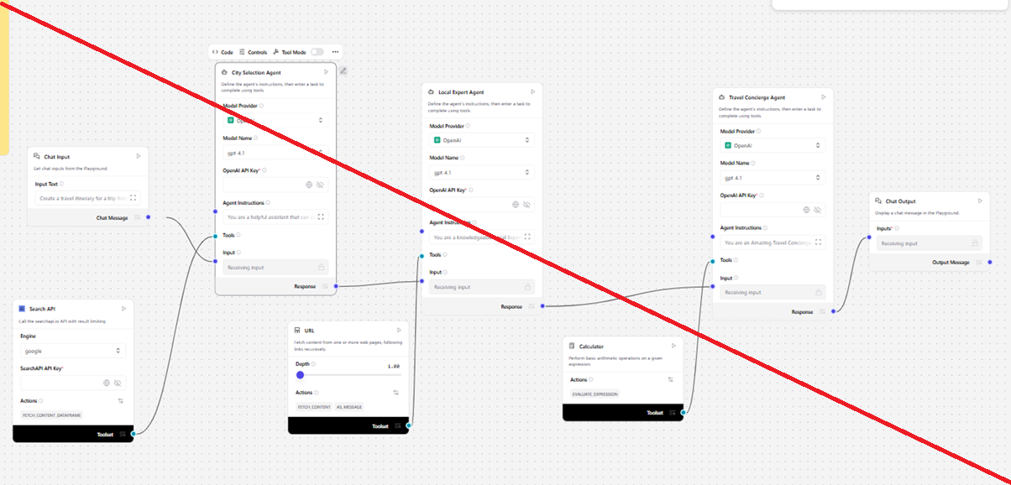
Langflow workflow -

Slide 8

Architecture blueprint

Slide 9

Role of Agentic AI in the solution
Role of Agentic AI in Nutrition Agent
Agentic AI enables the Nutrition Agent to function as an intelligent, autonomous system rather than a simple chatbot. Using IBM watsonx.ai and IBM Granite models, it coordinates multiple specialized agents to deliver personalized nutrition guidance.
Each agent performs a specific role—such as retrieving nutritional data, generating diet plans, providing health advice, and analyzing food logs—while working collaboratively. This multi-agent approach ensures efficient task execution and accurate results.
Agentic AI also brings context awareness, understanding user details like age, health conditions, and fitness goals to generate tailored recommendations. It supports real-time adaptation, continuously updating suggestions based on user inputs like daily meals.
Additionally, agents communicate with each other, enabling better decision-making and improved outcomes.
Overall, Agentic AI makes the system proactive, personalized, and goal-driven, acting like a smart digital nutritionist that helps users maintain a healthy lifestyle.

Slide 10


Token Usage
11,761 token are used
Before Prompt
After the Prompt
·
·
·

Slide 11
Novelty and Uniqueness
The proposed Nutrition Agent stands out by combining Agentic AI, RAG, and personalization into a single intelligent system.
Multi-Agent Intelligence – Instead of a single chatbot, multiple specialized agents collaborate to deliver accurate and context-aware nutrition guidance.
RAG-Based Accuracy – Integrates real-time data retrieval with AI generation, reducing misinformation and ensuring trustworthy recommendations.
Hyper-Personalization – Tailors diet plans based on health conditions, cultural preferences, and fitness goals.
Real-Time Feedback Loop – Continuously adapts recommendations based on daily food logs and user behavior.
Multi-Modal Input – Supports text, voice, and image-based meal tracking for better usability.
Preventive Healthcare Focus – Goes beyond diet planning to provide disease-specific nutrition advice.
Scalable & Enterprise-Ready – Built on IBM watsonx.ai with IBM Granite models, ensuring reliability and governance.
This makes the solution a smart, adaptive, and proactive digital nutritionist, not just a static diet recommendation tool.

Slide 12
Git Hub Link
Github URL – https://github.com/Tanmayi-Salunkhe/research-agent
·
·
·

Slide 13
Future Scope
1.Integration with Wearables & Health Devices –
The system can be integrated with smartwatches and fitness trackers to collect real-time data such as steps, calories burned, heart rate, and sleep patterns. This will enable the Nutrition Agent to provide more accurate and dynamic diet recommendations based on actual user activity and health metrics.
2.AI-Powered Voice Assistant & Multilingual Support –
Enhancing the system with a voice-enabled assistant and support for multiple languages will improve accessibility. Users can interact naturally in their preferred language, making the solution more inclusive and suitable for diverse populations, especially in regions with varied linguistic backgrounds.
·
·
·

Slide 14
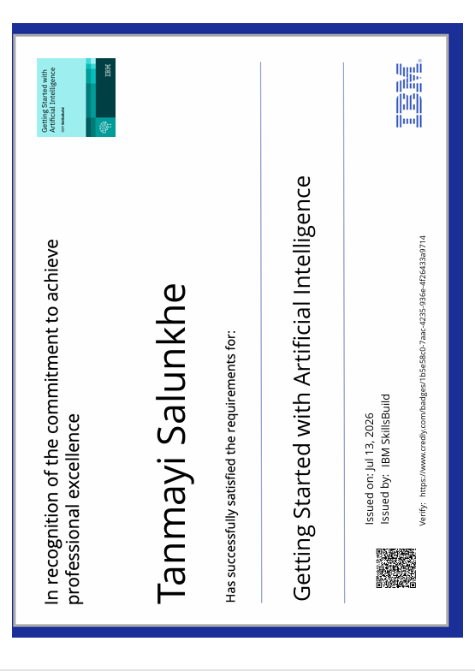
Certificates Earned:

Slide 15
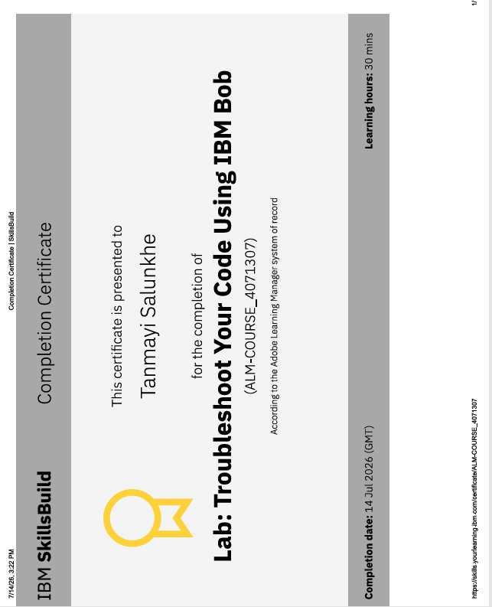
Certificates Earned:​

Slide 16


