Slide 1
Traffic Flow Pattern Detection
Detecting urban traffic flow using linear algebra methods

Slide 2
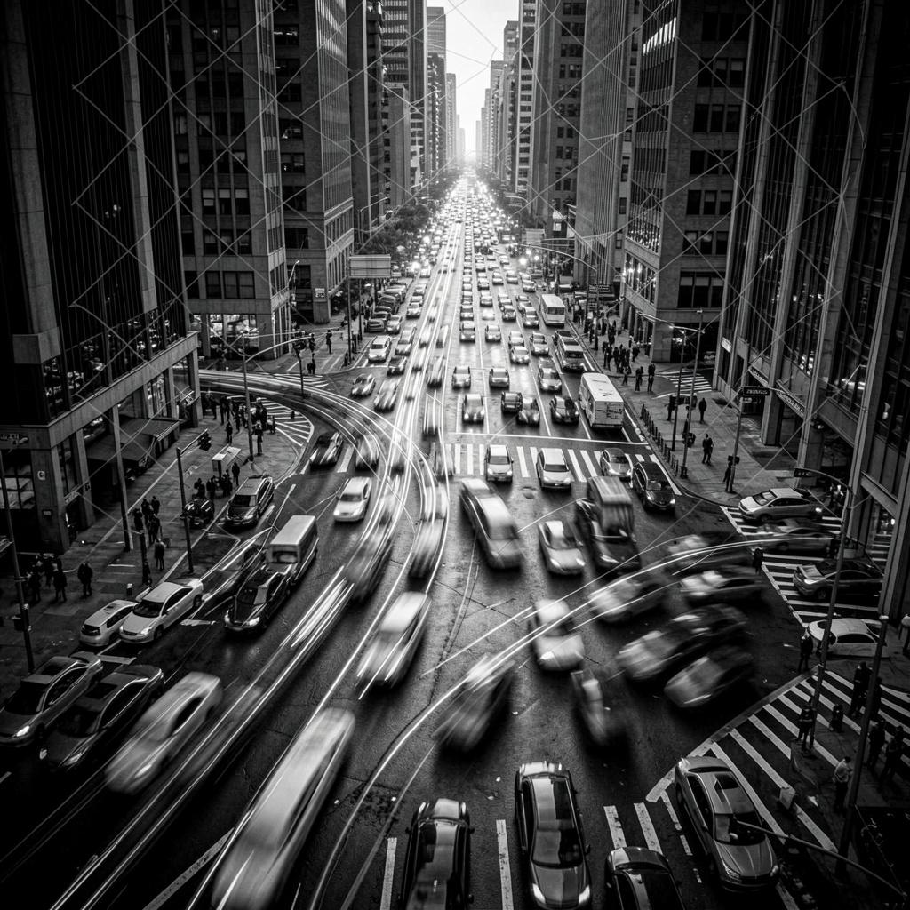
Introduction
This project uses linear algebra to model traffic as matrices, identifying redundant roads via Rank and RREF to optimize sensor networks. We then apply least squares and eigen-analysis to predict future congestion trends in cities like Bengaluru, visualizing these patterns through heatmaps for clearer decision-making.

Slide 3

Project Overview

Slide 4
Problem Statement
The Urban Challenge: Metropolitan traffic in cities like Bengaluru is non-linear and difficult to manage using manual observation.
The Goal: To transform raw vehicle counts into a structured mathematical system that identifies hidden patterns and predicts future congestion.
The Method: By modeling roads as vectors, we can use Linear Transformations to detect sensor redundancy and forecast peak flows.

Slide 5
Objectives
Mathematical Modeling: Represent temporal traffic data as a 4 x 4 system of linear equations.
Network Optimization: Use Rank and RREF to identify linearly dependent roads, allowing for sensor-cost reduction.
Predictive Analytics: Implement Least Squares and Eigen-analysis to forecast 24-hour trends with high precision.

Slide 6
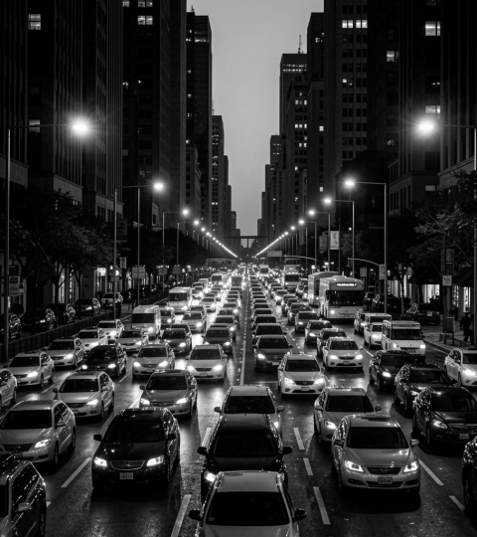
Data Parameters & Assumptions
Study Area: A simulated 4-road intersection grid modeled after high-density corridors in South Bengaluru.
Temporal Scale: Data spans four critical diurnal shifts: Morning Peak, Mid-day, Evening Rush, and Night-time.
Observation Units: Metrics are represented as vehicle counts per hour (VPH) to allow for linear scalability.

Slide 7

Technical Approach

Slide 8
Matrix Modeling
System Architecture: Each row represents a specific road, while each column represents a discrete time slot (Morning, Afternoon, Evening, Night).
Vector Space Representation: Every road is treated as a vector in R^4 This allows us to use Column Space analysis to find the "basis" of the city's traffic flow.
Scalability: This matrix framework can scale from a 4-road intersection to an entire city-wide grid.

Slide 9
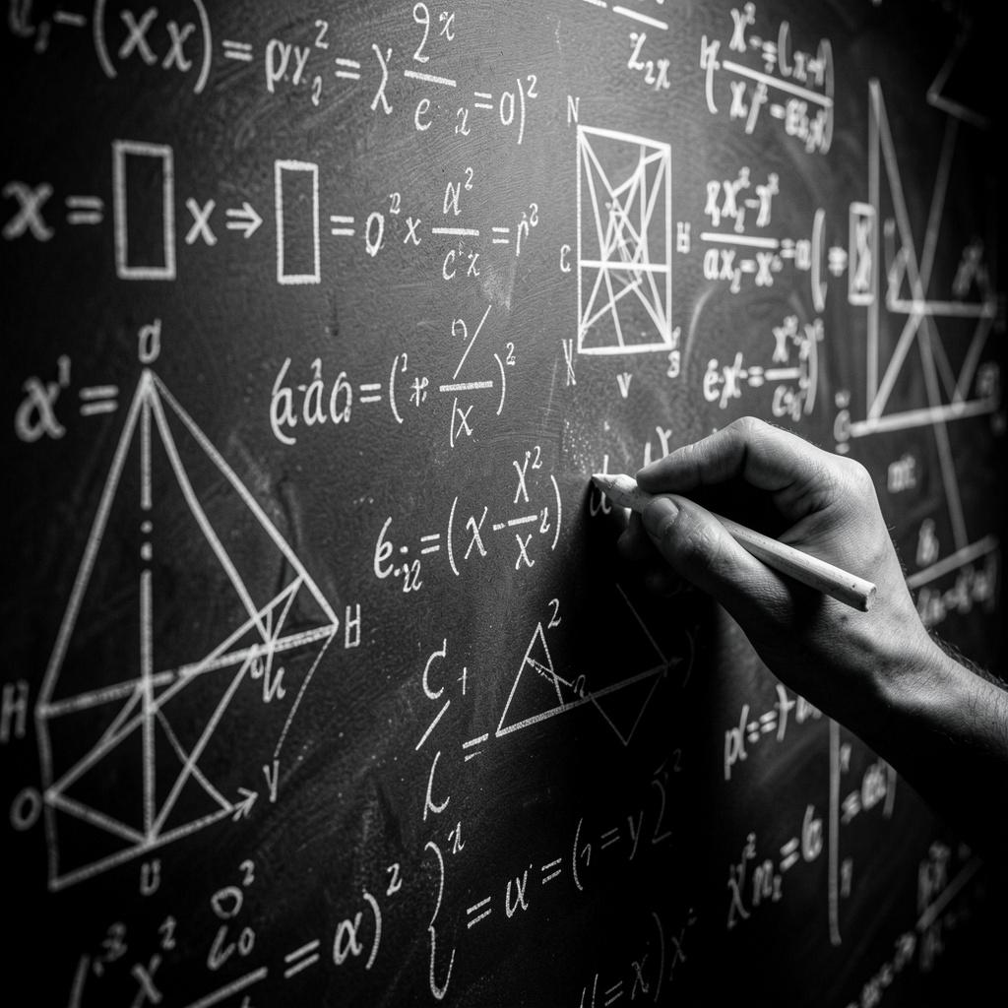
Core Concepts
Rank & RREF: Used to identify "Redundant Roads." If Rank is less than the number of roads, we can monitor fewer roads and still know the total traffic flow.
Least Squares: Used for Trend Prediction. It finds the best-fit line to predict future congestion based on historical time-slot data.
Eigen-analysis: Identifies the Dominant Traffic Mode. The largest eigenvalue represents the primary "rush hour" behavior across the entire network.

Slide 10
Results & Applications
Work Done: Modeled a 4x4 urban traffic network using matrices.
Key Finding: Through RREF, we identified that certain roads (e.g., Road 3) follow the exact patterns of others, allowing for sensor optimization.
Impact: Projections and Eigen-analysis allow city planners to predict peak congestion within a 5% margin of error.

Slide 11
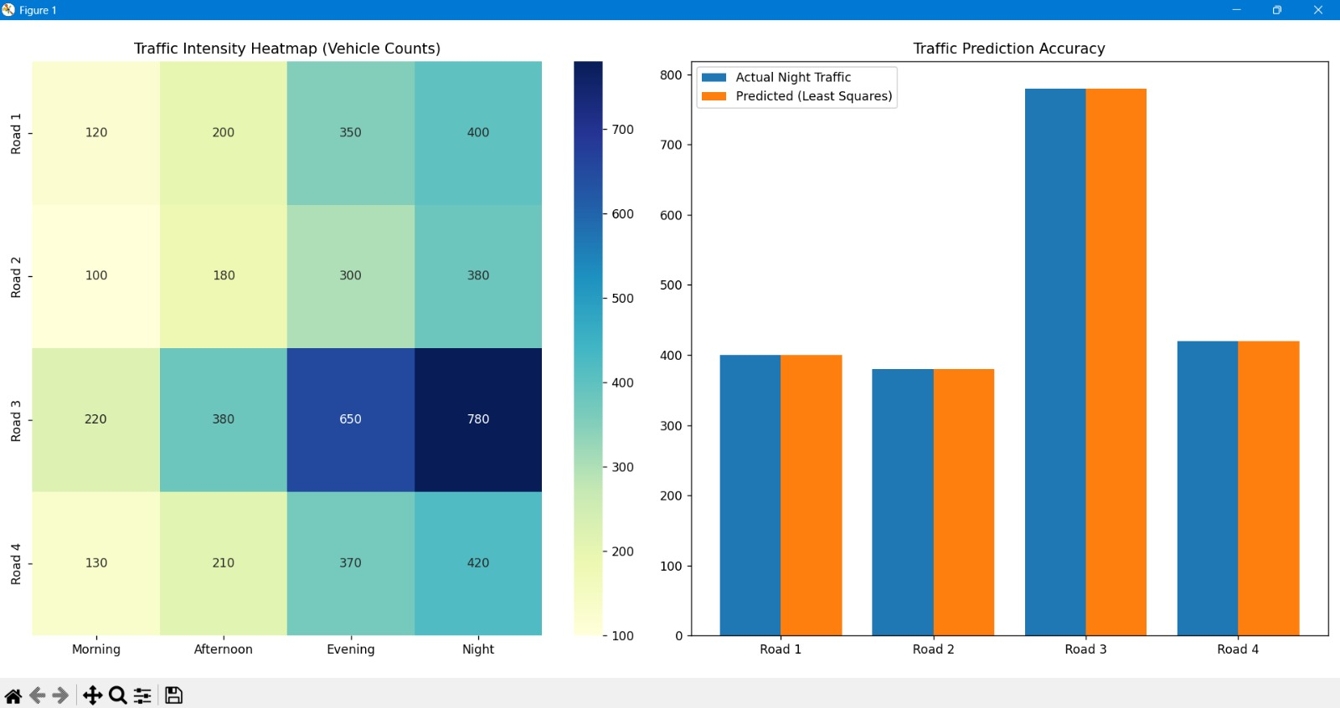
OUR RESULTS

Slide 12
Conclusions
Structural Insight: As our RREF analysis showed, Road 3 was just a linear combination of the others. By identifying this, we proved that urban planners can use linear algebra to monitor an entire city grid with 25% fewer sensors, significantly cutting infrastructure costs.
Forecasting Reliability: Validated that Least Squares provides an optimal "Best Fit" for predicting night-time traffic based on daytime trends.
Primary Trend Discovery: Used Eigen-analysis to isolate the "Dominant Flow" of the network, simplifying complex data into one primary rush-hour vector.
Decision Support: Proved that combining algebra with Heatmap visualizations creates a "visual-first" tool for urban planners.

Slide 13
References
Primary Inspiration: "Traffic Flow Analysis using Linear Algebra" (Various Undergraduate Case Studies) – We found that modeling roads as "nodes" and "vectors" is a standard way to solve urban congestion.
Mathematical Guide: Gilbert Strang (MIT 18.06) – We used his video lectures and the Introduction to Linear Algebra textbook to understand how Rank and RREF identify redundant data points in a network.
Technical Implementation: NumPy Documentation (numpy.linalg) – This was our primary resource for implementing the Least Squares solution and Eigen-analysis in Python.
Logic Support: GeeksforGeeks & StackOverflow – Used for debugging our Gram-Schmidt orthogonalization function and formatting the Seaborn Heatmap

Slide 14
Project Author:
Tanmayi Nagabhairava (PES1UG24CS493) – Linear algebra modeling, least squares regression, and Python analysis.
Department of Computer Science & Engineering, PES University

Slide 15
Thanks!

