Slide 1
JAKKAMPUDI TANMAYI SAI
Final Project
3/21/2024 Annual Review

Slide 2
PROJECT TITLE : KEYLOGGER AND SECURITY
3/21/2024 Annual Review

Slide 3


AGENDA
Introduction
Problem Statement
Project Overview
Who are the end users?
Your solution and its value proposition
The WOW in our solutionn
Modelling
Results
Project link
3/21/2024 Annual Review

Slide 4

Introduction
Definition : A keylogger is a type of malware that records every keystroke made on a computer, often without the user's knowledge or consent. This can be a serious security risk, as keyloggers can capture sensitive information such as passwords, credit card numbers, and personal information.
This enables on compromising sensitive data like
passwords etc..
3/21/2024 Annual Review

Slide 5

PROBLEM STATEMENT
The problem statement is that the keyloggers can be detected using antiviruses.
Installation of hardware keyloggers is difficult without the knowledge of the owner of the system.
We shall use pynput library to create a keylogger that captures keystrokes in real time and keeps them locally.
This tool would function as a learning tool for students and also who specialize in cybersecurity.
It helps in protecting sensitive information from keylogger attacks.
3/21/2024 Annual Review

Slide 6

PROJECT OVERVIEW
Overview of Keylogger Detection and Prevention Strategies
The project is to develop a keylogger—a software tool or device that records keystrokes on a computer or mobile device.
Keyloggers are used in cybersecurity for various purposes, including monitoring user activity, conducting security audits , and understanding user behavior for research purposes.
3/21/2024 Annual Review

Slide 7
WHO ARE THE END USERS ?
The end users of this keylogger program could be individuals or organizations looking to monitor and track keyboard activity for security or monitoring purposes. However, it is essential to use such tools responsibly and ethically.
User Roles:
Home users.
Business owners.
IT professionals.
Researchers.
Parental monitoring.

Slide 8

YOUR SOLUTION AND ITS VALUE PROPOSITION
This project provides a Python-based keylogger intended to help understand keylogging technology completely while prioritizing moral use and accountable usage.
Using the pynput library, our keylogger precisely tracks and records keystrokes currently made, which provide the basic functionality as well as advanced features.
Keylogger may be used as an effective teaching aid for those studying cybersecurity.
Protection against Keylogger attacks:
Install firewall in your PC/Computer
Install anti virus software
Turn on Two-step authentication
Frequently update your system
3/21/2024 Annual Review

Slide 9

THE WOW IN YOUR SOLUTION
Our solution's wow factor is the proactive implementation of robust detection and mitigation measures, which ensures the safeguarding of sensitive data and significantly reduces the risk of unauthorized access to critical information. This approach elevates cybersecurity resilience, providing a substantial boost in overall data security.
3/21/2024 Annual Review
9

Slide 10
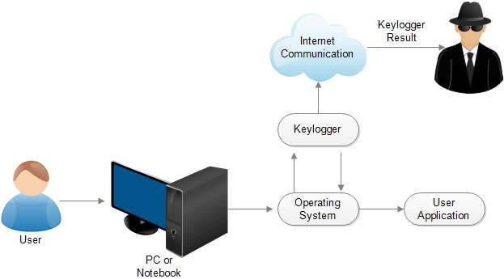
MODELLING
3/21/2024 Annual Review
10

Slide 11
RESULTS
Key_logjson :
[{"Pressed": "'k'"}, {"Held": "'k'"}, {"Released": "'k'"}, {"Pressed": "'e'"}, {"Held": "'e'"}, {"Released": "'e'"}, {"Pressed": "'y'"}, {"Held": "'y'"}, {"Released": "'y'"}, {"Pressed": "'l'"}, {"Held": "'l'"}, {"Released": "'l'"}, {"Pressed": "'o'"}, {"Held": "'o'"}, {"Released": "'o'"}, {"Pressed": "'g'"}, {"Held": "'g'"}, {"Released": "'g'"}, {"Pressed": "'g'"}, {"Held": "'g'"}, {"Released": "'g'"}, {"Pressed": "'e'"}, {"Held": "'e'"}, {"Released": "'e'"}, {"Pressed": "'r'"}, {"Held": "'r'"}, {"Released": "'r'"}]
Key_logtxt :
'k''e''y''l''o''g''g''e''r'
3/21/2024 Annual Review
11

