Slide 1

Types of Encryption

Slide 2
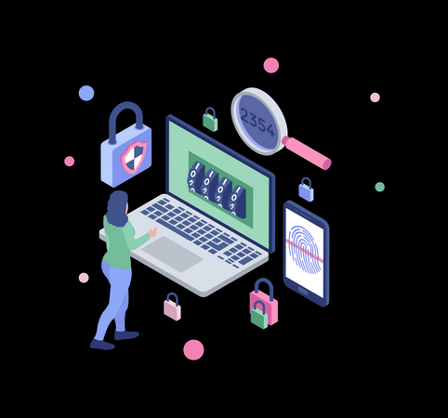
What is encryption?
In cryptography, encryption is the process of encoding a message or information in a way that only authorized parties can access it and those who are not authorized cannot.
Types / Methods
Asymmetric Encryption
In public-key encryption schemes, the encryption key is published for anyone to use and for encrypting messages. Only the receiving party has access to the decryption key that enables messages to be read. Public-key encryption was first described in a secret document in 1973. Before that, all encryption schemes were symmetric-key (also called private-key).
Symmetric Encryption
In symmetric-key schemes, the encryption and decryption keys are the same. Communicating parties must have the same key in order to achieve secure communication.

Slide 3

Encryption Algorithms

Slide 4
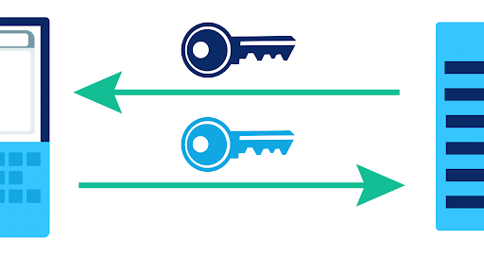
Triple DES Encryption
Triple DES was designed to replace the original Data Encryption Standard (DES) algorithm, which hackers learned to defeat with ease. At one time, Triple DES was the recommended standard and the most widely used symmetric algorithm in the industry.
Triple DES uses three individual keys with 56 bits each. The total key length adds up to 168 bits, but experts say that 112-bits in key strength is more like it.
Though it is slowly being phased out, Triple DES is still a dependable hardware encryption solution for financial services and other industries.

Slide 5
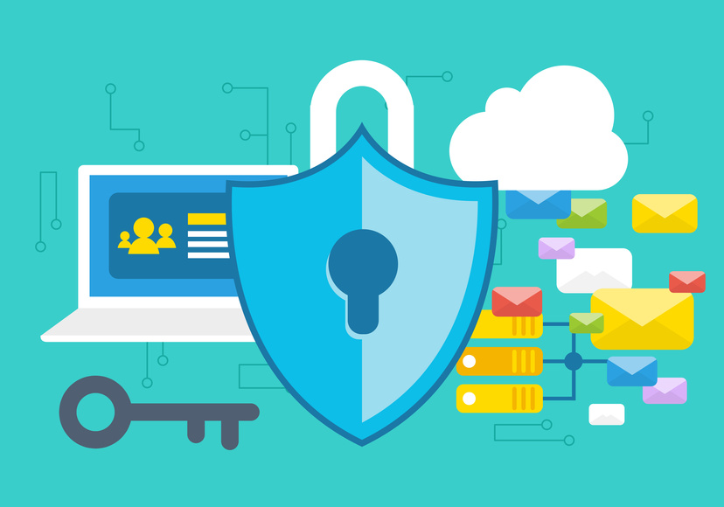
RSA Encryption
RSA is a public-key encryption algorithm and the standard for encrypting data sent over the internet. It also happens to be one of the methods used in PGP and GPG programs.
Unlike Triple DES, RSA is considered an asymmetric encryption algorithm because it uses a pair of keys. The public key is used to encrypt a message and a private key to decrypt it. It takes attackers quite a bit of time and processing power to break this encryption code.

Slide 6

Advanced Encryption Standards (AES)
The Advanced Encryption Standard (AES) is the algorithm trusted as the standard by the U.S. government and many other organizations.
Although it is extremely efficient in 128-bit form, AES encryption also uses keys of 192 and 256 bits for heavy-duty encryption.
AES is considered resistant to all attacks, with the exception of brute-force attacks, which attempt to decipher messages using all possible combinations in the 128-, 192- or 256-bit cipher. Still, security experts believe that AES will eventually become the standard for encrypting data in the private sector.

Slide 7
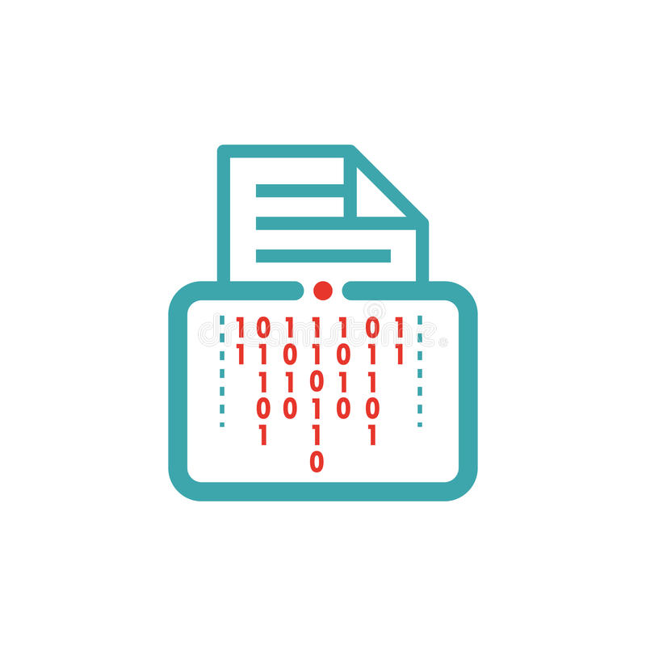
BLOWFISH
Blowfish is yet another algorithm designed to replace DES. This symmetric cipher splits messages into blocks of 64 bits and encrypts them individually.
Blowfish is known for both its tremendous speed and overall effectiveness as many claim that it has never been defeated. Meanwhile, vendors have taken full advantage of its free availability in the public domain.
Blowfish can be found in software categories ranging from e-commerce platforms for securing payments to password management tools, where it used to protect passwords. It’s definitely one of the more flexible encryption methods available.

Slide 8

TWOFISH
Computer security expert Bruce Schneier is the mastermind behind Blowfish and its successor Twofish. Keys used in this algorithm may be up to 256 bits in length and as a symmetric technique, only one key is needed.
Twofish is regarded as one of the fastest of its kind, and ideal for use in both hardware and software environments. Like Blowfish, Twofish is freely available to anyone who wants to use it. As a result, you’ll find it bundled in encryption programs such as PhotoEncrypt, GPG, and the popular open source software TrueCrypt.

Slide 9
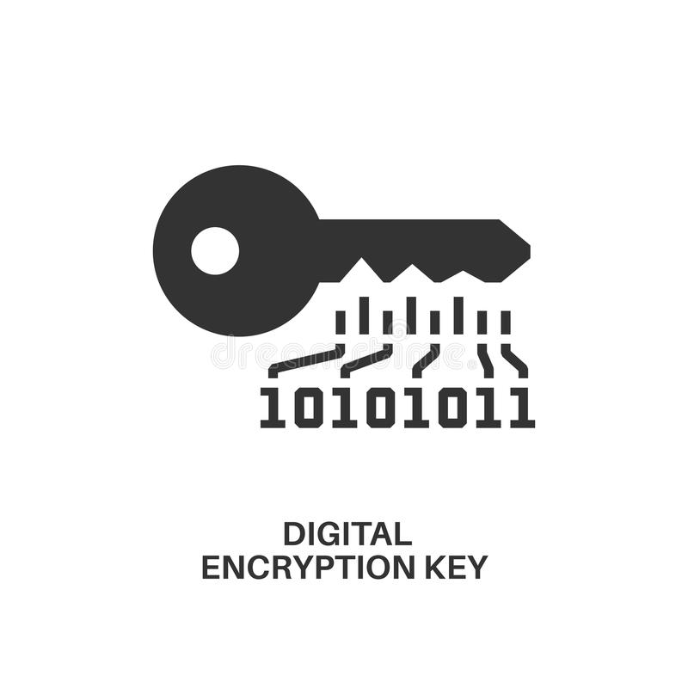
WHY AES?
Over the years, AES has proven itself to be a reliable and effective method of safeguarding sensitive information. Some of the key benefits of using AES include the following:
This robust security algorithm may be implemented in both hardware and software.
It is resilient against hacking attempts, thanks to its higher-length key sizes (128, 192, and 256 bits).
It is an open source solution. Since AES is royalty-free, it remains highly accessible for both the private and public sectors.
AES is the most commonly used security protocol today, used for everything from encrypted data storage to wireless communications.

