Slide 1
ToyJoy Inventory Optimization Report
Prepaid by:- Tanmay Parial
Data-driven insights on overstock, stockouts, and seasonal demand

Slide 2
🧸 Products Tying Up Capital in Excess Inventory

Slide 3
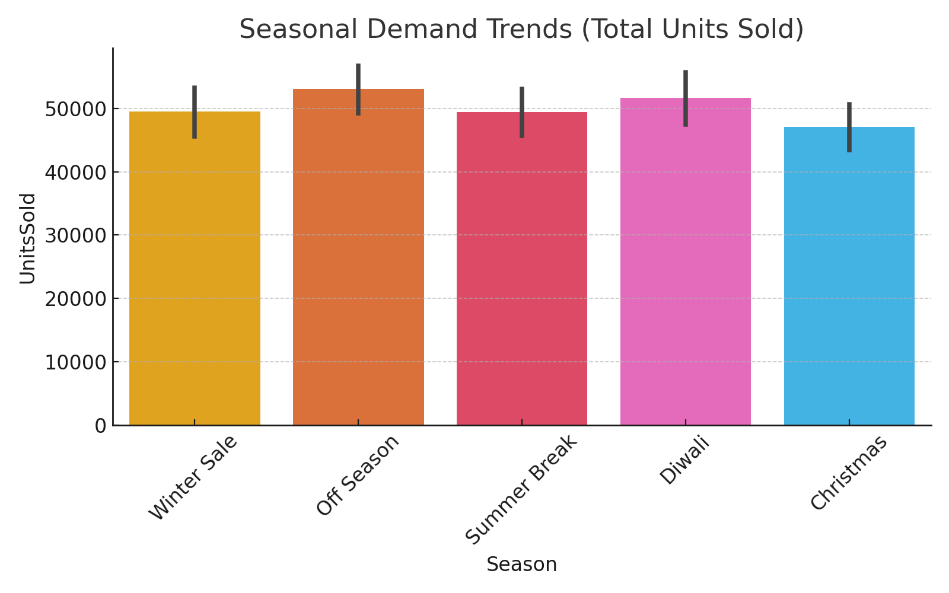
Seasonal Demand Trends
Winter Sale and Summer Break drive high unit sales.
Off-season months show sluggish performance.
Promotions and limited-time offers can help boost off-season sales.

Slide 4
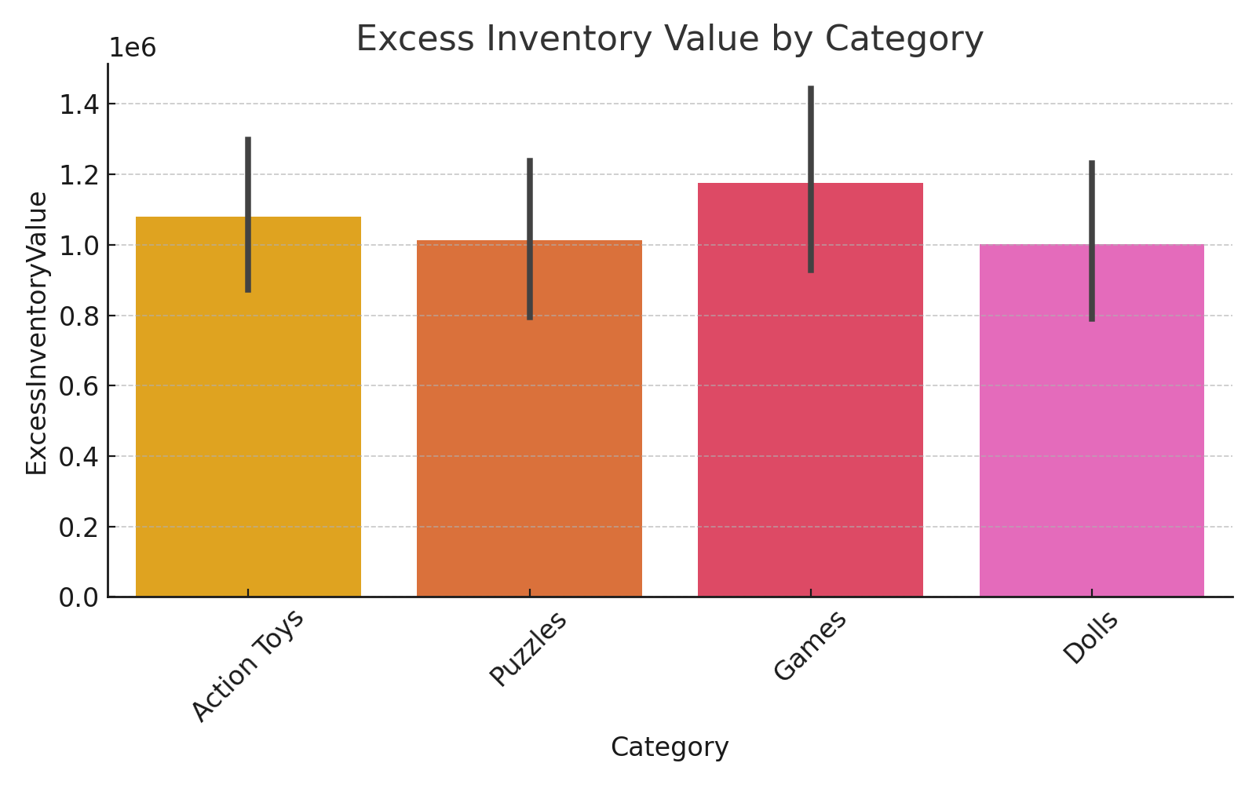
Excess Inventory by Category
Excess inventory concentrated in Dolls and Puzzles categories.
Overstock increases holding costs and reduces profitability.
Plan clearance campaigns and optimize reorder cycles.

Slide 5
⚠️ Frequently Out-of-Stock Products

Slide 6
📆 Seasonal Sales Summary

Slide 7
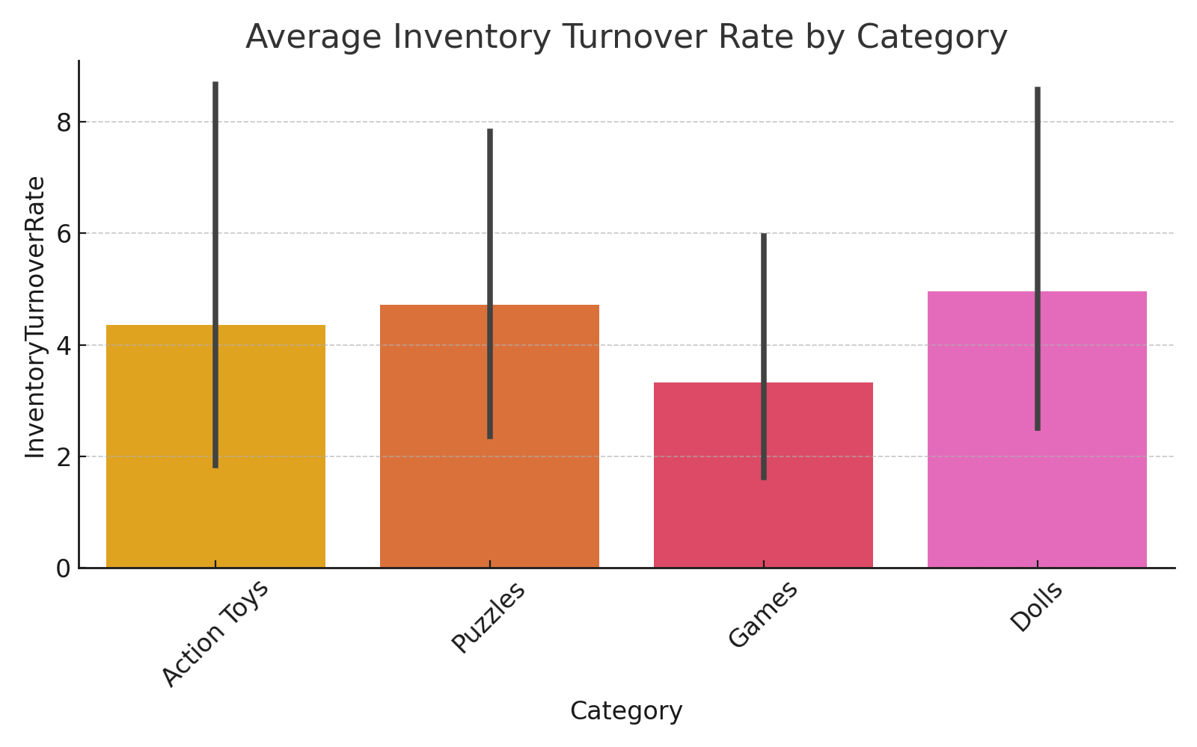
Inventory Turnover by Category
Action Toys and Games have faster movement through inventory.
Puzzles and Dolls show lower turnover — may require discounting or reduced orders.
Optimized stock levels prevent capital lock-in.

Slide 8
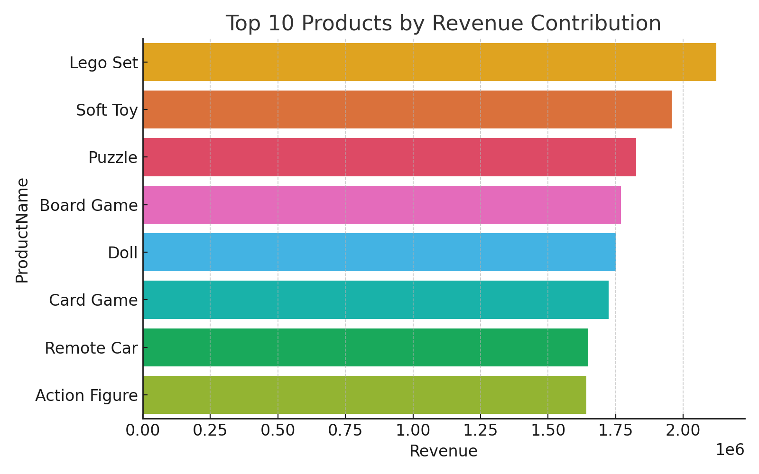
Top 10 Products by Revenue Contribution
Lego Sets, Remote Cars, and Board Games dominate revenue generation.
Top 10 products contribute ~70% of total sales (Pareto 80/20 principle).
Strategically maintain higher safety stock for top SKUs.

Slide 9
Summary & Recommendations
• Overstocked items such as Board Games and Soft Toys are tying up significant capital.
• Card and Board Games frequently face stockouts — requiring better reorder management.
• Seasonal sales peaks occur during Off Season and Diwali.
• Recommendation:
- Reduce production of overstocked products.
- Increase stock for high-demand items before festive seasons.
- Implement predictive forecasting for next-year demand cycles.
Automate stockout alerts and real-time replenishment systems.
Long-term: Implement JIT and data-driven reorder optimization.

