Slide 2
Historical Evolution
From the initial computers performing batch processing to the user-centric design, there were several milestones which are mentioned below −
Early computer (e.g. ENIAC, 1946) − Improvement in the H/W technology brought massive increase in computing power. People started thinking on innovative ideas.
Visual Display Unit (1950s) − SAGE (semi-automatic ground environment), an air defense system of the USA used the earliest version of VDU.
Development of the Sketchpad (1962) − Ivan Sutherland developed Sketchpad and proved that computer can be used for more than data processing.
Douglas Engelbart introduced the idea of programming toolkits (1963) − Smaller systems created larger systems and components.
Introduction of Word Processor, Mouse (1968) − Design of NLS (oNLine System).
Introduction of personal computer Dynabook (1970s) − Developed smalltalk at Xerox PARC.

Slide 3
Windows and WIMP interfaces − Simultaneous jobs at one desktop, switching between work and screens, sequential interaction.
The idea of metaphor − Xerox star and alto were the first systems to use the concept of metaphors, which led to spontaneity of the interface.
Direct Manipulation introduced by Ben Shneiderman (1982) − First used in Apple Mac PC (1984) that reduced the chances for syntactic errors.
Vannevar Bush introduced Hypertext (1945) − To denote the non-linear structure of text.
Multimodality (late 1980s).
Computer Supported Cooperative Work (1990’s) − Computer mediated communication.
WWW (1989) − The first graphical browser (Mosaic) came in 1993.
Ubiquitous Computing − Currently the most active research area in HCI. Sensor based/context aware computing also known as pervasive computing.

Slide 4
Shneiderman’s Eight Golden Rules
Ben Shneiderman, an American computer scientist consolidated some implicit facts about designing and came up with the following eight general guidelines −
Strive for Consistency.
Cater to Universal Usability.
Offer Informative feedback.
Design Dialogs to yield closure.
Prevent Errors.
Permit easy reversal of actions.
Support internal locus of control.
Reduce short term memory load.
These guidelines are beneficial for normal designers as well as interface designers. Using these eight guidelines, it is possible to differentiate a good interface design from a bad one. These are beneficial in experimental assessment of identifying better GUIs.

Slide 5
Norman’s Seven Principles
To assess the interaction between human and computers, Donald Norman in 1988 proposed seven principles. He proposed the seven stages that can be used to transform difficult tasks. Following are the seven principles of Norman −
Use both knowledge in world & knowledge in the head.
Simplify task structures.
Make things visible.
Get the mapping right (User mental model = Conceptual model = Designed model).
Convert constrains into advantages (Physical constraints, Cultural constraints, Technological constraints).
Design for Error.
When all else fails − Standardize.

Slide 6
Heuristic Evaluation
Heuristics evaluation is a methodical procedure to check user interface for usability problems. Once a usability problem is detected in design, they are attended as an integral part of constant design processes. Heuristic evaluation method includes some usability principles such as Nielsen’s ten Usability principles.

Slide 7
Nielsen's Ten Heuristic Principles
Visibility of system status.
Match between system and real world.
User control and freedom.
Consistency and standards.
Error prevention.
Recognition rather than Recall.
Flexibility and efficiency of use.
Aesthetic and minimalist design.
Help, diagnosis and recovery from errors.
Documentation and Help
The above mentioned ten principles of Nielsen serve as a checklist in evaluating and explaining problems for the heuristic evaluator while auditing an interface or a product.

Slide 8
Interface Design Guidelines
General Interaction
Be consistent.
Offer significant feedback.
Ask for authentication of any non-trivial critical action.
Authorize easy reversal of most actions.
Lessen the amount of information that must be remembered in between actions.
Seek competence in dialogue, motion and thought.
Excuse mistakes.
Classify activities by function and establish screen geography accordingly.
Deliver help services that are context sensitive.
Use simple action verbs or short verb phrases to name commands.

Slide 9
Information Display
Information provided by the HCI should not be incomplete or unclear or else the application will not meet the requirements of the user. To provide better display, the following guidelines are prepared −
Exhibit only that information that is applicable to the present context.
Don't burden the user with data, use a presentation layout that allows rapid integration of information.
Use standard labels, standard abbreviations and probable colors.
Permit the user to maintain visual context.
Generate meaningful error messages.
Use upper and lower case, indentation and text grouping to aid in understanding.
Use windows (if available) to classify different types of information.
Use analog displays to characterize information that is more easily integrated with this form of representation.
Consider the available geography of the display screen and use it efficiently.

Slide 10
-+*
The following guidelines focus on data entry that is another important aspect of HCI −
Reduce the number of input actions required of the user.
Uphold steadiness between information display and data input.
Let the user customize the input.
Interaction should be flexible but also tuned to the user's favored mode of input.
Disable commands that are unsuitable in the context of current actions.
Allow the user to control the interactive flow.
Offer help to assist with all input actions.
Remove "mickey mouse" input.

Slide 11
Usability Engineering
Usability Function features of the entire process of abstracting, implementing & testing hardware and software products.
Requirements gathering stage to installation, marketing and testing of products, all fall in this process.
Goals of Usability Engineering
Effective to use − Functional
Efficient to use − Efficient
Error free in use − Safe
Easy to use − Friendly
Enjoyable in use − Delightful Experience

Slide 12
Usability has three components
Effectiveness − The completeness with which users achieve their goals.
Efficiency − The competence used in using the resources to effectively achieve the goals.
Satisfaction − The ease of the work system to its users.

Slide 13
Usability Study
The methodical study on the interaction between people, products, and environment based on experimental assessment. Example: Psychology, Behavioral Science, etc.
Usability Testing
The scientific evaluation of the stated usability parameters as per the user’s requirements, competences, prospects, safety and satisfaction is known as usability testing.
Acceptance Testing
Acceptance testing also known as User Acceptance Testing (UAT), is a testing procedure that is performed by the users as a final checkpoint before signing off from a vendor. Let us take an example of the handheld barcode scanner.

Slide 14
Software Tools
A software tool is a programmatic software used to create, maintain, or otherwise support other programs and applications. Some of the commonly used software tools in HCI are as follows −
Specification Methods − The methods used to specify the GUI. Even though these are lengthy and ambiguous methods, they are easy to understand.
Grammars − Written Instructions or Expressions that a program would understand. They provide confirmations for completeness and correctness.
Transition Diagram − Set of nodes and links that can be displayed in text, link frequency, state diagram, etc. They are difficult in evaluating usability, visibility, modularity and synchronization.
Notes:
Let us assume that a supermarket has bought barcode scanners from a vendor. The supermarket gathers a team of counter employees and make them test the device in a mock store setting. By this procedure, the users would determine if the product is acceptable for their needs. It is required that the user acceptance testing "pass" before they receive the final product from the vendor.

Slide 15
Statecharts − Chart methods developed for simultaneous user activities and external actions. They provide link-specification with interface building tools.
Interface Building Tools − Design methods that help in designing command languages, data-entry structures, and widgets.
Interface Mockup Tools − Tools to develop a quick sketch of GUI. E.g., Microsoft Visio, Visual Studio .Net, etc.
Software Engineering Tools − Extensive programming tools to provide user interface management system.
Evaluation Tools − Tools to evaluate the correctness and completeness of programs.

Slide 16
HCI and Software Engineering
Software engineering is the study of designing, development and preservation of software. It comes in contact with HCI to make the man and machine interaction more vibrant and interactive.
The Waterfall Method

Slide 17
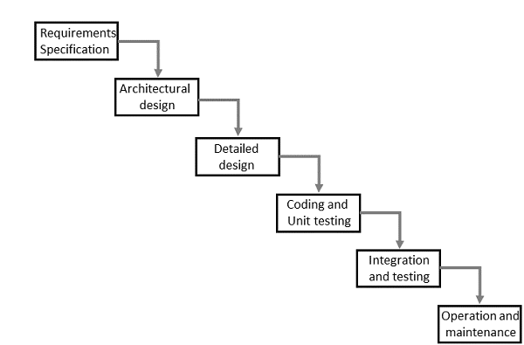
The waterfall model

Slide 18
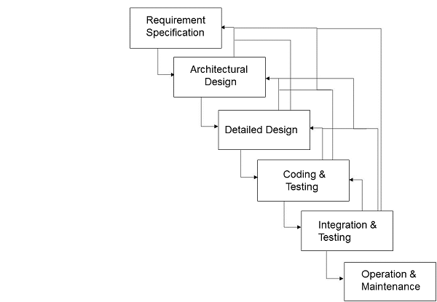
Interactive System Design

Slide 19
Obtain user ideas about the proposed system
Decide general design approach
Initial requirements specification
Design
Prototype .
Evaluate
Redesign
Reimplement
Notes:
Obtain user ideas about the proposed system Discuss the system with the prospective users/customers. Compare it to an existing one, if there is one, and identify the weaknesses and strengths of the existing system. Detailed questionnaires to targeted prospective users. Task analysis.
Decide general design approach May depend on hardware and software to be used, and past conventions, as well as suitability to task in hand. Questions that may have to be considered: WIMP interface or command line? What input/output devices, what hardware, software tools? Interface guidelines?
Initial requirements specification User requirements (what the user wants it to do: enter this, display that). May also include initial attempt at architectural design (how the system will provide the services).
Design Interaction design and interface design � how the system responds to things, how and what information is presented and entered. Ties in to architectural design and detailed design i.e. structure and detail of code modules.
Prototype Produce a developmental version to check that designers ideas meet customers requirements, and to try out novel concepts to see if they work, and so on. Prototypes are not necessarily functional, particularly if they are trying out new interface/interaction ideas - they can be mocked up, perhaps first on paper, then on the machine, before ever being attached to pieces of code.
Evaluate Prototypes and near-working systems, in alpha or beta release, should be carefully evaluated to see if they meet the clients requirements and are easy, intuitive and sensible to use. It is often the case that prospective users are very different to the actual designers and so find certain things particularly difficult with the current system, and the aim of evaluating the system at this stage is to catch these errors.
Redesign The system should be redesigned to correct the problems found earlier � this may be minor or may be major, depending on what was discovered.
Reimplement The reimplemenation may be to produce the final version, or another prototype for another round of refinement of ideas. It is sometimes the case that many prototypes are tested, until finally the design is agree. For some projects, the prototype is then discarded and the system reimplemented from scratch, often in a different language, with considerations of efficiency and functionality as well as interaction and interface.

Slide 20
The uni-directional movement of the waterfall model of Software Engineering shows that every phase depends on the preceding phase and not vice-versa. However, this model is not suitable for the interactive system design.
The interactive system design shows that every phase depends on each other to serve the purpose of designing and product creation. It is a continuous process as there is so much to know and users keep changing all the time. An interactive system designer should recognize this diversity.

Slide 21
Prototyping
Prototyping is another type of software engineering models that can have a complete range of functionalities of the projected system.
In HCI, prototyping is a trial and partial design that helps users in testing design ideas without executing a complete system.
Example of a prototype can be Sketches. Sketches of interactive design can later be produced into graphical interface. See the following diagram

Slide 22
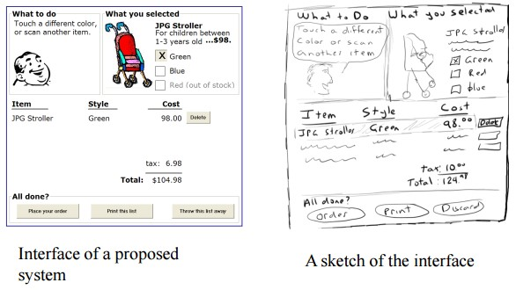
Prototyping
The above diagram can be considered as a Low Fidelity Prototype as it uses manual procedures like sketching in a paper.
A Medium Fidelity Prototype involves some but not all procedures of the system. E.g., first screen of a GUI.
Finally, a Hi Fidelity Prototype simulates all the functionalities of the system in a design. This prototype requires, time, money and work force

Slide 23
User Centered Design (UCD)
The process of collecting feedback from users to improve the design is known as user centered design or UCD.
User-centered design (UCD) is an iterative design process in which designers focus on the users and their needs in each phase of the design process.
In UCD, design teams involve users throughout the design process via a variety of research and design techniques, to create highly usable and accessible products for them.

Slide 24
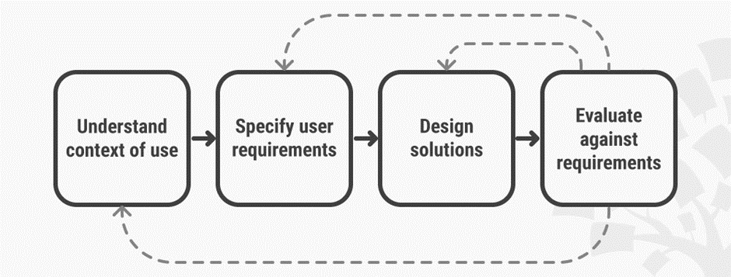
In user-centered design, designers use a mixture of investigative methods and tools (e.g., surveys and interviews) and generative ones (e.g., brainstorming) to develop an understanding of user needs.
Notes:
each iteration of the UCD approach involves four distinct phases.
First, as designers working in teams, we try to understand the context in which users may use a system. Then, we identify and specify the users’ requirements.
A design phase follows, in which the design team develops solutions.
The team then proceeds to an evaluation phase. Here, you assess the outcomes of the evaluation against the users’ context and requirements, to check how well a design is performing. More specifically, you see how close it is to a level that matches the users’ specific context and satisfies all of their relevant needs.
From here, your team makes further iterations of these four phases, and you continue until the evaluation results are satisfactory.

Slide 25
UCD Drawbacks
Passive user involvement.
User’s perception about the new interface may be inappropriate.
Designers may ask incorrect questions to users.

Slide 26
GUI Design & Aesthetics
Aesthetics is a core design principle that defines a design’s pleasing qualities.
In visual terms, aesthetics includes factors such as balance, color, movement, pattern, scale, shape and visual weight.
Designers use aesthetics to complement their designs’ usability, and so enhance functionality with attractive layouts.

Slide 27
Graphic User Interface (GUI) is the interface from where a user can operate programs, applications or devices in a computer system. This is where the icons, menus, widgets, labels exist for the users to access.
It is significant that everything in the GUI is arranged in a way that is recognizable and pleasing to the eye, which shows the aesthetic sense of the GUI designer. GUI aesthetics provides a character and identity to any product.

