Slide 1
Clustering the Neighborhoods of two Cities

Slide 2
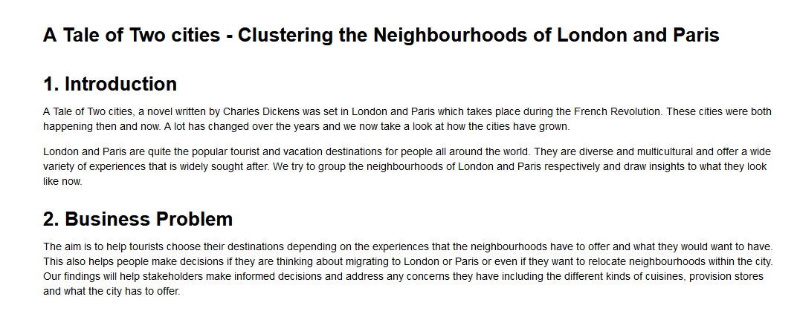

Slide 3
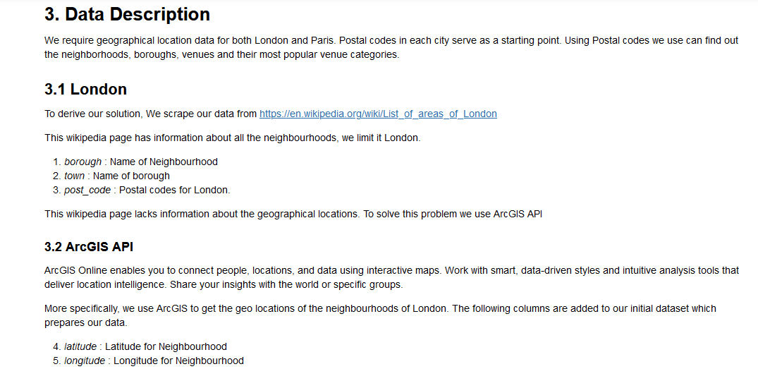

Slide 4
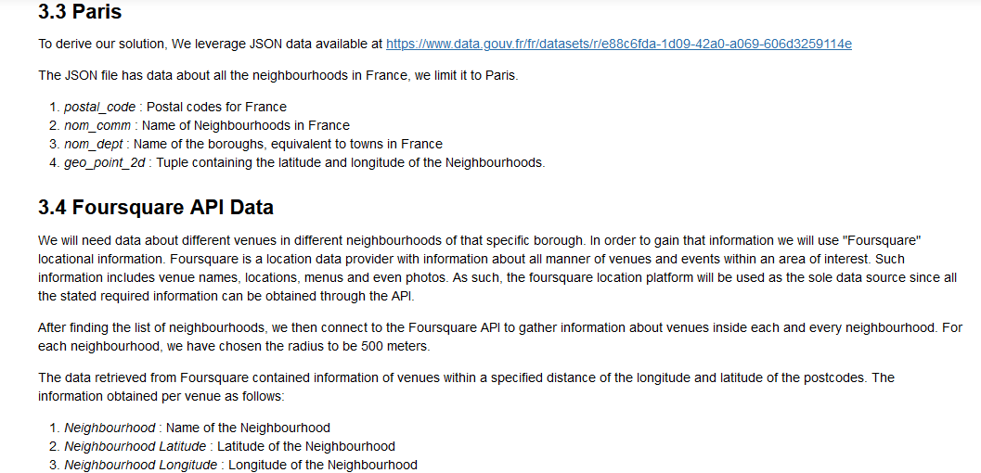

Slide 5
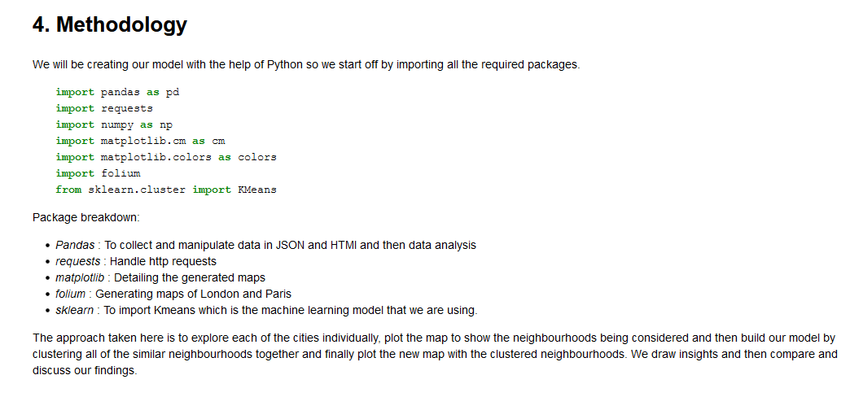

Slide 6
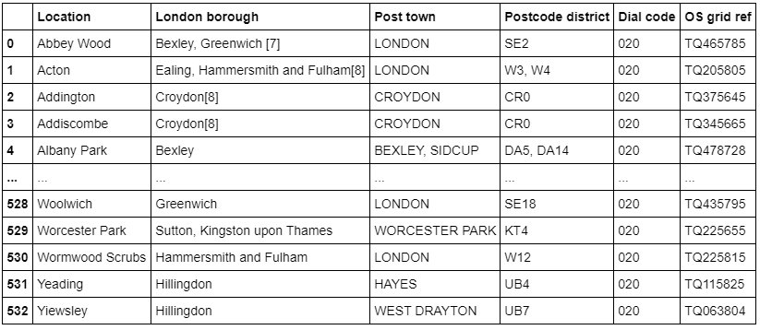
Wiki London Data

Slide 7
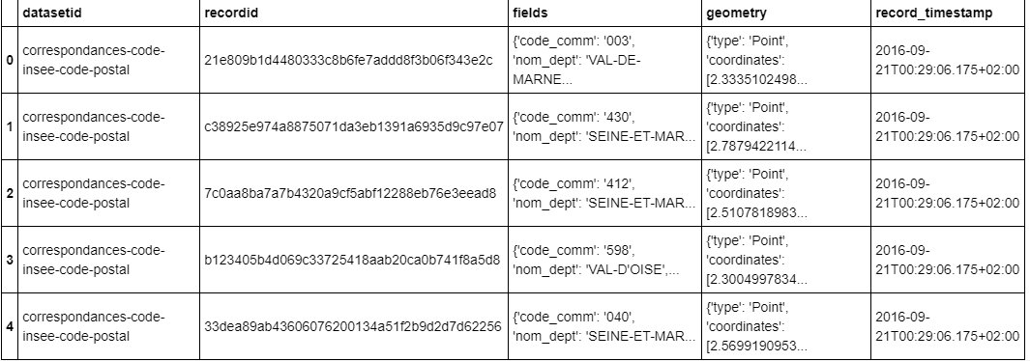
Paris Raw Data

Slide 8
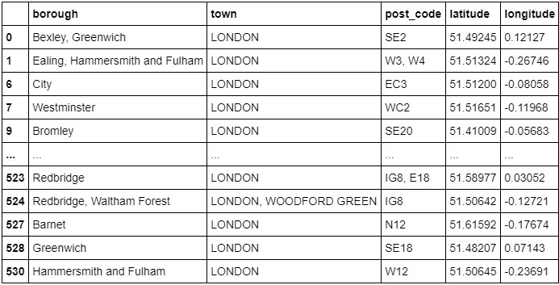
London Feature Engineered

Slide 9
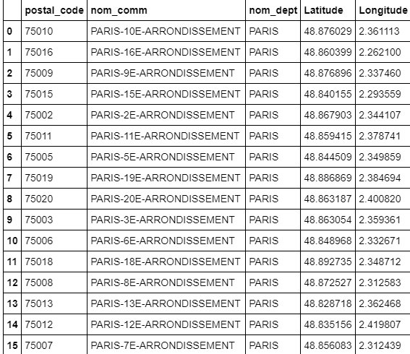
Paris Feature Engineered

Slide 10
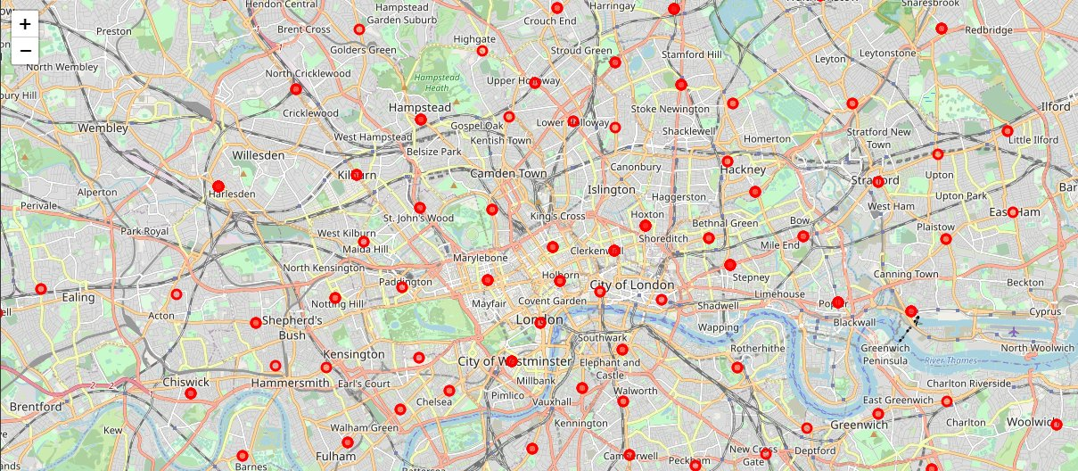
London

Slide 11
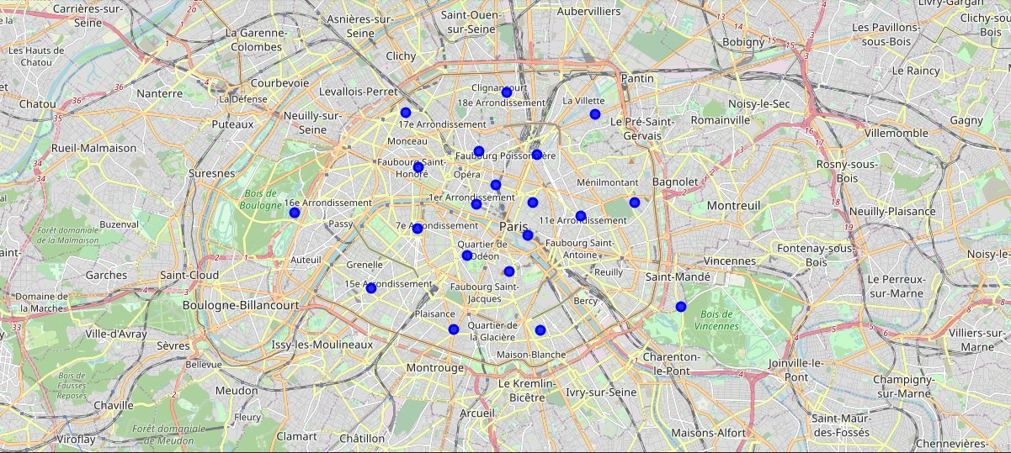
Paris

Slide 12

Venues

Slide 13

One Hot Encoding

Slide 14
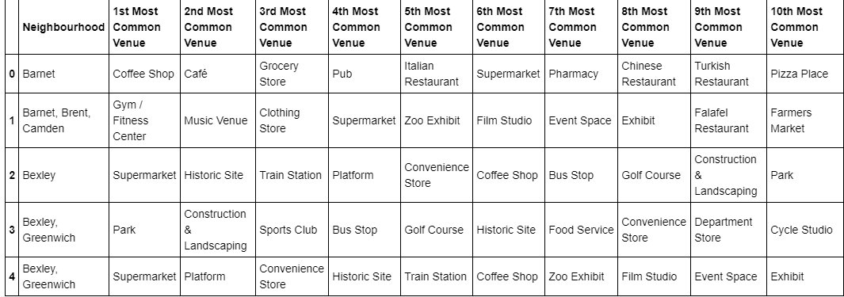
Top 10 Categories

Slide 15
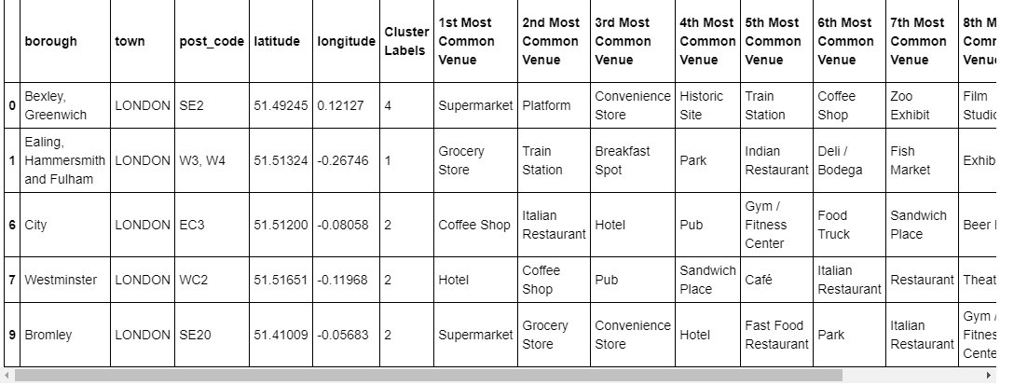
K-Means Labelled

Slide 16
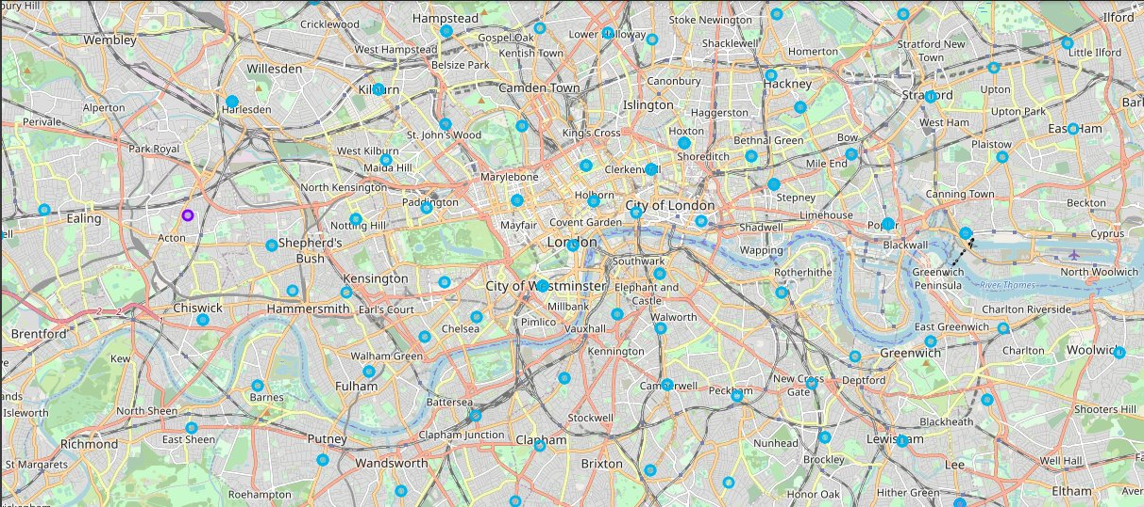
London Clustered

Slide 17
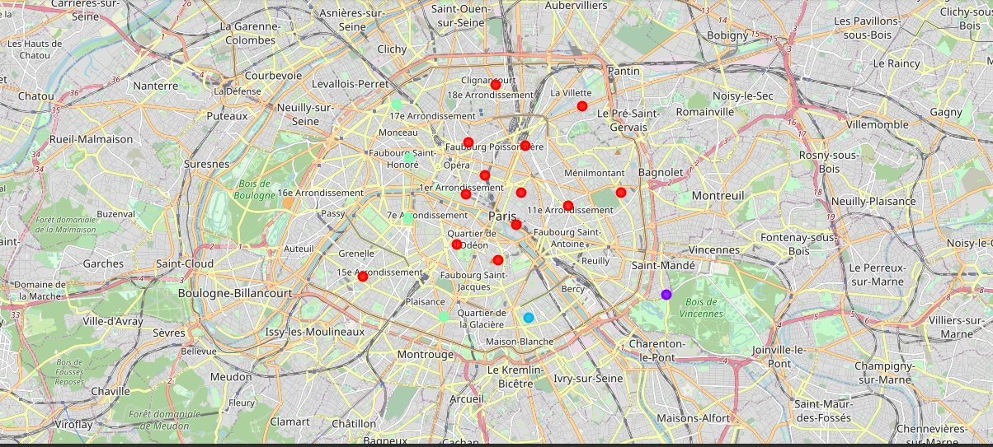
Paris Clustered

Slide 18
