Slide 1
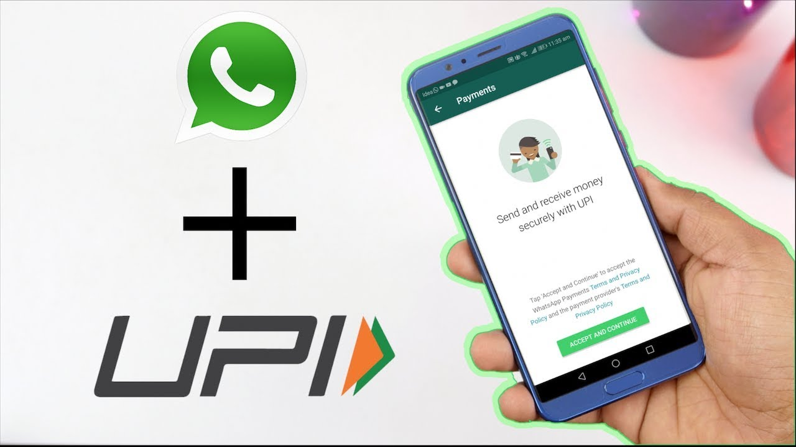
INCREASE ACTIVATION OF WHATSAPP
TANMAY SINGH ,2021ceb1031@iitrpr.ac.in

Slide 2

Overview Problem statement User flow(old) User Persona Problems Solutions Features(1-3) User flow(new) Metrics
About About Whatsapp Pay Pay
UPI in India
Trail run in India - Feb 2018
Launched in India - Nov 2020
7,404 crore transactions for Rs. 125 lakh crores in 2022
In 2022, UPI transactions jumped 91.11% YoY
Permissible user limit - 100M
No. of downloads - 5B+
Value of UPI transactions saw ~75% YoY increase
High transaction category - Groceries, supermarket, restaurants, recharges, fast food restaurants & games
India in talks with 30 countries for UPI adoption
VISION
NPCI capping market share limit to 30%- extended to Dec 2024
Everything under one app
Only 8% Whatsapp users user Whatsapp Pay

Slide 3
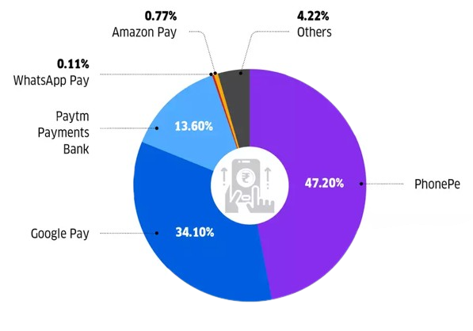

Overview Problem statement User flow(old) User Persona Problems Solutions Features(1-3) User flow(new) Metrics
Improve Activation of Whatsapp Pay
You have recently joined as a product head at Whatsapp pay
You have realized that your app has very less market share as compared to Paytm, Phonepe and Gpay. People are not using it as much as you want...
Why to solve this now?
WhatsApp pay has a market share of just 0.11% in a huge market of 8,164.65 Cr
WhatsApp has over 400 million users in India, and the country is a key market for the company

Slide 4
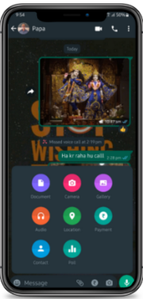
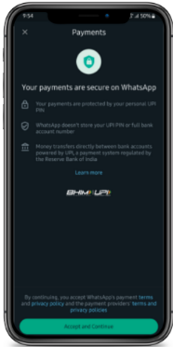
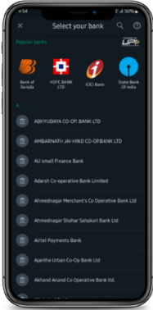
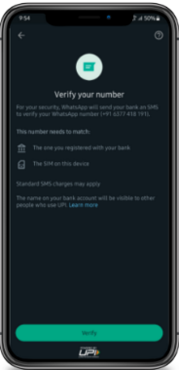
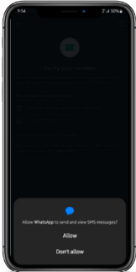
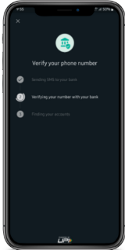
Overview Problem statement User flow(old) User Persona Problems Solutions Features(1-3) User flow(new) Metrics

Slide 5
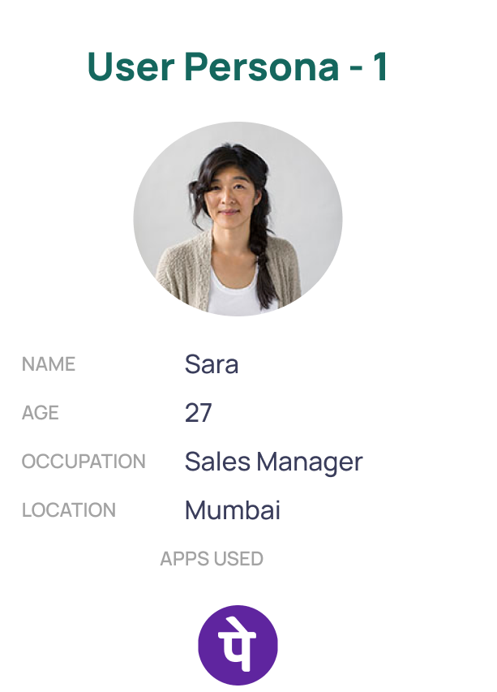
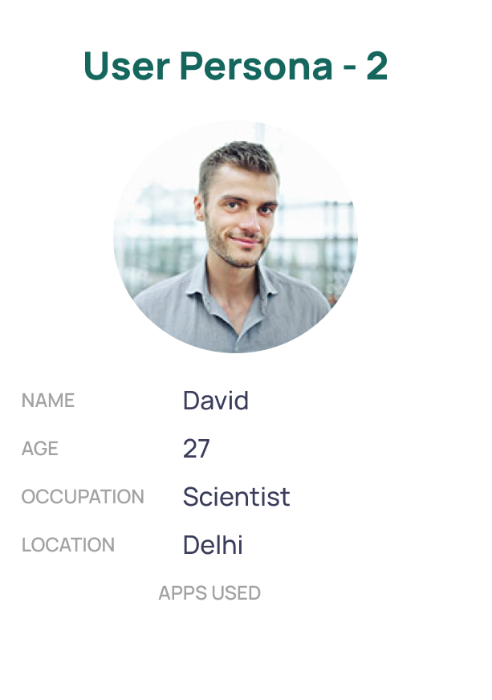
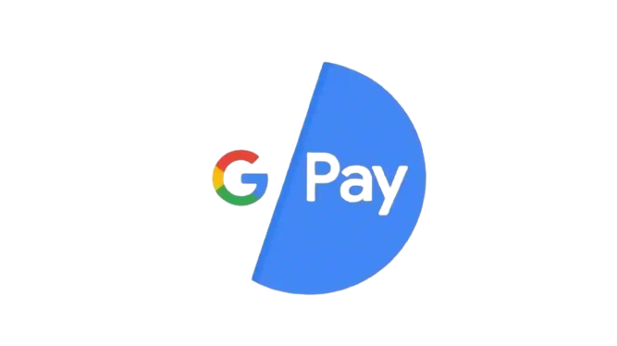
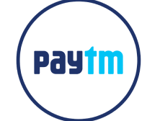



Overview Problem statement User flow(old) User Persona Problems Solutions Features(1-3) User flow(new) Metrics
BIO
She finished her master in
business and has just been promoted to Sales Manager. She likes to shop and go out with friends on long holidays.
BIO
He is a very busy scientist.
He likes to chill at home when free.
FRUSTRATION
Server issues from bank
Unwanted rewards have now made that feature useless
Can’t split bills
FRUSTRATION
Whatsapp Pay is not easy to navigate to
Not able to pay bills or merchants via Whatsapp Pay
CORE NEEDS
Wants cashback instead of rewards
Secure and hustle free payment
Split payments with friends
CORE NEEDS
Simplicity in life, be it in the onboarding stage or having a single app for multiple usage
QR code feature
For me, ‘payments’ and ‘transactions’ have been serious terms. Security
is my first priority.
I like using less apps, payments and messaging in one app is all I wanted!

Slide 6
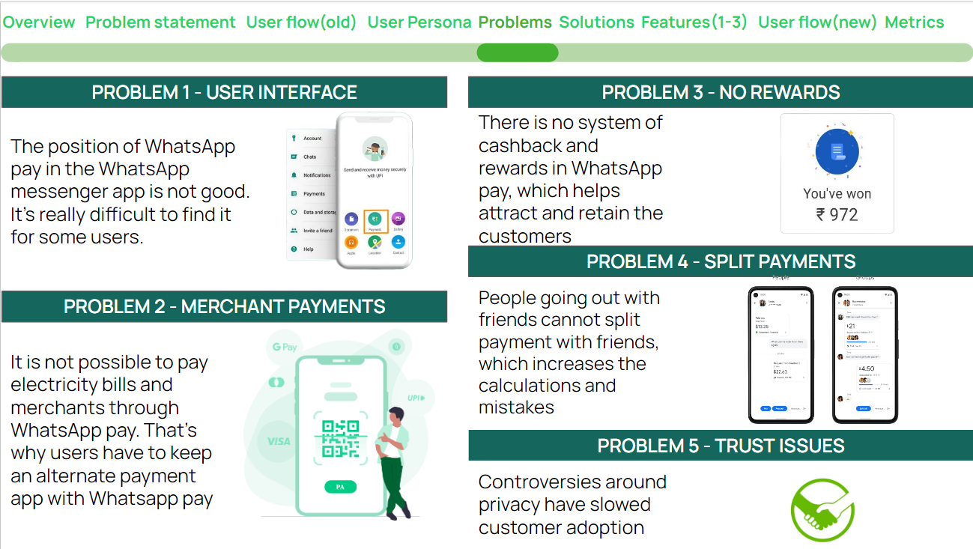

Slide 7
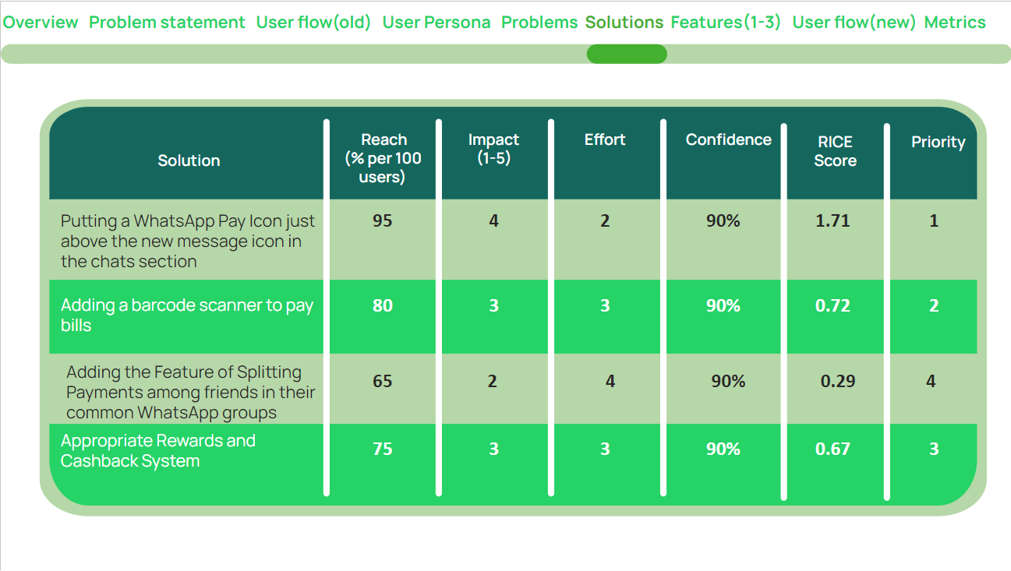

Slide 8
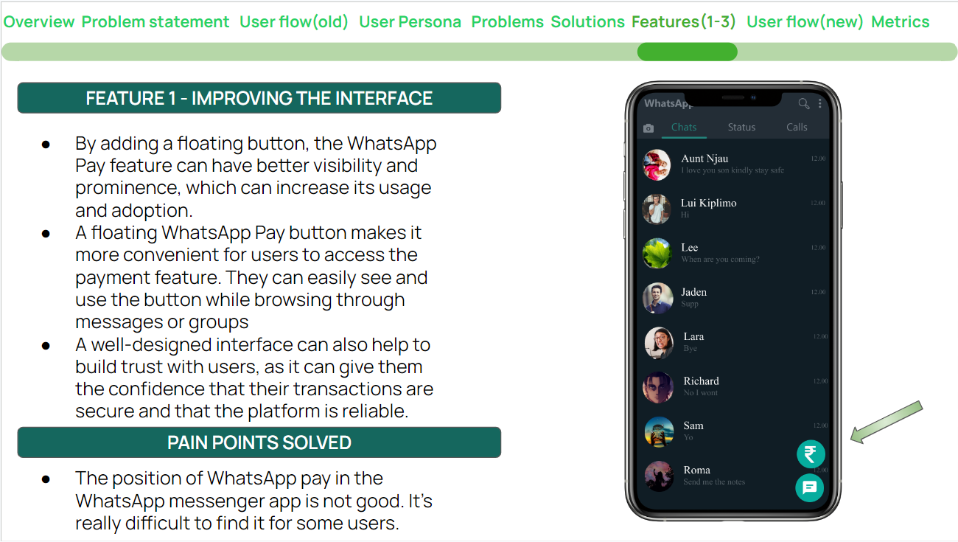

Slide 9
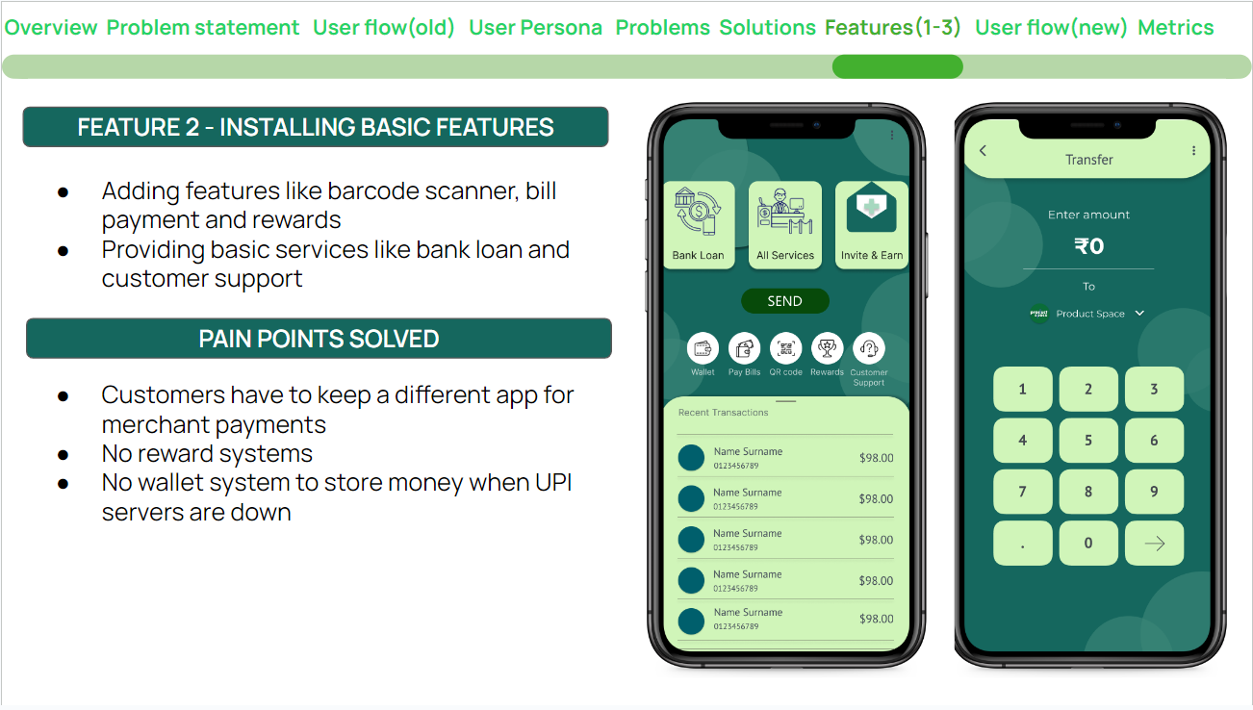

Slide 10
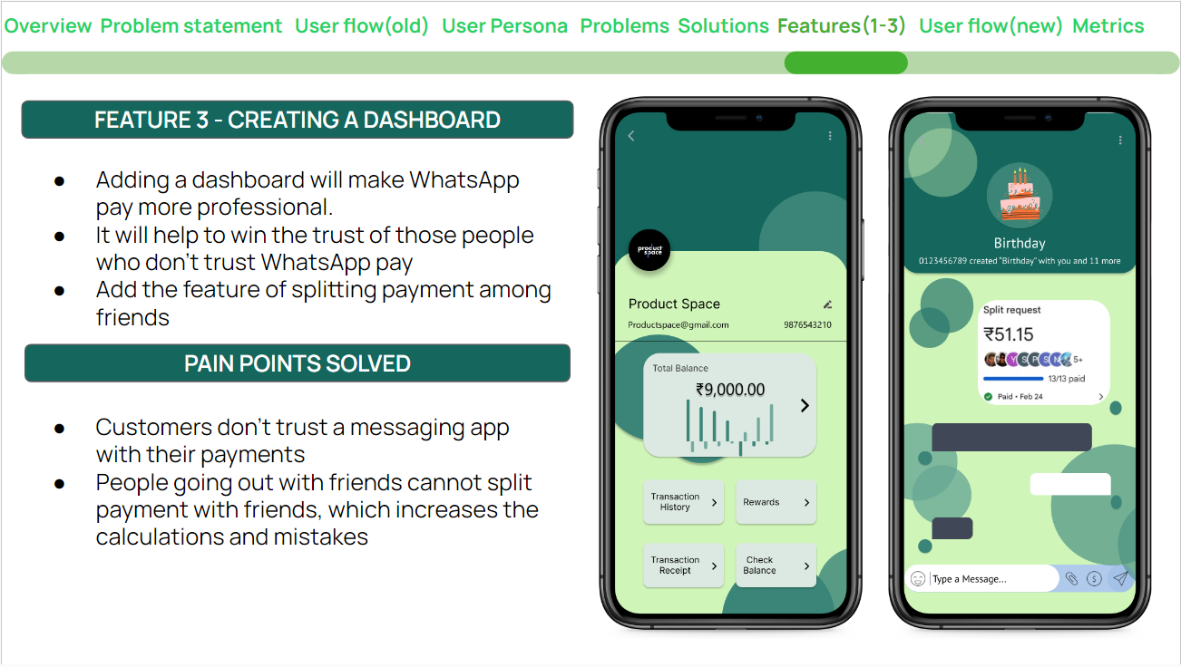

Slide 11
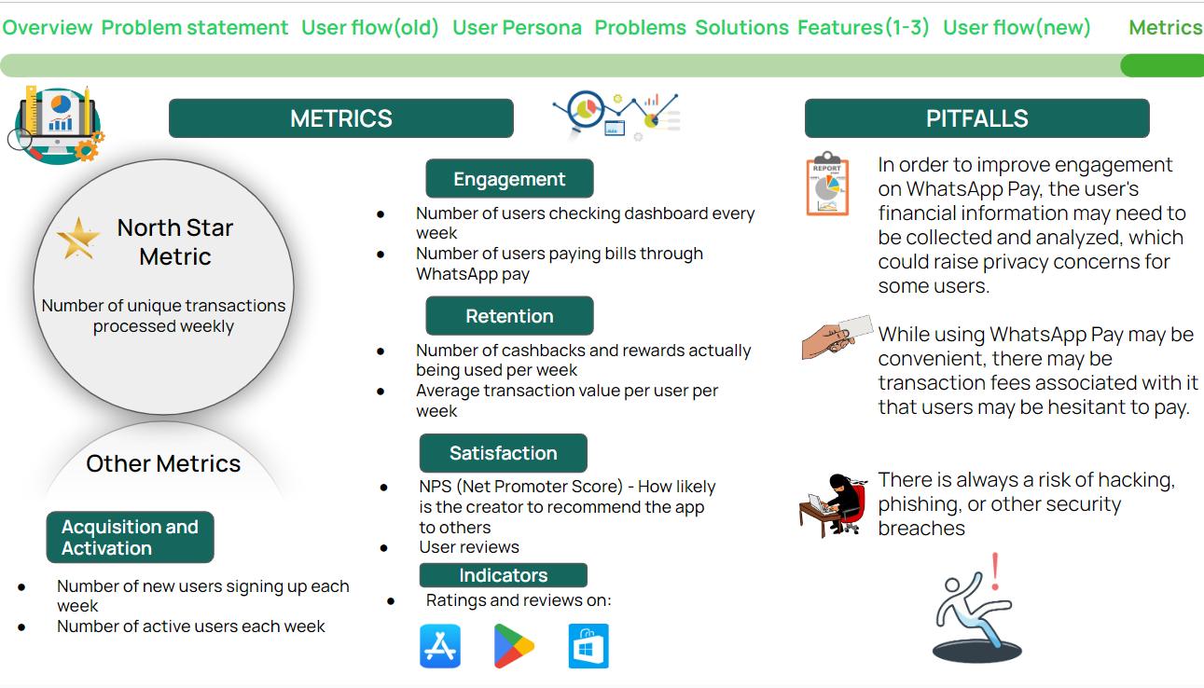

Slide 12
