Slide 1
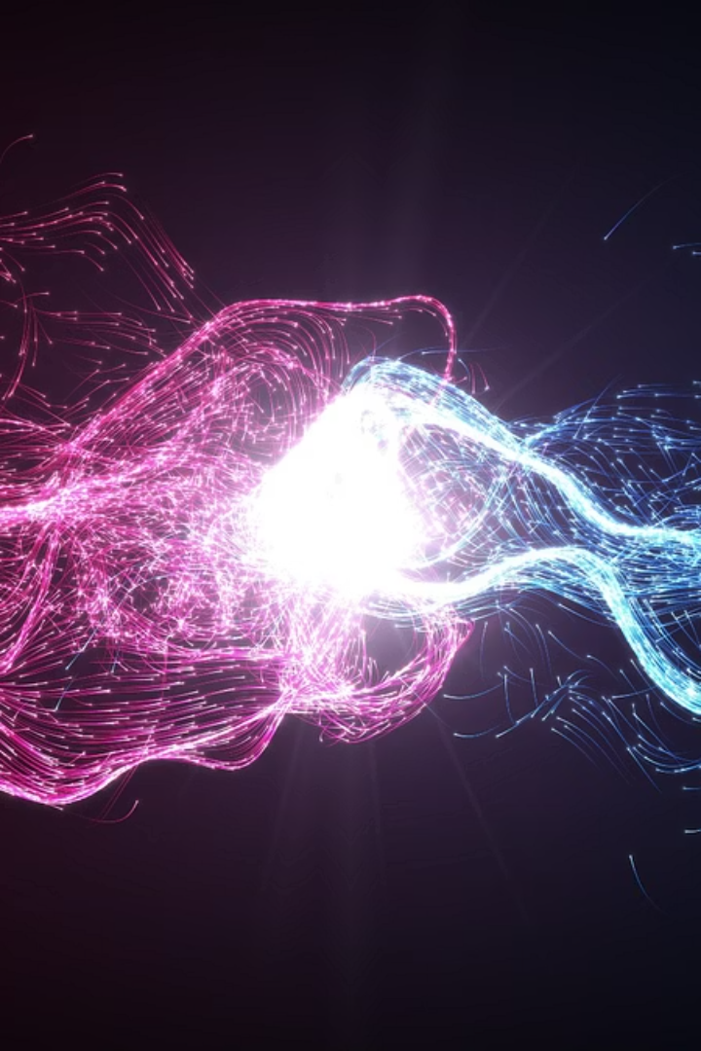
The Compton Effect
When Light Meets Matter
Presented by:
Ayush Vashisth
Ayush Dhangar
Gopesh Agrawal
Nihal Chaudhary
Shlok Bhatia
Saurabh Chahal
Tanmay Singh

Slide 2
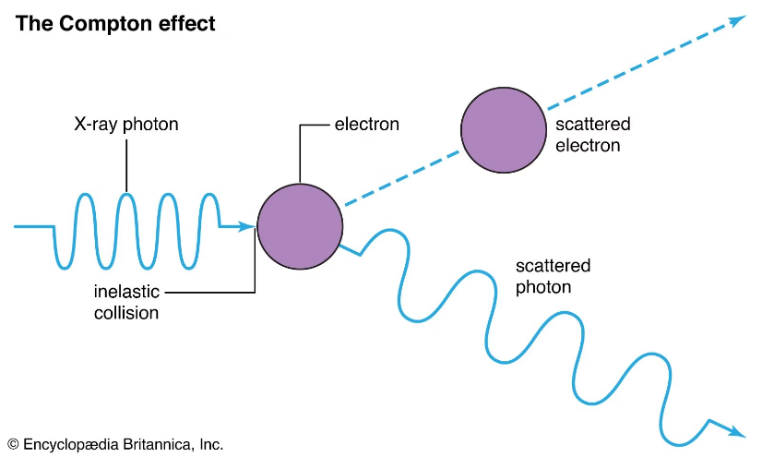
What is the Compton Effect?
Discovered by Arthur H. Compton in 1923, the Compton Effect describes how X-rays scatter off electrons. This groundbreaking phenomenon provided crucial evidence that light behaves like particles, also known as photons, fundamentally changing our understanding of its nature.

Slide 3
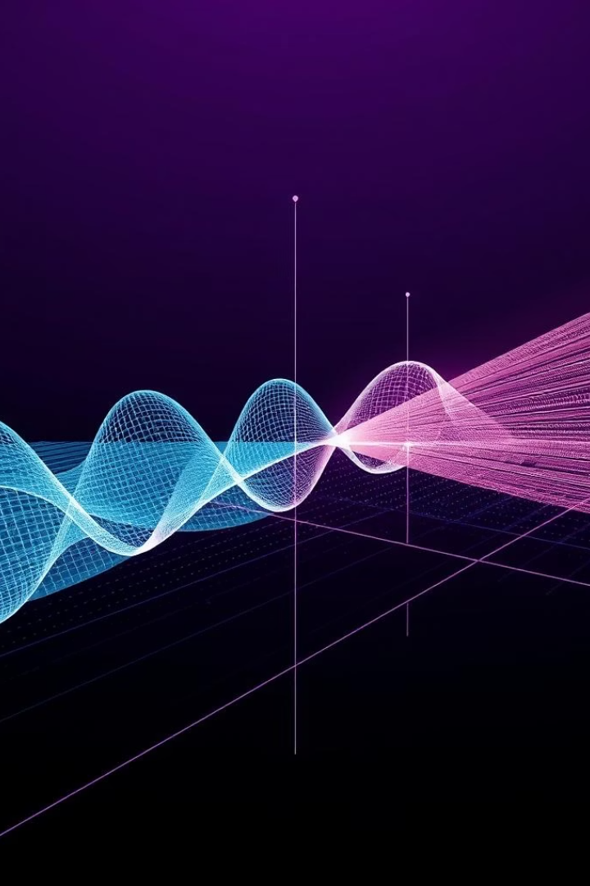
Before Compton: Wave Theory of Light
1
Continuous Wave
2
Thomson Scattering
Before Compton, light was primarily understood as a continuous wave and also does not have momentum.
Classical Thomson scattering explained light scattering.
3
Wavelength Shift
But experiments showed a puzzling shift in wavelength in EM wave. Classical physics could not explain this.

Slide 4

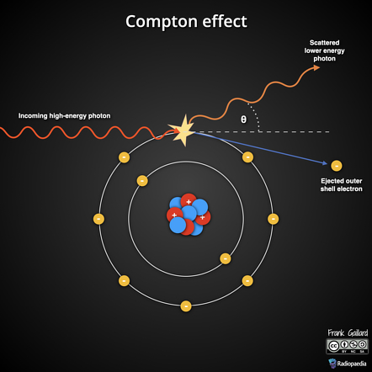
Compton's Setup
Graphite Target
Monochromatic X-rays
Compton used graphite, a light material, as the target for the X-rays.
He employed a source of monochromatic X-rays to ensure precise measurements.
Increased Wavelength
His observations revealed that the scattered rays exhibited an increased wavelength.

Slide 5

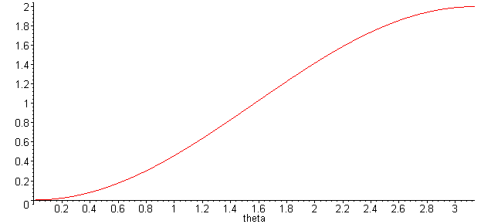
∇λ
The Compton Equation
This equation quantifies the Compton shift. Here, h is Planck's constant, me is the electron mass, c is the speed of light, and theta is the scattering angle.

Slide 6
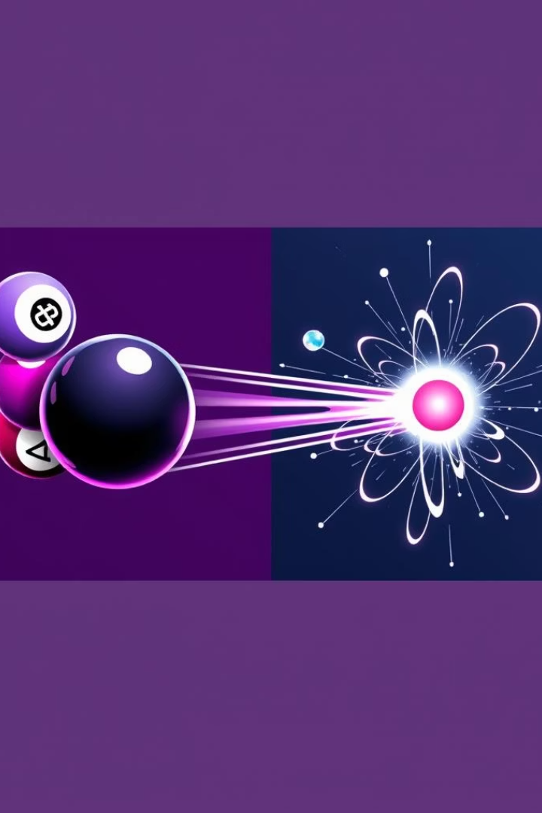



Think of It Like a Collision
Photon Hits Electron
Energy Transfer
Longer Wavelength
The photon transfers part of its energy and momentum to the electron.
Imagine a photon striking an electron directly.
Consequently, the photon loses energy, resulting in a longer wavelength.

Slide 7




Significance of Compton Effect
Particle Properties
Photon Theory
1
2
It decisively proved light has particle properties, not just wave properties.
The effect strongly supported Einstein's groundbreaking photon theory.
Nobel Prize
Quantum Mechanics
Arthur Compton received the Nobel Prize in Physics in 1927 for this discovery.
Compton's work helped establish the foundations of quantum mechanics.
4
3

Slide 8
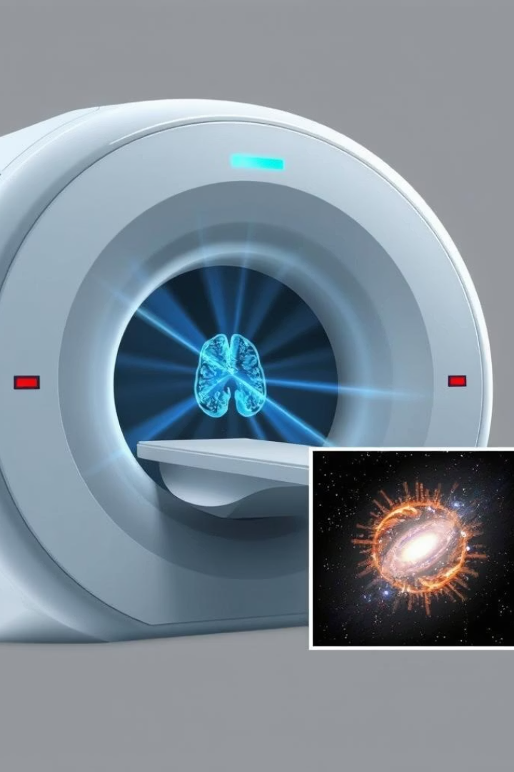




Where is Compton Scattering Used?
Astrophysics
It helps scientists study cosmic X-rays from distant celestial bodies.
Medical Imaging
Crucial for X-ray and Positron Emission Tomography (PET) scans.
Radiation Safety
Used to detect and manage scattered radiation in various environments.
Particle Physics
Fundamental for understanding interactions at subatomic levels.

Slide 9
Key Takeaways
Light as Particles
1
Light fundamentally behaves as discrete particles, called photons.
Energy Conservation
2
Compton scattering demonstrates the conservation of energy and momentum.
Quantum Foundation
3
The effect is a foundational cornerstone for modern quantum theory.

Slide 10
Thank You!
I didn't just read about physics , I made it move.
https://github.com/Tanmaysingh2210/projectphysics

