Slide 1
Introduction
To
Responsive Website Design
Presented By – Tanmay Sood

Slide 2
Agenda
Introduction to CSS: Styling Web Pages
Understanding HTML: The Structure of Web Pages
HTML Elements and Attributes
CSS Box Model Explained
CSS Layout Techniques
Styling Text and Fonts with CSS
Colors and Backgrounds in CSS
Responsive Web Design Principles
CSS Frameworks: Bootstrap and Tailwind
Web Accessibility: Making Sites Usable for Everyone
SEO Basics for HTML and CSS
Common HTML and CSS Mistakes to Avoid
Tools and Resources for Web Designers

Slide 3


Slide 4
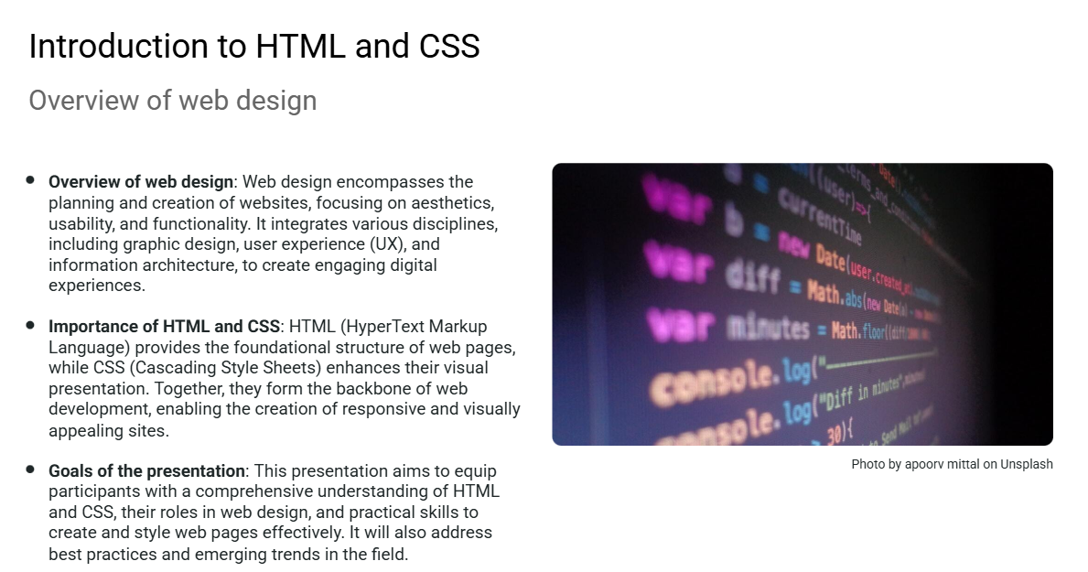

Slide 5
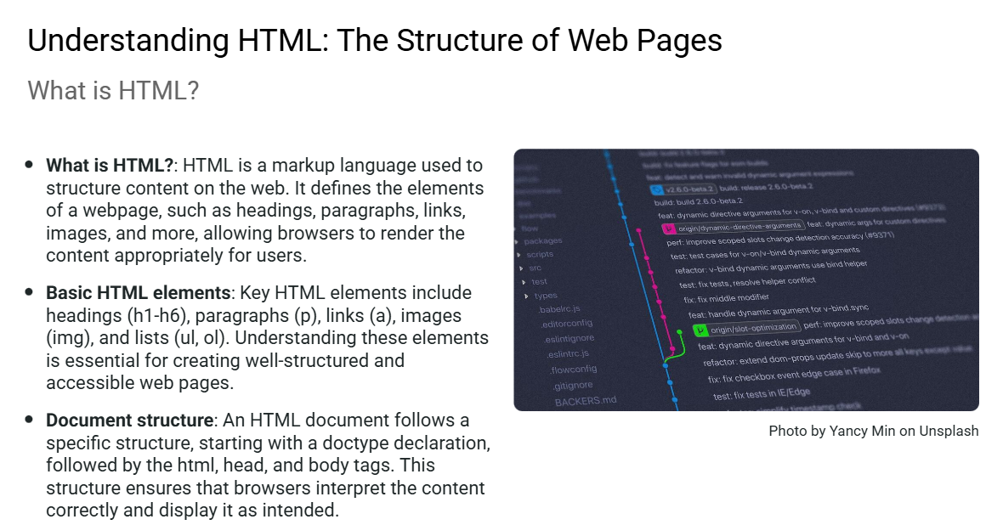

Slide 6
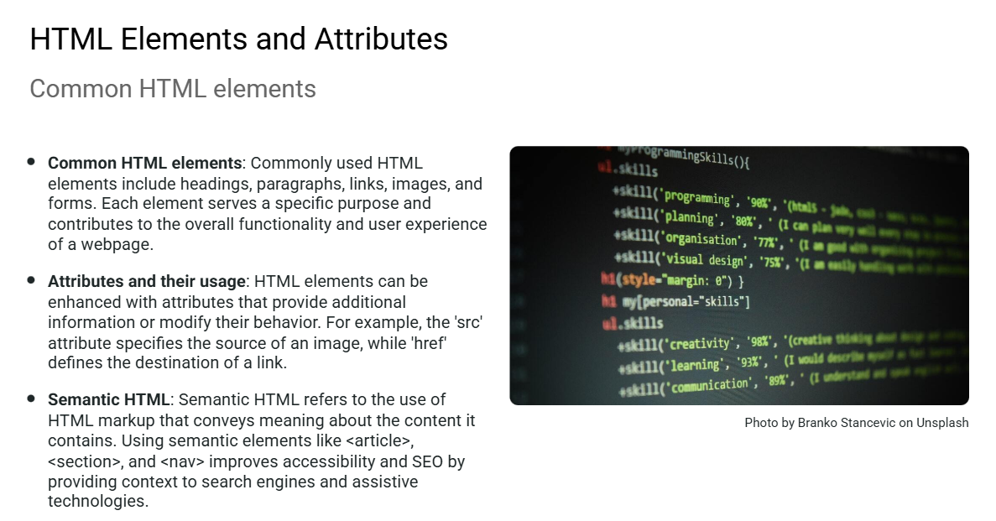

Slide 7
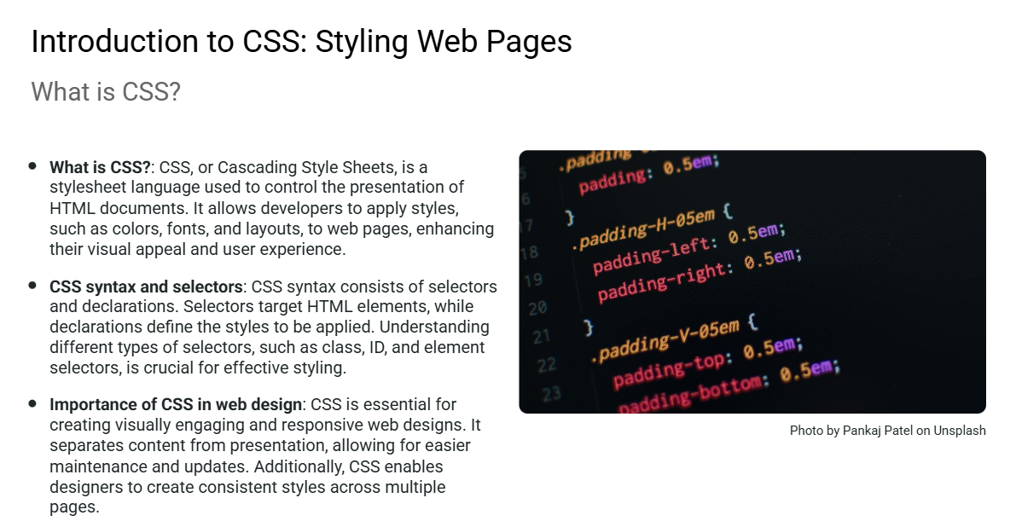

Slide 8
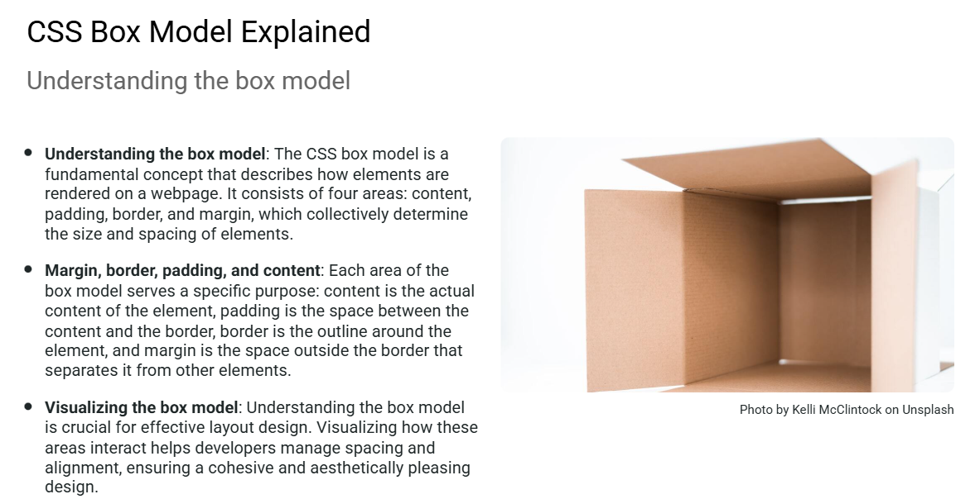

Slide 9
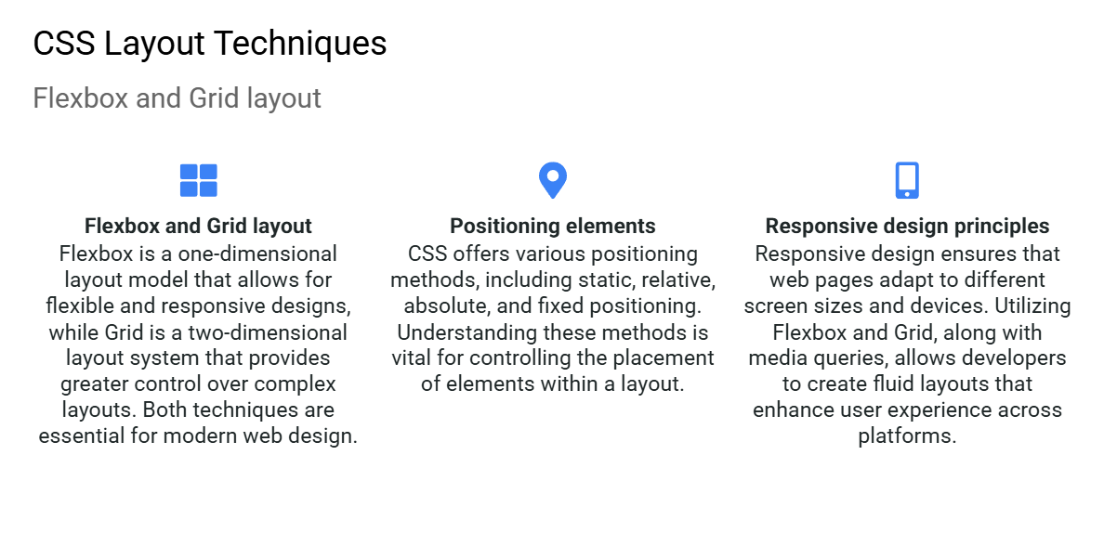

Slide 10
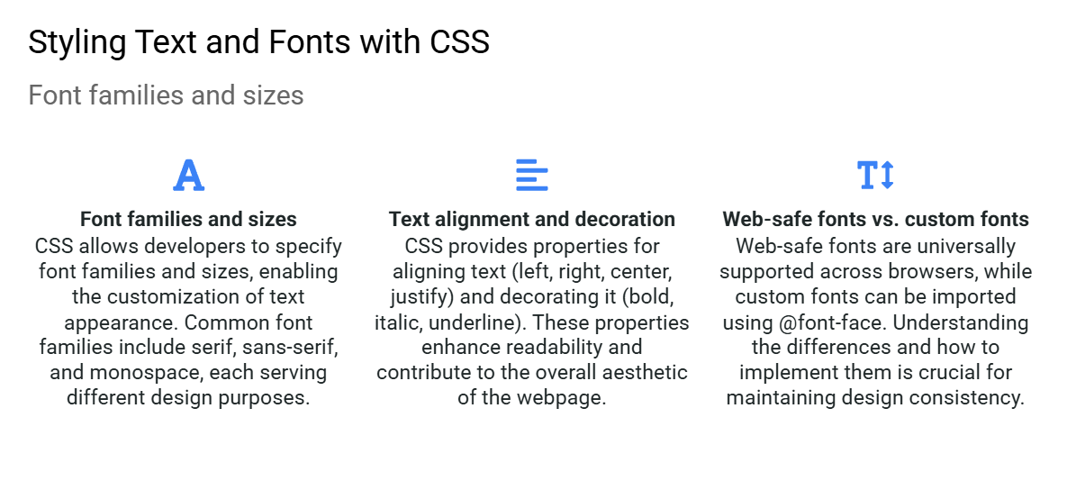

Slide 11
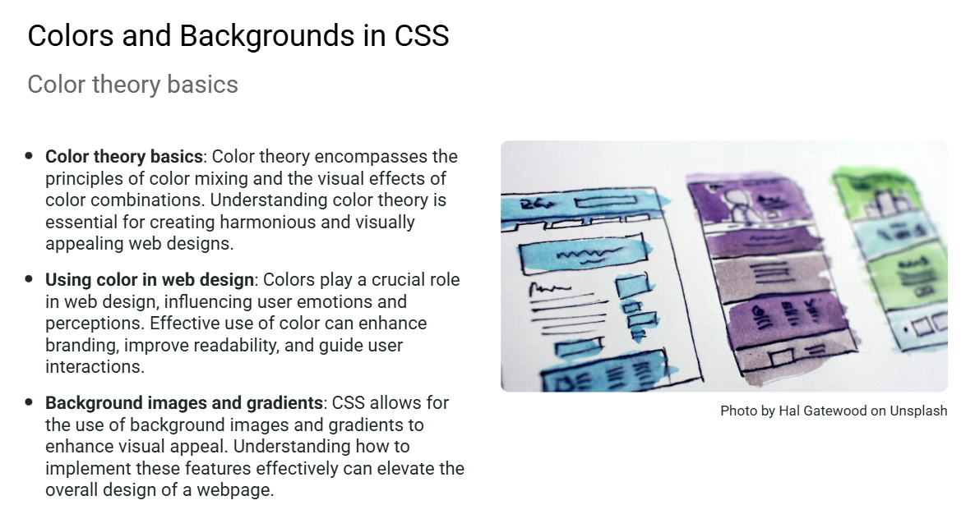

Slide 12
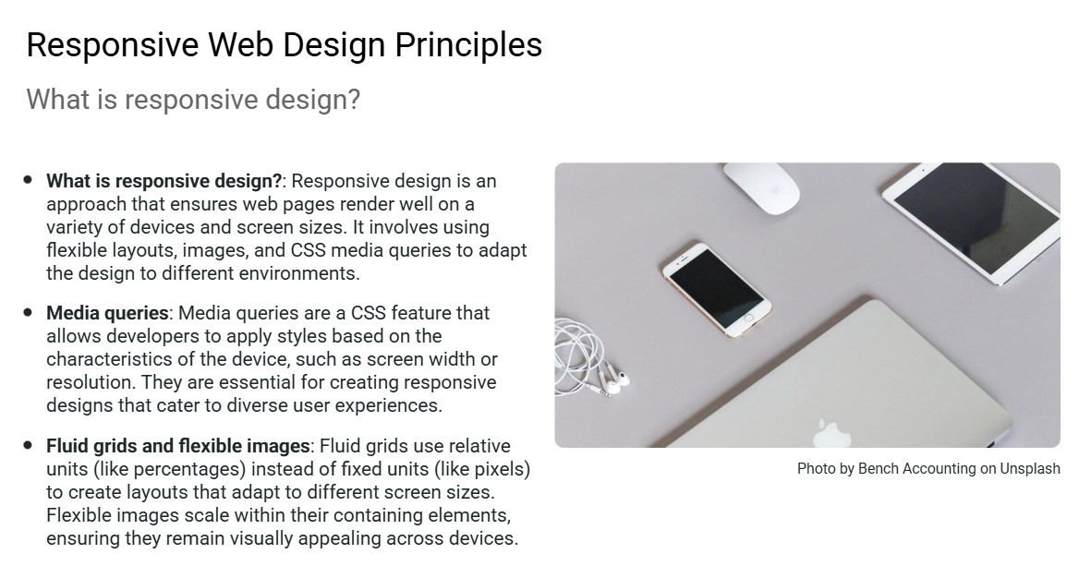

Slide 13
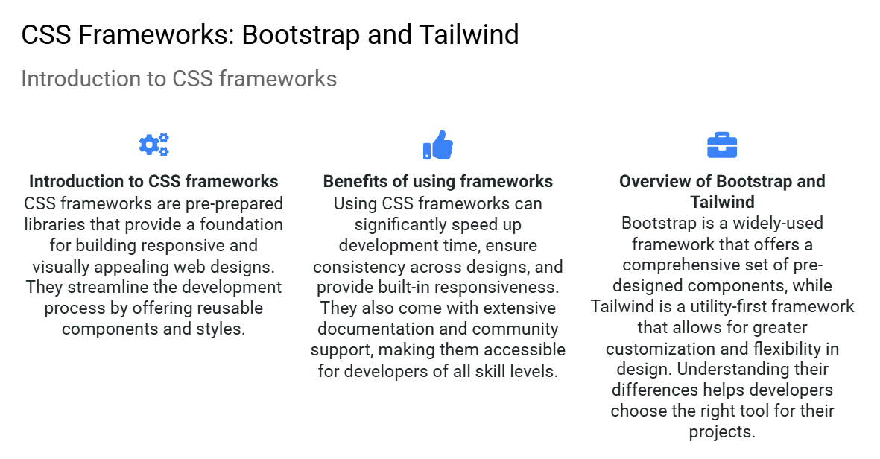

Slide 14
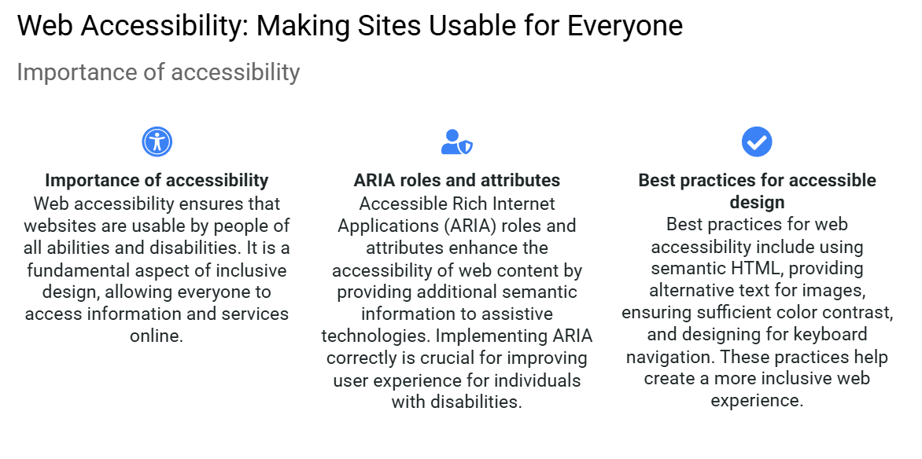

Slide 15
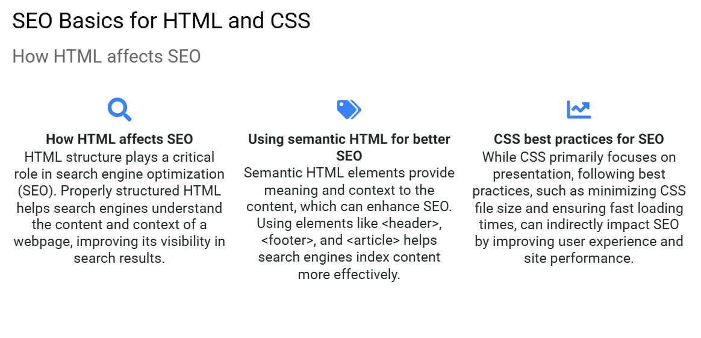

Slide 16
THANK
YOU

