Slide 1

Deaths Data Analysis

Slide 2
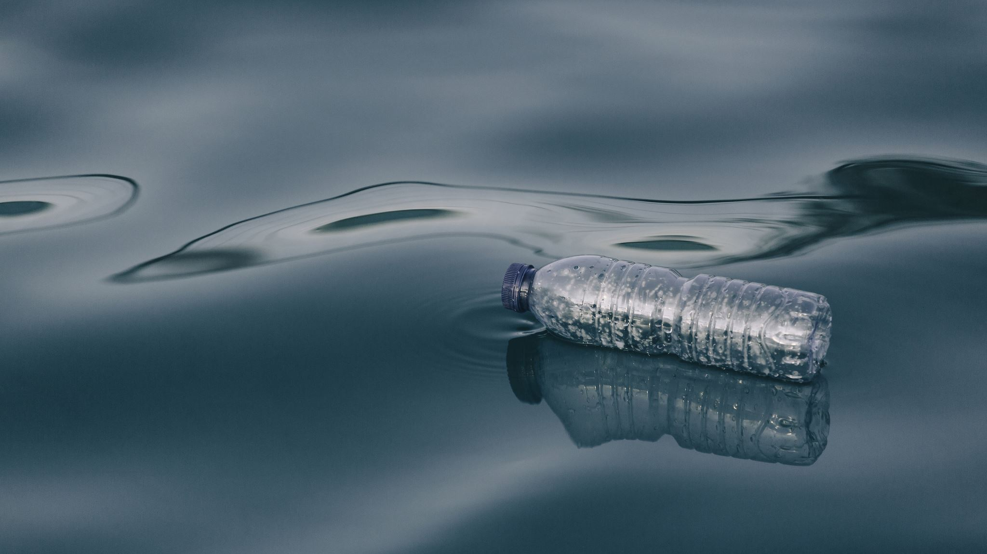
Deaths due to consumption of Unsafe Drinking Water

Slide 3
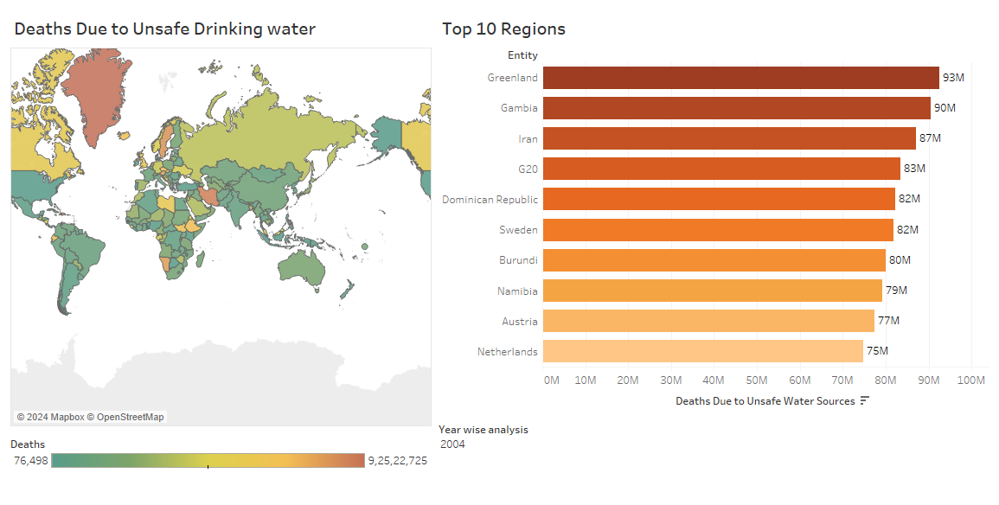

Slide 4
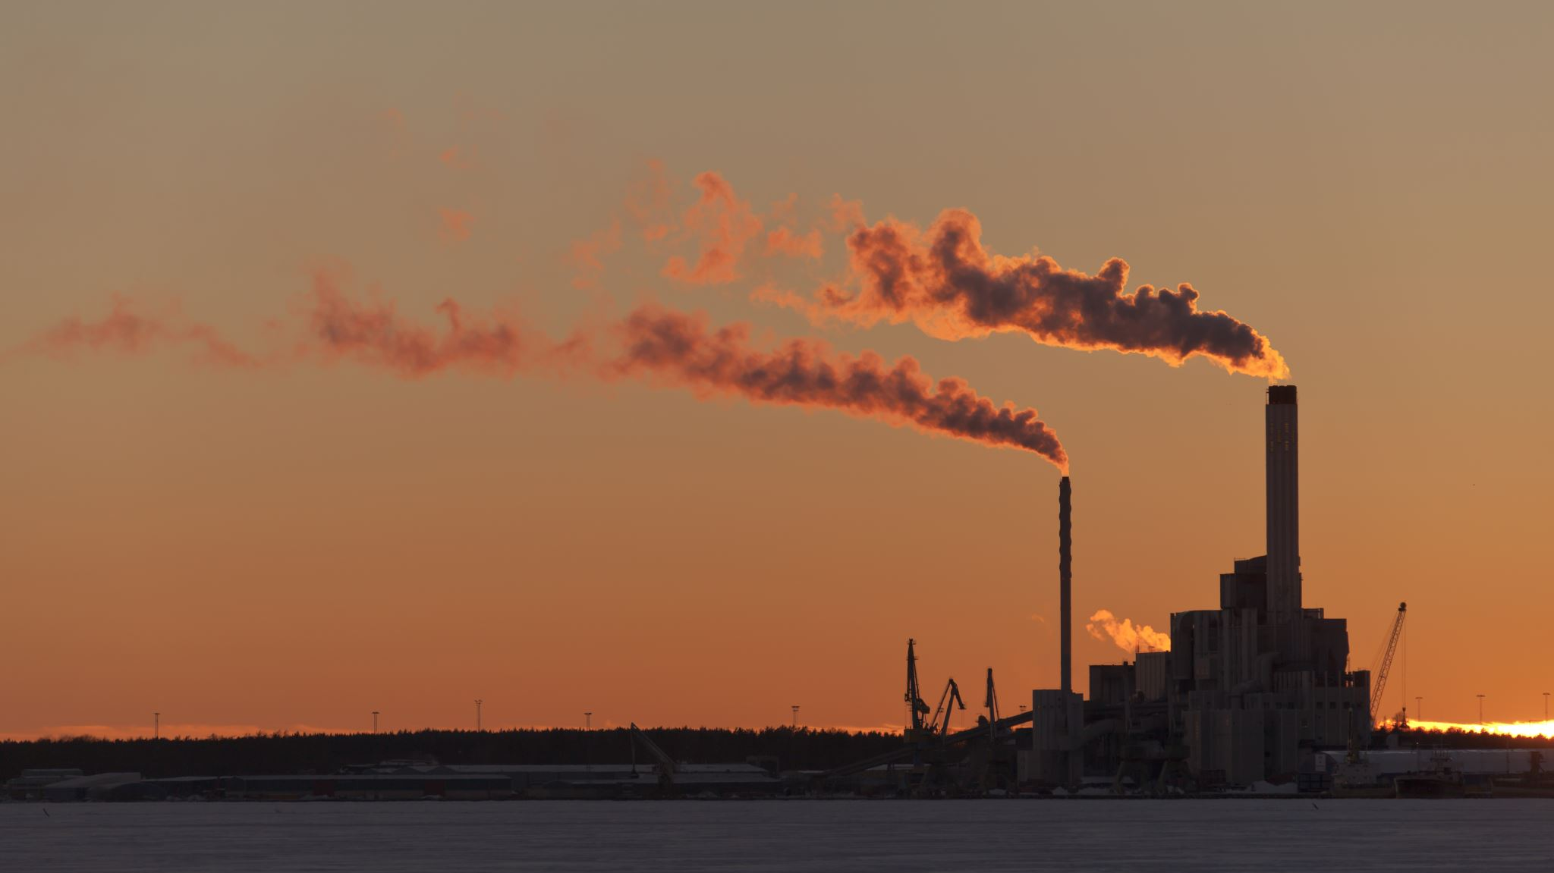
Deaths due to Air Pollution

Slide 5
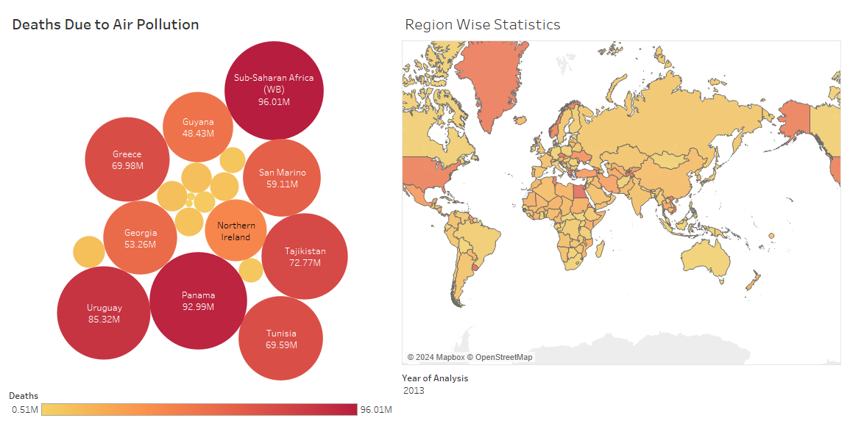

Slide 6
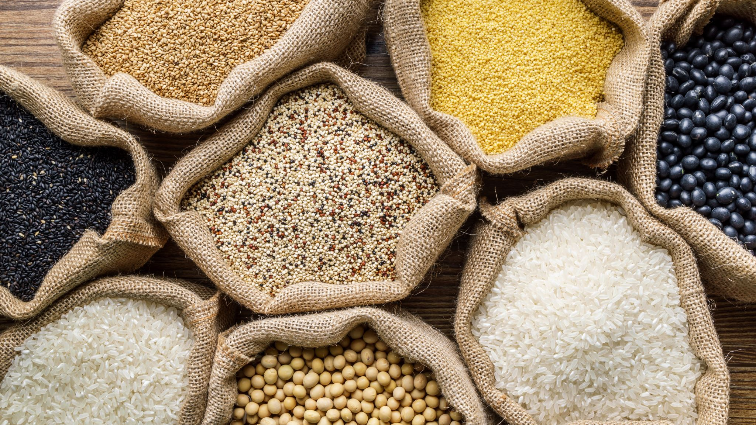
Deaths due to Malnutrition

Slide 7
