Slide 1
Artificial Neural Networks
TECHNICAL WORKSHOP

Slide 2
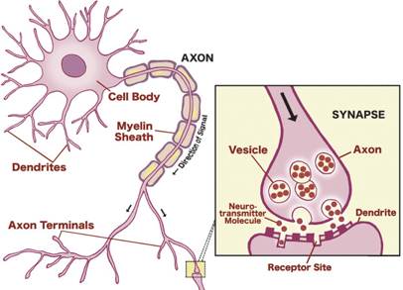
Brain, Neurons, Synapses

Slide 3
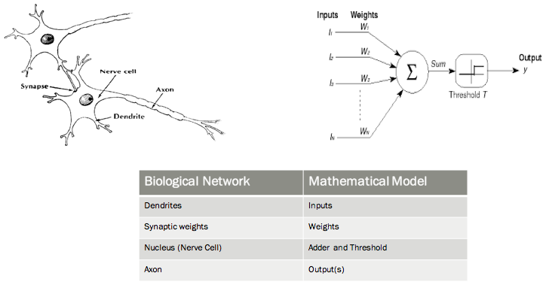
Biological vs Mathematical Model

Slide 4
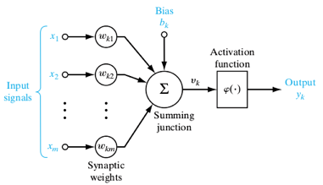
Neuron - McCulloch and Pitts
Bias
Binary Threshold Device
Limitation – Too simple

Slide 5
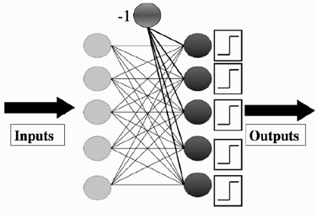
Neural Network - Perceptron
Collection of McCulloch and Pitts neurons
Learning happens in the synapse – weights.

Slide 6

Perceptron Network - Learning
Error: Target - Predicted
Learning rate (η) – Moderate (0.1 to 0.4)

Slide 7
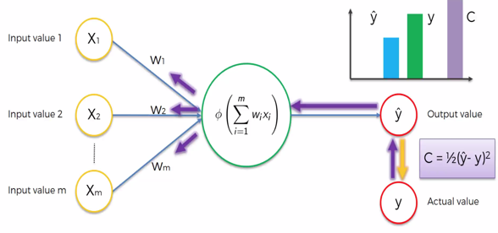
Perceptron Network – Back Propagation

Slide 8
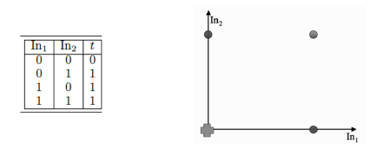
Perceptron Network Application – OR
perceptron_or.py

Slide 9
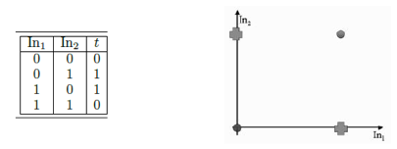
Perceptron Network Application – OR
perceptron_xor.py

Slide 10
Perceptron Network – Non-Linearity Issue
Perceptron computes decision boundary such as line or hyperplane.
Works well for linearly separable case as we see in OR example but not in non-linearly separable case such as XOR function

Slide 11
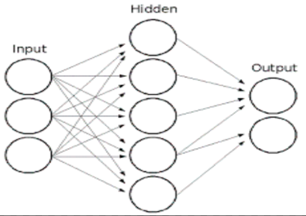
Multi-Layer Perceptron
Hidden Layers
http://playground.tensorflow.org

Slide 12
MLP
Going Forward -> Input to Hidden to Output Layers
Going Backwards -> Output to Hidden to Input layers and in the process updating the weights to reduce the error.
Gradient Descent Algorithm – Differentiation w.r.t weights

Slide 13
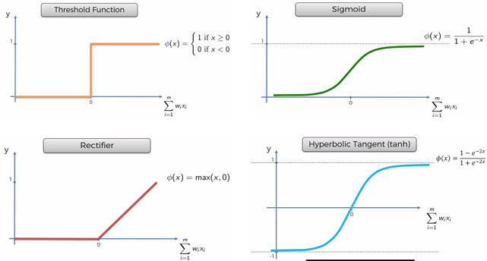
Activation Functions
From threshold to continuous function for differentiation.

Slide 14

Multi-Layer Perceptron
Weight Initialization:
Suggestion: small random values
Guideline: −1/√n < w < 1/√n
Uniform learning
Output Activation Function
Sigmoid: Binary Classification
Soft-max: Multi-nominal Classification (1-of-N encoding)

Slide 15
Local Minima & Global Minima
Like any optimization technique, gradient descent only guarantees local minima.
Solutions to find Global Minima:
Different starting points while training different network
Momentum
Adding a product of momentum constant (mostly around 0.9) and previous weight change.
Makes learning rate to be possible -> stable learning process.
Speed up training process
Stochastic Gradient Descent

Slide 16
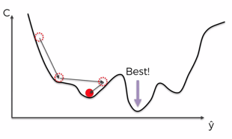
GD – Batch/Stochastic/Mini-batch – Big Data
Batch – All records are considered for every iteration.
Faster
Local Minima
Computational expensive or not possible for big data
Stochastic: One record per iteration
Very Slow
Higher chances of global minima
Can handle big data
Mini-batch: Batch of records per iteration
Faster than Stochastic
Higher chances of global minima
Can handle big data

Slide 17
Implement Steps
Select inputs and outputs for your problem
Normalize inputs
Split the data into training, testing, and validation sets
Select a network architecture – Number of hidden layers, neurons per layer
Train and evaluate a network
Test the network

Slide 18
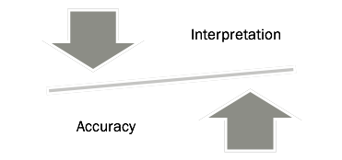
Weights Interpretation Vs. Accuracy
Without hidden layers, the interpretation is easier as the inputs link to the output variables directly.
With hidden layers, original variables are transformed which makes the interpretation difficult.

Slide 19
MLP – Practical Considerations
Amount of training data
With a, b, c number of nodes in input, hidden and output layer respectively, we end up with these many weights:
(a+1) * (b+1) * c
Guideline: Number of records >= 10 times the weight

Slide 20
MLP – Practical Considerations
Number of hidden layers and Number of neurons per layer:
Guideline for layers:
Most of the time single layer is enough.
In fact adding more layers could be counter-productive (Prone to over-fitting).
Guideline for neurons:
At least equal to number of input nodes:
With low number on nodes, 2-3 times more
With large number of nodes, around 10-20% more

Slide 21
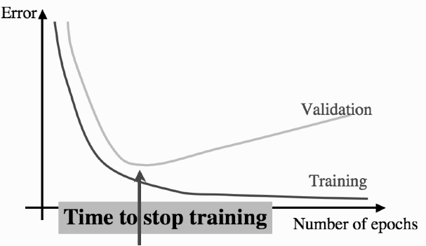
MLP – Practical Considerations
When to stop learning:
Setting number of iterations could lead to over-fit.
Setting the error rate might mean never ending iterations.
Balancing act: Validation/Cross-Validation:
Stop when validation error increases.

Slide 22
MLP – Practical Considerations
Regularization
L2 – Similar to Ridge regression. Adding the squared term of the weights with the regularization constant.
L1 – Similar to Lasso regression. Adding the absolute term of the weights with the regularization constant.
Dropout – Some percentage of neurons are disabled at each iteration.
Done only during training.

Slide 23
Thanks!
Any questions?

