Slide 1
Convolutional Neural Networks
TECHNICAL WORKSHOP

Slide 2
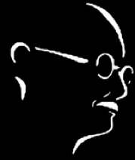

Identify the famous personalities?

Slide 3

Convolution
Input Image * Filter/Kernel => Feature Map/Activation Map.
Image Reduction – very helpful as generally the input image size is huge.
Information Loss – Yes, but we are trying to extract the features.
Position Invariance
Zero-Padding

Slide 4
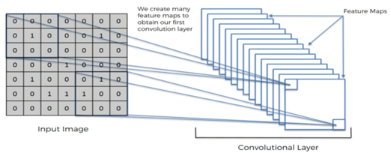

Convolution
Multiple filters to get multiple feature maps -> Each feature map tries to extract different information.

Slide 5
Feature Learning
Feature engineering is automatic
No pre-defined filters are required.
Optimal filter weights are based off of the raw data
Learns the best features.

Slide 6
Filter’s Size
Filters are 4-dimensional
# No of filters * 3-D tensors
Tensors – Size (m*n) * channel
Input Layer = Number of samples * Color (Channel) * Width * Height
Filter layer = # Feature in, # Features out, filter width, filter height
So, what all of the above 4 should we specify?

Slide 7
Filter’s Size - Example
Input shape size = (30, 3, 64, 64)
Filter shape = (?, 32, 3, 3 )
Assuming we have zero-padded
What is the shape after convolution?

Slide 8
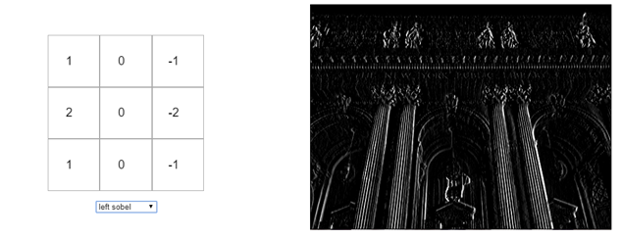
Activation Function
Images have non-linearity -> Borders, colors, Intensity
ReLU (Rectifier Linear Unit) – To add non-linearity

Slide 9
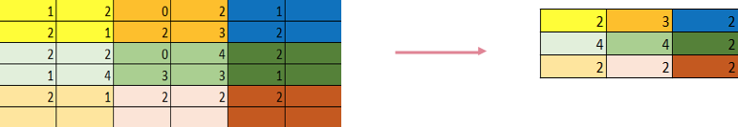
Max Pooling/ Down sampling
“A common practice to gain invariant features in object recognition models is to aggregate multiple low-level features over a small neighborhood.”
Take max of n * n dimension of the feature map.
For instance, 2 * 2 is as below:

Slide 10
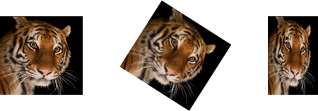
Max Pooling/ Down sampling
Retaining even more less data. For instance, for 2*2 dimension, we are storing just one of the four pixels, i.e. just 25% of the data.
Max pooling will account for features which are distinct and also accounts for spatial or textural differences in the image.
One way of avoiding over-fitting
Other pooling techniques – Mean/Sum.

Slide 11
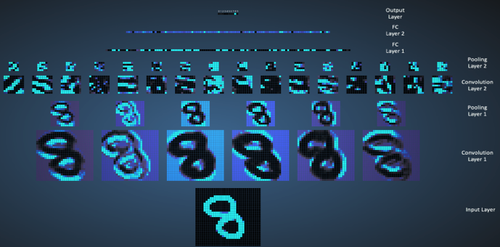
Visualizing the operations
Source: http://scs.ryerson.ca/~aharley/vis/conv/flat.html

Slide 12
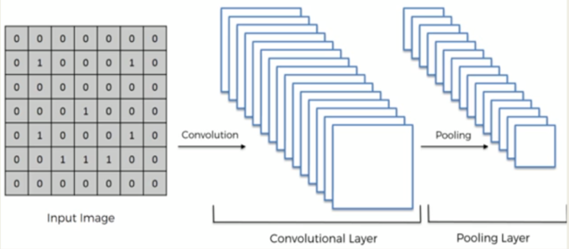
Max Pooling/ Down sampling

Slide 13
Filter’s size continued…
We have the input shape = N * C * W * H
Which are the dimensions which get affected by the pooling operation?
Continuing with same example, what is the output shape after pooling?

Slide 14
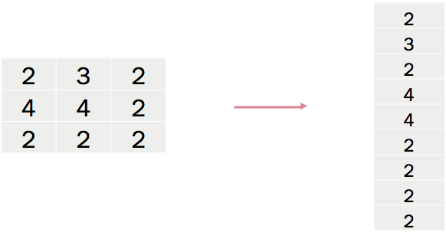
Flattening

Slide 15
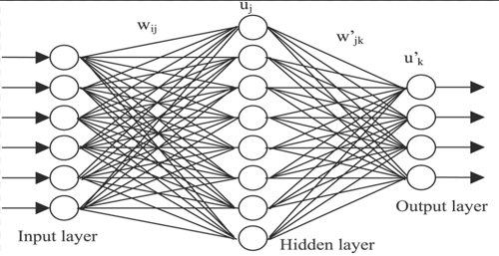
Fully Connected Layer
All the nodes are inter-connected.
Notes:
In back-propagation, even the filter is modified.
Explanation -> Imagine the hidden layer nodes -> some of them fire for dog and some of them fire for cat. The activated output (not the weights) of the node for dog or cat will define which gets fired for what.
Need to explain what each node explains?

Slide 16
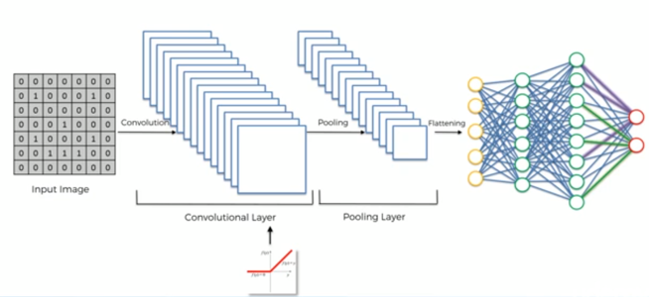
Full Network

Slide 17
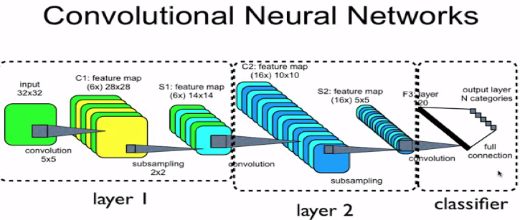
Full Network with multiple convolution layers
Image source: http://www.mshahriarinia.com/home/ai/machine-learning/neural-networks/deep-learning/python/theano-mnist/3-convolutional-neural-network-lenet

Slide 18
Question
Input size = (20, 3, 32, 32)
First Convolution Layer = # Filters=12, Filter size = (3,3), pool = (2,2)
Second Convolution layer = # Filters = 10, Kernel size = 5, pool_size = (2,2)
1 hidden layer = # hidden neurons = 64
Assume – zero padding is applied.
What is the size of the weight matrix linking between the flattened layer to the hidden layer?

Slide 19
Answer
Input size = (20, 3, 32, 32)
First Convolution Layer = # Filters=12, Filter size = (3,3), pool = (2,2)
1st Convolution output = (20, 12 32, 32)
After pooling = (20, 12, 16, 16)
Second Convolution layer = # Filters = 10, Kernel size = 5, pool_size = (2,2)
2nd Convolution output = (20, 10, 16, 16)
After pooling = (20, 10, 8, 8)
1 hidden layer = # hidden neurons = 64
Weight matrix = 640 * 64 [640 is from 10 * 8 * 8]

Slide 20
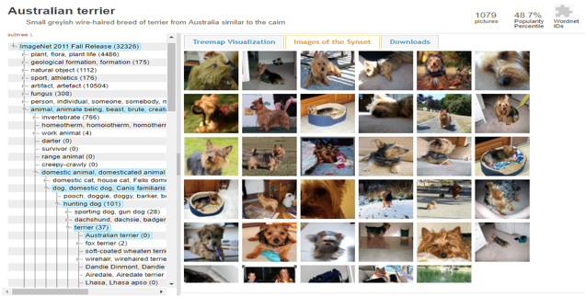

Image-net Challenge
http://www.image-net.org/

Slide 21
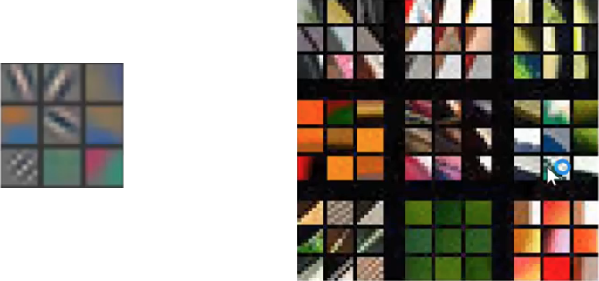
Visualizing the Conv Layers – Layer 1
Source: Visualizing and Understanding Convolutional Networks - Matthew D. Zeiler & Rob Fergus

Slide 22
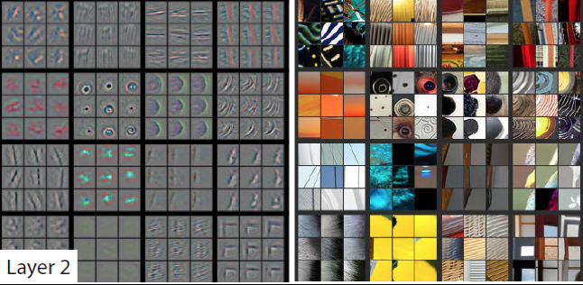
Visualizing the Conv Layers – Layer 2
Source: Visualizing and Understanding Convolutional Networks - Matthew D. Zeiler & Rob Fergus

Slide 23
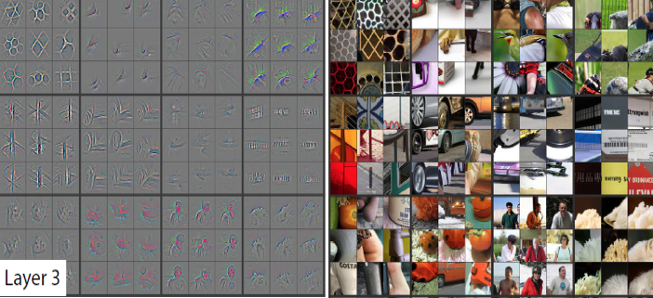
Visualizing the Conv Layers – Layer 3
Source: Visualizing and Understanding Convolutional Networks - Matthew D. Zeiler & Rob Fergus

Slide 24
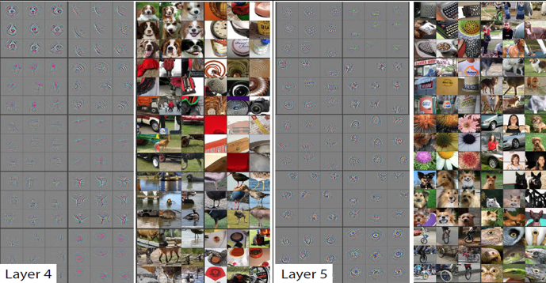
Visualizing the Conv Layers – Layer 4 & 5
Source: Visualizing and Understanding Convolutional Networks - Matthew D. Zeiler & Rob Fergus

Slide 25
Transfer Learning
Pre-train a ConvNet on a very large dataset (e.g. ImageNet, which contains 1.2 million images with 1000 categories), and then use the ConvNet either as an initialization or a fixed feature extractor for the task of interest.
3 Ways:
ConvNet as fixed feature extractor -> Remove the last FC layer.
Fine-tuning the ConvNet -> Fine-tuning complete or only higher-level layers.
Pre-trained models -> Use modern ConvNets as is for similar problems.
Fine-tuning is decided based on size of the dataset and its similarity to the original dataset.

Slide 26
Overfitting: Regularization, Data Augmentation and Batch Normalization
Regularization -> Drop Out
Data Augmentation -> Changing the image to consider different angles, rotations, stretching, shearing etc.
Not to be overdone -> flipping.
Batch Normalization ->
Scaling at input layer was done earlier as well.
Normalizing the activation outputs were undone by SGD.
Two new parameters are added to the activation output and train them during back-propagation using SGD itself.
Modern NN uses this - 10x faster and outlier effect is reduced.

Slide 27
Word Embeddings
Text to Vectors -> Mapping of words from a vocabulary to a corresponding vector of real numbers.
Bag of Words -> Sparse one-hot encoded vectors.
Idea of word embeddings:
Dimension Reduction
Contextual Similarity
Semantic Information of words and relations between them

Slide 28
Word Embeddings
Dimension Reduction:
If the vocabulary is of 50,000 words, and if the document has a maximum of 500 words, then the document is represented by 50000 * 500 matrix
However, with word embeddings, imagine we assume 20 vector length for a word, then the embedding matrix would be of 50000 * 20.

Slide 29
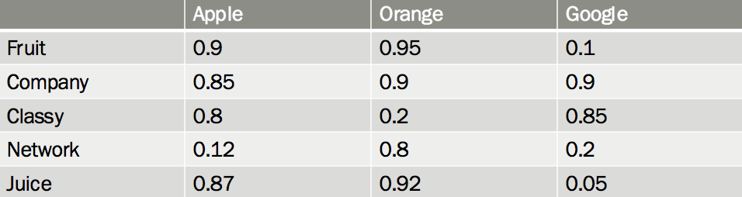
Word Embeddings
Contextual Similarity – Captures meaning of the word enabling natural language understanding.

Slide 30
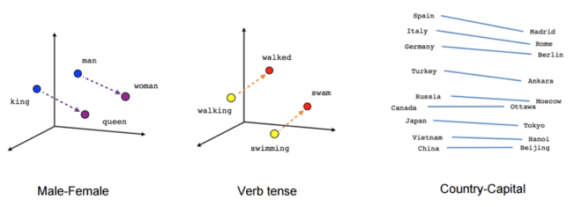
Word Embeddings
Visualizing the vectors on 2-dimensional space after applying dimension-reduction technique (t-SNE) shows the semantic information about words and their relationships to one another.

Slide 31
Applications of Word Embeddings
Named Entity Recognition
Document Classification
Sentiment Analysis
Paraphrasing
Word Clustering
Machine Translation

Slide 32
RNN
Variable Length Sequence
Long-term dependency
Memory
Stateful representation

Slide 33
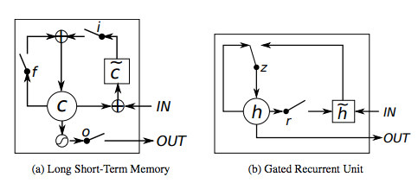

Slide 34
Thanks!
Any questions?

