Slide 1
MAT 8446 Survival Analysis Project:
Survival and Hazards Analysis of Clinical Trials
Duane Stanton

Slide 2
Background/Introduction (1)
Survival analysis within clinical trials;
why not survival analysis of clinical trials?
Data source: ClinicalTrials.gov
Database of clinical trials
Maintained by the Nat’l Library of Medicine (NLM) within the Nat’l Institute of Health (BIH)
Data from all 50 states and 204 countries
Final dataset: 40,618 clinical trials (137 countries/territories)

Slide 3
Background/Introduction (2)
Key information available:
Study phase (0/Early 1, 1, 2, 3, 4)
Study title
Condition(s) studied, Intervention(s) / treatment(s) involved, Study outcome measures
Participant details: gender(s), age group(s), enrollment size
Sponsor details: organization names, funder category (e.g. NIH, other U.S. Fed., Industry)

Slide 4
Background/Introduction (3)
Key information available (cont’d):
Study design (participant allocation, intervention model, masking type(s))
Study site location(s): institution, city, country
Study status: completed, suspended, terminated
Key dates: start of study, primary completion date, (overall) completion date
Created variables: study location in OECD country, funded by a major pharma co. (both True/False)

Slide 5
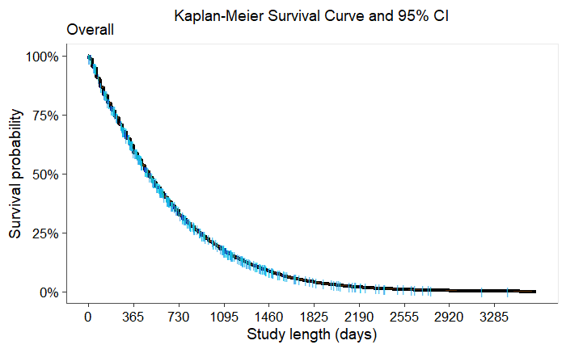
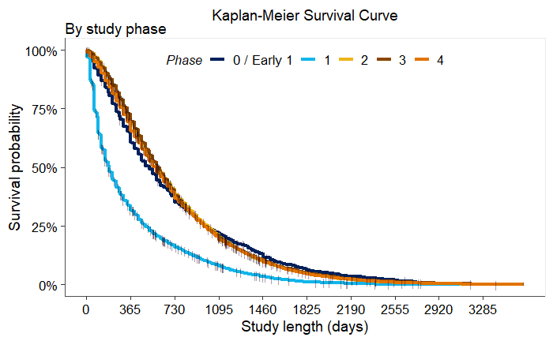
Preliminary: K-M Survival Curves
Noticeable discrepancy for Phase 1 curve...

Slide 6
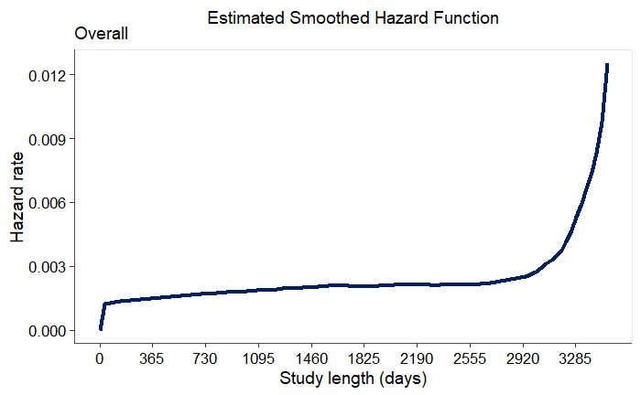
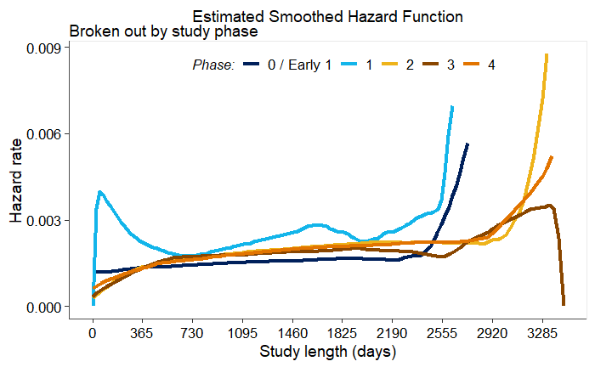
Preliminary: K-M Hazard Curve (!)
...which is even more pronounced for the hazard curve.
Proportional hazards assumption definitely doesn’t hold
Cox PH models checked, but same story as prior slide’s right plot

Slide 7
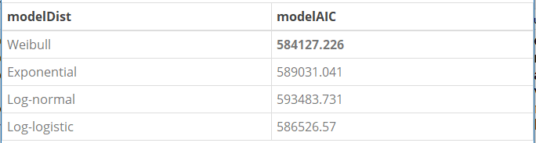
AFT Model: Distribution and Selection Criterion
Based on the ‘full’ model (45 potential variables):
Gamma and Generalized gamma not considered; had to use survreg rather than flexsurvreg (data/full model size)
(Automated) Stepwise AIC and BIC selection applied
AIC: 71 covariates (35 variables) – Failed to reject H₀ for LRT
BIC: 62 covariates (26 variables) – subset of the AIC model

Slide 8
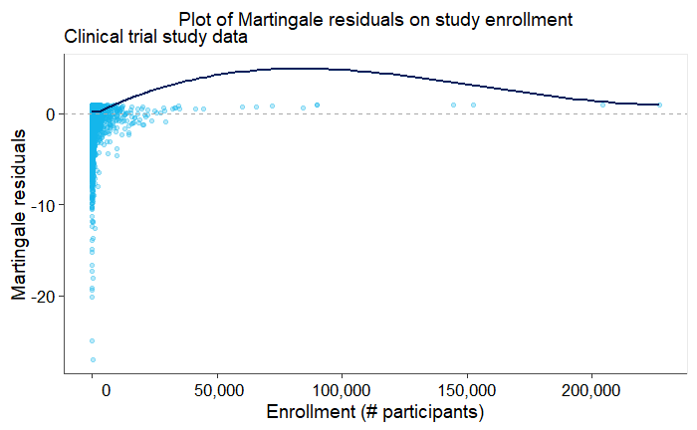
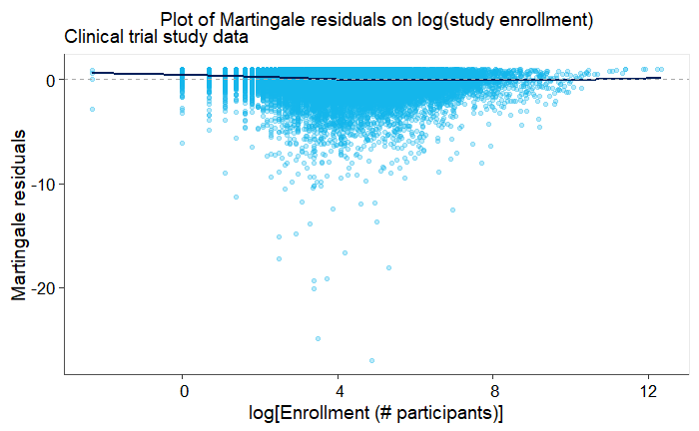
AFT Model: Covariate Forms
Only ‘Enrollment’ as quantitative variable in the selected model (all others logical or categorical)
Original data
Log-transformed data
5 cases of ‘0’ Enrollment;
4 Terminated, 1 Completed (this case was removed and the analysis rerun with Enrollment = 0.1 for the remaining 4 )
Minor change to coefficients / survival & hazard curves

Slide 9
AFT Model: Considering Interactions
Focused on condition(s) examined
32.4% of studies were ‘multi-condition’
txDynamics most common among ‘multi-condition’ studies (64.9%), followed by healthy (20.3%) and cancer (18.7%)
Checking txDynamics interation with top 8 ‘multi-condition’ variables (#8 in 9.3% of applicable cases):
Cancer, Diabetes, Digestive, Healthy, Respiratory each stat. sig. at α = 0.05, but no noticeable survival/hazard curve improvement
Circulatory, Immune System, Infectious Disease not stat. sig.
txDynamics x Healthy interaction kept in the final model (applies to 5.7% of all data; other stat. sig. interactions were < 2%)

Slide 10
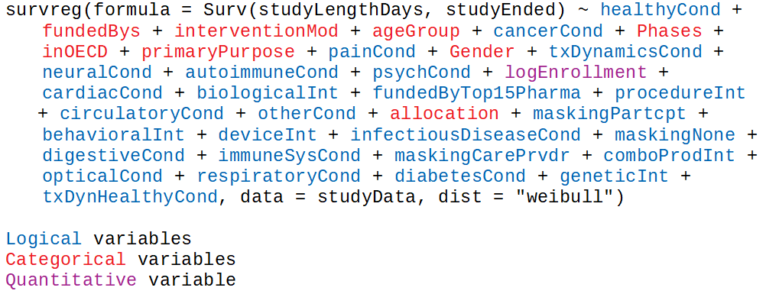
Final AFT Model

Slide 11
Final AFT Model cont’d
Stat. sig. association (p-value < 0.05) with decreased survival (negative coeff., shorter study) for these logical variables (“True”):
healthyCond, immuneSysCond, infectiousDiseaseCond, painCond, txDynamicsCond, txDynHealthyCond, comboProdInt
Stat. sig. association with increased survival (positive coeff., longer study) for these logical variables (“True”):
autoimmuneCond, cancerCond, cardiacCond, circulatoryCond, digestiveCond, neuralCond, opticalCond, psychCond, otherCond, behavioralInt, biologicalInt, deviceInt, geneticInt, procedureInt, fundedByTop15Pharma, maskingPartcpt, maskingNone
Quantitative logEnrollment and categorical inOECDYes also positive and stat. sig.

Slide 12
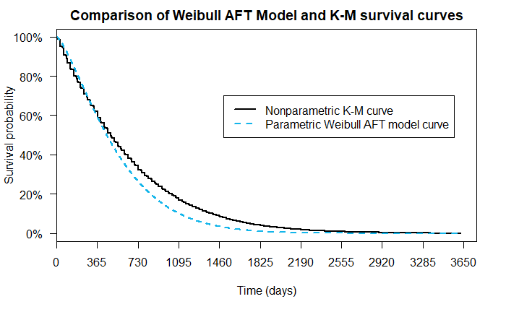
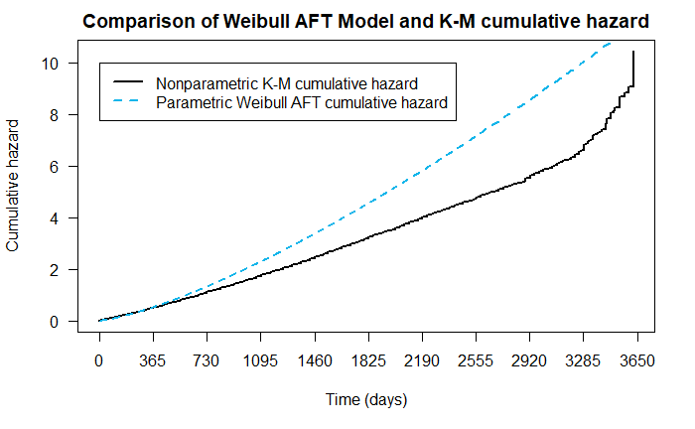
Final AFT Model: Goodness-of-Fit
Iffy survival curve, and red flags for hazard curve

Slide 13
Final AFT Model: Influence/Outlier Diagnostics
Based on ldcase residuals, at least one fairly influential study (ldcase = 1.68; next three obs. were 1.12, 1.00, and 0.94)
Top case:
‘Phase 0 / Early Phase 1’, not censored, in OECD (Boston, MA hospital), enrollment size 133 (Adult-only Males)
Duration: 2,803 days (7.67 years)
Conditions: Healthy, Circulatory
Primary Purpose: Diagnostic
Study title: “Dietary Salt Intake and Vascular Function”
None of the top 10 funded by a top 15 pharma co., but all either exclusively funded by Industry or Other

Slide 14
Final AFT Model: Takeaways
Not an ideal fit, but (large) Weibull AFT model provides a less-than-great fit for survival – cumulative hazard is even more “off”
Several condition categories associated with shorter/longer studies
Studies with larger enrollment and hosted in OECD countries associated with longer studies

Slide 15
Fin

Slide 16
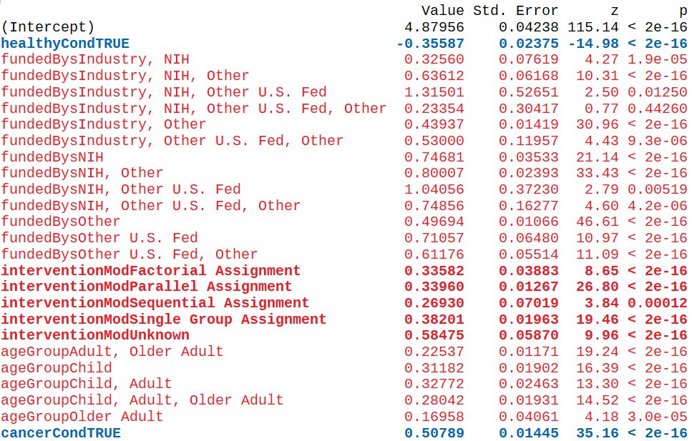
Full Model Summary (1):

Slide 17
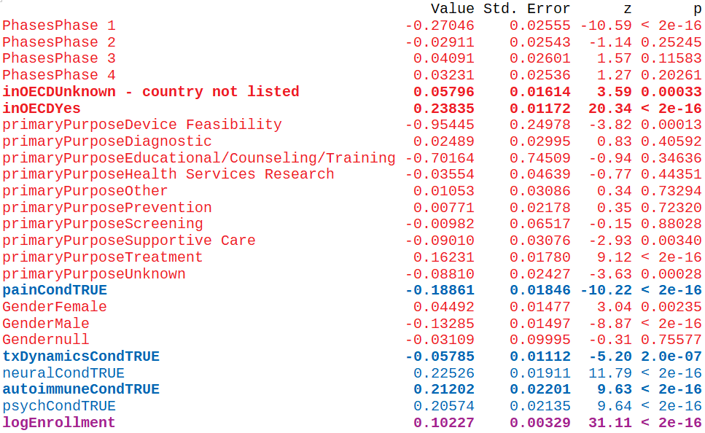
Full Model Summary (2):

Slide 18
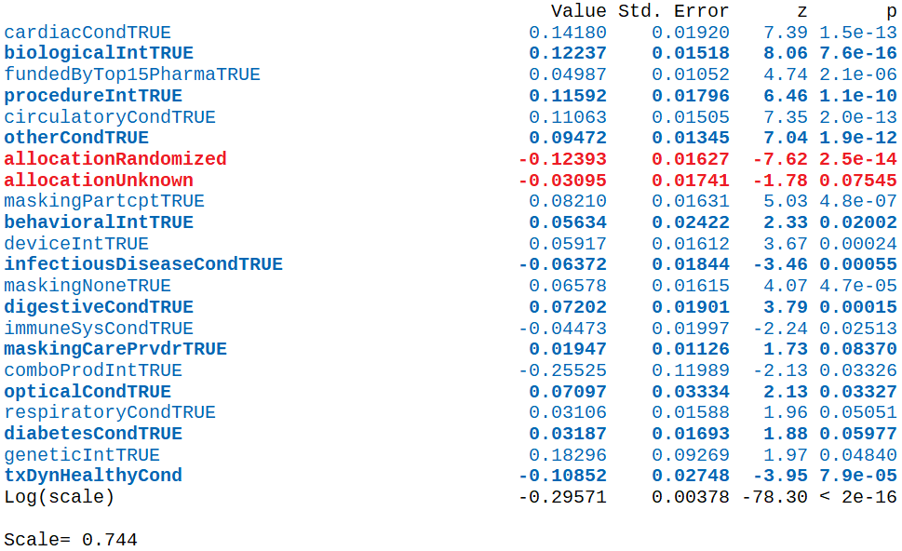
Full Model Summary (3):

Slide 19
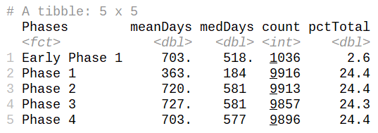
Appendix:
Summary table of analysis data by clinical trial phase:

Slide 20
Appendix:
Top 15 Pharma companies by 2017 revenues:
Johnson & Johnson, Hoffman-La Roche, Pfizer, Novartis, Sanofi, Merck Sharp & Dohme, GlaxoSmithKline, Bayer, AbbVie, Gilead Sciences, Eli Lilly and Co., Amgen, AstraZeneca, Teva, Bristol-Myers Squibb
Source: https://www.fiercepharma.com/special-report/top-15-drugmakers-by-2017-revenue
Example terms for cardiacCond:
angina, arrhythmia, atria, atrioventricular, brachycardia, bradycardia, Brugada sydrome, cardiac, coronary, Ebstein's anomaly, heart, myocardial, myocarditis, inflammatory cardiomyopathy, Lev's disease, pericardial, tachycardia, mitrial, tricuspid, ventricle, ventricular

Slide 21
Appendix:
OECD member countries (35 as of 2018):
Australia, Austria, Belgium, Canada, Chile, Czechia, Denmark, Estonia, Finland, France, Germany, Greece, Hungary, Iceland, Ireland, Israel, Italy, Japan, Latvia, Lithuania, Luxembourg, Mexico, Netherlands, New Zealand, Norway, Poland, Portugal, Slovakia, Slovenia, South Korea, Spain, Sweden, Switzerland, Turkey, UK, US
Source: https://www.oecd.org/about/membersandpartners/list-oecd-member-countries.htm
Age groups: Child (0-<18yrs), Adult (18-<65yrs), Older Adult (65+yrs)
Stepwise AIC model AIC score: 584,124.7
+ Interaction: 583,185.6
Stepwise BIC model AIC score: 584,151.8
285 studies were censored (“Suspended”) - 0.7% of data

