Slide 1
Computer Security Training Platform
An Introduction Into Computer Security Competitions
By: Tanner Burns
Instructor - Dr. Qijun Gu
Independent Study - CS4395

Slide 2
Goal
Cybersecurity has become increasingly popular in the past few years. Recent hacks have brought cybersecurity into the spotlight, thus increasing the demand for cybersecurity professionals. Merging the gap between academic and real world experience is increasingly difficult because computer security is constantly evolving and becoming more complex.
To help push professionals and devotees, there are competition type events hosted by the government, companies, and schools. These events, known as “capture the flag”, test the competitors on their cybersecurity skillset. There are many different categories that these competition events test. However, for this study I focus on the coding and cryptography categories.
A way to help students learn cybersecurity is to allow them to have an open platform that mimics these competitions. Step by step solutions will also be included with the platform so that they can learn how to approach these problems and overcome unknowns that are found in cybersecurity issues. I will be presenting challenges and the step by step solutions for the challenge to help teach students learn how to solve these competition type problems.

Slide 3
Overview
Understanding CTF competitions (Categories and difficulty)
Find a platform to build on (Pico CTF, Facebook CTF, Tiny CTF, etc..)
Testing the platform (Windows, Mac, and Linux)
Understanding the platform (Hosting, Problems, Security, etc..)
Implementing problems into the platform (JSON, static, and grader)
Securing the problems and platform from being exploited (Servers)

Slide 4
CTF Competitions and Statistics
The best way to learn about CTF competitions is to compete in them. We competed in a few competitions during the summer.
To fully understand the categories and types of problems these competitions were hosting, we gathered data based on competitions hosted in 2014 and 2015. We examined the write-ups from these competitions and created data tables based on the category and difficulty of the problem. We also kept track of what type of solutions and tools were being widely used in the competitions.
From this research we began to obtain statistics based on the competitions. Focusing on the type of problems that repeated frequently. This was most likely an indicator of known vulnerabilities in security.

Slide 5
Finding A Platform To Build On
There is a variety of platforms that are available to build on.
Facebook CTF, Pico CTF, Tiny CTF, and more.
The two platforms that we picked between were Facebook CTF platform and Pico CTF platform
Overall, it seemed that the Pico platform was a better decision for building a training environment for students to use.

Slide 6
Learning The Pico Platform
To build on the platform, we had to understand how certain things were being handled.
The first thing to understand was how the platform was hosted on a local machine.
The second thing to understand was how the problems were set up and created.
The third thing was to understand how to keep the platform secure.

Slide 7
Hosting On A Local Machine
The method for hosting the Pico platform was using Vagrant with Virtualbox.
Virtualbox is software for running multiple operating systems on any given OS. I.e. Running Linux in a Virtualbox that is hosted on a windows machine
Vagrant is a software for creating a virtual machine on the host system using a script. This makes it easy for re-use and development. Vagrant makes it easy for someone to run the platform without knowing how to set up a virtualbox and create a virtual machine. Vagrant allows us to create a single script that will create the virtual machine and install any dependencies that the machine requires. This way after running a vagrant script, everything is set up and ready to be used.

Slide 8
Modifying The Vagrant Script
A number of changes were made to the Vagrant script that is responsible for setting up the platform.
The first major change was made to fix the script to be able to run on any operating system. Changes were made in the libraries that the virtual machine used because it would cause conflict with the host operating system.
The second change was made to add the problems to the database so that when the site is deployed the problems are hosted and ready to be solved.
The third change was to add the command to deploy the site to run when the system has begun. This keeps the site hosted whenever the virtualbox is live.
Many small tweaks such as folder and file permissions of mounted(shared) folders, opening ports for the servers, and running other scripts to make the set up easier.

Slide 9
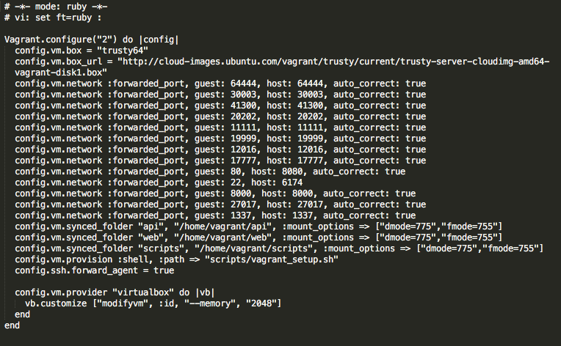
Vagrant File

Slide 10
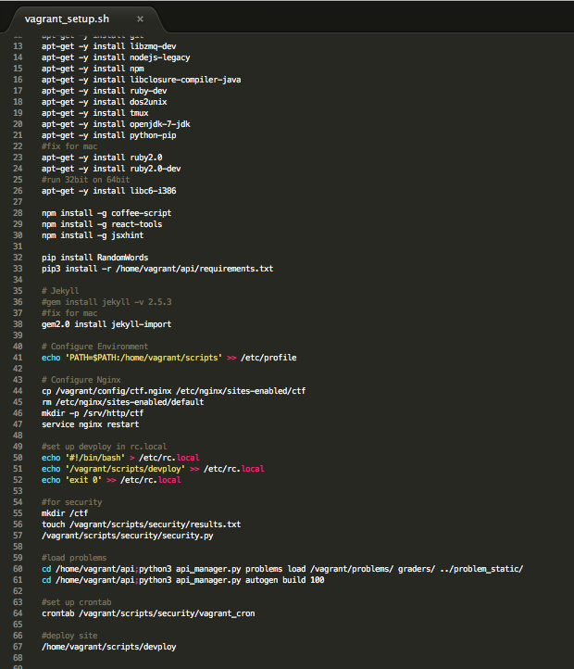
Vagrant Setup Script File

Slide 11
Creating And Hosting Problems
To add problems to the platform, an understanding of how to create the problem was needed. This involved knowing how the problems were read into the database. An understanding of the file system for the problems was essential.
Luckily, the platform came with a few sample problems. This enabled us to see the file structure of the problems.
The structure:
Category – main directory for the category of problems
Problem – directory containing the problem files
Static – directory containing the static files (files that are referenced on the website)
JSON – file containing information about the problem
Grader – directory containing the grader python file used for checking flags

Slide 12
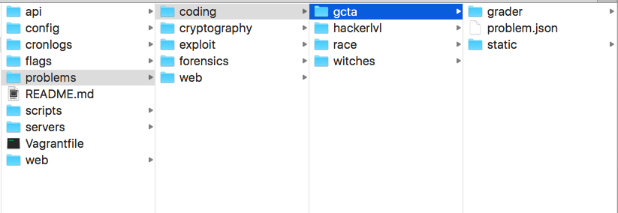
File Structure

Slide 13
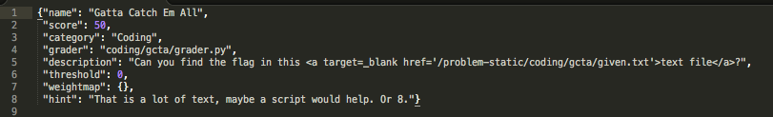
JSON File

Slide 14
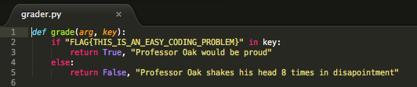
Grader File

Slide 15
Problem Overview (Coding and Cryptography)
For each category, there were main points and tools that we wanted to cover in the platform.
Coding
Code conversion – being able to convert a given data type to another (ord(), int(), and base64())
String manipulation – being able to manipulate strings (split() and join())
File manipulation – being able to open, read, and write files
Remote – being able to write a script that connects to a server (socket and pwnlib)

Slide 16
Problem Overview (Coding and Cryptography) Cont.
Cryptography
Ciphers – being able to decrypt a message that uses a cipher (Caesar, Vigenère, and xor ciphers)
AES encryption/decryption – being able to decrypt and understand AES encryption (plaintext and CBC)
RSA encryption/decryption – being able to decrypt and understand RSA encryption (weak public key attack)
Hashing - knowing how hashing is used and produced (length extension attack and collision attack)

Slide 17
Coding Problems On The Platform
Witches – Easy
String decoding and encoding
Decode the given string → reveals flag
The Race – Easy
Remote Static – connect to server
Get data from server → find pattern → answer in small time limit → returns flag
Hacker Level – Medium
Remote Dynamic – connect to server
Get data from server → find pattern → answer 10000 times → returns flag
Gatta Catch Em All – Medium
File manipulation and string manipulation
Decode file → find pattern → strip pattern from large string → reveals flag

Slide 18
Cryptography Problems On The Platform
Messy Aes – Easy
AES plaintext
Search file for the given encrypted string → reveals flag
Stolen Password – Easy
Easy md5 Hash
Connect to server → get hash for server → use online md5 cracker → reveals flag
Super Old Cipher – Easy
Caesar cipher
Download file → use script or online tool → reveals flag
HLE – Medium
Hash Length Extension
Use given logic → Write script and use tool to generate extended hash → reveals flag

Slide 19
Cryptography Problems On The Platform Cont.
Vigenere ^ Cipher – Medium
Vigenere and Xor Cipher combination
Download given file → Write script to decrypt → reveals flag in decryption
Poison IV – Medium
AES Encryption – Initial Vector Problem
Use given strings → Write script to produce new initial vector → Send to server → returns flag
Clash of Titans – Medium
Hash Collision
Use given logic → Use exploit of used function to produce hash collision → returns flag when logged on
Easy RSA – Medium/Hard
RSA encryption and decryption - Small public key
Download files → factor public key → Write script to produce private key → decrypt for flag

Slide 20
Solving Problems
When a problem is solved in a CTF, the flag is obtained for that problem.
i.e. FLAG{THIS_IS_AN_EASY_CODING_PROBLEM}
When the flag is obtained, you can then submit the flag to the website to see if it is correct.
In these competitions there is normally fake flags or flags that are actually not a flag. This is where experience with these type of competitions comes into play.

Slide 21
Solutions And Write-Ups
Solutions were documented for each problem that in the platform. This platform is meant to help students learn the type of problems that these competitions provide. Therefor, step by step instructions on each problem are included with the platform.
The platform is meant to provide a sense of struggle because the competitions that are hosted by large security companies and the government are very challenging.

Slide 22
Securing The Platform
Many of the problems that were implemented involved creating a server. The servers were needed either to get information regarding the problem or to submit the required information to obtain a flag.
This creates a security flaw. If the person interacting with the server exploits into the system then they have access to the entire platform. Therefor, it is required to secure the platform by securing the servers.
To handle this issue, I made a python script that secured the servers as the platform installs. This involves the following:
Create a new user with a random name
Create a new group with the random user
Make a directory for that user that contains a directory for flags, servers, and home
Then, set the proper permissions on the directories and files and grant ownership to the user ‘nobody’ and the group
Lastly, run the server as the user.
When this is all done, it creates a locked environment for the user that is able to exploit into the system. This is then repeated for each server.

Slide 23
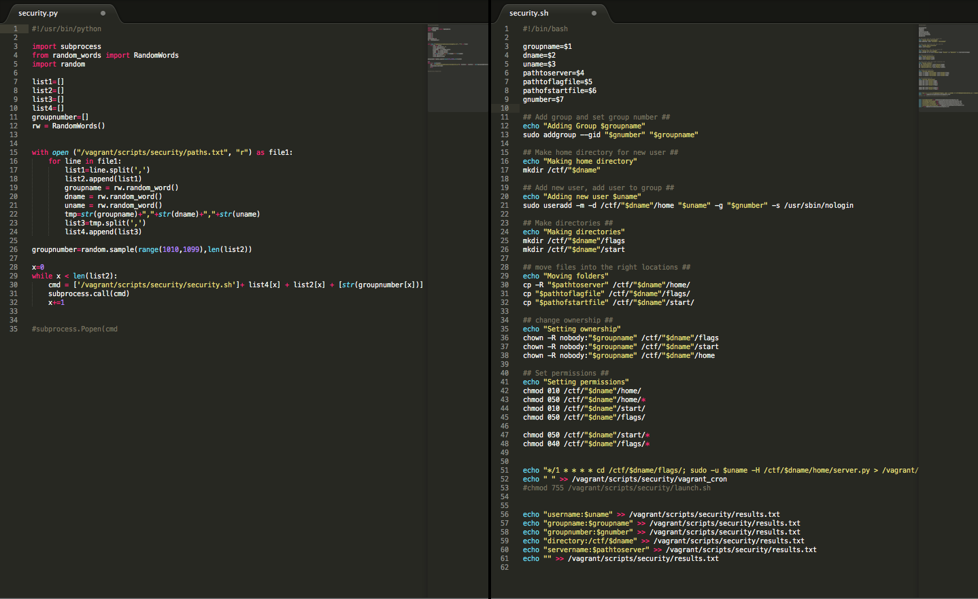

Slide 24
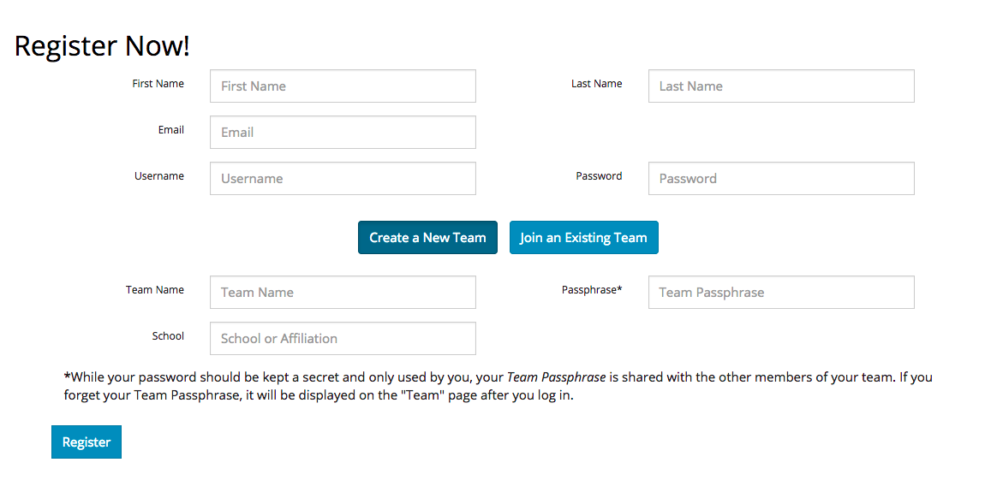
Registration

Slide 25
Navbar

Slide 26
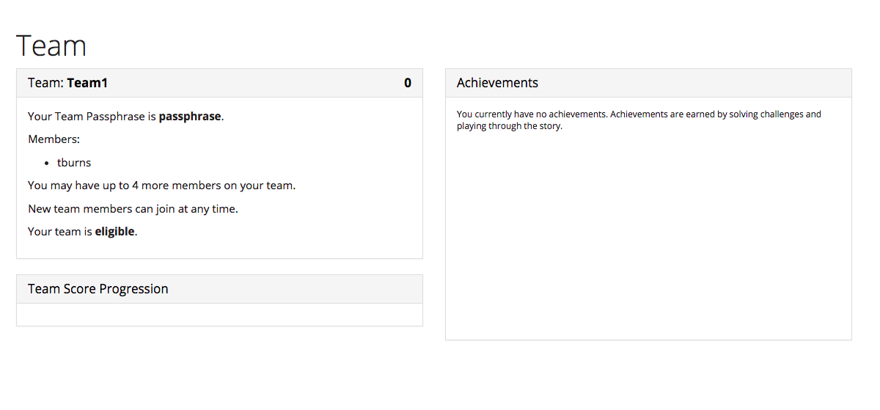
Profile

Slide 27
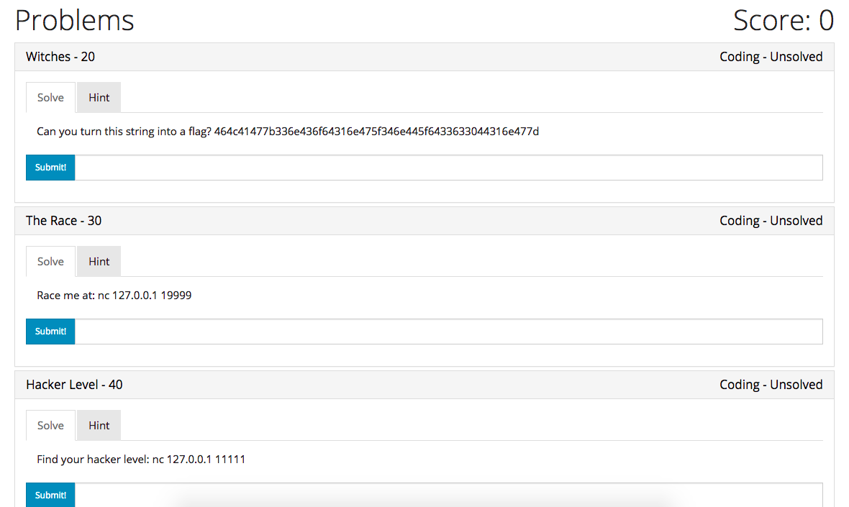
Problems

Slide 28
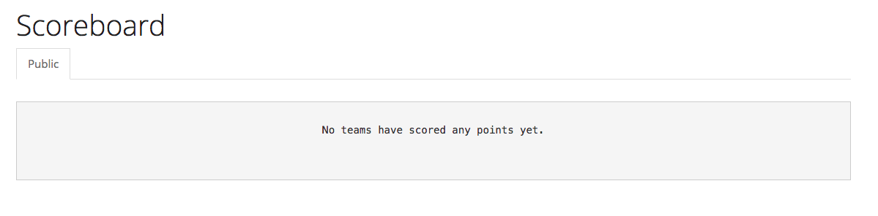
Scoreboard

Slide 29
Github
Site:
https://github.com/TannerBurns/ctf
Write-ups:
https://github.com/TannerBurns/ctf-writeups
Problem Implementation:
https://github.com/TannerBurns/platform-problems

