Slide 1
Data Analyst Jobs in the Northeast U.S.
By Tanner Sax

Slide 2
Agenda
Introduction of problem
Glassdoor Web scrape
Analysis of data
Recommendations
Further research

Slide 3
Introduction of problem
Massive shift to technology careers, involving a lot of data
Data analyst job to break into the industry
What are the most preferred programming language skills and degree fields?

Slide 4
Introduction of problem
Common Programming Languages:
Python
SQL
R
Java
Matlab
Scala
SAS
Julia

Slide 5
Introduction of problem
Common Degree Fields:
Accounting
Computer science
Finance
Economics
Engineering
Statistics
Mathematics
Information technology
Physics
Software engineering
Chemistry
Information systems

Slide 6
Glassdoor Web Scrape
Number of pages, create data frame, iterate over pages, use url
page_result_start <- 1 # starting page
page_result_end <- 30 # last page results
full_df <- data.frame()
for(i in page_result_start:page_result_end) {
url_base <- "https://www.glassdoor.com/Job/philadelphia-data-analyst-jobs-SRCH_IL.0,12_IC1152672_KO13,25."
url <- paste0(url_base, "_IP", i, ".htm")
page <- xml2::read_html(url)

Slide 7
Glassdoor Web Scrape
Links contain the job description page
# get links
links <- page %>%
html_nodes("div") %>%
html_nodes(xpath = '//*[@id="MainCol"]/div/ul/li/div[2]/div[1]/div[1]/a') %>%
html_attr("href")

Slide 8
Glassdoor Web Scrape
Iterate along links, Retrieve entire job summary
job_description <- c()
for(i in seq_along(links)) {
url <- paste0("https://www.glassdoor.com", links[i])
result <- try({
page <- xml2::read_html(url)
job_description[[i]] <- page %>%
html_nodes("div") %>%
html_nodes('.jobDesc') %>%
html_text() %>%
stri_trim_both()
} ,silent = TRUE)
if(!inherits(result, "try-error")) result}

Slide 9
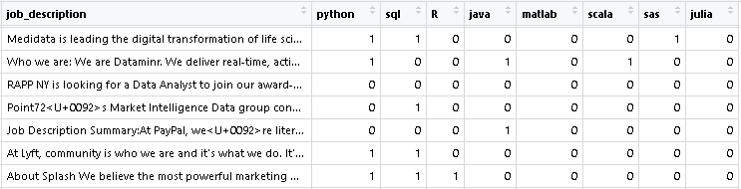
Analysis of Data
Binary columns to show appearances of keywords
Mean of the columns represent percent of job postings that contain the keyword

Slide 10
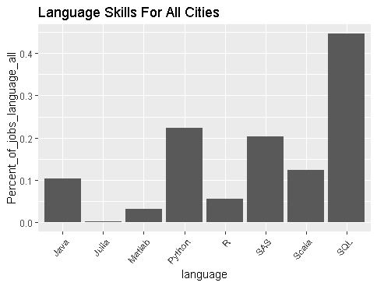
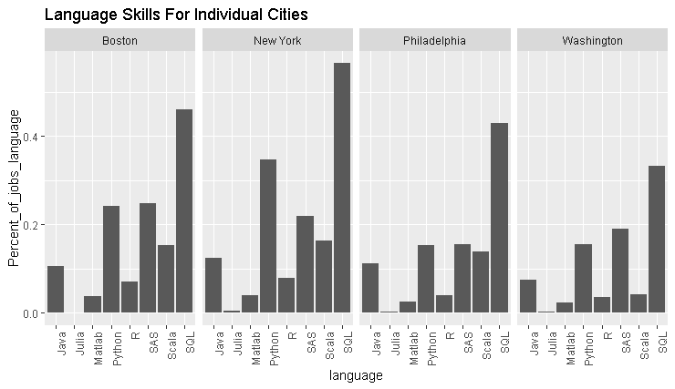
Analysis of Data

Slide 11
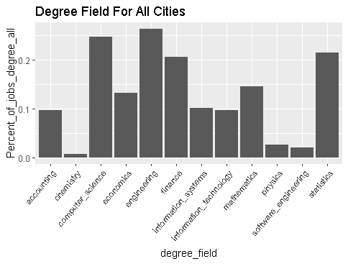
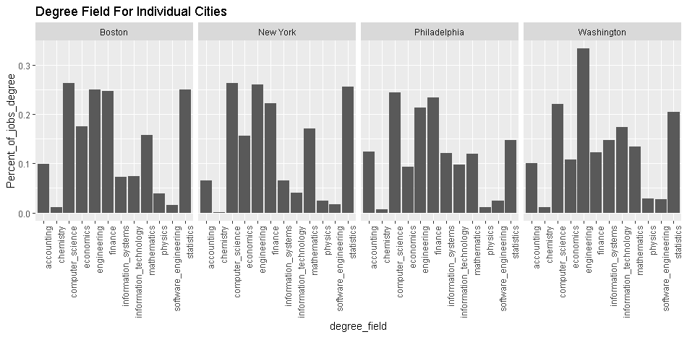
Analysis of Data

Slide 12
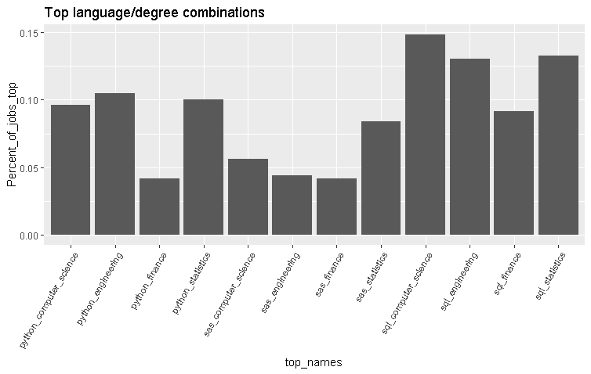
Analysis of Data

Slide 13
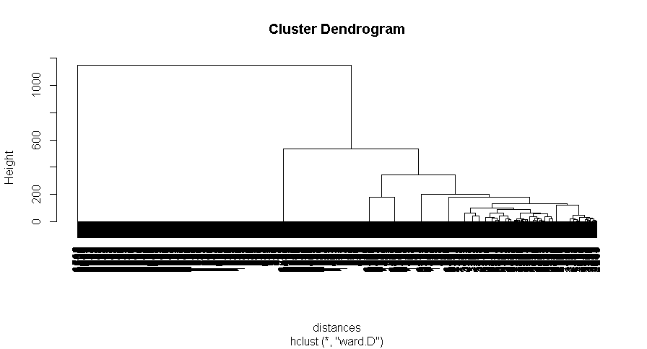
Analysis of Data

Slide 14
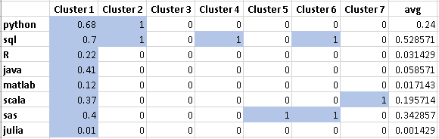
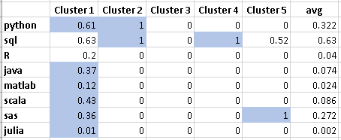
Analysis of Data
7 Clusters
5 Clusters

Slide 15
Recommendations
SQL is the most preferred
Washington D.C.
Information Technology is preferred more than other cities
Scala is not as important than in other cities
The best combinations include SQL and computer Science, Engineering, or Statistics
New York City
Python is more important than in other cities
Preferred programming language combinations
SQL and Python
SQL and SAS

Slide 16
Further Research
Predicting emerging programming languages
Cluster new languages such as Julia with other similarly mentioned languages, to figure out which languages companies will pair it with
Collect data over several time periods
Create a model that predicts the appearance of Julia based on the appearances of other languages (Predictors)
Use the model to predict if Julia will become a more popular programming language, based on the other languages that companies are already using

Slide 17
Data Analyst Jobs in the Northeast U.S.
By Tanner Sax

